Slide 1
Search for the K⁻pp bound state via the in-flight ³He(K⁻,n) reaction
MESON2014
Yuta Sada for the E15 collaboration
RCNP, Osaka Univ & RIKEN

Slide 2
Contents
Kaonic nuclei
J-PARC E15 experiment
Setup
Preliminary result
Exclusive ³He(K⁻,Λp)n events
Summary

Slide 3
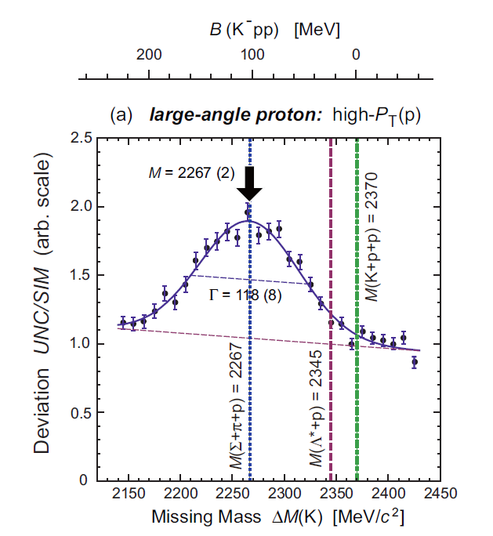
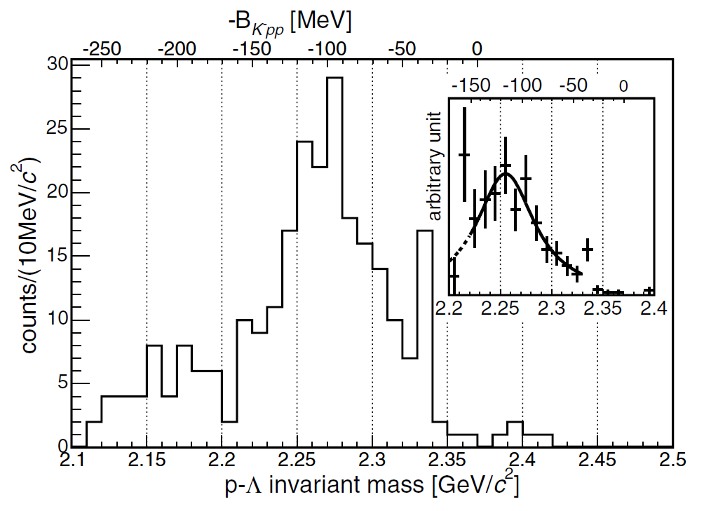
Kaonic nuclei
3
Bound state of anti-kaon and nuclei with strong interaction
K^{bar}N is attractive in isospin=0
Low energy KN scattering experiments
Kaonic hydrogen X-ray measurements
Existence of Λ(1405) 27MeV below K⁻p threshold
=> Kaonic nuclei (K⁻pp) exists or not??
FINUDA
DISTO
B = 115±6±4 MeV
Γ = 67±14±3 MeV
B = 105±2±5 MeV
Γ = 118±8±10MeV
⁶Li, ⁷Li, ¹²C target, stop K− reaction
Λp invariant mass
p+p →X +K⁺, X →Λ + p reaction
missing-mass & invariant mass
These bumps are really K⁻pp?
⇒We need more results on various reactions about K⁻pp!!

Slide 4
Theoretical calc. of
K^{bar}NN(K⁻pp)
Phenomenological potential (energy independent) | Binding energy[MeV] | width[MeV]
T. Yamazaki, Y. Akaishi(2002) | 48 | 61
N.V. Shevchenko, A. Gal, J. Mares(2007) | 50-70 | 90-110
Y. Ikeda, T. Sato (2007,2009) | 60-95 | 45-80
S. Wycech, A.M. Green (2009) | 40-80 | 40-85
Chiral & energy dependent | Binding energy[MeV] | Width[MeV]
A. Dote, T. Hyodo, W. Weise(2008,2009) | 17-23 | 40-70
Y. Ikeda, H. Kamano, T. Sato(2010) | 9-16 | 34-46
N. Barnea, A. Gal, E.Z. Liverts(2012) | 16 | 41
There are large difference in theoretical models.
Energy dependent models suggest shallow bound??

Slide 5
J-PARC E15 experiment
5
in-flight ³He(K⁻, n) reaction & its exclusive measurement
=> Search for K⁻pp bound states both via formation & Decay
K⁻
^{1.0GeV/c}
³He
Neutron
Formation
Kpp
cluster
Missing mass
Spectroscopy via neutron
Decay
Mode to decay charged particles
Λ
p
π⁻
We are able to detect all particles from formation & decay of K⁻pp!!
Invariant mass reconstruction
p

Slide 6
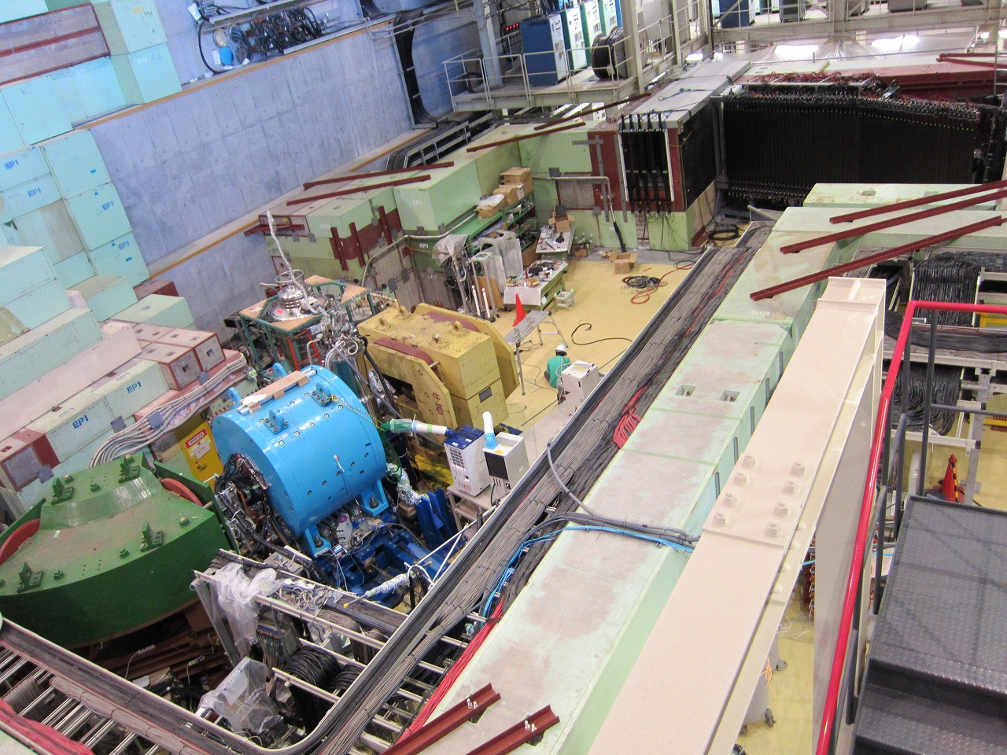
J-PARC K1.8BR beam line[Jun. 2012]
beam dump
beam sweeping
magnet
n
p
K⁻
neutron counter &
TOFstop/proton counter
CDS
³He-target
³He(K⁻,N) reaction
K⁻
 | Primary-beam intensity | Duration | Kaons on target
March, 2013 (Run#47) | 14.5 kW (18 Tppp, 6s) | 30 h | 1.1 x 10⁹
May, 2013 (Run#49c) | 24 kW (30 Tppp, 6s) | 88 h | 5.1 x 10⁹
beam line
spectrometer

Slide 7
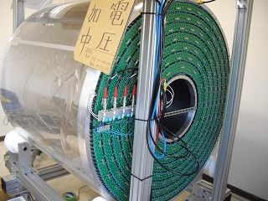
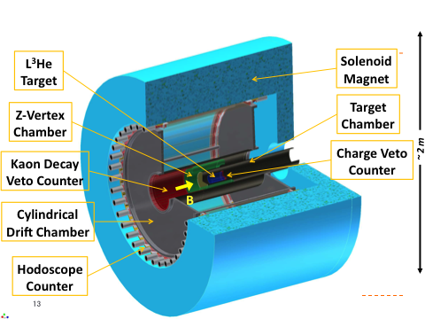
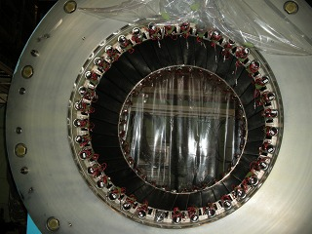
Cylindrical Detector System
7
CDC
To detect the decay particles from ³HeTarget
Momentum reconstruction
Particle identification
Cell Drift length~9mm
Layer 15 layers
Read out : 1816 ch
Gas : Ar-C₂H₆ (50:50)
Hodoscope
And Solenoid
Size : 99 x 30 x 700 mm³ (W x T x L)
Configuration : 36 modules
PMT : fine-mesh type (H8409)
CDC (15 layers, 1816ch) + CDH (36 seg) + 0.7T
solid angle: 60% of 4π
Mass resolution (Kpp) ~10MeV/c²

Slide 8
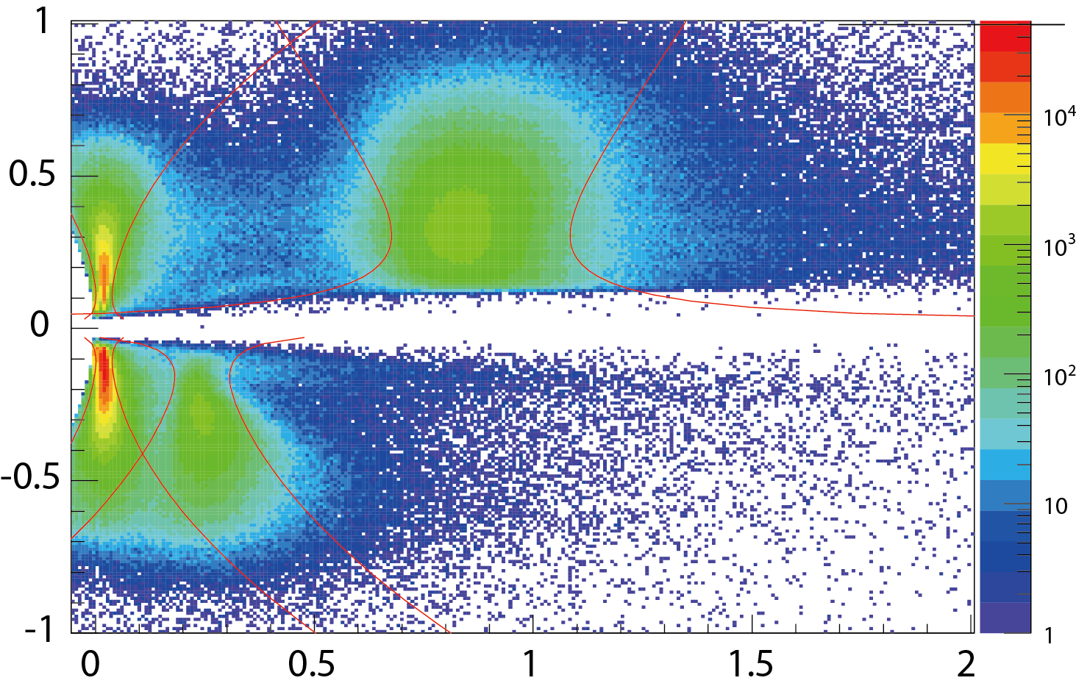
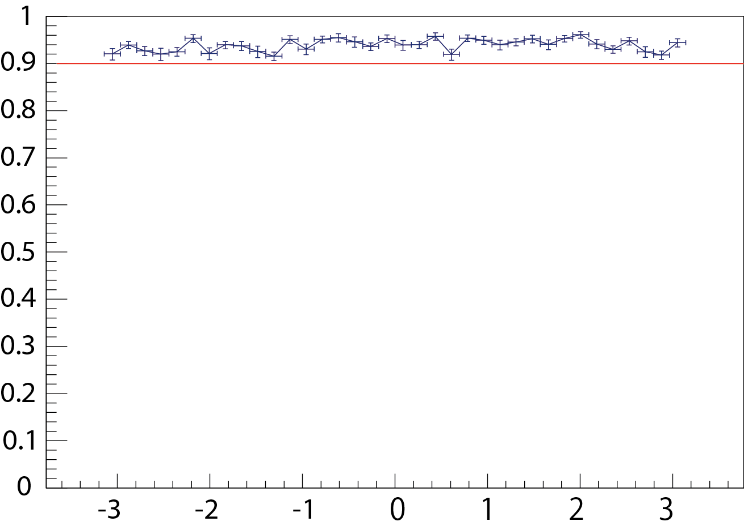
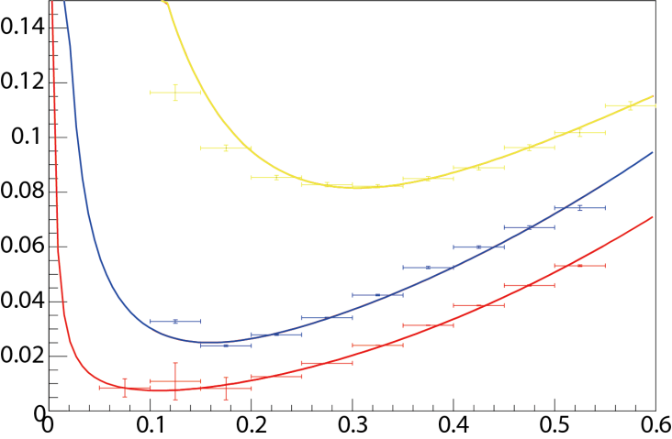
PID & Tracking efficiency
π/K/p/d are clearly separated
Tracking eff
P
π
Momentum[GeV/c]
Tracking eff.]
K
Mass^2 [(GeV/c2)^2]
Phi angle[rad]
P
K
π
Total eff =94.0%
There is no geometrical asymmetry!
σ of Mass^2 [(GeV/c2)^2]
Momentum[GeV/c]

Slide 9
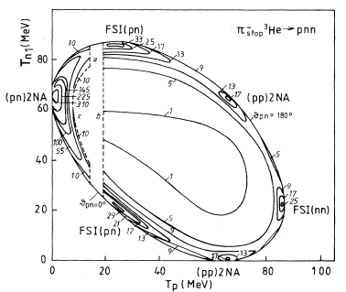
There are two purposes 1. K⁻pp search : K⁻+³He ⇒n+K⁻pp→Λp 2. Study of multi-Nucleon absorption@³He target =>Measurement of In-flight K- multi-nucleon absorption is NEW!!
³He(K⁻,Λp)n reaction
[1] D. Gotta, etal., Phys. Rev. C 51. 2 (1995)
[2] P. Weber etal., Nucl. Phys A501 (1989) 765-800
[3] G. Backenstoss etal., Phys. Rev. Lett 55. 25(1985)
π⁻ stopped [1]
2nucleon absorption
&FSI (50%/π _{stopped}) are clearly seen
3nucleon absorption <3% /π _{stopped}
π⁻ in-flight [2],[3]
2nucleon absorption 0.85 ± 0.17mb (266 MeV/c)
3nucleon absorption 3.7 ± 0.6 mb(220 MeV/c)
2NA/3NA ~25%

Slide 10
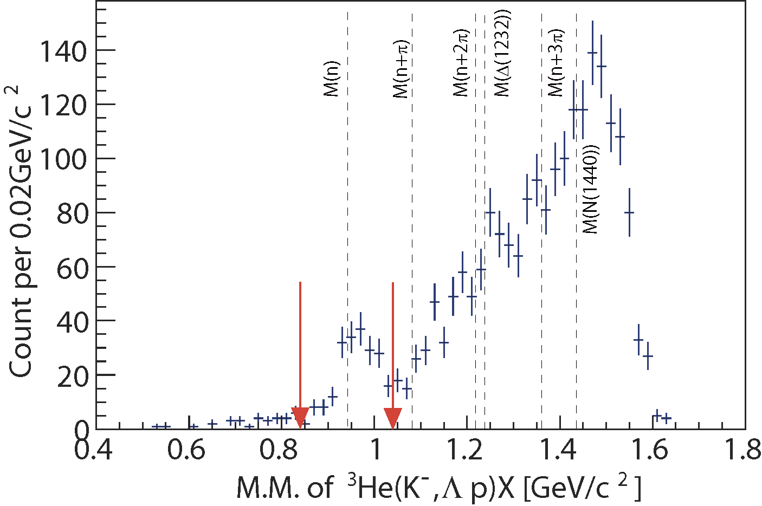
Exclusive ³He(K⁻,Λp)n events
CDS
p
missing n
Preliminary
n
Λ
π⁻
p
1GeV/c
K⁻ beam
K⁻³He→Λ(Σ⁰)pn events can be identified exclusively
# of Λ(Σ⁰)pn events: ~190
Σ⁰pn contamination: ~20%

Slide 11
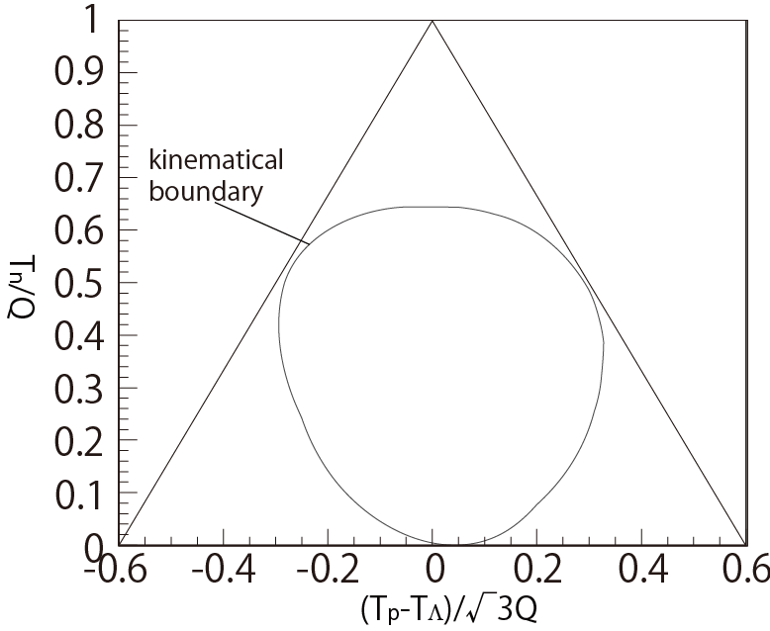
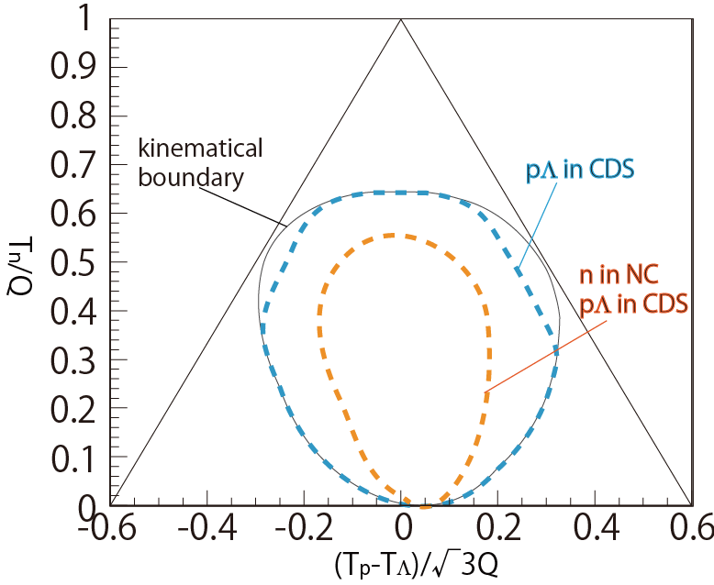
³He(K⁻,Λp)n: Dalitz plot
To check Λpn events phase space distribution
To plot in this figure, kinematics is fixed.
Checking 3 nucleon absorption or 2 nucleon absorption
If events are distributed uniformly
=> 3NA is dominant
T proton
T Λ
T neutron

Slide 12
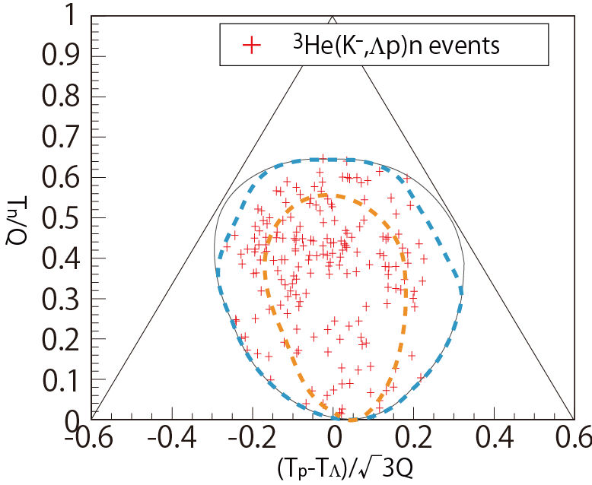
³He(K⁻,Λp)n: Dalitz plot
2NA:
e.g. K⁻³He→Λpn_{s}
Preliminary
2NA+2step:
e.g. K⁻³He→Σ⁰pn_{s},
Σ⁰n_{s}→Λn
2NA+2step:
e.g. K⁻³He→Σ⁰np_{s},
Σ⁰p_{s}→Λp
K⁻pp form.:
K⁻³He→(K⁻pp)n,
K⁻pp→Λp
Events are scattered widely in the phase-space of K⁻+³He->Λ+p+n
=>3NA is dominant!!
Notes:
Proton specも

Slide 13
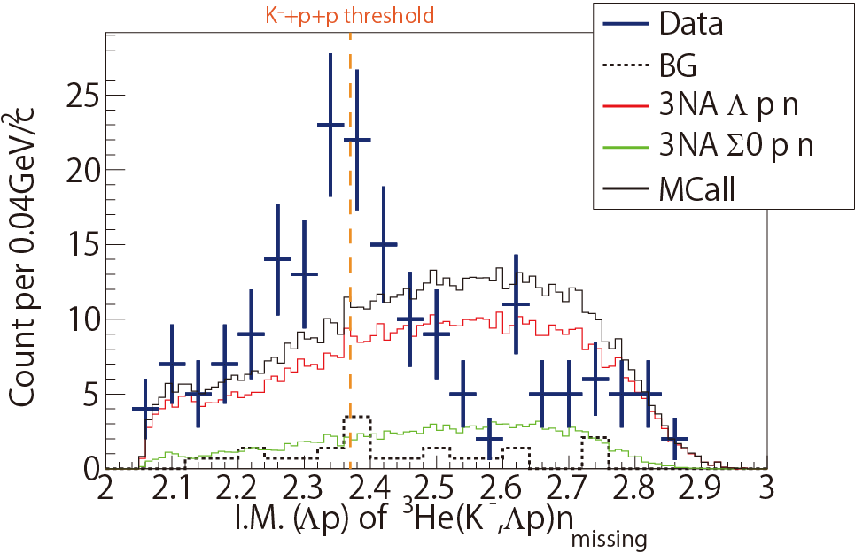
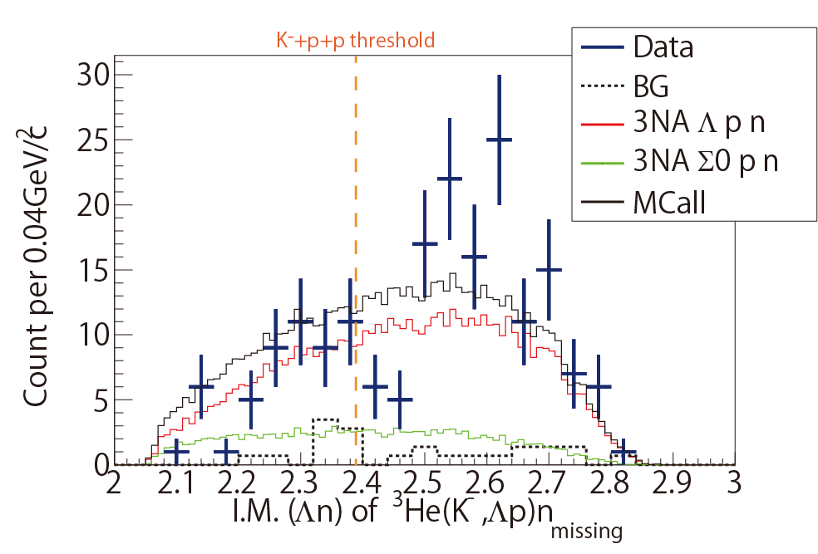
³He(K⁻,Λp)n: Invariant Mass
IM(Λp)
~190 events
Preliminary
IM(Λn)
Preliminary
total CS : ~200 μb
when phase-space distributions are assumed
Excess around the threshold?
(~ 0.1% of total cross section of K⁻³He)

Slide 14
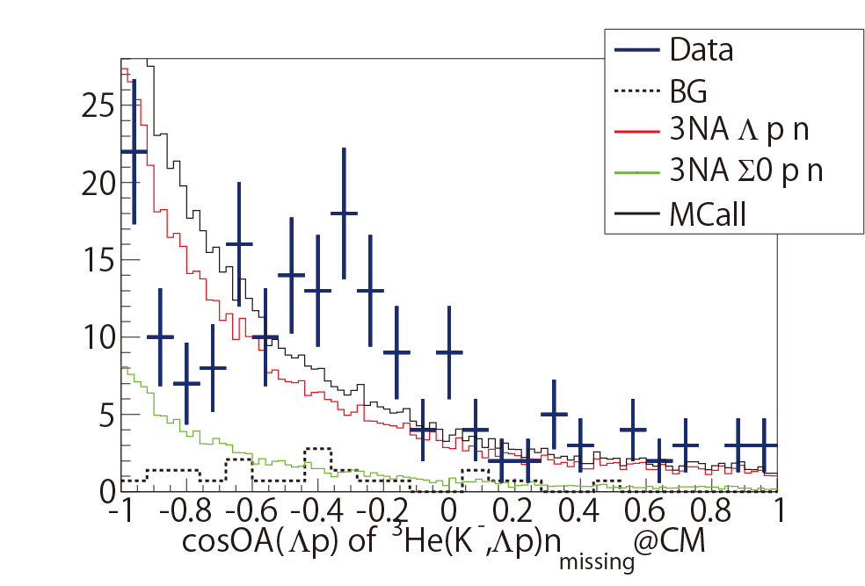
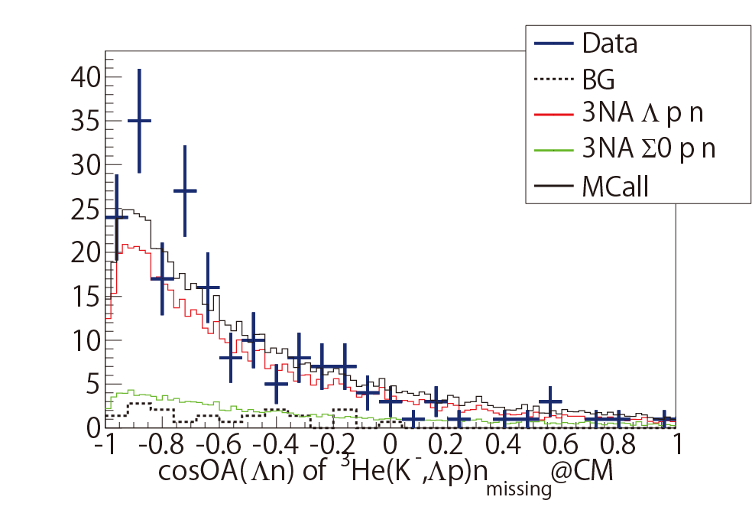
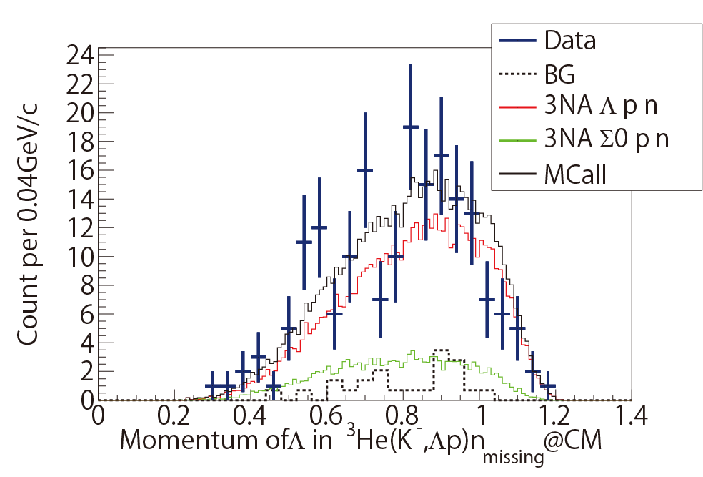
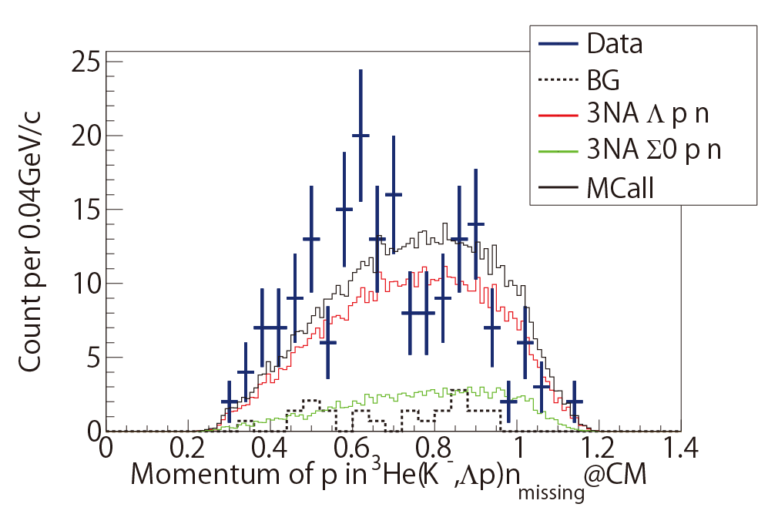
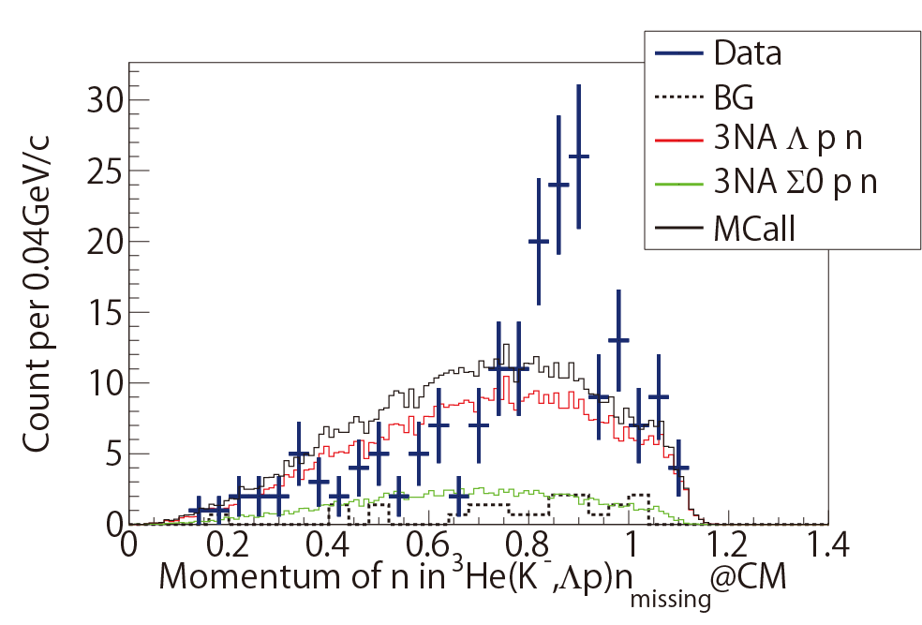
³He(K⁻,Λp)n: Comparison with Phase-Space
cos(Λp)
cos(Λn)
Preliminary
p_{Λ}
p_{p}
p_{n}
data cannot be reproduced only by the phase-space?

Slide 15
Summary
J-PARC E15 experiment
We have performed the 1st physics experiment
(we accumulated 5.1 x 10⁹ Kaons on ³He target )
All detectors performance have been archived as designed value
Preliminary results
Exclusive ³He(K⁻,Λp)n events
First measurement of in-flight K⁻ multi-nucleon absorption !!
Our data suggest that 3NA processes are dominant in ³He(K⁻,Λp)n reaction.
Total CS of ³He(K⁻,Λp)n event (3NA) is estimated to be
~200μb. i.e. 0.1% of total CS of K-³He interaction
If we assume all events mainly come from 3NA processes, there is an excess around K+p+p threshold.

Slide 16
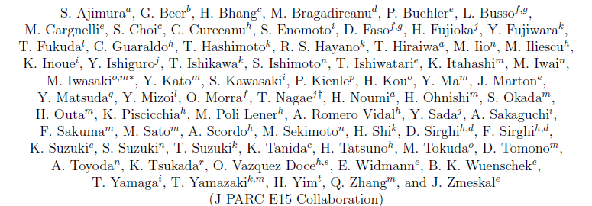
Thank you for your attention
J-PARC E15 collaboration

Slide 18
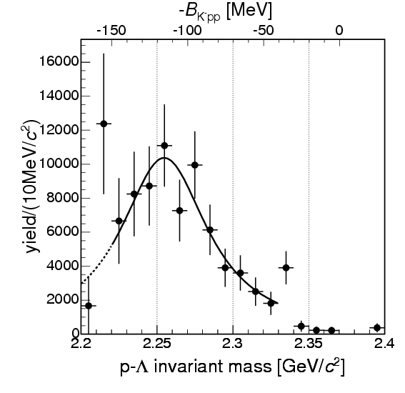
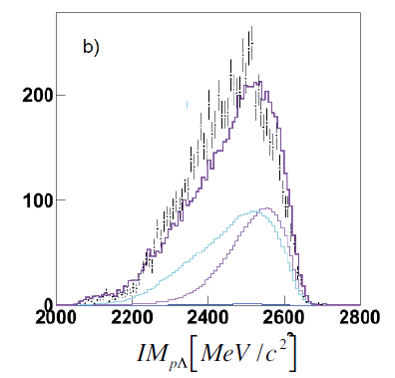
Experimental situation
FINUDA
B.E. = 115MeV
Γ = 67MeV
FINUDA experiment @DAΦNE =>positive?
Stopped K- @Light nuclei ->Λp invariant mass
DISTO experiment @SATARNE =>positive?
p + p → (Λ + p) + K⁺ @ 2.85GeV
HADES experiment @GSI =>negative?
p + p → (Λ + p) + K⁺ @ 3.5GeV
And
LEPS experiment =>negative?
photon -induced reaction
J-PARC E27 experiment =>positive?
d(π⁺, K⁺) @1.7GeV/c
Situation is not clear.
We need more studies of K^{bar}NN in various reaction channels!!
DISTO
B.E. = 103MeV
Γ = 118MeV
HADES
Notes:
ハデスも入れる
岡村さんも

Slide 19
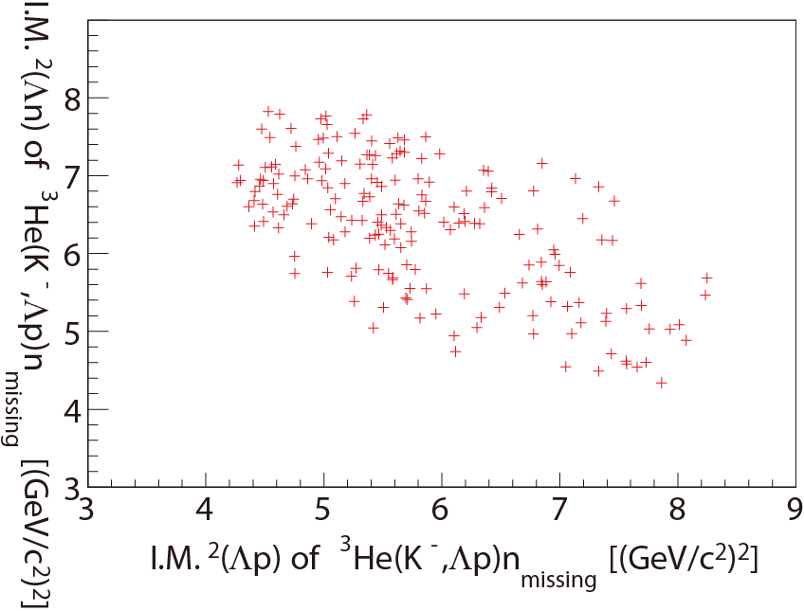

Slide 20
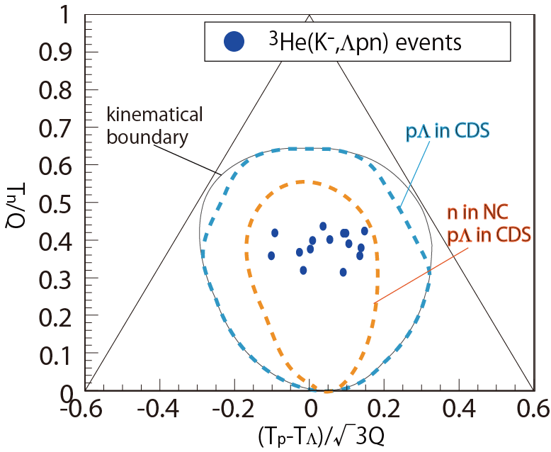
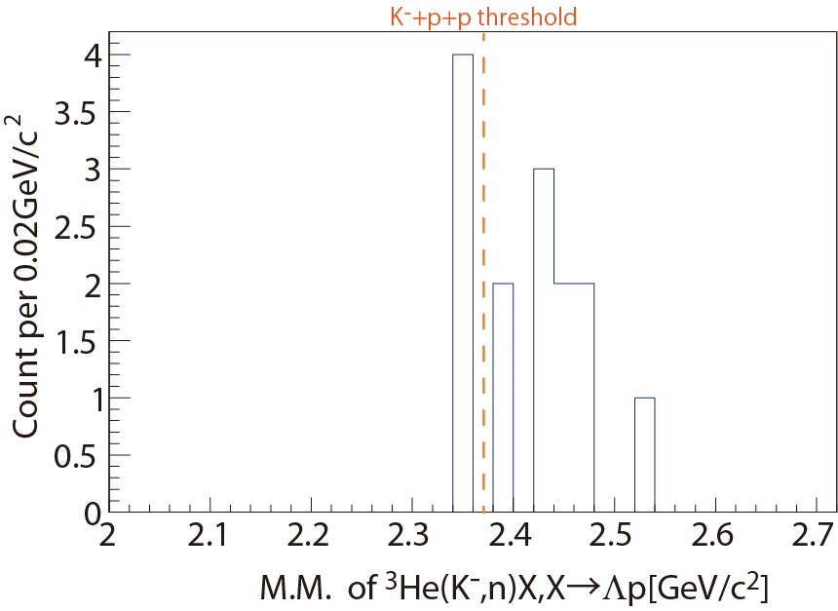
³He(K⁻,Λpn_{NC}) reaction
Events are less than 20

Slide 21
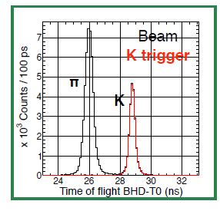
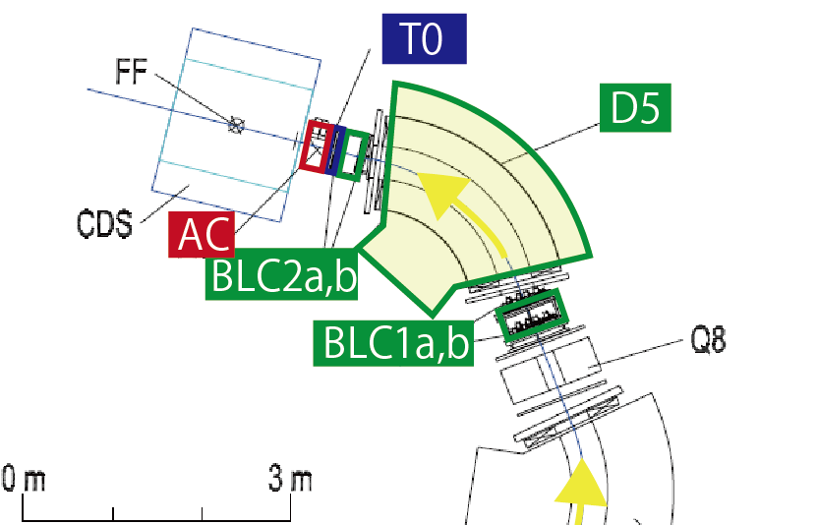
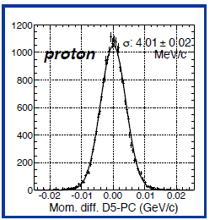
Beam line performance
K/π ratio: 0.45
σ_{beam} ~2MeV/c @1GeV/c

Slide 22
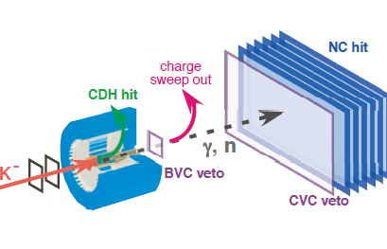
Neutron counter
K+p+p
threshold
Resolution [MeV/c²]
20 15 10 5 0
σ~10 MeV/c²
@threshold!
2.0 2.1 2.2 2.3 2.4 2.5 2.6 2.7
³He(K⁻,n)X missing mass[GeV/c²]
Resolution is estimated with width of γ peak

Slide 23
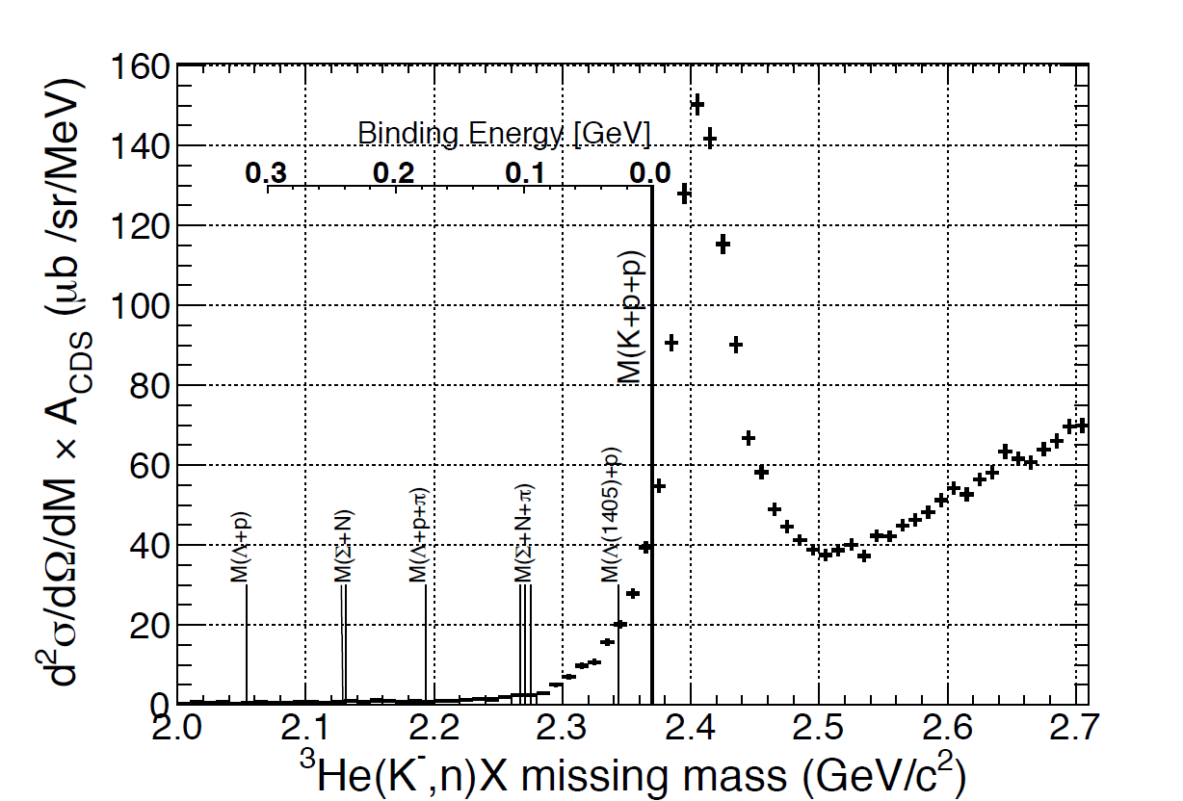
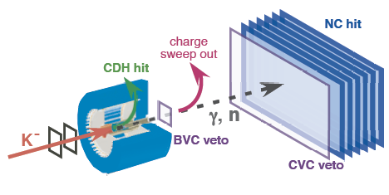
Semi-Inclusive ³He(K⁻,n)X M.M. spectrum
Semi-Inclusive : (CDC-track > 1) is required to determine the reaction vertex
(θ_{lab}=0º)
Integrated luminosity of K⁻+³He: 540 μb⁻¹

Slide 24
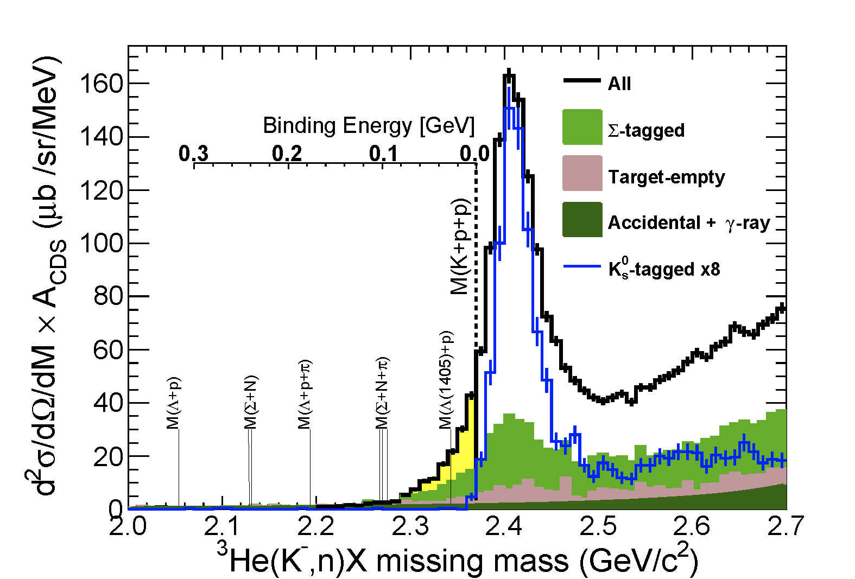
Semi-Inclusive ³He(K⁻,n)X M.M. spectrum
(θ_{lab}=0º)
excess
DISTO/FINUDA
CANNOT be explained by any experimental effects nor well-known “elementally” processes

Slide 25
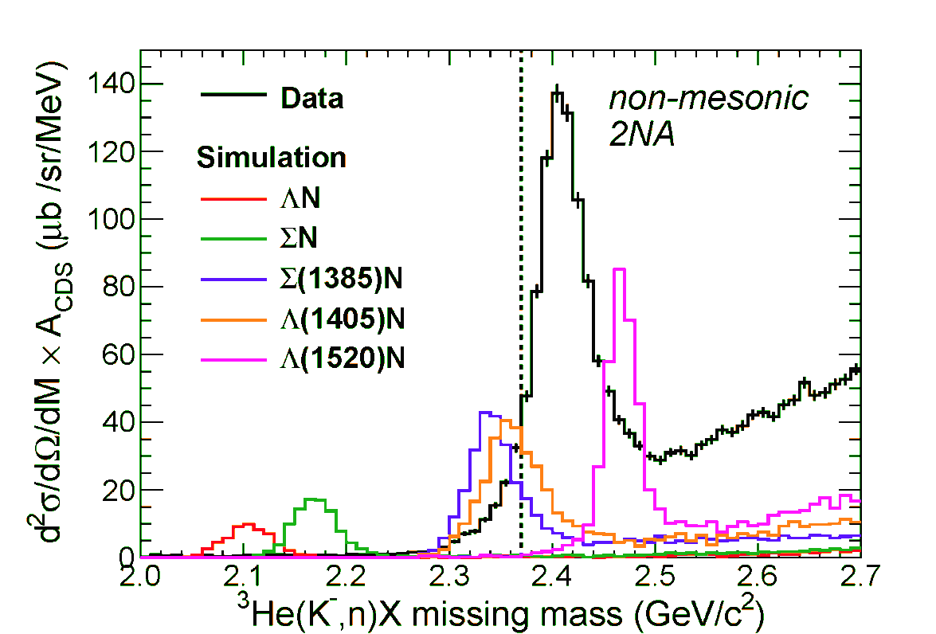
³He(K⁻,n): non-mesonic 2NA?
BW shape with
PDG values
non-mesonic-2NA reactions
K⁻+³He→Y^{(*)}+N+N_{s}
ΛN/ΣN branches are negligibly small!
large contribution of Y* branches?
Spectral shape of Λ(1405) is “simple BW with PDG values”
reproduce the excess with Λ(1405)n of ~5mb/sr

Slide 26
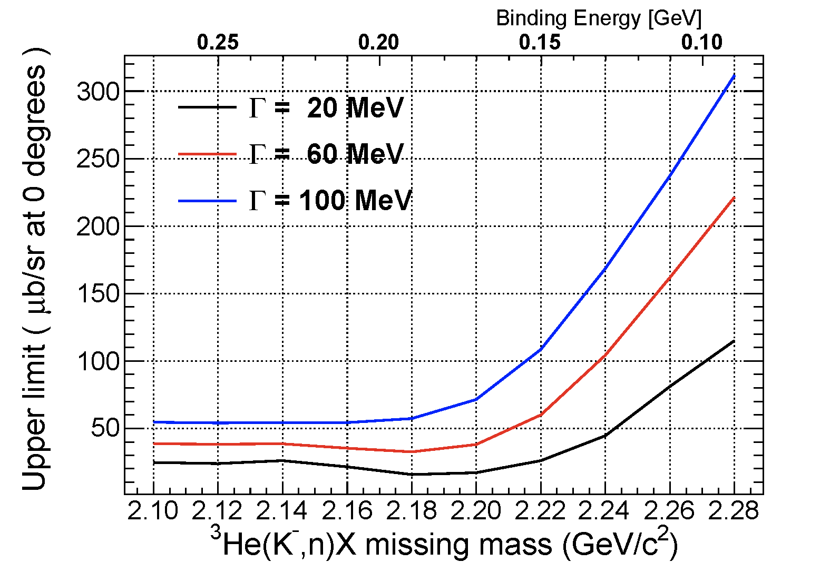
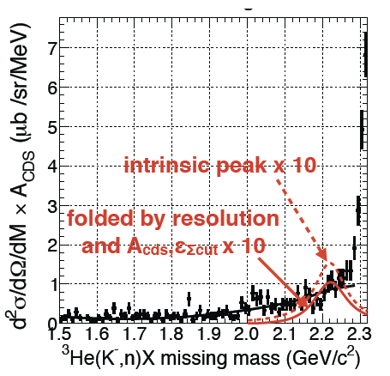
³He(K⁻,n): deeply-bound K⁻pp search
DISTO
FINUDA
No clear structure was found in B.E. ~ 100 MeV/c²
95% C.L. of dσ/dΩ(θ_{lab}=0º) is ~0.3 mb/sr
 | B.E. (MeV) | Γ (MeV) | 95% C.L. (mb/sr)
FINUDA | 115 | 67 | ~0.2
DISTO | 103 | 118 | ~0.3

Slide 27
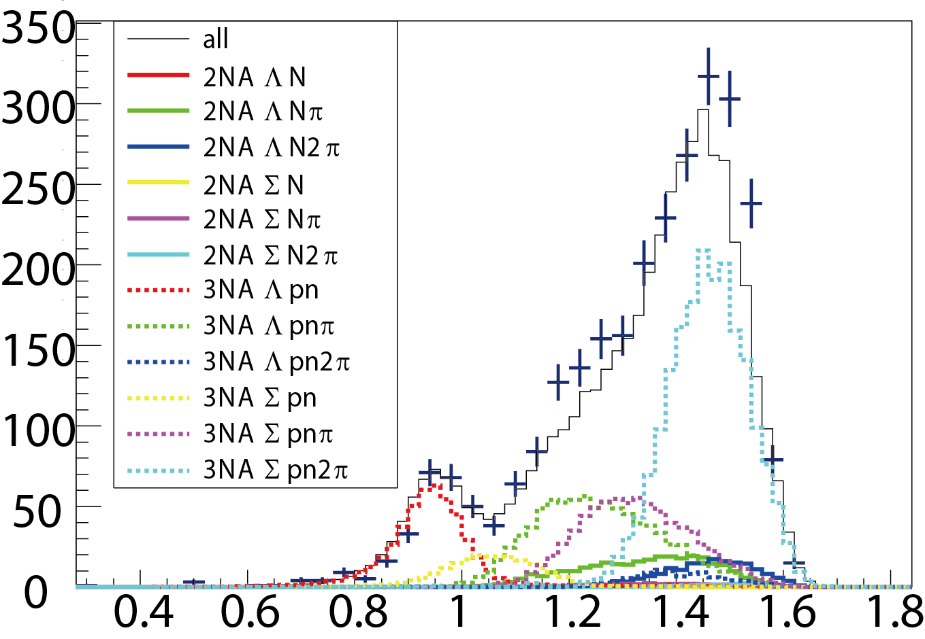
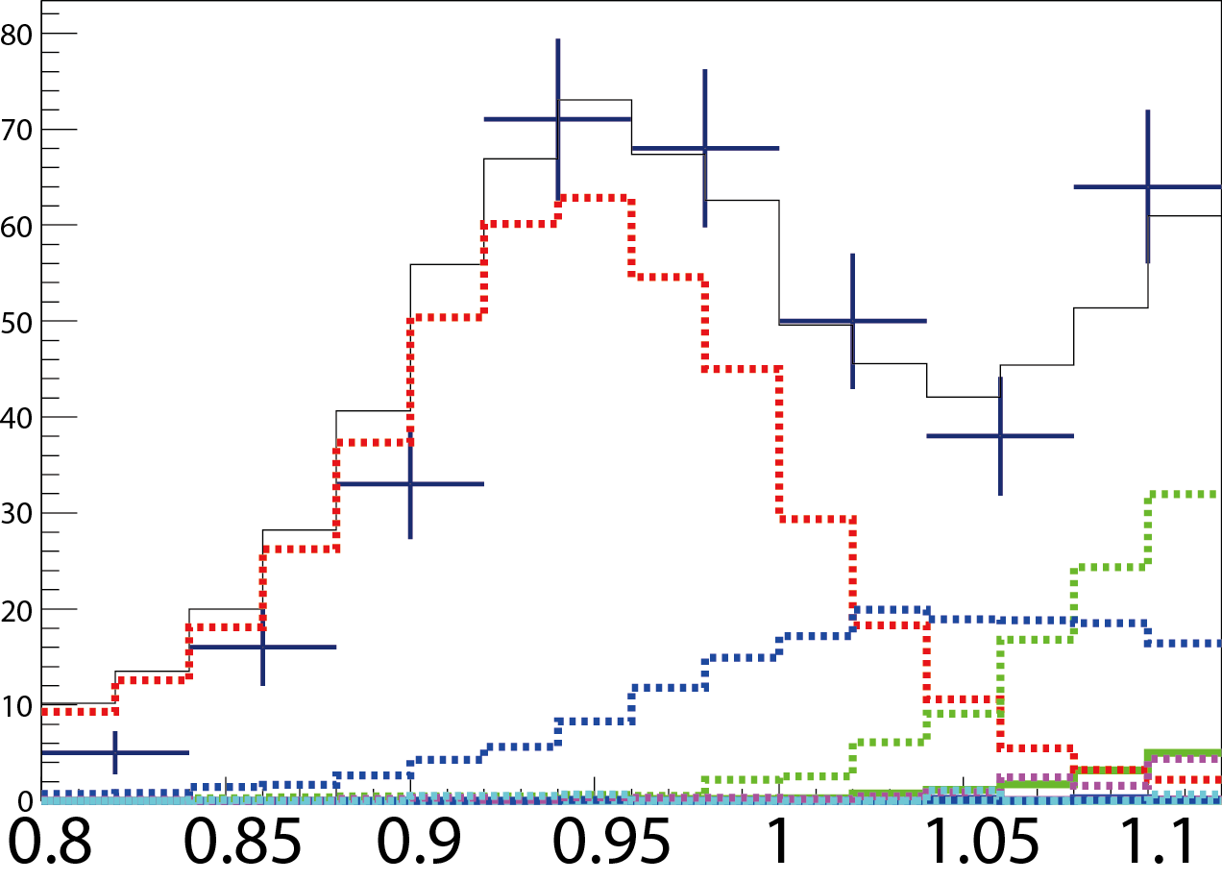
Decomposition of “missing neutron” region
3NA Λpn ~75%
3NA Σ0pn ~20%
3NA Λpnπ ~4%
else(i.e2NA+π) ~1%
Preliminary
3NA Λpn
Preliminary
M.M of ³He(K⁻,Λp)X [GeV/c²]
3NA Λpnπ
3NA Σ0pn
Fitting 3NA/2NA + π events produced MC
M.M of ³He(K⁻,Λp)X [GeV/c²]

