Slide 2
THE ETA-MESIC NUCLEUS
η meson bound with nucleus via
STRONG INTERACTION
+
+
N*
π‾
+
η
N*
COSY, J-PARC, MAMI, GSI, LPI/JINR
Talk by Wojciech Krzemień at this conference …
G. A, Sokol et al., arXiv:nucl-ex/0106005

Slide 3
THE ETA-MESIC NUCLEUS
η meson bound with nucleus via
STRONG INTERACTION
γ
+
+
η
γ
COSY, J-PARC, MAMI, GSI, LPI/JINR
Talk by Wojciech Krzemień at this conference …
G. A, Sokol et al., arXiv:nucl-ex/0106005
Notes:
For the first time also this mechanisms …

Slide 4
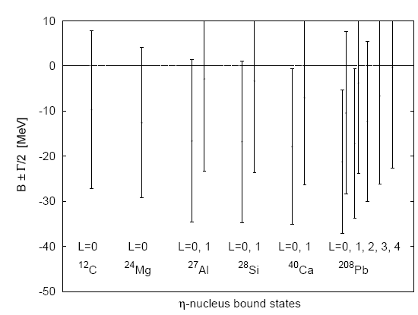
Attractive interaction between η and N
(R. Bhalerao and L. C. Liu, Phys. Lett. B54 (1985) 685 )‏
possible existence of bound states
of the η meson with nuclei for A>10 (Q. Haider and L. C. Liu, Phys. Lett. B172 (1986) 257 )‏
(C.Garcia-Recio, T. Inoue, J.Nieves,
E. Oset, Phys. Lett. B550 (2002) 47).

Slide 5
η bound state possible with the light nuclei
C. Wilkin, Phys. Rev. C47 (1993) 938
³He-η ³H-η ⁴He-η
Supported by model calculations of:
- S. Wycech et al., Phys. Rev. C52(1995)544
(the multiple scattering theory)
…
…
…
η-nuclear bound states revisited
E. Friedman, A. Gal, J. Mares, Phys. Lett. B725 (2013) 334
A. Gal et al., Acta Phys. Polon. B45 (2014) 673

Slide 7
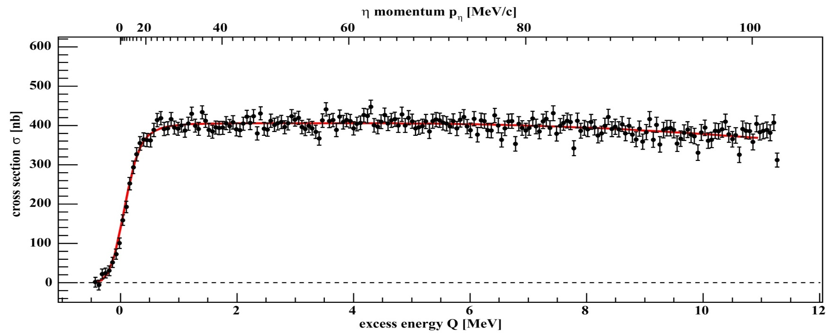
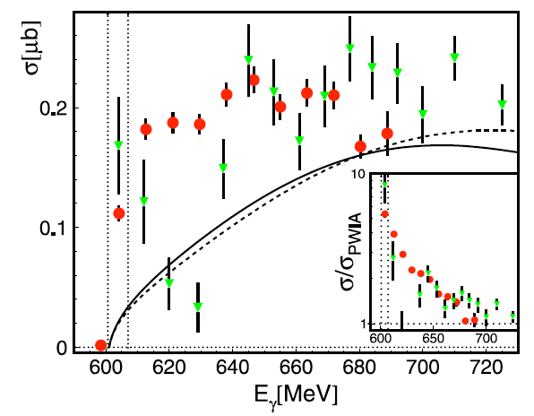
+
η - ³He
+
dp→ ³Heη γ ³He → ³Heη
COSY
MAMI
η
MAMI:
M. Pfeiffer et al., Phys. Rev. Lett. 92 252001 (2004)
F. Pheron et al., Phys. Lett. B709 21 (2012)
ANKE: T. Mersmann et al., Phys. Rev. Lett. 98 242301 (2007)
COSY-11: J. Smyrski et al., Phys. Lett B 649 258-262 (2007)
T. Mersmann et al., Phys. Rev. Lett. 98, 242301 (2007)
Notes:
SO its connected to the eta-3He system !!!
Is it production or interaction in the final state??? It has rather something to do with hel-eta because…

Slide 8
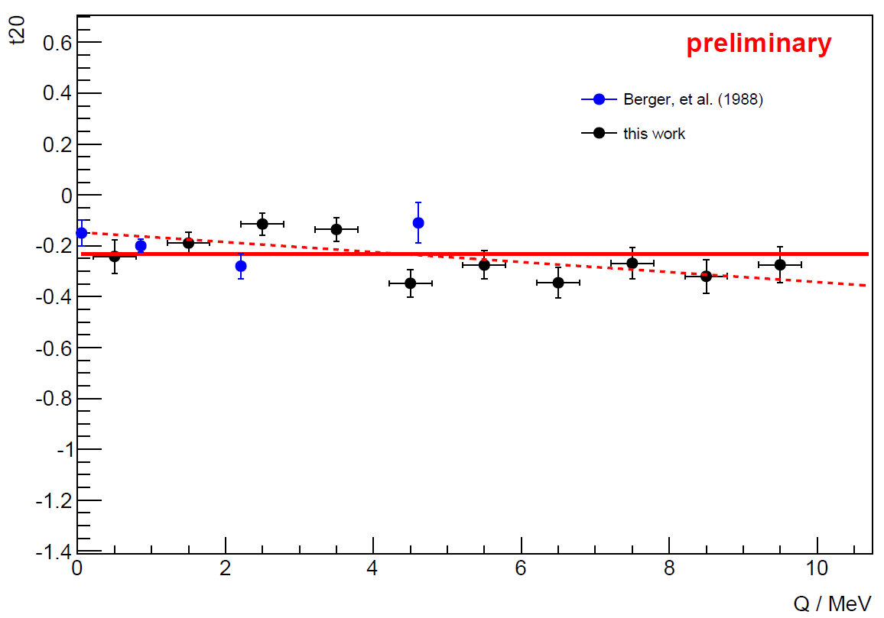
+
η - ³He
+
η
ANKE 2014
A. Khoukaz et al., Acta Phys. Polon 45 (2014) 655

Slide 9
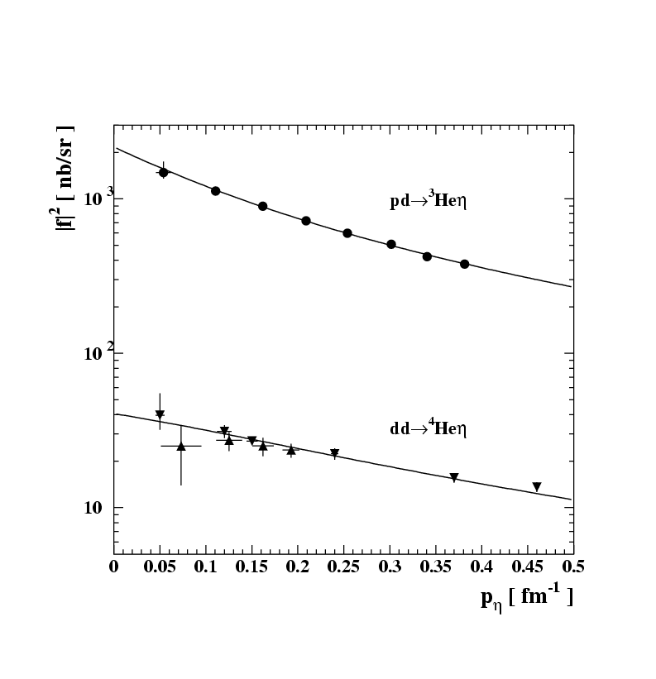
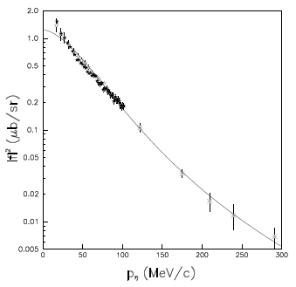
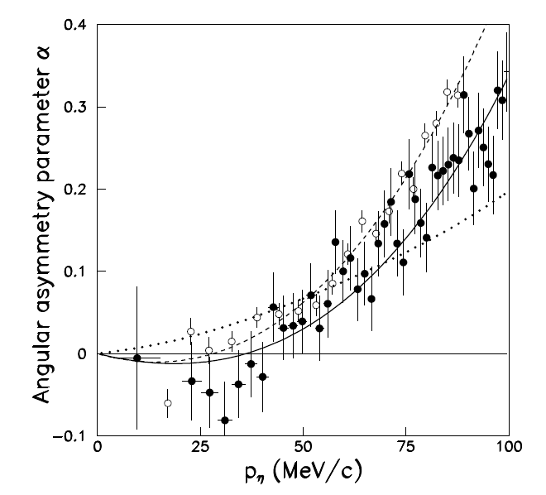
+
η - He
η
+
dp→ ³Heη
C.Wilkin et al., Phys. Lett. B654 (2007) 92‏
|Re(a)| > Im(a)
σ_{tot} = p_{cm}/p^{cm}_{beam} |f_{B}/(1-ip_{cm}a)|²
|Re(a)| = 2.9 ± 0.6 fm
Im(a) = 3.2 ± 0.4 fm
+
η
COSY-11 , COSY-ANKE
and also MAMI …
+
ANKE: T. Mersmann et al., Phys. Rev. Lett. 98 242301 (2007)
COSY-11: J. Smyrski et al., Phys. Lett B 649 258-262 (2007)
Notes:
Differences in steep are perhaps better seen directly at excitation function (see next page)

Slide 10
E. Friedman, A. Gal, J. Mares, Phys. Lett. B725 (2013) 334
D. Jido et al., Nucl. Phys. A 914 (2013) 354
N. G. Kelkar et al., Rept. Prog. Phys. 76 (2013) 066301
H. Nagahiro et al., Phys. Rev. C87 (2013) 045201
S. D. Bass, A. W. Thomas, Acta Phys. Polon. B45 (2014) 627
A. Gal et al., Acta Phys. Polon. B45 (2014) 673
Q. Haider, L.-C. Liu, Acta Phys. Polon. B45 (2014) 827
S. Hirenzaki, H. Nagahiro, Acta Phys. Pol. B45 (2014) 619
J. Niskanen, Acta Phys. Polon. B45 (2014) 663
C. Wilkin, Acta Phys. Polon. B45 (2014) 603
S. Wycech, W. Krzemien, Acta Phys. Polon. B45 (2014) 745

Slide 11
COSY P. Adlarson et al., Phys. Rev. C87 (2013) 035204
ELSA M. Nanova et al., Phys. Lett. B 727 (2013) 417
V. Metag et al., approved ELSA/03-20120BGO-OD
GSI Y. K. Tanaka et al., Few Body Syst. 54 (2013) 1263 K. Itahashi et al., Prog. Theor. Phys. 128 (2012) 601
JINR/NUCLOTRON
S. V. Afanasiev, Phys. Part. Nucl. Lett. 8 (2011) 1073
S. V. Afanasiev et al., Nucl. Phys. Proc. Suppl. 245 (2013) 173
J-PARC H. Fujioka, J. Phys. Conf. Ser. 374 (2012) 012015
LPI V. A. Baskov et al., PoS Baldin-ISHEPP-XXI (2012) 102
MAMI B. Krusche et al., J. Phys. Conf. Ser. 349 (2012) 012003
F. Pheron et al., Phys. Lett. B709 (2012) 21
Notes:
Jak dotąd jeśli chodzi o eta-3He najlepsze ograniczenia są z COSY-11 i tu wymienic…nastepa strona
Afanasiev S. V. et al.: Search for eta-mesic nuclei in the reaction d + C at JINR. Phys. Part. Nucl. Lett.
8 (2011) 1073-1077
Lebedev Physical Institute, Leninsky prospect 53, Mos
cow 119991, Russia
LPI electron synchrotron
GSI: We plan to
carry out a missing-mass spectroscopy experiment with the
12C(p,d) reaction at GSI-SIS

Slide 12
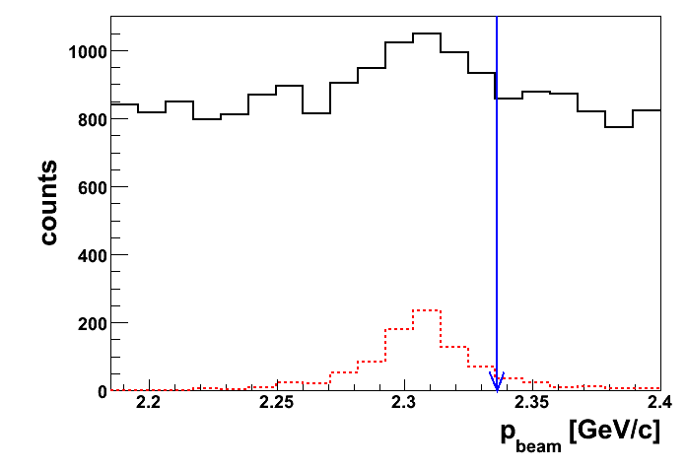
d+d → (⁴He-η)_{bound}→ ³He + p + π⁻
d+d → ³He + p + π⁻
d+d → ³He N*→ ³He + p + π⁻
SIMULATIONS

Slide 13
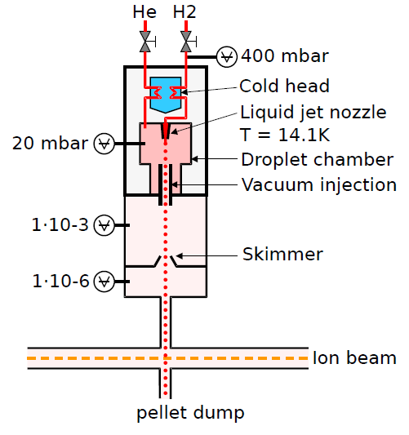
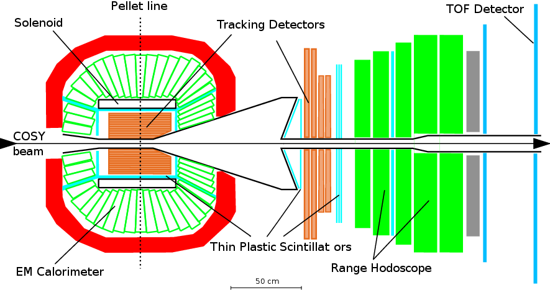
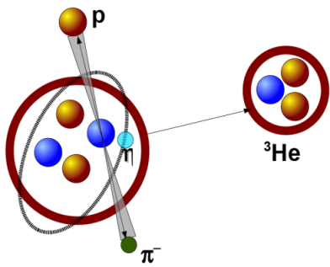
WASA-at-COSY
→
Notes:
Tu wpsomniec o Pelletach … Polaryzacj at Q=15 and at Q=72…

Slide 14
WASA
gives
UNIQUE OPPORTUNITY TO DETECT ALL EJECTILES
EXCLUSIVE MEASUREMENT
COSY
enables measurement of the excitation function with
continuous change of the beam momentum RAMPED BEAM MOMENTUM

Slide 15
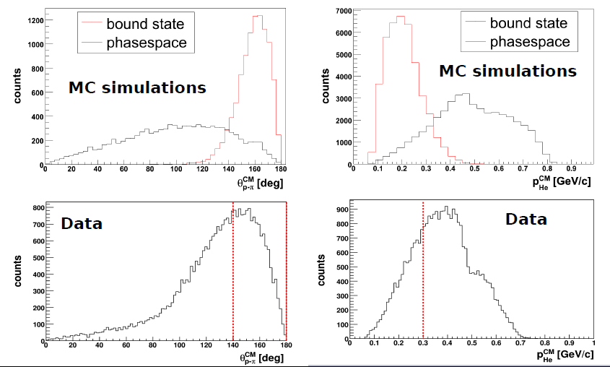
d+d → (⁴He-η)_{bound}→ ³He + p + π⁻
d+d → ³He + p + π⁻

Slide 16
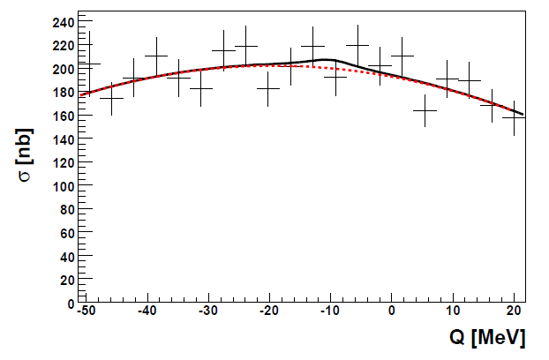
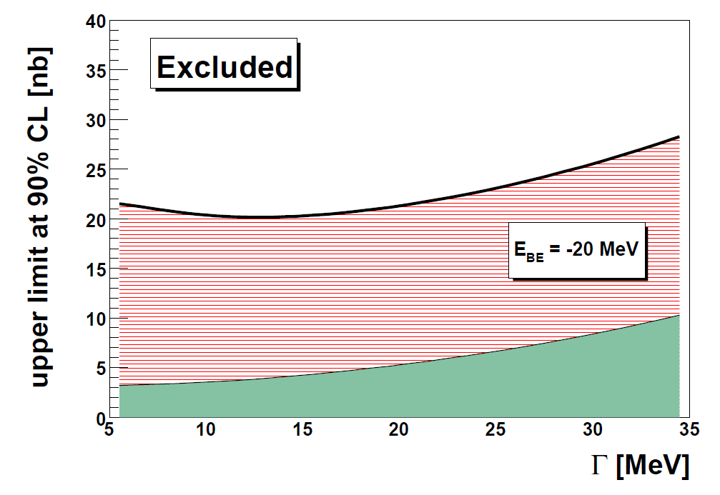
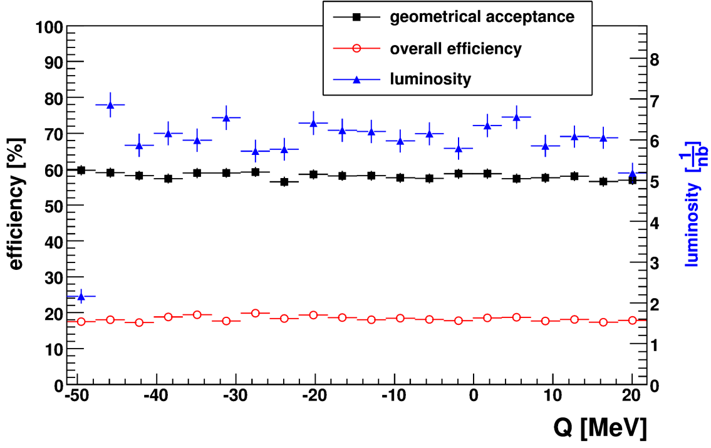
ETA MESIC NUCLEUS, COSY
d+d → ³He + p + π⁻
d+d → (⁴He-η)_{bound}→ ³He + p + π⁻
WASA-at-COSY:
Phys. Rev. C 87, 035204 (2013)

Slide 17
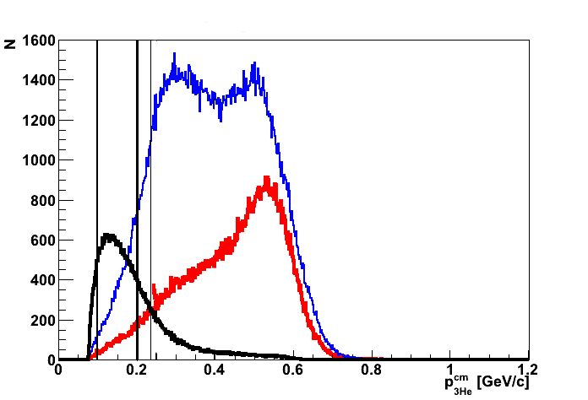
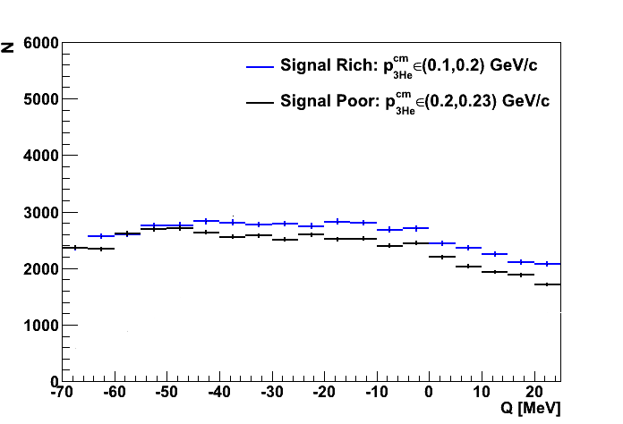
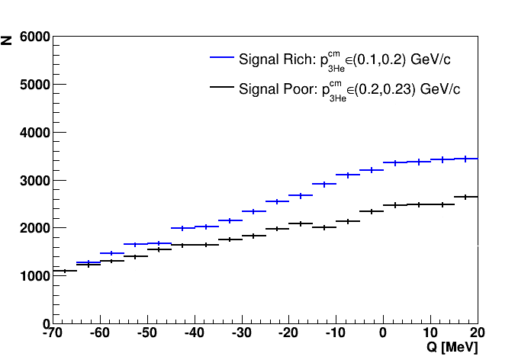
WASA-at-COSY
preliminary
preliminary
dd → ³He p π⁻
dd → ³He n π⁰

Slide 18
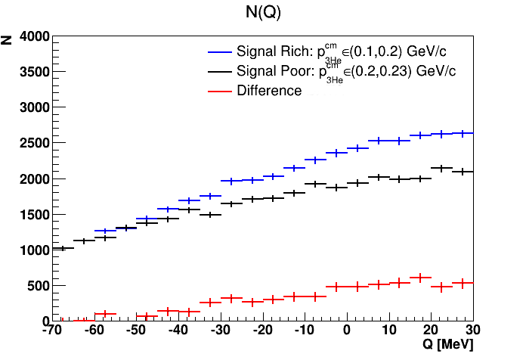
WASA-at-COSY
dd → ³He n π⁰
PRELIMINARY DATA
SIMULATIONS
dd → ³He N* → ³He n π⁰

Slide 19
E.g. for pppπ‾ a present upper limit of 270 nb (COSY-11: P.M and J. Smyrski Acta Phys.Polon. B41 (2010) 2281-2292)
we expect to lower to 30 nb
and 3 nb may be achieved for the first time for ³He 6γ

Slide 21
THANK YOU
FOR YOUR ATTENTION

Slide 22
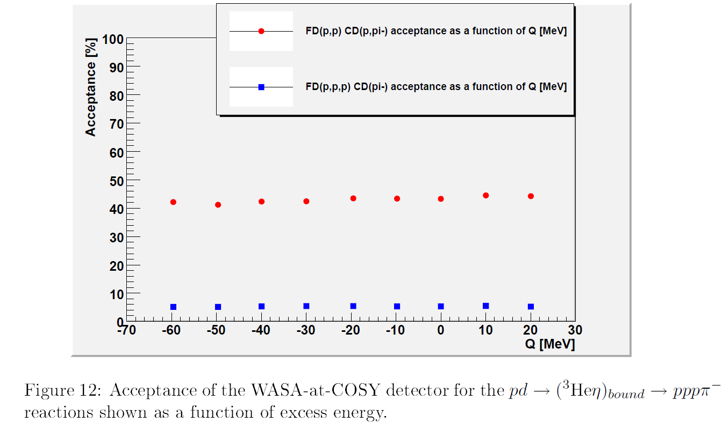

Slide 24
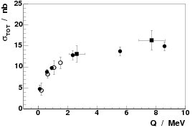
η - ³He
T. Mersmann et al., Phys. Rev. Lett. 98, 242301 (2007)
σ(dp → ³He η)
R. Frascaria et al., Phys. Rev. C 50 (1994) 573.
N. Willis et al., Phys. Lett. B 406 (1997) 14.
A. Wrońska et al., Acta. Phys. Pol. 56 (2006) 279
η - ⁴He
σ(dd → ⁴He η)
Notes:
SO its connected to the eta-3He system !!!
Is it production or interaction in the final state??? It has rather something to do with hel-eta because…

