Slide 1


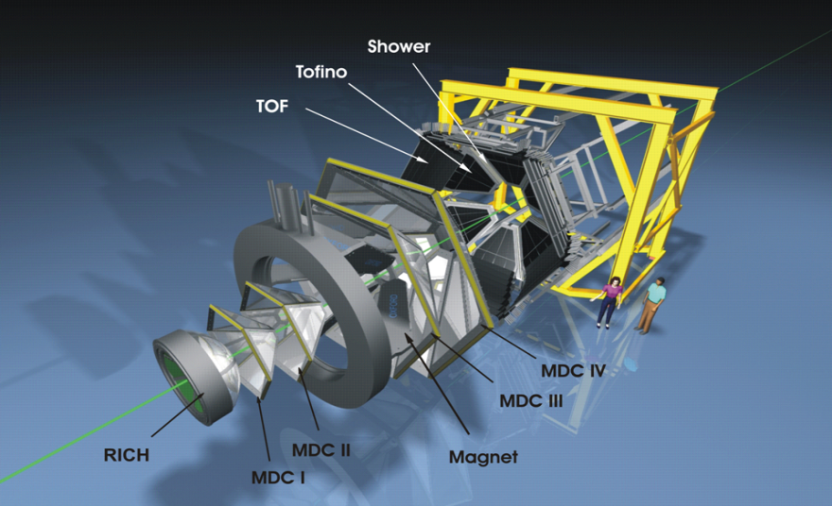
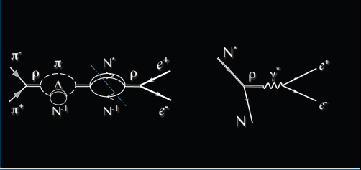
HADES results in elementary reactions
B. Ramstein, IPN Orsay
for the HADES collaboration
29/05/2014, Cracow

Slide 2
Outline
Introduction:
General motivations of HADES experiments
Results from NN reactions with HADES
Role of baryonic resonances in
  Dilepton emission
  Strangeness production
Perspectives of HADES measurements with the GSI pion beam
(summer 2014)
Conclusions

Slide 3
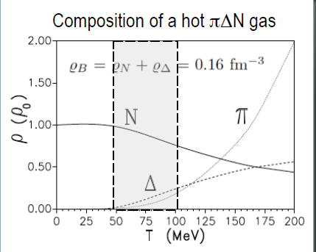
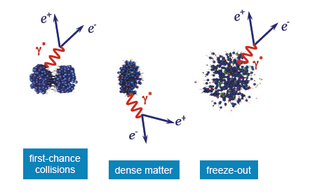
Motivations of the HADES experiment
Studying hadronic matter…..
….. in a baryon rich environment
SIS18, E/A=1-3.5 GeV
ρ/ρ_{o} ~ 1-3,
τ ~ 15 fm/c
T < 80 MeV
N_{π}/A_{part} ≈ 10%
Rapp, Wambach, Adv. Nucl. Phys. 25 (2000)
K, Λ,Φ, Ξ
….. using penetrating (but rare) probes:
dileptons
strange particles

Slide 4

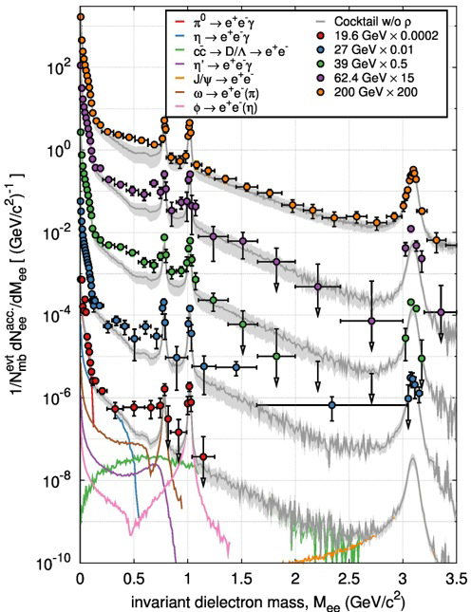
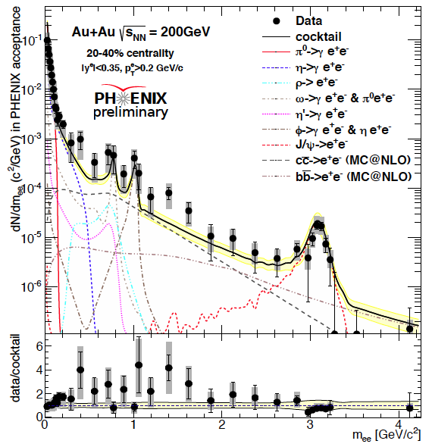

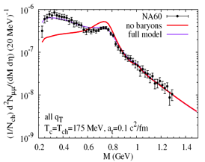

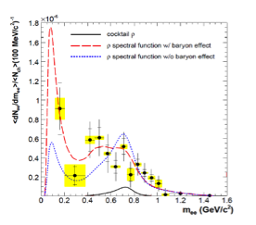

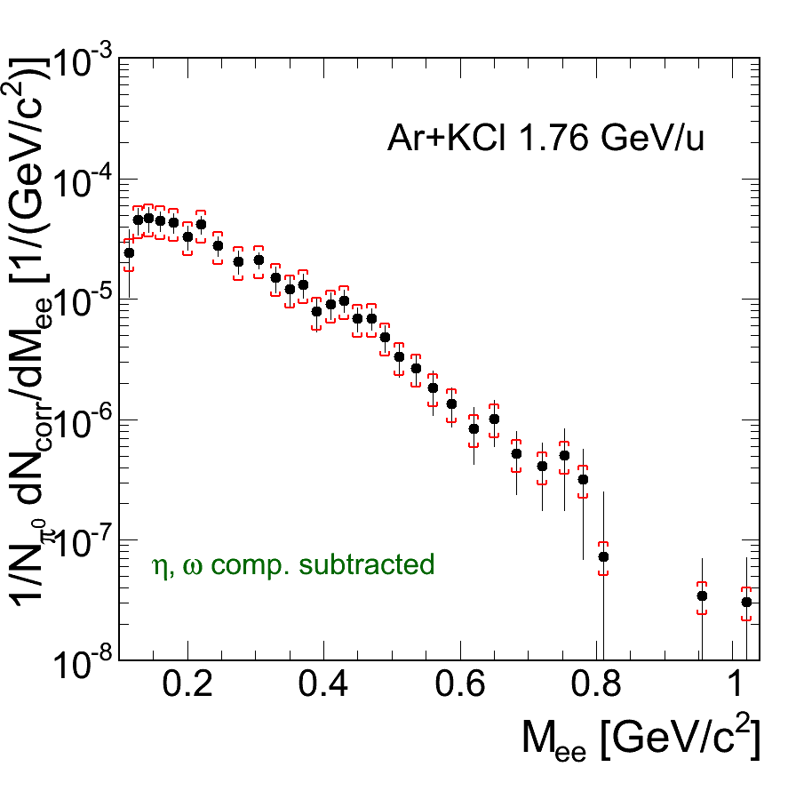
Virtual photon emission from hot and dense matter
T
Na60
µ _{B}

Slide 5
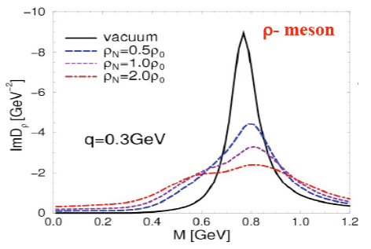
Dileptons: a probe of in-medium vector meson modifications:
see e.g. Leupold ,Metag,Mosel Int. J. of Mod. Phys. E19 (2010) 147 for a recent review
« in-medium broadening »
π
N
ρ
ρ
ρ
ρ
Δ
+
N⁻¹
N⁻¹
In-medium spectral function depends on ρ NN* coupling
main players: N(1520), N(1720), Δ (1910)
Rapp and Wambach EPJA 6 (1999) 415
Rapp, Chanfray and Wambach NPA 617, (1997) 472
ρ, ω,φ
γ∗
N*
e⁺
Link to electromagnetic structure of the
baryonic transitions
can be studied in NN and πN collisions
at 1-3 GeV
e⁻
N
Notes:
5

Slide 6
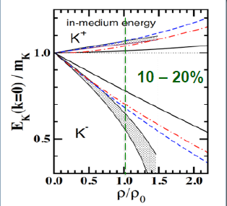
Strange particles in nuclear matter
highlights at low energy
K⁺/K⁰ sensitivity to in-medium potential
(weak absorption) and EOS
K⁻ coupling to resonances
Φ : no OZI suppression at low energies
Double strange Ξ⁻
→ Production far below thresholds:
sensitivity to production mechanisms
Λ (1405)
K⁻
K⁻
N⁻¹
G.E. Brown et al., NPA 567 (1994) 937
T. Waas et al., Phys. Lett. B379 (1996) 34
J. Schaffner_Bielich et al. NPA 625 (1997)
C. Fuchs, Prog. Part. Nucl. Phys. 56 (2006) 1
Zhi-Gang Xiao et al. arXiv.1312.5790v1.pdf
Constraints to be obtained from NN reactions
kaon production mechanism:
  exclusive channels
  role of baryonic resonances
K⁻N potential: Λ (1405): bound K⁻p system ?
Search for bound K⁻pp system

Slide 7
Hades « strategy » : 2014 status
Study dilepton and strangeness emission in dense and hot matter
C+C, Ar+KCl, (last Au+Au run in 2012)
cold matter at normal nuclear density p+Nb 3.5 GeV
and π⁻A in summer 2014
Elementary collisions pp, dp and soon π⁻p (summer 2014)
HADES@FAIR (2019): pp, pA, AA E/A<8 AGeV
recent review of HADES in-medium studies
T. Galatyuk, Quark Matter 2014

Slide 8



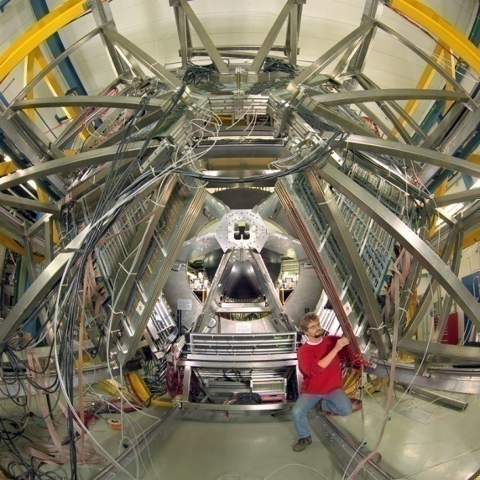
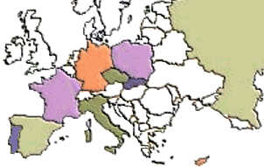

The Collaboration
Catania (INFN - LNS), Italy
  Cracow (Univ.), Poland
    Darmstadt (GSI), Germany
      Dresden (FZD), Germany
        Dubna (JINR), Russia
        Frankfurt (Univ.), Germany
        Giessen (Univ.), Germany
        Milano (INFN, Univ.), Italy
        München (TUM), Germany
        Moscow (ITEP,MEPhI,RAS), Russia
        Nicosia (Univ.), Cyprus
        Orsay (IPN), France
      Rez (CAS, NPI), Czech Rep.
    Sant. de Compostela (Univ.), Spain
  Valencia (Univ.), Spain
Coimbra (Univ.), LIP, Portugal
GSI
SIS
8
Notes:
8
The HADES detector is installed on the GSI facility, but HADES is a european collaboration. Actually 150 persons working in about 156institutions all over Europe. 15” tot 45”

Slide 9
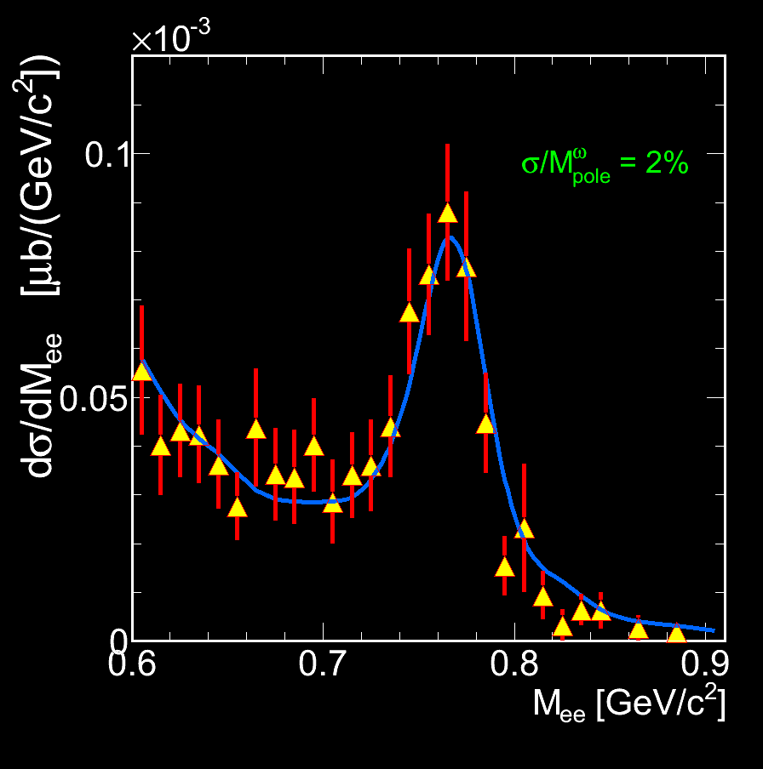
HADES
2nd generation dilepton
spectrometer
Acceptance: Full azimuth, polar angles 18º - 85º
Pair acceptance ≈ 0.35
Particle identification:
RICH, Time Of Flight, Pre-Shower (pad chambers & lead converter) ( also MDC (K±))
Trigger:
~ 50 kHz
Momentum measurement
  Magnet: ∫Bdl = 0.1- 0.34 Tm
  MDC: 24 Mini Drift Chambers
  Leptons: Δx~ 140 μ per cell, Δp/p ~ 1-2 %
  ΔM/M ~ 2% at ω peak
Electromagnetic Calorimeter for experiments
with SIS 100/FAIR P.Ramos, poster session
9
Notes:
9
Consists of 6 sectors,

Slide 10
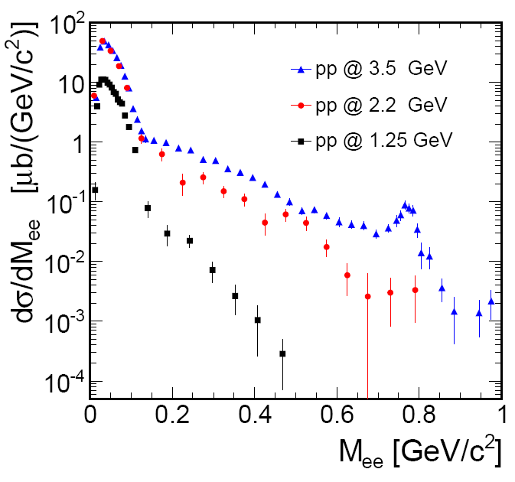
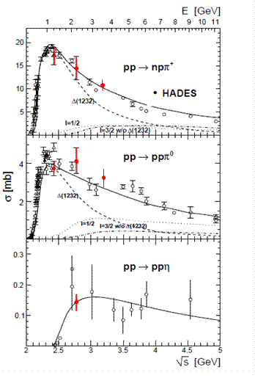
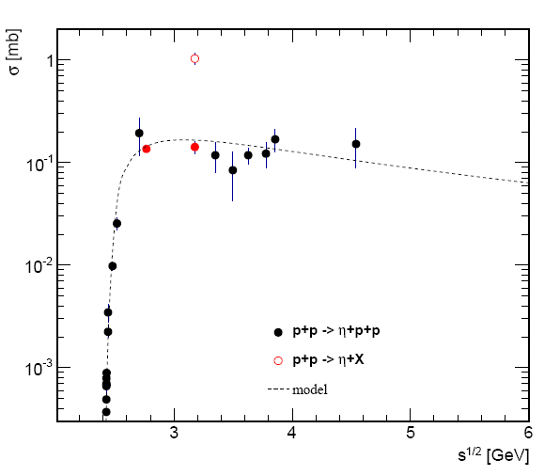
HADES measurements in pp E=1.25 GeV,2.2 GeV,3.5 GeV
Exclusive meson production in hadronic channels
Inclusive dilepton production
HADES:EPJA 48 (2012)74, EPJA50 (2014) 82
π°→γ e⁺e⁻
HADES: pp→ωX
η→e+e-γ
HADES
HADES: pp→ρX
ω→e⁺e⁻
(η, Δ)
HADES: Eur.Phys.J. A48 (2012) 64
Δ→Ne⁺e⁻
O pp→ηX
ᵒ
PRC85 054005 (2012)
• pp→ppη
Dominance of pp→NΔ below 2 GeV
η and higher resonances above 2 GeV
ρ/ω production at 3.5 GeV
10
Sqrt(s) (GEV)
Notes:
I would like to start the presentation of the results obtained in proton-proton reactions by a general slide which illustrates the evolution with energy of inelastic channel cross-sections.
Complementarity between elctron and hadronic channels exploited all the time in the data analysis

Slide 11
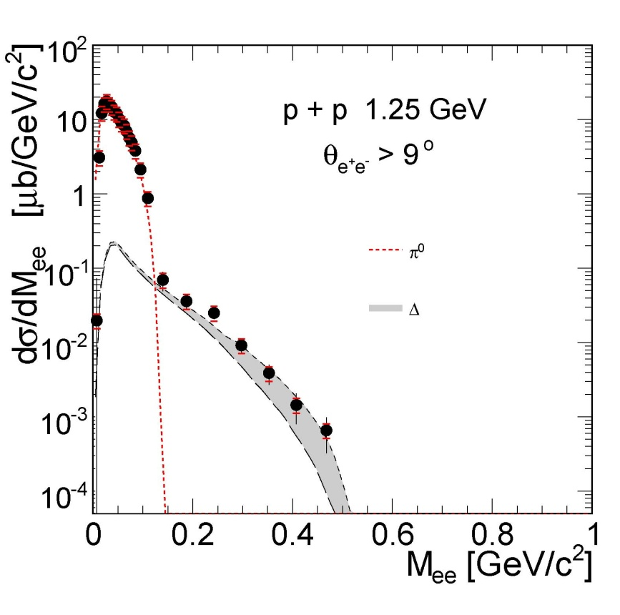
Dilepton production in pp reaction at 1.25 GeV
HADES: Phys.Lett.B690 (2010)118
Non resonant contribution is small
Dominance of Δ Dalitz decay :
branching ratio Δ → Ne⁺e⁻ (QED :4.2 10⁻⁵)
not measured yet!
Moderate sensitivity to Time-like N-Δ transition electromagnetic form factors
N
G_{M}(q²)
R
γ∗
e⁺
e⁻
0.6m²_{ρ}
Resonance model results:
π° Dalitz
Dalitz)+ effect of Iachello FF
Wan and Iachello Int. J Mod. Phys. A20 (2005) 1846
G. Ramalho and T. Pena Phys.Rev. D85 (2012) 113014
Notes:
11

Slide 12
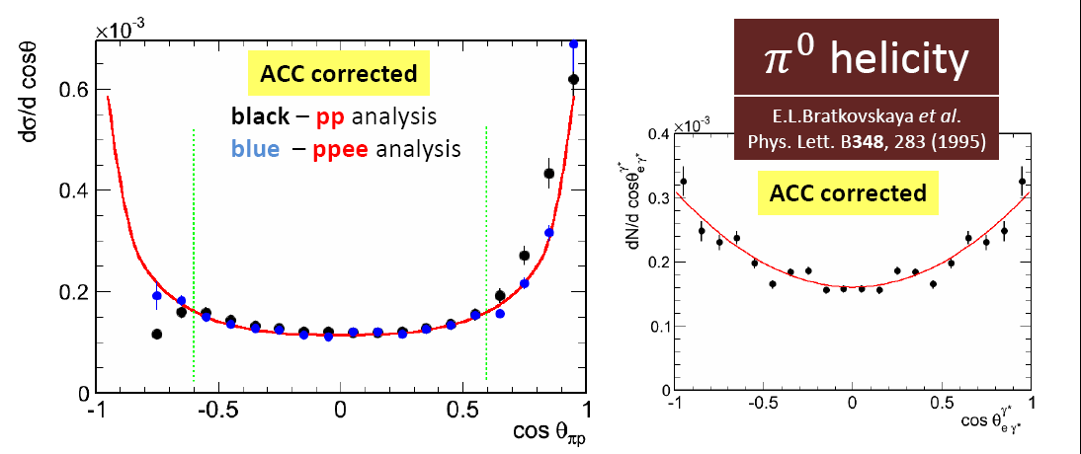
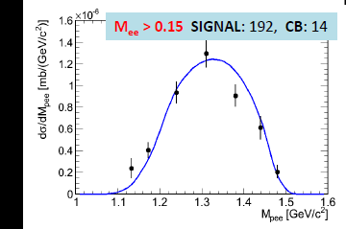
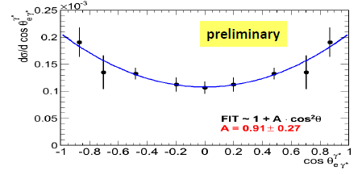
Exclusive analysis : pp→ppe⁺e⁻ at 1.25 GeV
Good agreement with
simulation of
Δ production + Dalitz decay
(cf hadronic channels)
In HADES acceptance
acceptance corrected
preliminary
preliminary
p
p
1
p₂
p
Δ⁺
e⁺
(p,e⁺,e⁻) invariant mass (GeV/c²)
cos(θ^{CM}_{pe+e-})
q²=M²_{inv}(e⁺e⁻)=M²_{γ*}
e⁻
First measurement !
Dalitz decay branching ratio in agreement with QED value (4.2 10 ⁻⁵)
BR= 4.42 10⁻⁵ ±20% ( syst.) ± 9% (stat)
Helicity distributions γ* → e⁺e⁻
dσ/dΩ_{e}~ 1+cos²α
Supported by the analysis of 1π production channels:
W. Przygoda’s parallel session A1
30.05.2014, 15:40
α
e⁻
γ*
e⁺
Δ
N
cosα

Slide 13
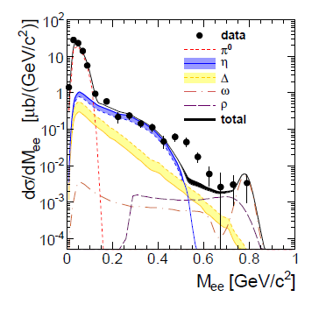
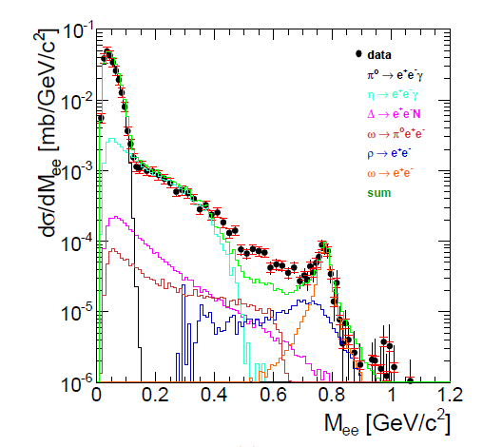
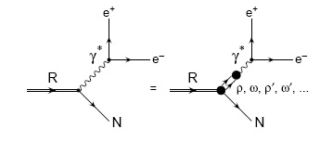
pp→e⁺e⁻X E=2.2 GeV, 3.5 GeV
Comparison to cocktail of point-like dilepton sources
Direct production of ρ/ω
Dalitz decay of Δ resonance (point-like)
E=2.2 GeV
E=3.5 GeV
Hades data,
EPJA48 (2012) 64
Hades data,
PRC85 054005 (2012)
Effect of electromagnetic form factors / Coupling of ρ to baryonic resonances ?

Slide 14
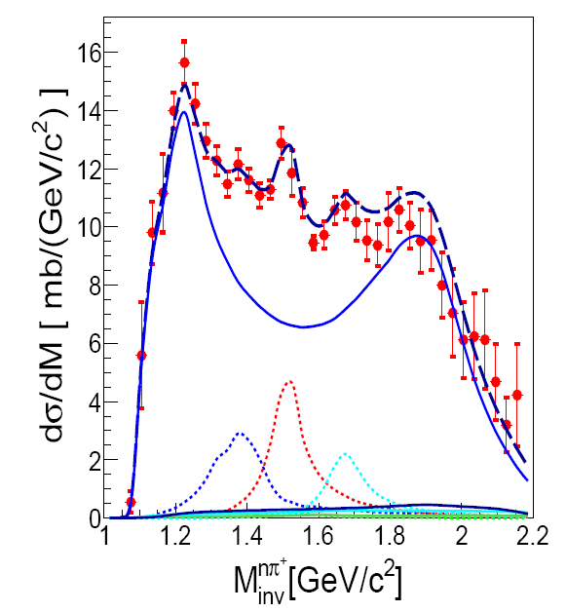
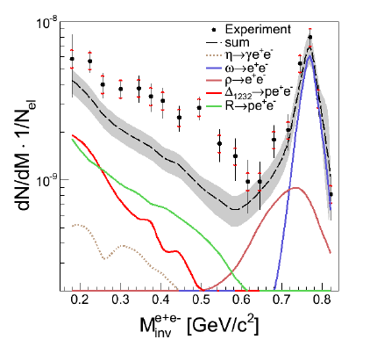
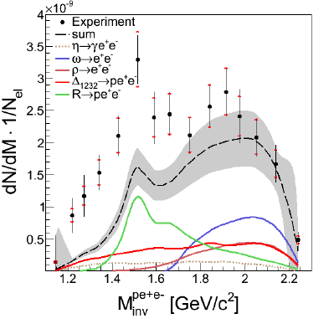
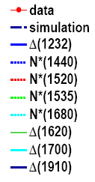
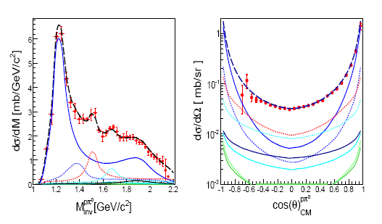
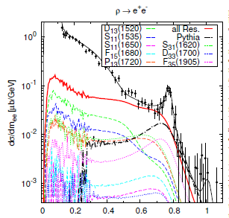
Exclusive pp→ppe⁺e⁻ channel at 3.5 GeV
Cocktail of baryonic resonances
constrained by hadronic channels
Dalitz decays of point-like baryonic resonances
+ “direct” ρ and ω
pnπ⁺
ppe⁺e⁻
ppe⁺e⁻
R
ω
Δ
R
ω
Δ
ρ
G. Agakishiev et al. Eur.Phys.J. A50 (2014) 8
ppπ⁰
Excess related to light baryonic resonances N(1520)
ρ is modified
in NN collisions !
J. Weil, H. van Hees
and U. Mosel, EPJA 48, 111 (2012)

Slide 15
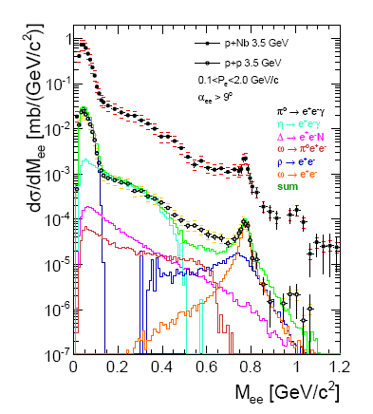
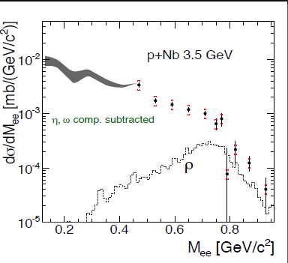
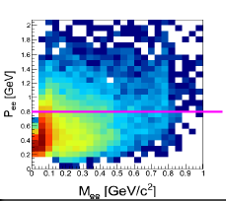
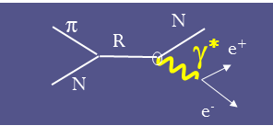
Studying cold nuclear matter
p+p/p+Nb
3.5 GeV
Phys.Lett. B715 (2012) 304
HADES added value
p_{e+e-} measured
down to 0.2 GeV/c
« ρ-like» contribution strongly distorted
Δ (1720),N* (1520),.. →Nρ→Ne⁺e⁻
From primary NN and secondary πN reactions .

Slide 16
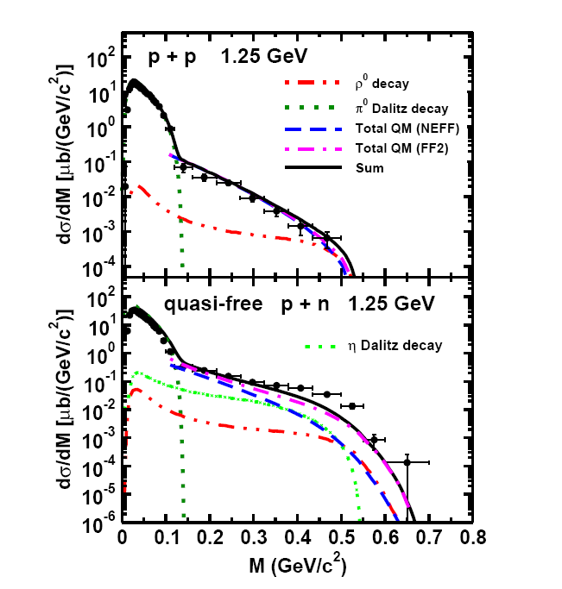
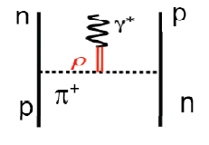
The « pn puzzle »:tentative explanations
HADES: Phys.Lett.B690 (2010)118
Large excess of dilepton yield in pn over
the π°+η + Δ contribution
Can not be explained by pn Bremsstrahlung
cf OBE predictions
R. Shyam & U. Mosel, PRC 79 (2009) 03520
L.P. Kaptari, B. Kämpfer, NPA 764 (2006) 338
R. Shyam and U. Mosel, Phys.Rev.C,82:062201(2010)
π VDM Electro
magnetic form factor
Improved descriptions
np→de⁺e⁻ and ρ coupling
to baryonic resonances (R)
ρ production by ΔΔ FSI ….
B. Martemyanov et al.Phys.ReV.C 84 (2011) 047601
Can be checked experimentally by HADES:
exclusive analysis pn→ de⁺e⁻ on going

Slide 17
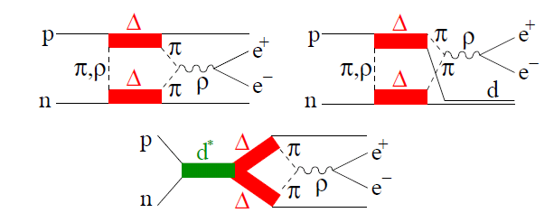
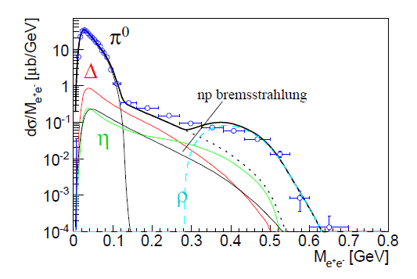
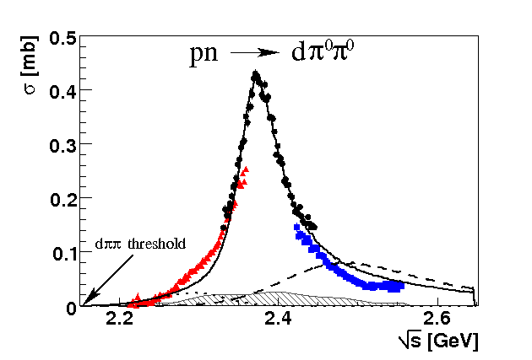
HADES « pn puzzle »:the ΔΔ explanation ?
production by ΔΔ FSI is a source of e⁺e⁻ with high Mee (exclusively in pn)
d* resonance (if it exists) could also contribute to e⁺e⁻ production
M. Bashkanov and Clement,
arXiv:1312.2810 [nucl-ex]
d* M ≈ 2380 MeV
Γ ≈70 MeV
systematic studies :
pp →ppπ⁺π⁻
pn →dπ⁺π⁻ , pnπ⁺π⁻ , ppπ°π⁻
→ Double Δ contribution:
→ independent checks of WASA
results on d*
WASA results: H. Clement plenary session
30.05.2014, 12:30
HADES results: A.Kurilkin parallel session A2
30.05.2014, 17:30

Slide 18
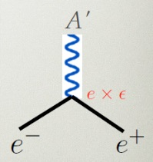
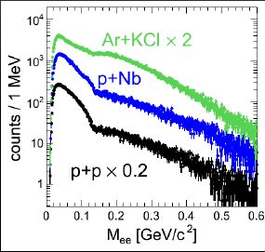
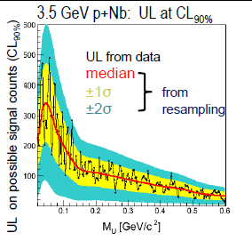
Searching for the U boson with HADES
Upper limit on
mixing parameter
Upper limit for a peak in the raw dN/dM_{ee} spectrum
HADES results: M. Gumberidze parallel session 02.06.2014, 16:20
Phys. Lett. B, volume 731, 265-271 (2014)
Very significant contribution of HADES to
dark photon search:
Very broad mass range 0.02 < M < 0.6 GeV/c²
New limits on mixing parameter
η→e⁺e⁻
PDG entry 2012:
Upper limit = 5.6 10 ⁻⁶ (CL=90%)
New limit 2014:
Upper limit = 2.5 10 ⁻⁶ (CL=90%)
Notes:
Not so bad for a side-product of an experiment first dedicated to nuclear medium studies!

Slide 19
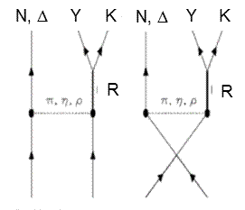
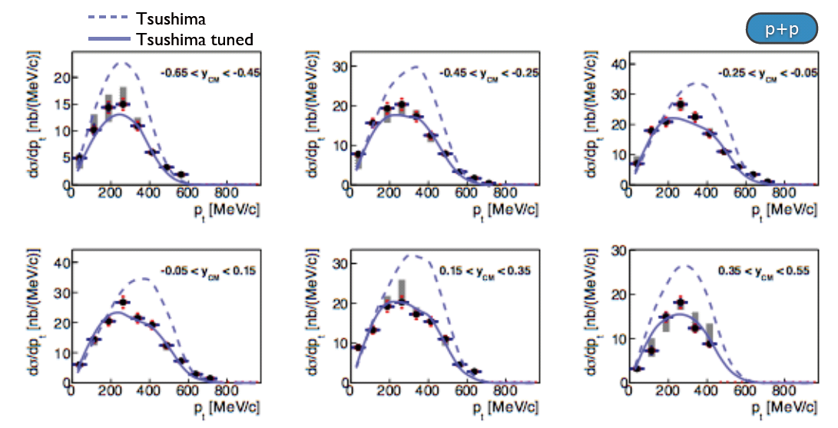
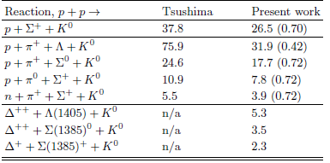
K⁰_{S} inclusive production in pp E= 3.5 GeV
HADES data, submitted to PRC
« Tsushima original » Y= Σ or Λ
« Tsushima tuned »:
Extension
to Y= Σ(1385) or Λ(1405).
cross-sections adjusted using HADES data
Exclusive analysis submitted to PRC
Good description of elementary process
Reference for kaon potential studies
in p +A and A+A reactions

Slide 20
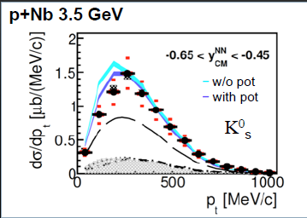
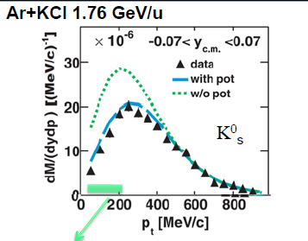
Sensitivity to kaon nuclear potential
submitted to PRC
GiBUU: J. Weil et al. EPJA48 (2012)111
HADES data: PRC82 (2009) 044907
IQMD: C. Hartnack et al., EPJA1(1988)151
E. Bratkovskaya et al., Phys.Rev. C87 (2013) 6, 064907
Data in agreement with repulsive K°potential ~40 MeV
Larger sensitivity in Au+Au (on-going analysis)
  azimuthal anisotropies → flow measurement

Slide 21
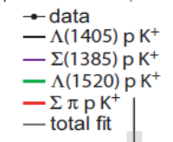
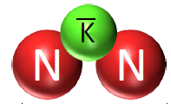
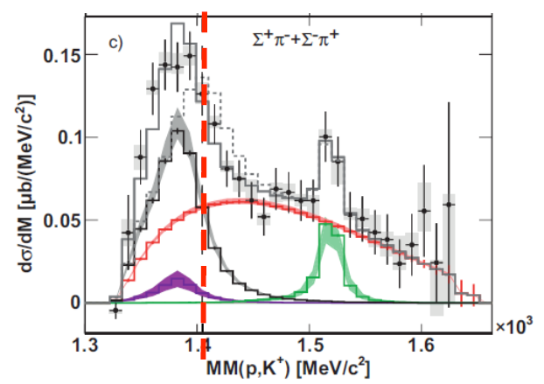
More about strange channels with HADES
Λ(1405) a KN bound state ?
Search for K⁻pp bound states
Work in progress: HADES pp E=3.5 GeV
explored range 2220-2370 MeV/c²
PWA analysis of pp→pΛK⁺ events
Upper limit for pp→ ppK⁻ + K⁺ cross-section
HADES: Nucl.Phys. A881 (2012) 178
E. Epple parallel session A3
02.06.2014, 16:00

Slide 22





Pion beam experiments HADES
Diamond detectors
GSI pion beam
momentum 0.6 < p <1.5 GeV/c
average pion flux ~ 4 10⁵/s
Pion beam tracker:
2 Double-Sided Silicon sensors
100 x100mm², 300μm thick
2 x128 channels
η
ω
April 2014, GSI , test with a proton beam
performance of Si detectors
beam optics
→ Ready for data taking in July/August

Slide 23


Pion-nucleon reactions with HADES hadronic channels
√s=M_{R}=1.4 to 2 GeV/c²
π⁻p →π⁻p, π⁻p →π⁻π⁺n, π⁻p →π⁻π⁰p
π⁻p →π⁻ηp ,….
π⁻p → K⁰Λ, π⁻p → Σ⁻K⁺ , π⁻p → Σ⁰K⁰
π⁻p→ne⁺e⁻
Main goal:
Determine precisely the ρNN* couplings
→ crucial to constrain the predictions of
in-medium modifications of the ρ meson
spectral function
Controversial results with Manley PWA analysis:
V. Shklyar Hades symposium, Seillac 2011
Bonn-Gatchina PWA analysis
π⁻p→π⁺π p
π⁻p→π⁺π p
dominated
by Δπ contribution
ρ contribution
factor 10 lower

Slide 24

Pion-nucleon reactions with HADES dielectron channels
Exclusive channel
π⁻p→ne⁺e⁻
√s=M_{R}=1.52 GeV/c²
Controversial yield predictions:
Highly dependent on ρNN* couplings
destructive interference between I=0 (ω) and I=1 (ρ) contributions
B. Kaempfer , A Titov , R.Reznik NPA 721(2003)583
M.F.M. Lutz , B. Friman, M. Soyeur Nuclear Physics A 713 (2003) 97–118
The combination of π⁺π⁻ and e⁺e⁻ channels will provide a
unique sensitivity to off-shell ρ effects
VDM electromagnetic form factors:
M. Zetenyi and G. Wolf, Phys.Rev. C86 (2012) 065209
Resonance model: J.Weil
Sensitivity of M_{ee} distribution to to Δπ and ρN contributions (Bonn-Gatchina predictions)

Slide 25




Pion-nucleus reactions with HADES
cold nuclear matter effects :
K⁰,K⁺
FOPI data
Factor 2:
multistep processes
Strangeness
production
K⁰
Elementary
cross sections
measure K⁺, K⁰ : kaon potential
K⁻ , Φ : absorption
Dielectron
production
ρ
« offshell ρ » contribution
N(1520)
ρ
ρ
+ ...
N⁻¹

Slide 26

Conclusion
Discover more in paralell sesiions !
HADES results in pp/pn reactions
Large variety of results
meson production, strangeness, e⁺e⁻ production
Indispensable complement for in medium studies
Still to come on HADES side:
Au+Au data analysis
pion beam experiments
data taking in 2 months
HADES at FAIR/SIS100 (2019)
HADES
CBM

Slide 27
dziękuję

Slide 28


Slide 29


Hyperon production
D. Manley
large discrepancies in exp data around 1.7 GeV !

Slide 30
Motivations of π⁻p→ne⁺e⁻ experiments with HADES
“off-shell ρ production”
N
N(1520)
R
γ∗
ρ
ρ
e⁺
ρ, ω,φ
+ ...
e⁻
N⁻¹
Time-Like electromagnetic form factors
Space-Like electromagnetic form factors
π ⁻
R
n
e⁺
q² <0 fixed
γ*
Inverse pion electroproduction
e⁺
γ*
R
p
q² > 0
variable
e⁻
e⁻
p
π⁻
e⁻⁻
p
studied at JLab/CLAS
π⁻p→ne⁺e⁻ below ρ/ω production threshold at √s=1.52 GeV/c²
unique chance
to study the Time-Like electromagnetic structure of N*(1520)
to constrain the in-medium modifications of the ρ meson spectral function
30
Notes:
30

Slide 31



exclusive K⁰_{S} production channels in pp E= 3.5 GeV
Analysis of events with p, π⁺, π⁺, π⁻
Simultaneous fit of 3 inv. masses
and 2 missing masses
anisotropies of angular
distributions taken into account
Large contribution of Δ⁺⁺ in
pp→ Λ+p + π⁺+ K⁰ and pp→ Σ⁺+ p + K⁰
Cross sections extracted for
pp→ Σ⁺ + p + K⁰
Σ(1385)⁺+ p + K⁰
Λ + p + π⁺+ K⁰
Λ + Δ⁺⁺ + K⁰
Σ⁰ + p + π⁺+ K⁰
Σ⁰ + Δ⁺⁺ +K⁰
Λ
Σ⁺

Slide 32


Hadronic channels:
ppη (E=2.2 and 3.5 GeV), ppω (3.5 GeV)
pp→ppX→ppπ⁺π⁻ π° E=3.5 GeV
E=3.5 GeV
pp→ppη→ppπ⁺π⁻ π°
ω
ω
η
η
pp→ppη
pp→ppη
M_{X} (MeV/c²)
role of N*(1535) in η production
pη invariant mass
K.Teilab PhD (U.Frankfurt)
Cross-check of dilepton analysis
Béatrice Ramstein
32

