Slide 1
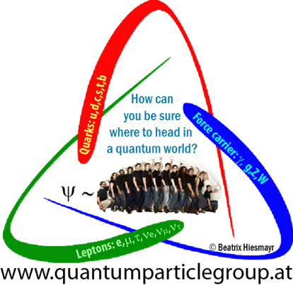


Can strong correlations be revealed for K-mesons experimentally?
Spooky action at distance also for neutral kaons?
by
Beatrix C. Hiesmayr
University of Vienna
Fundamental Problems in Qu.Theory
Projects:
FWF-P21947
FWF-P23627
FWF-P26783

Slide 2

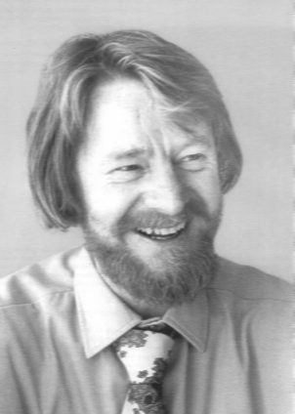
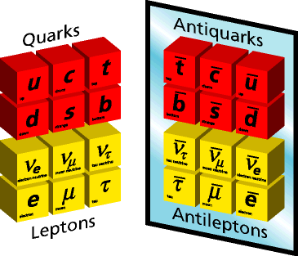
50 YEARS since…
Are Bell inequalities violated for neutral K-mesons ?
Hobby:
Foundations of QM
CP violation
world
anti-world
Bell’s Theorem
1964: John St. Bell

Slide 3
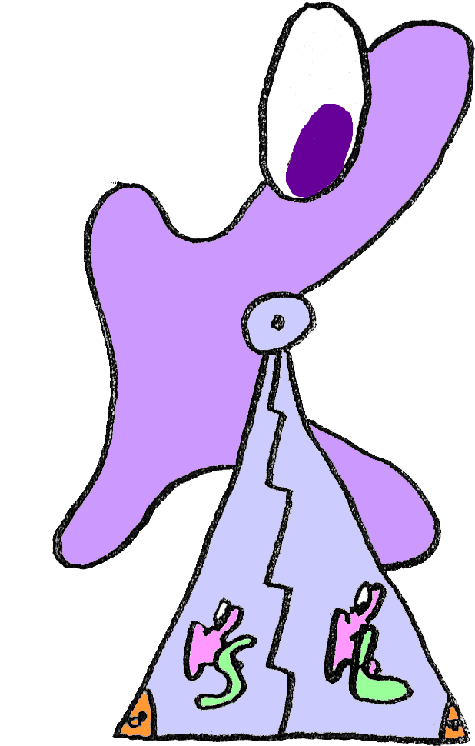
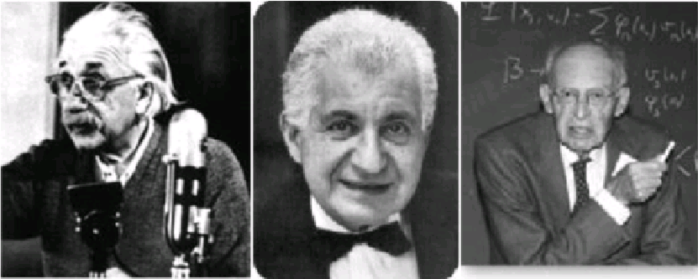
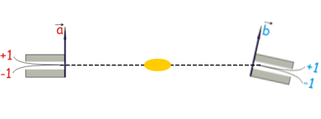
Very short history…
1935: Einstein-Podolsky-Rosen-PARADOX
ALICE
BOB
The EPR reality criterion: “If without in any way disturbing a system, one can predict with certainty (i.e. with the probability equal to one) the value of a physical quantity, then there exists an element of physical reality corresponding to this physical quantity.”
→ Quantum Theory is not complete!
ALICE
BOB
1. pair
2. pair
3. pair
4. pair
…

Slide 4
The EPR scenario
1935: Einstein-Podolsky-Rosen-PARADOX
Bell state:
... spin 1/2
... qubit
... photon
... molecules
... (single) trapped ion
... single neutron in interferometer
High Energy
Physics
... kaons (K-mesons)
... B-meson

Slide 5

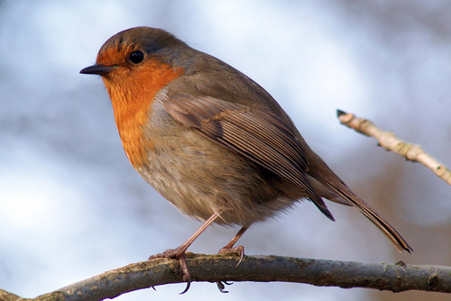
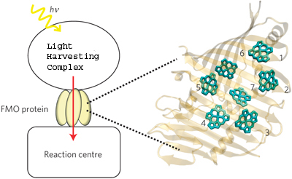
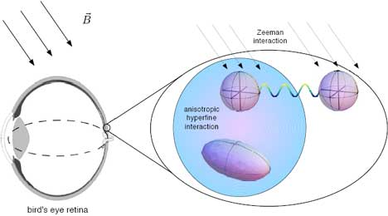
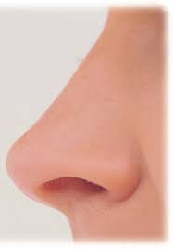
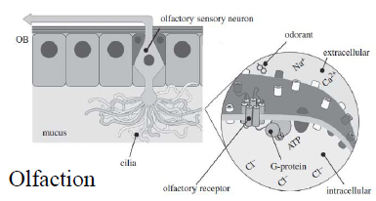
Entanglement in biological systems
photosynthesis
avian navigation
European robin
Olfaction

Slide 6
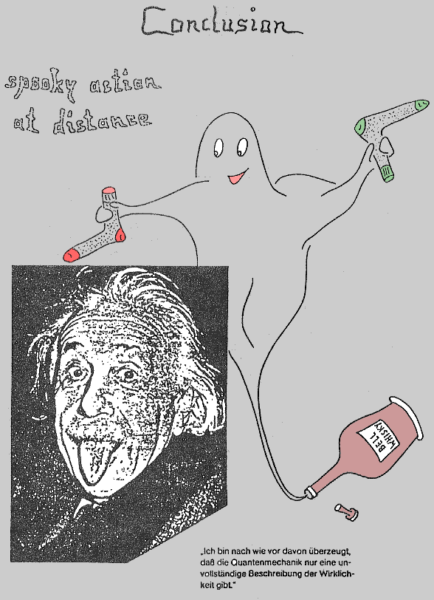
What are Bell inequalities?
No spooky action at distance!
realism
locality
freedom of choice*
*exerting the independence of both experimenters; sharing randomness; free will
Local realistic theories:
Quantum Mechanics:
Bell’s locality hypothesis
inequalities for probabilities → always satisfied!
→ QM probabilities may violate the inequalities!
Experiment has to decide!

Slide 7
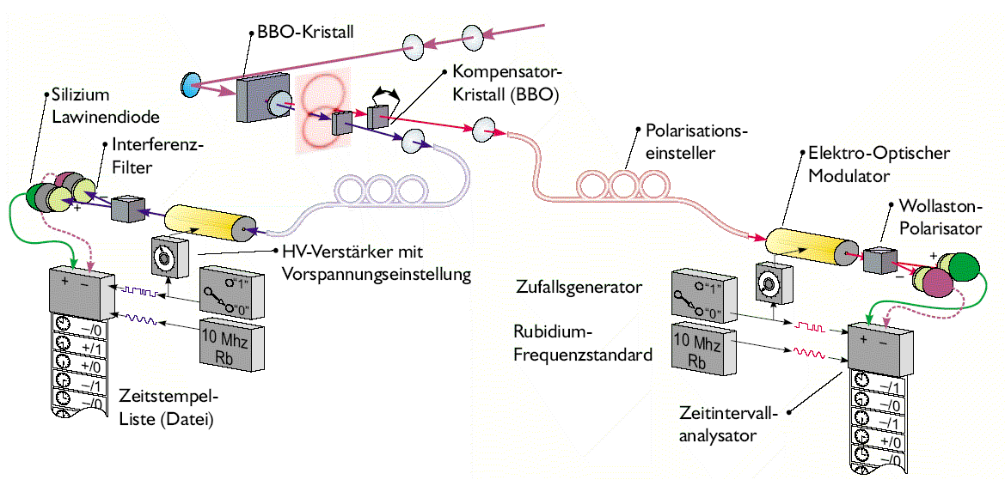
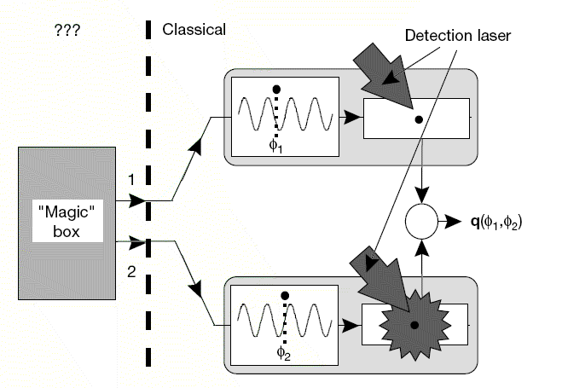
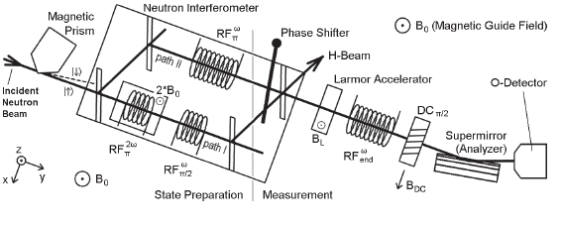
Current experimental status:
Photons: many experiments, show violations but still loopholes
Various ordinary matter systems: show violations but still loopholes
!Single! neutrons: show violations but tests different aspects (contextuality)

Slide 8


What are Bell inequalities good for?
Has been proven: quantum cryptography protocols are save if a Bell inequality is violated!
Quantum Computers/Quantum Communication Complexity: Bell inequalities are necessary and sufficient conditions for quantum protocols to beat the classical ones!

Slide 9
Requirements for tests LRT versus QM
Requirements for a conclusive proof of the existence of correlation stronger than those explainable by locality and realism:
“Active ” measurements (opening the possibility for Alice and Bob to choose among alternative setups-> free choice)
“Use all information” (test the whole ensemble; decay product states are included→ this “additional” information cannot be ignored)
Only for kaons & strangeness measurements!!
was/is overlooked by many researchers !!
are not “only” loopholes!

Slide 10
Generalized Bell inequality for kaons
Bertlmann, Hiesmayr, PRA 63 (2001)
What can the experimenters measure?
measurement device
Are you in a certain quasispin k_{n} or not at time t_{a}?
t_{a}
O(k_{n},t_{a})
vary in times
vary in quasi-spin
or both
local realistic theories
QM:
Notes:
Anolgies ?

Slide 11
Generalized Bell inequality for kaons
local realistic theories
I. Vary in time:
Violation!
Bertlmann, Bramon, Garbarino, H., Phys. Lett. A (2004)
Bertlmann, H.,Phys. Rev. A (2001)
Kaons?
NO violation!
Strangeness oscillation/decay:
PROPOSITION:
The CHSH-inequality is violated iff x>2 for kaons or for other mesons x>2.6.
B-mesons: x=0.77
D-meson: x=0.01
B_{s}-mesons: x=26.2
Notes:
Anolgies ?

Slide 12
Bell-CHSH type inequality for kaons
Is there really no possibility to test for correlations stronger than those for classical systems in the neutral kaon system?
Bell-CHSH type inequality for kaons
Bertlmann, Hiesmayr, PRA 63 (2001)
Photons:
Violation!
You have to be more tricky!
Kaons?
NO violation!
Bertlmann, Bramon, Garbarino, Hiesmayr, Phys. Lett. A (2004)
Bertlmann, Hiesmayr, Phys. Rev. A (2001)
Strangeness oscillation/decay:
PROPOSITION:
The CHSH-inequality is violated iff x>2 for kaons or for other mesons x>2.6.
B-mesons: x=0.77
D-meson: x<0.03
B_{s}-mesons: x>20.6
Notes:
Anolgies ?

Slide 13
What has a symmetry violation to do with nonlocality?
II. Vary in quasi-spin:
?! CP violation related to nonlocality !?
Bertlmann, Grimus, Hiesmayr,PRA (2001)
Hiesmayr, Found. of Phys. Lett (2001)
single kaon experiment
Leptonic charge asymmetry:
Notes:
Anolgies ?

Slide 14
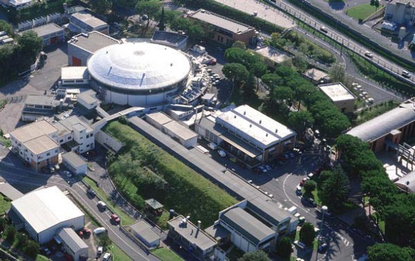

Summarizing…
If we believe in QM, then there is “spooky action at distance” also for this system at different energy scale, but there exists NO CONCLUSIVE EXPERIMENT so far.
Hiesmayr, Eur. Phys. J. C (2007)
A violation for observables that can be actively measured can be found, but for an initial non-maximally entangled state.
Frascati, Italy
Hiesmayr, Domenico, Curceanu, Gabriel, Huber, Larsson, Moskal,
Eur. Phys. J. C (2012)
New Bell inequality for unstable systems that is
experimentally feasible & can be performed with current
technology!
Notes:
QFT concept of entanglement, pre-resultat

Slide 15
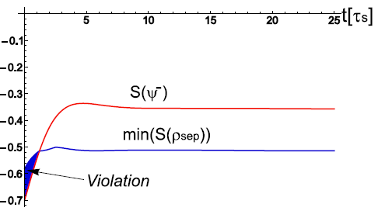
Conclusive test for kaons
Future:
DAPHNE ?
FAIR ?
CERN ?
Bell inequality
Bound

Slide 16
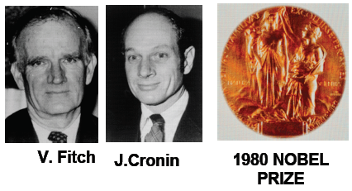
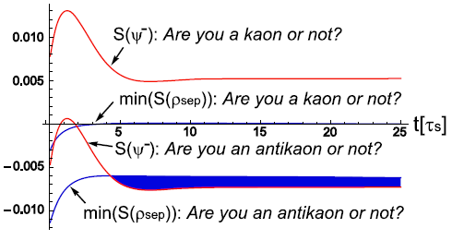
Conclusive test for kaons
→ sensitive to CP violation !!!
Bell inequality
Bound
Bell inequality
Bound

Slide 17
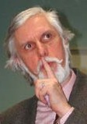
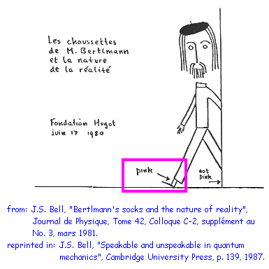
A little history…
Drawn by R.A. Bertlmann to the 60th birthday of John Bell

Slide 18
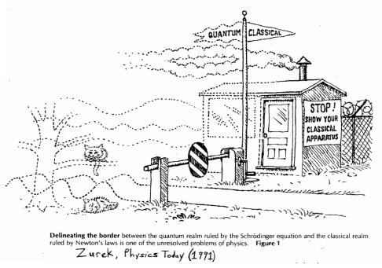
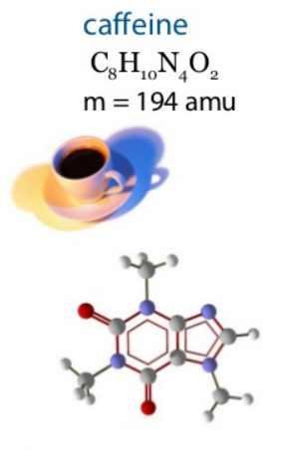
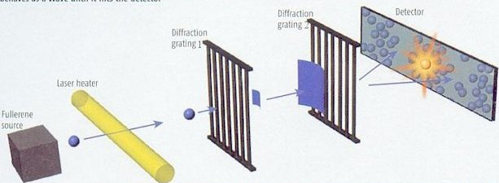
II. Part: Does the superposition principle hold at all scales?
Arndt group (Univ. Vienna):
Collapse models: breakdown 10⁶ to 10⁹ amu→ current record 10⁴ amu

Slide 19
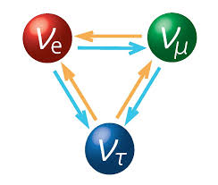
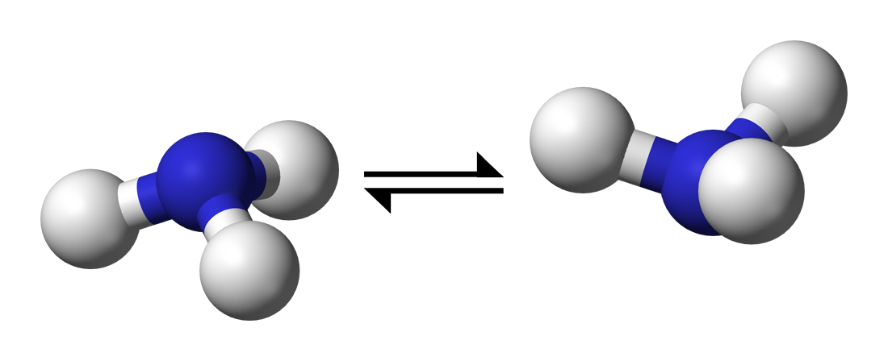
Are Collapse Models testable in High Energy Physics?
Naturally oscillating systems (no setup needed to get interference!):
Flavour oscillating neutral meson systems
Flavour oscillating neutrinos
Chiral molecules
"Testing Collapse Models with Neutrinos, Mesons and Chiral Molecules"
M. Bahrami, S. Donaldi, L. Ferialdi, A. Bassi, C. Curceanu, A. Di Domenico
and B. C. Hiesmayr
Nature: Scientific Reports 3, 1952 (2013)
"Are Collapse Models Testable via Flavor Oscillations?"
S. Donadi, A. Bassi, C. Curceanu, A. Di Domenico and B. C. Hiesmayr
Foundations of Physics: Volume 43, Issue 7 (2013), Page 813-844

Slide 20
Can the collapse be measured for flavor oscillations?
CSL model (mass depending): connect the spatiotemporal collapse with the 2-dim flavour oscilation
Notorious cumbersome
For entangled mesons:
strength of the collapse
correlation length
Experiments ?
Notes:
Anolgies ?

Slide 21

Can the collapse be measured for flavor oscillations?
Collapse:
“Decoherence”
Hiesmayr, Diploma Thesis (1999)
Experiments (KLOE):
Hiesmayr et al, PRA 68 (2003) 012111
Different observable!
No one-to-one correspondence:
DAPHNE, Frascati (Italy)
Notes:
Anolgies ?

Slide 22
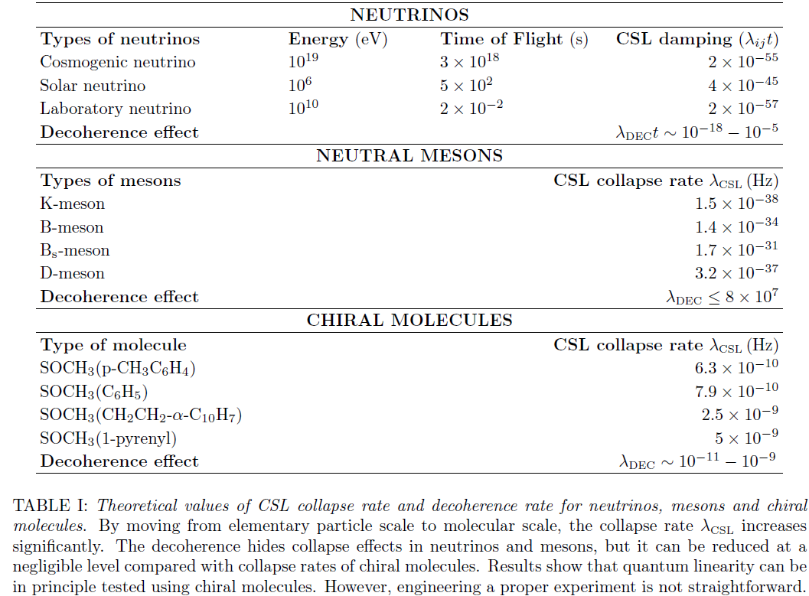
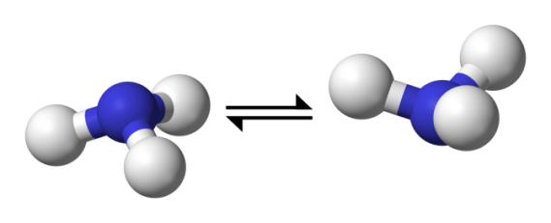
Tests possible with kaons, neutrinos and molecules???
M. Bahrami, S. Donaldi, L. Ferialdi, A. Bassi, C. Curceanu, A. Di Domenico and B. C. Hiesmayr
Nature: Scientific Reports 3, 1952 (2013)

Slide 23
Summary
Testing Foundations of QM at all energy scales has just started!
Higher energy regimes reveal different aspects and new physics!
To obtain a full picture of entanglement and to reveal its role in our universe all systems have to be considered!
Accelerator experiments can add to our understanding of quantum foundations!
… experiments ? KLOE, ELENA, FLAIR, …
source, design, detectors !?!

Slide 24
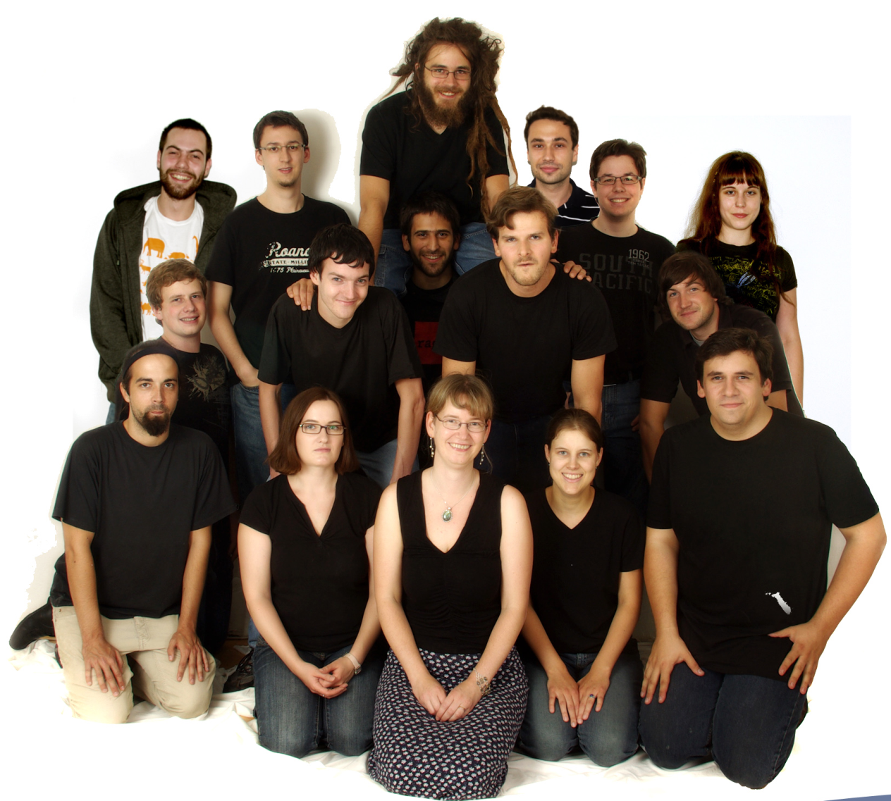
Thank you for Your attention!
The Quantum-Particle Group
www.quantumparticlegroup.at

