Slide 1
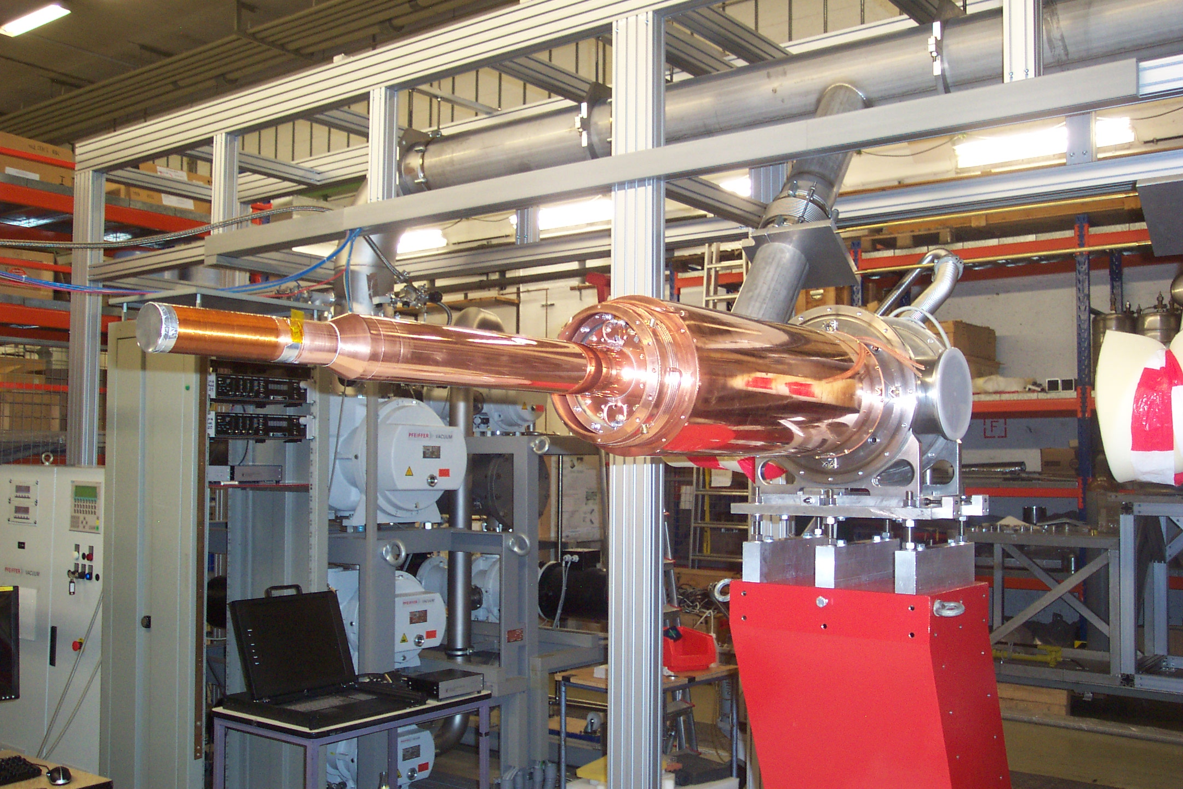
Institut
für Kernphysik
Recent Results from the A2 Collaboration at MAMI
1.-Introduction: Why do we need polarisation to investigate structures and interactions of hadrons?
2.-Experimental setup I: Tagger + CBall@MAMI
3.-Experimental setup II: Frozen Spin Target
4.-Double Polarised Experiments : Precision measurements of the Nucleons Excitations Determination of Fundamental Properties
Meson 2016
Krakau, June 3rd , 2016
Andreas Thomas
for the A2 Collaboration

Slide 2
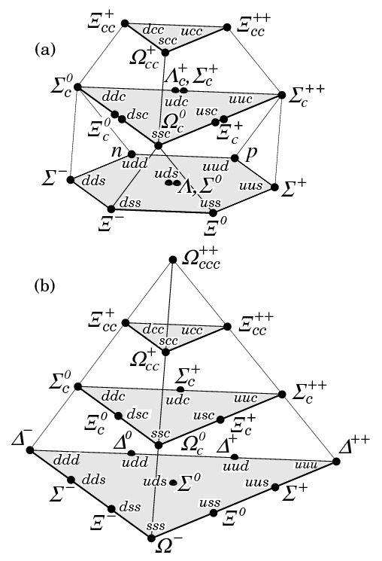
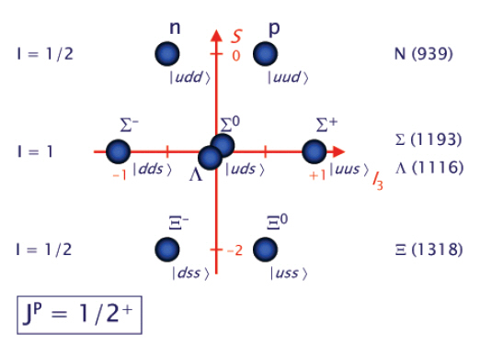
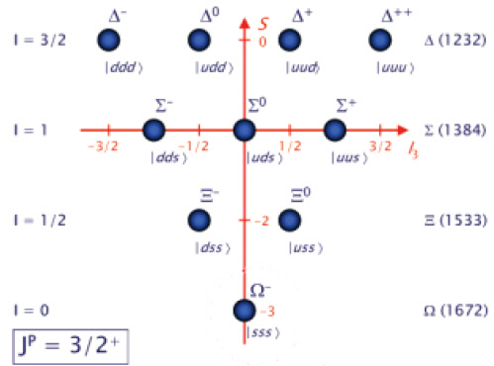
Introduction Physics:
Quark Model
Classification of Baryons
qqq; only uds
Oktett
Dekuplett
Simple Constituent quark picture:
Proton p(938): |uud> ~ |hhi> Spin 1/2
Delta Δ(1232): |uud> ~ |hhh> Spin 3/2
M1-Transition
(Small 2.5% E2)

Slide 3
Introduction: Excitation Spectrum of the Nucleon
H
He
Hg
Löhrig, Metsch, Petry, Eur.Phys.J. A10 (2001) 395-446
Atom
Nucleon
The light baryon spectrum in a relativistic quark model

Slide 4
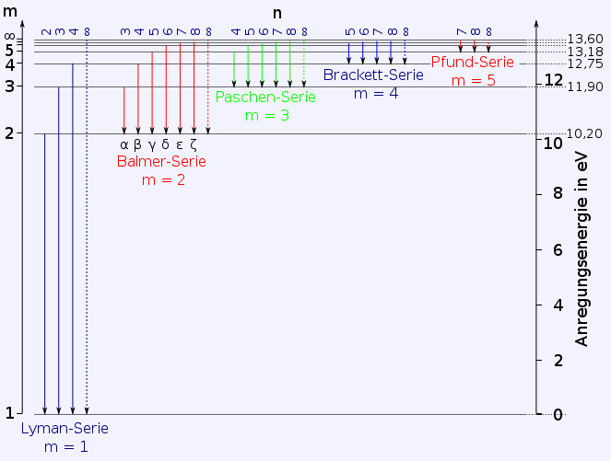
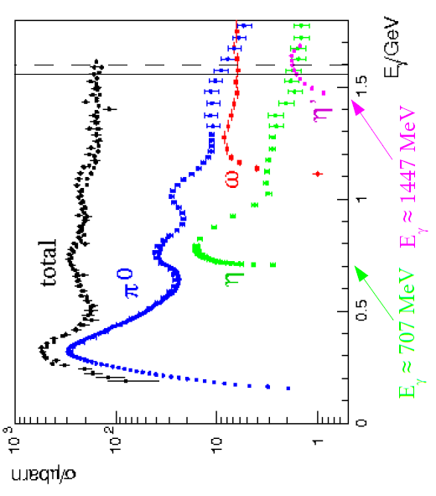
QED
E[eV]
QCD
E[GeV]
S₁₁(1535)
P₃₃(1232)
Hydrogen
t ~ 10⁻⁸ s
ΔE ~ 10⁻⁶ eV
Scale ~ 10⁻¹⁰ m
Nucleon
t ~ 10⁻²³ s
ΔE ~ 200 MeV
Scale ~ 10⁻¹⁵ m
10¹⁵ s ~ 3* 10⁸a

Slide 5
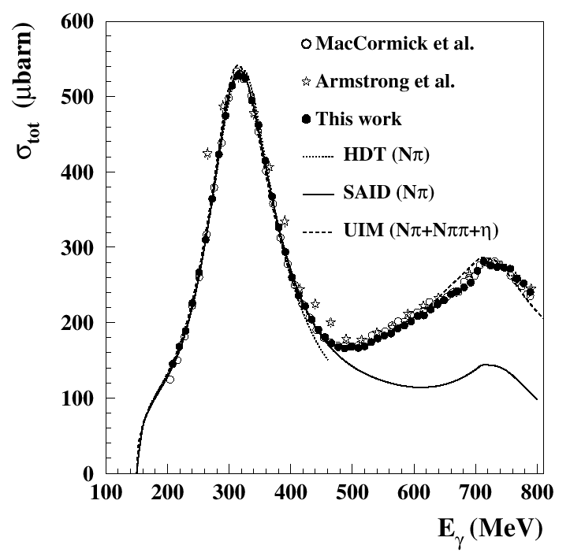
What is the nature of the Nucleon Resonances?
-Excitation inner deg. of freedom
-Molecule
-Quark – Diquark Structure
-Dynamical Generation
- …….?
Unpolarised total photoabsorption cross section
Phys. Rev. Lett. 87, 022003 (2001)
Phys. Rev. Lett. 84, 5950 (2000)
Nucl. Phys. A642, 561 (1998)
Phys. Rev. C 53, 430 (1996); SP01
Nucl. Phys. A645, 145 (1999)

Slide 6
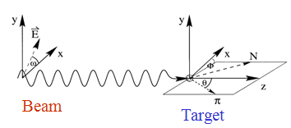
Nature and Properties of nucleon resonances
Polarisation observables used to disentangle broad, overlapping resonances.
Beam
γ
P
lin
P
lin
P
circ
unpol
γ
γ
γ
⎛
π
⎞
⎛
+
π
−
π
⎞
Target
⎜
0
,
⎟
⎜
,
⎟
⎝
2
⎠
⎝
4
4
⎠
⎛
d
σ
⎞
Σ
P
unpol
⎜
⎟
-
-
⎝
d
Ω
⎠
Beam
P
x
-
-
H
F
Target
P
T
P
-
-
y
P
z
-
-
G
E

Slide 7
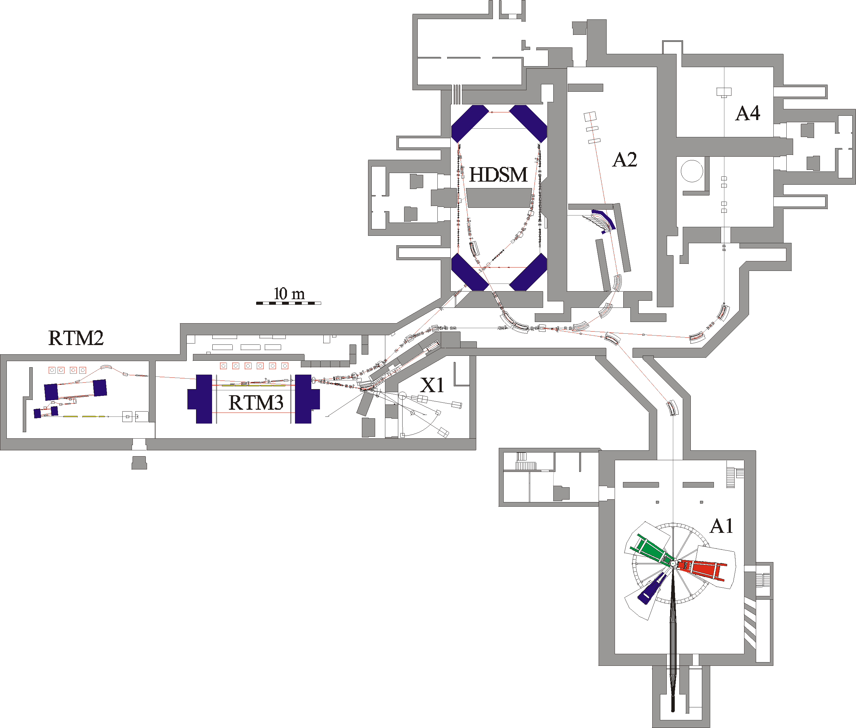
Parameter
1604MeV, σ_{E}=0.100MeV
max. 40μA polarised
ε_{h}=9 nm rad, ε_{v}=0.5 nm rad
~6500h/year as MAMI B !

Slide 8
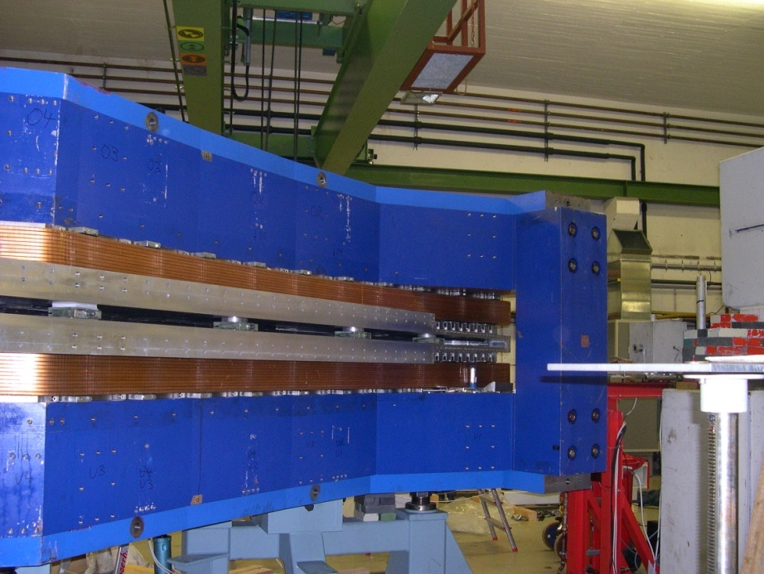
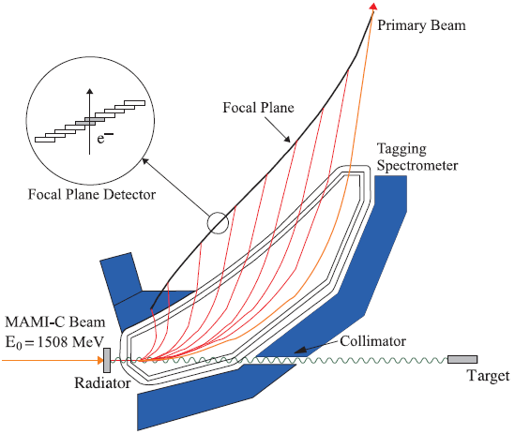
A2 Tagging system (Glasgow, Mainz)
1.
Production and energy measurement of the Bremsstrahlung photons.
Glasgow Tagging Spectrometer
EPJ A 37, 129 (2008)
2.
Determination of the degree of polarization of
the electron beam (Moeller Polarimeter).
Circularly pol. photons.
3.
Coherent production of linearly polarized
photons on a diamond radiator

Slide 9
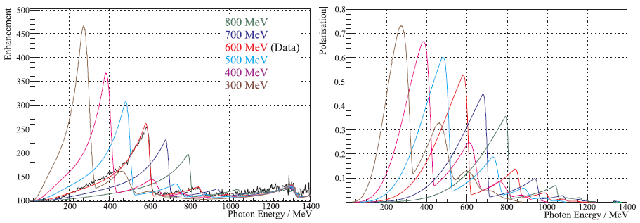
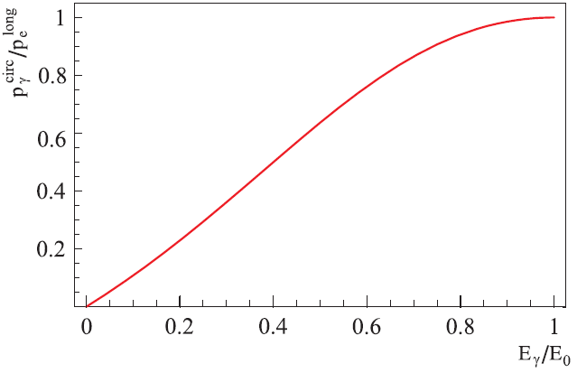
Polarised Photons @ MAMI C
Linear
Polarisation
E_{γ} = 75 ... 1480 MeV
ΔE_{γ} = 4 MeV
N_{γ} = 2 . 10⁵ s⁻¹ MeV⁻¹
Circular
Polarisation
Transfer
High Polarisation
High Photon Flux

Slide 10
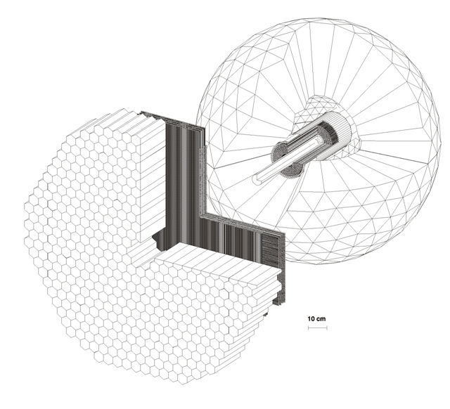
4π photon Spectrometer @ MAMI
TAPS:
366 BaF₂ detectors
72 PbWO₄ detectors
Max. kin. energy:
π⁺⁻ : 180 MeV
K⁺⁻ : 280 MeV
P : 360 MeV
Crystal Ball:
672 NaJ detectors
Max. kin. energy:
μ⁺⁻ : 233MeV
π⁺⁻ : 240 MeV
K⁺⁻ : 341 MeV
P : 425 MeV
Vertex detector:
2 Cylindr. MWPCs
480 wires, 320stripes
PID detector:
24 thin plastic detectors
γp ◊ S11 ◊ pη
π⁰π⁰π⁰
γγγγγγ

Slide 11
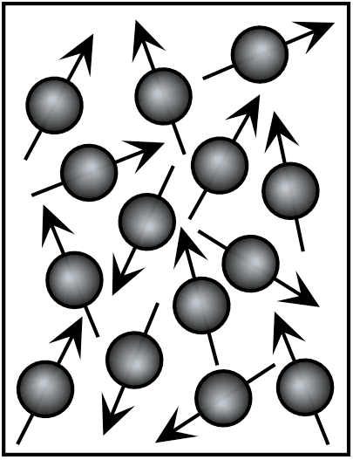
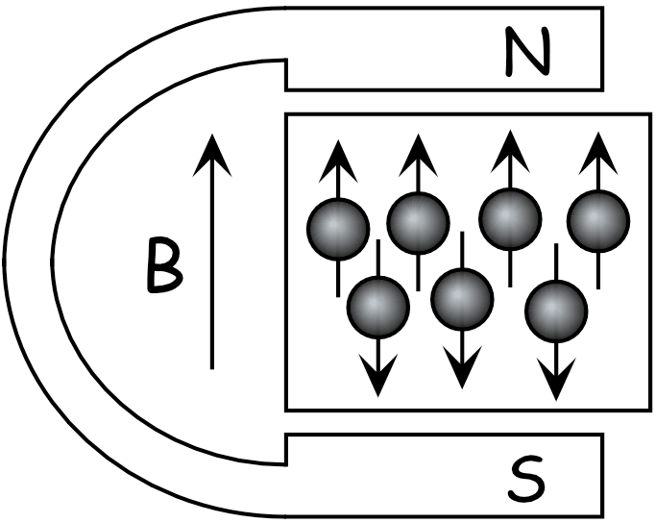
Polarised Target
Polarisation = Orientation of Spins in a magnetic field
Ideally: All spins in field direction
P=100%
Complicated interplay between
Polarising force ~ magnetic field B
and
Depolarising force ~ thermal motion of spin particles
(temperature T – relaxation)

Slide 12
Magnetic moment in magnetic field:
ΔE
B=0T
B=2.5T
B=0T
B=2.5T
electron
proton
Thermal equilibrium
Boltzmann distribution
B [Tesla] | T [mK] | e⁻ [%] | p [%] | d [%]
2,5 | 100 | 99,8 | 0,51 | 0,10
 | 1000 | 93,3 | 0,25 | 0,05
5,0 | 100 | 100,0 | 5,09 | 1,05
 | 1000 | 99,8 | 1,28 | 0,11
Trick: Transfer of the high electron polarization to the nucleon via
μ-wave irradiation (DNP)

Slide 13
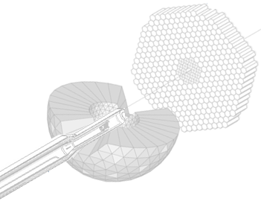
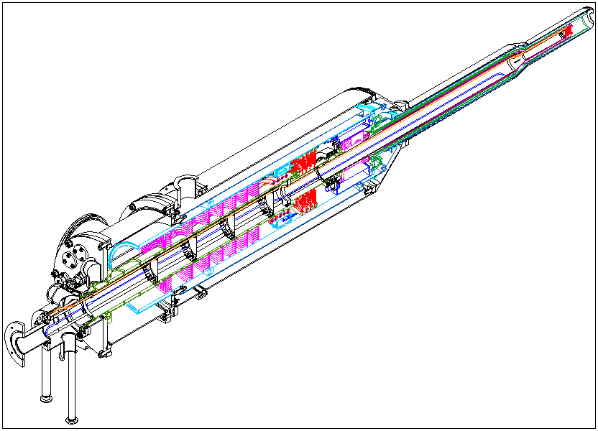
Mainz/Dubna Dilution refrigerator
Mixing chamber(25mK)
Still (0.7K)
Evaporator (1.5Kelvin)
Separator (4.2Kelvin)
Transverse
And
Longitudinal
Internal
Holding coil
1.2 Kelvin
1Tesla at 46A
achieved

Slide 14
Internal transverse holding coil
Copper/scandium wire with 54 Nb-Ti filaments embedded in it.
Cu:Sc=1.35:1
Alloy composition: Nb47wt.%Ti
Diameter=0.222mm
It achieves currents up to 50A at 4.2K and 1T.

Slide 15
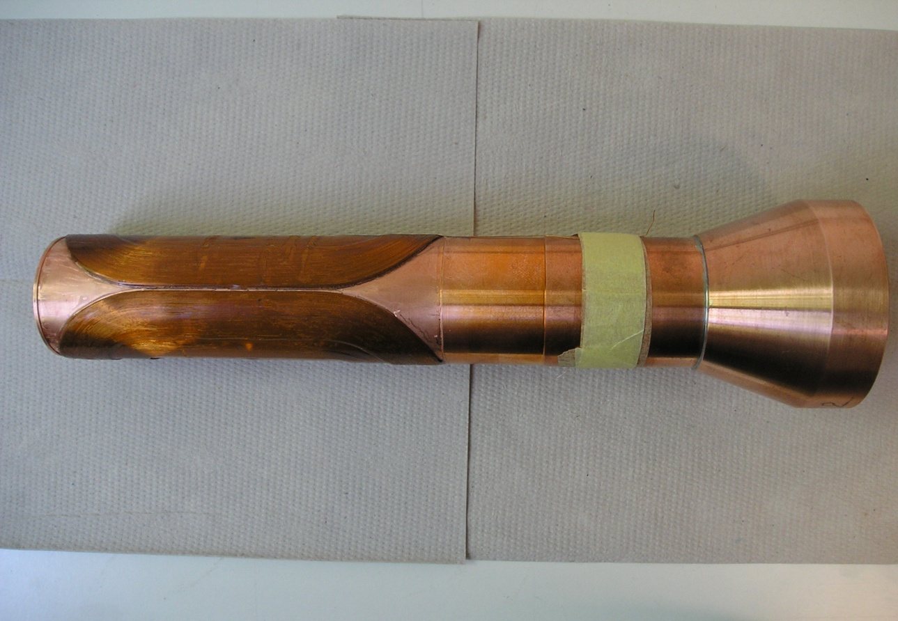
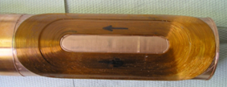
4-layer dipole:
N1=N2=138
N3=N4=78
150mm

Slide 16
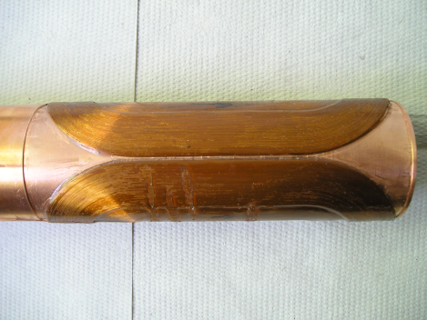
Magnet Technology
DNP at 200mK and 2.5T with 70GHz microwaves.
Frozen spin target (25mKelvin, 0.6T).
Secondary particles punch through holding coil.
All directions of polarization.
Transverse (Saddle coil)
and
Longitudinal (Solenoid)
Internal
Holding Field (1.2K, 0.6T)

Slide 17
Single and Double Polarised Experiments
Excitation Spectrum
1.- Longitudinal PT: a) E and G of Meson Photoproduction off protons b) E and G of Meson Photoproduction off neutrons
2.- Transverse PT: a) T and F of Meson Photoproduction off protons b) T and F of Meson Photoproduction off neutrons
A2-talk neutron (D-Butanol) → N.Walford, 16:00
Additional measurements on Fundamental Properties
1.- Long. and trans. PT: Spin Polarisabilities and Polarisibilities in Compton process
2.- Transverse PT: Transverse asymmetries T and F in π−photoproduction in the threshold region → m_{u} - m_{d}

Slide 18
Pion Production
Eta Production
Experiment: polarisation observables and different channels essential
(Mainz, Bonn, JLAB ….)
Theory: several models and PWA groups (MAID, BNGA, SAID, JuBo…)

Slide 19
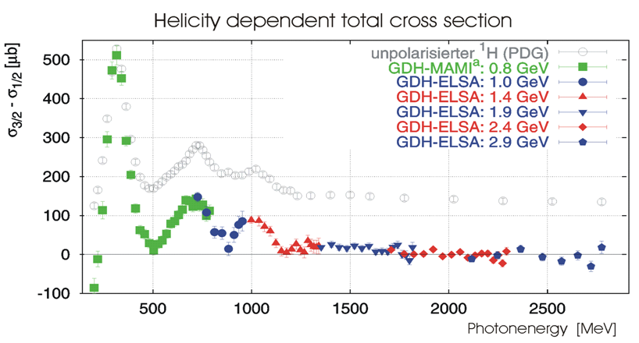
Helicity Dependence E of Meson Photoproduction on the Proton and Neutron
1998-
2003
Mainz and Bonn
2010-
2016
New
Mainz
Exp.
with CBall
Gerasimov-Drell-Hearn sum rule (GDH)
Simultaneous measurement of E and G

Slide 20
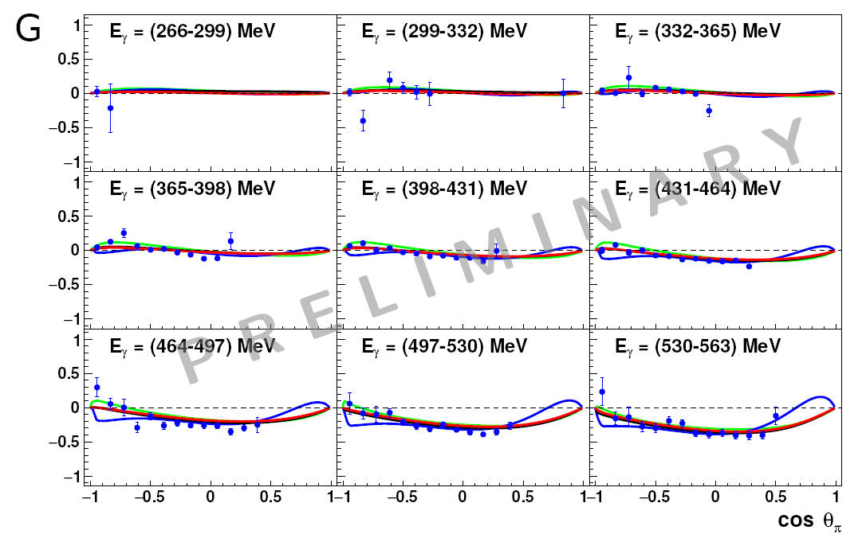
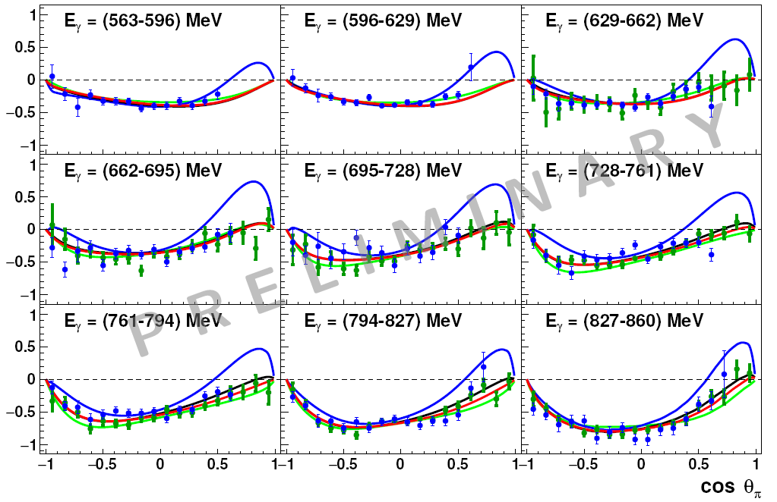
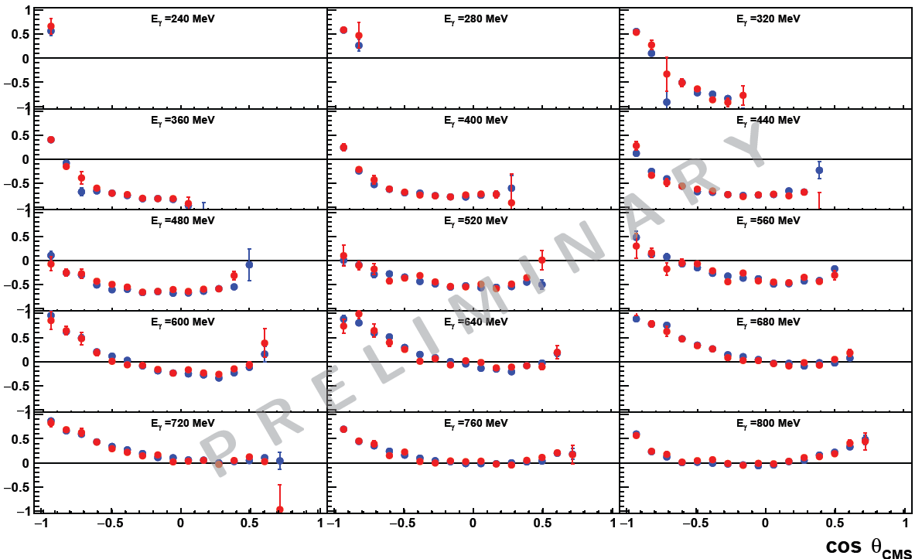
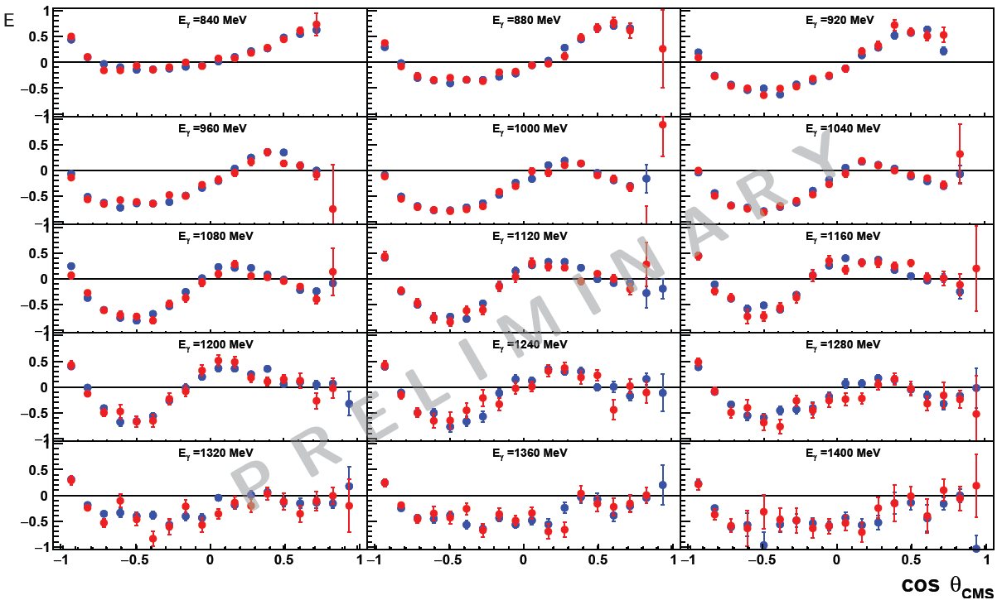
Simultaneous measurement of G and E for π⁰ production (F.Afzal, K.Spieker)
G
E

Slide 21
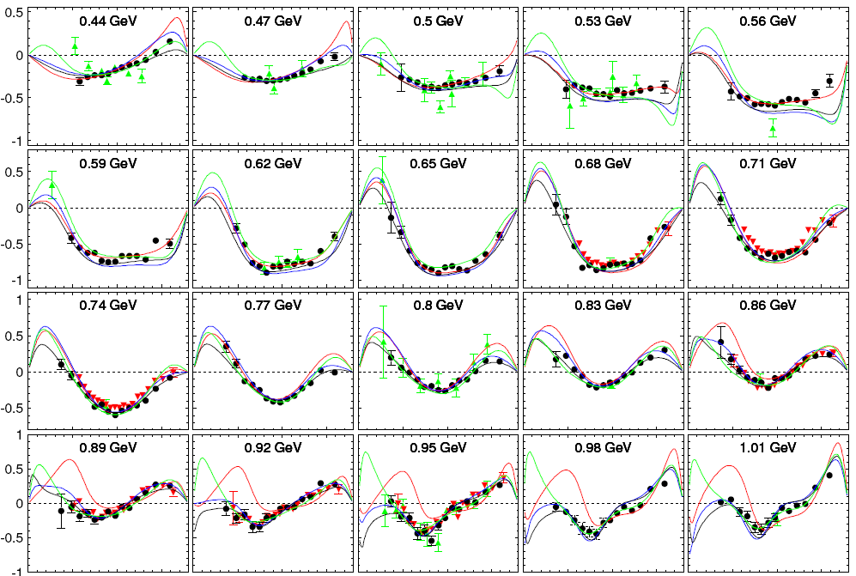
T in π⁰−photoproduction
Red line: MAID 2007
blue line: SAID PR15
green line: JUBo2015-B
black line: BG2014-2
J. R.M. Annand et al.
Phys. Rev. C 93, 055209 –
Published 31 May 2016
Black Circles – new MAMI Measurement, red triangles Bonn CBELSA, green triangles older data.

Slide 22
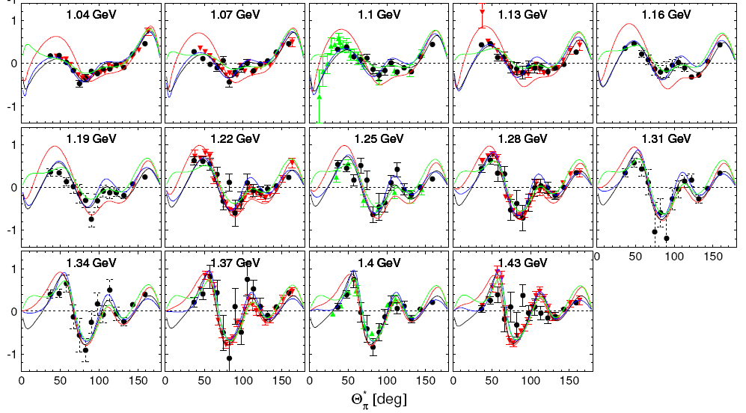
Red line: MAID 2007
blue line: SAID PR15
green line: JUBo2015-B
black line: BG2014-2
T in π⁰−photoproduction
Black Circles – new MAMI Measurement, red triangles Bonn CBELSA, green triangles older data.

Slide 23
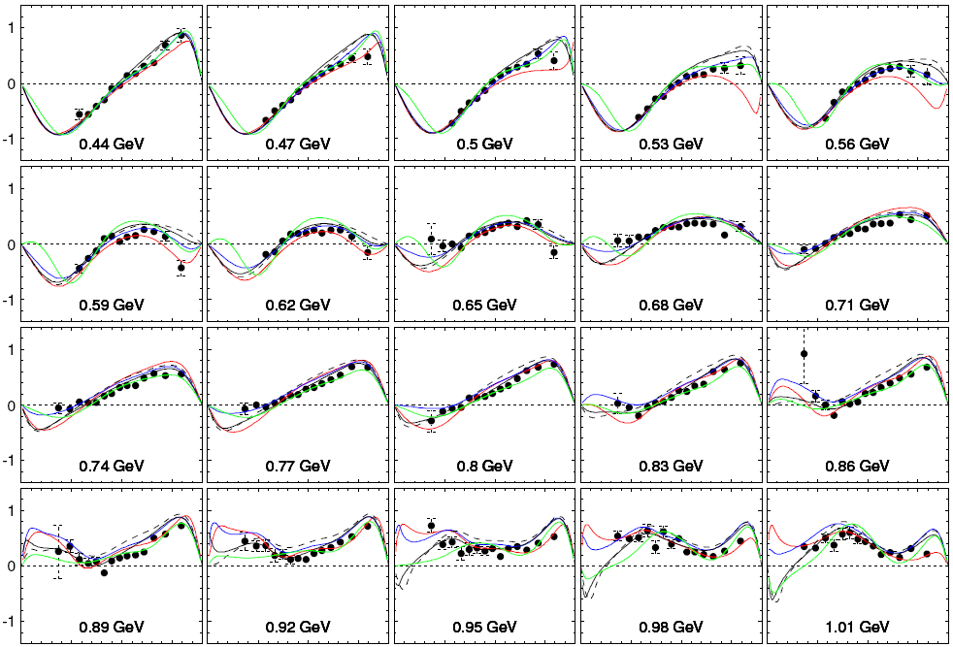
F in π⁰−photoproduction
γp ◊ pπ⁰
Red line: MAID 2007
blue line: SAID PR15
green line: JUBo2015-B
black line: BG2014-2
Black Circles – new MAMI Measurement.

Slide 24
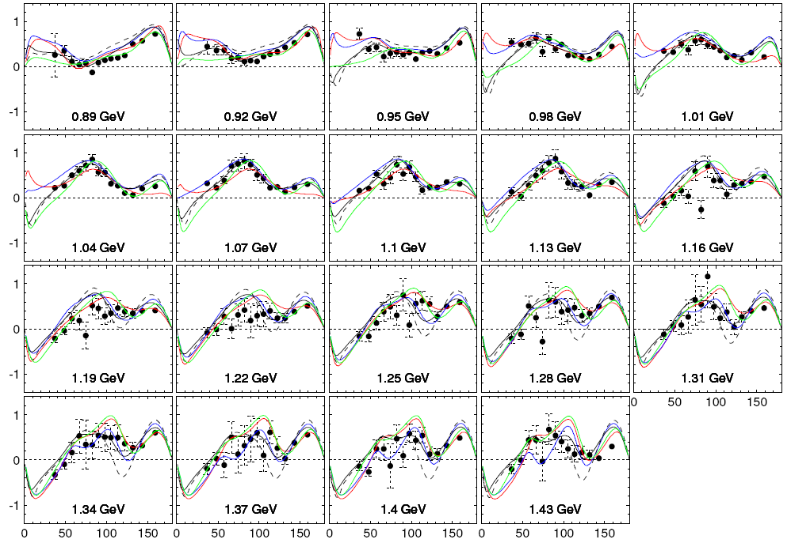
F in π⁰−photoproduction
γp ◊ pπ⁰
Red line: MAID 2007
blue line: SAID PR15
green line: JUBo2015-B
black line: BG2014-2
Dashed li: BG2011-2
In BG2014-2 new data
for T, P and H were included
as well as our new precise
cross section data.
Adlarson et al.,
Phys. Rev. C 92, 024617 (2015)
Black Circles – new MAMI Measurement.

Slide 25
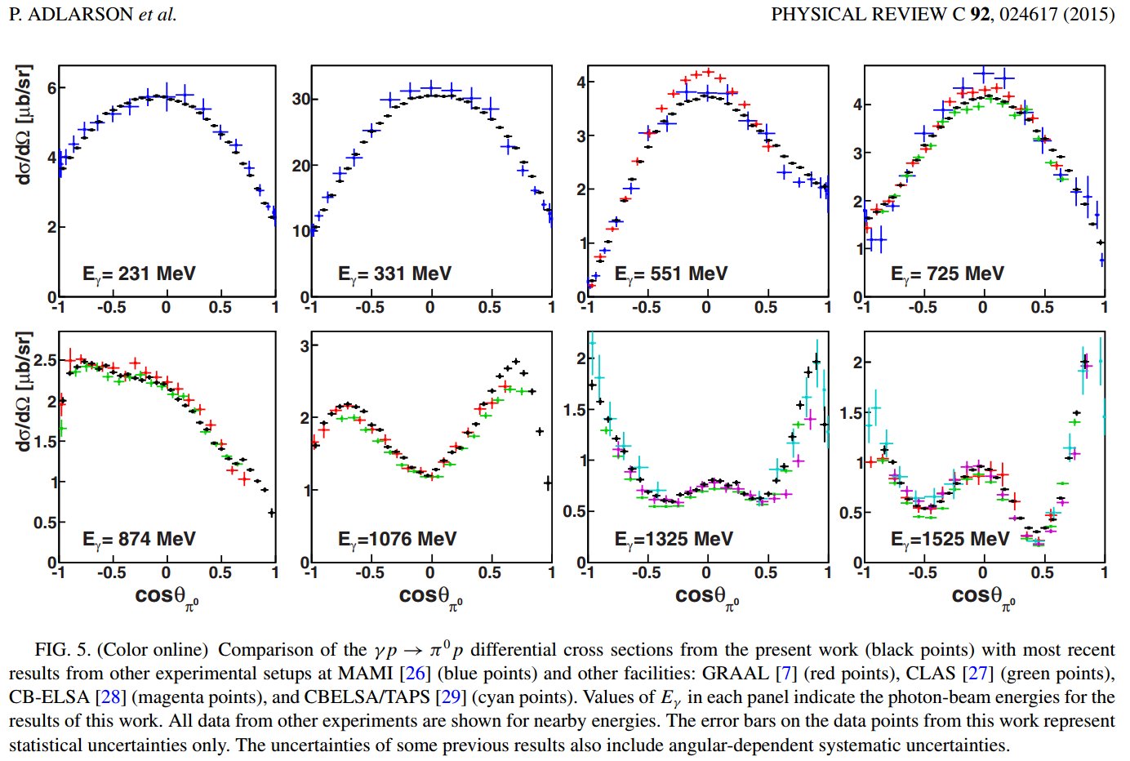

Slide 26
arXiv:1604.05704
We find that the new data force the multipoles to get closer to each other, the variance is reduced by about a factor of two.
Even more important seems to be that the multipoles converge to similar values in the region of leading resonances while the “background" and the contribution of higher-mass resonances remain less constrained by the new data. Clearly, the aim is to get very similar answers
also in the mass range which contains higher-mass resonances. This task will require more precise data, in particular more precise data on polarization observables.

Slide 27
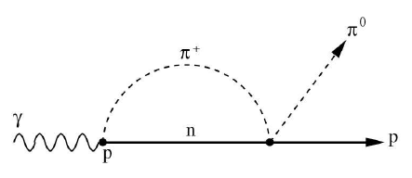
Asymmetries T and F in γp → pπ⁰ at threshold
Study of the dynamic consequences of m_{d} − m_{u} > 0.
m_{π}0 =135 MeV
m_{π}+=139.6 MeV
Rescattering diagram responsible for the
unitary cusp observed in E0+(γp → pπ⁰ )
Precission experiment to test the unitary calculations [Bernstein et al. arXiv:0902.3412 [nucl-th]
and ChPT calculations [V.Bernard, N.Kaiser, and U.G.Meissner, Eur. Phys. J. A11, 209 (2001)] of ImE0+.
Threshold π⁰ photoproduction on transverse polarised protons at MAMI, S.Schumann et al.,
PLB 750 (2015) 252- 258

Slide 28
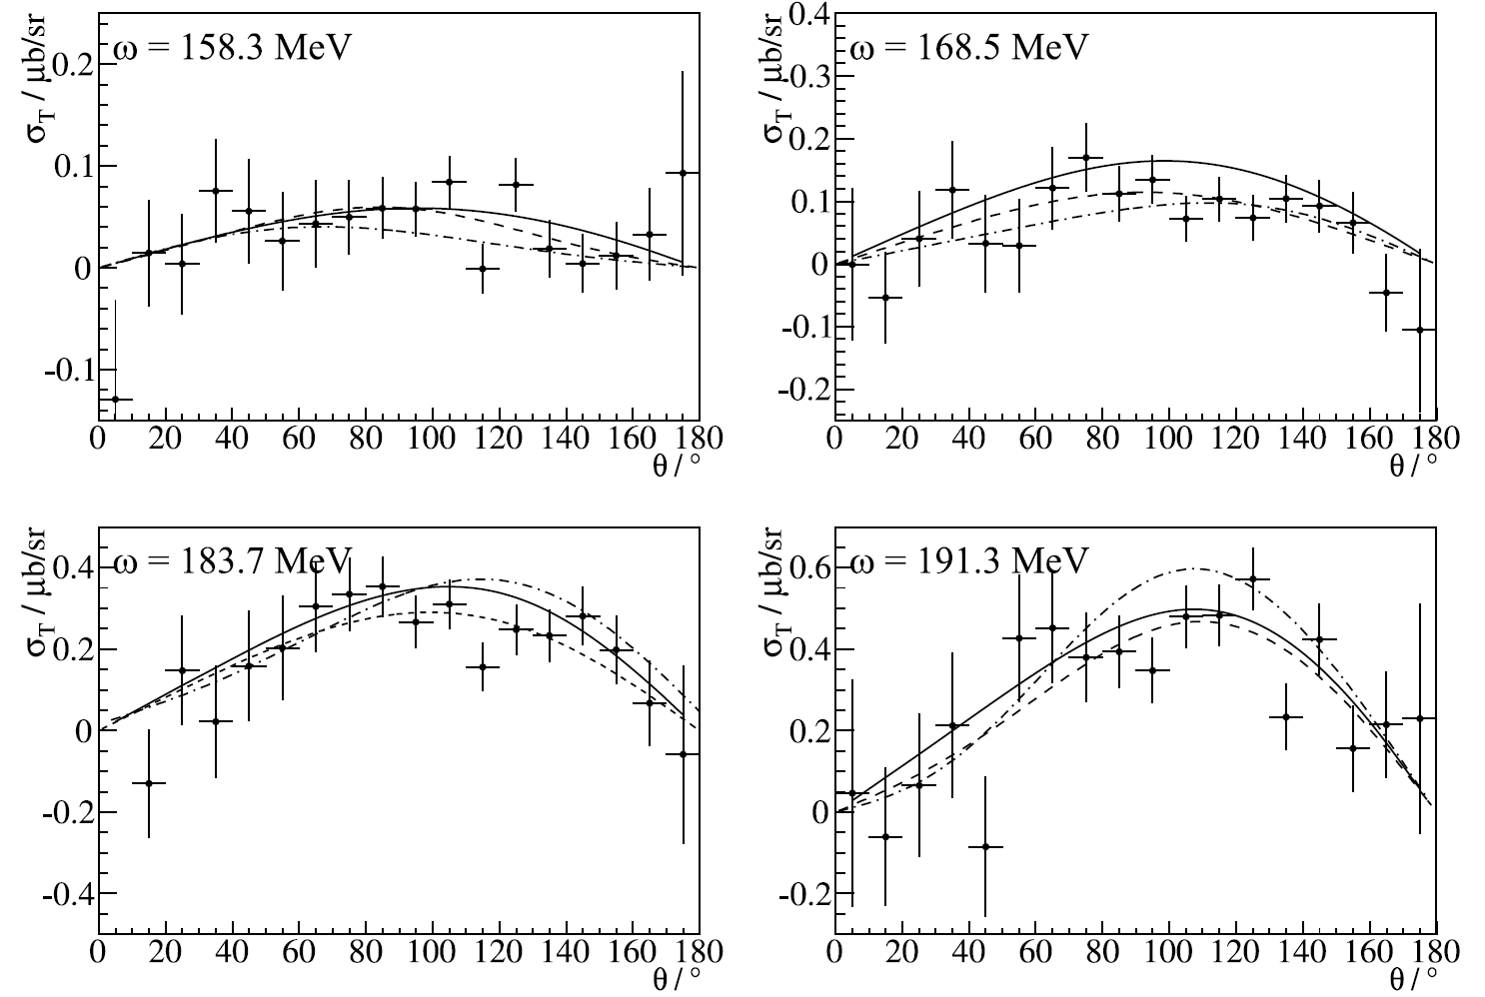
PLB 750 (2015) 252- 258
γp → pπ⁰

Slide 29
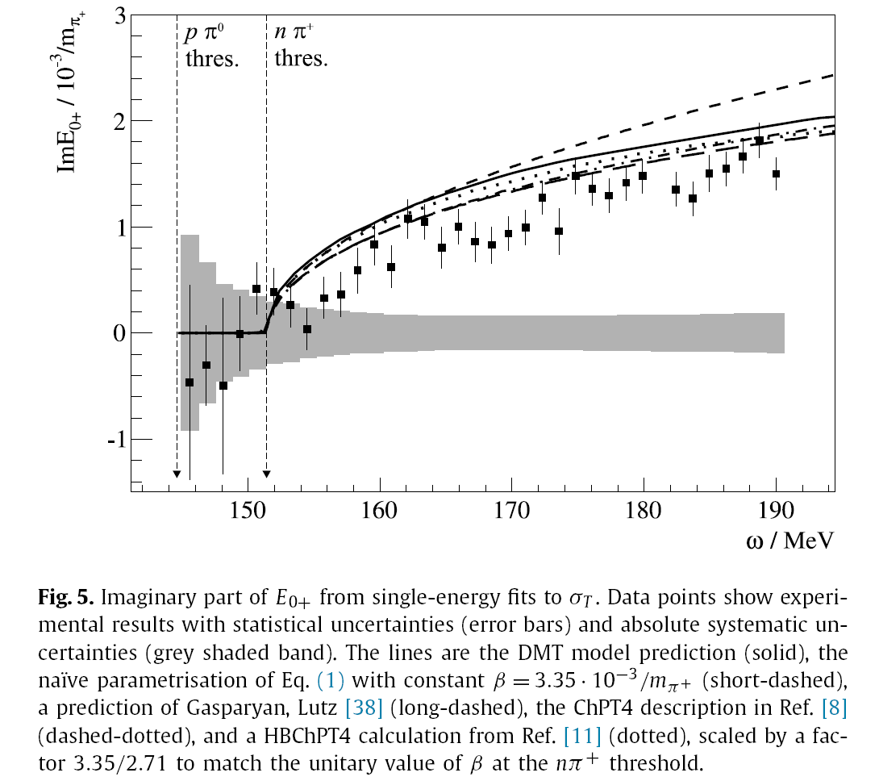

Slide 30
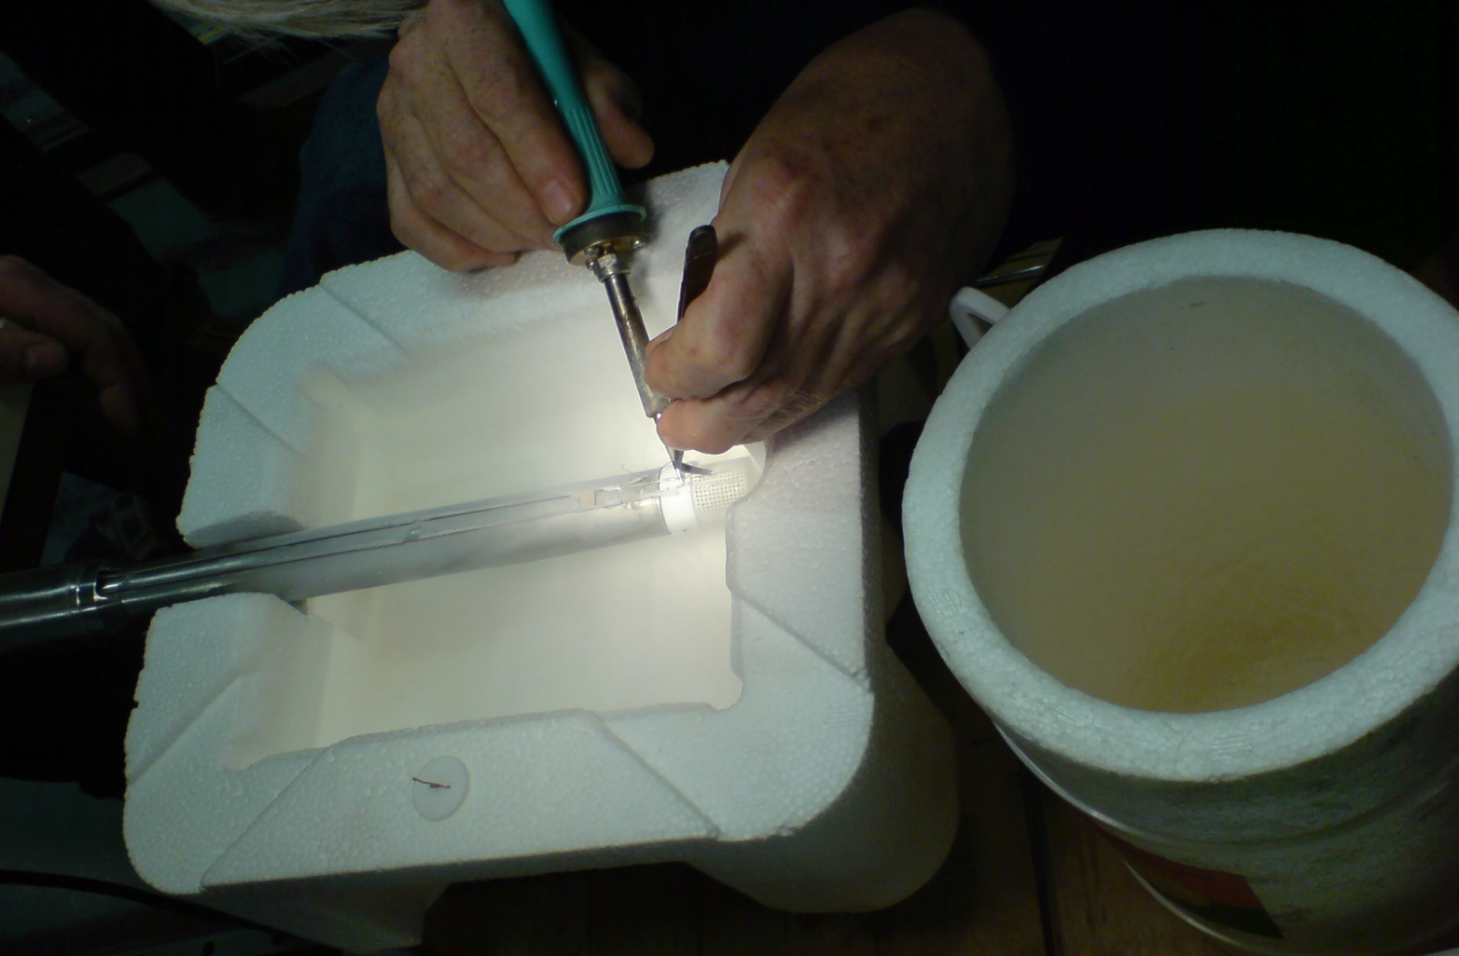
Target Material Frozen Spin Target
Butanol
2cm
X-ray picture with
Beamspot and
NMR coil

Slide 31
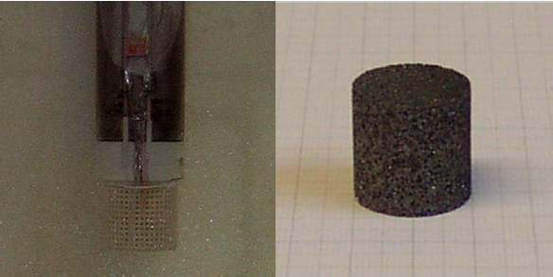
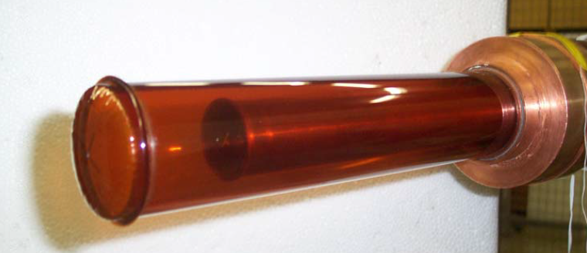
Challenges for the analysis of experiments with Frozen Spin Target → Dilution Factor.
Butanol
Carbon
Hydrogen

Slide 32
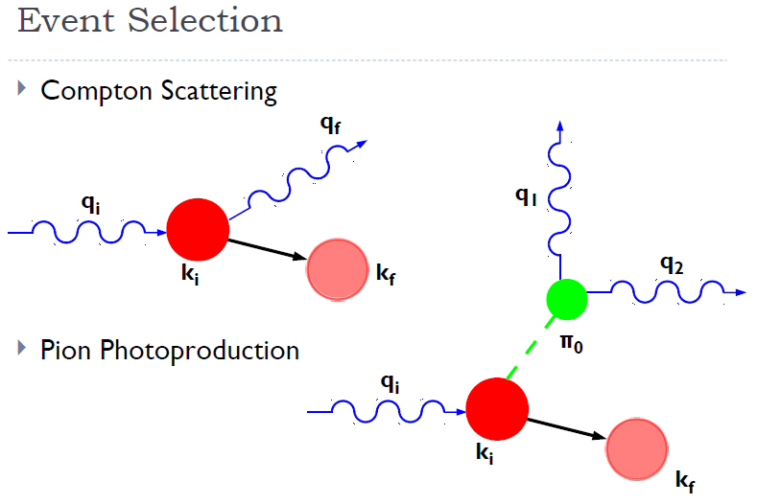
Pion photoproduction off of a proton is 75-100 times more likely than Compton (in the 240-280 MeV range) →
Kinematic overdetermination used for cuts (missing mass, proton angle, …).
Test with ‘substraction target’.
Measurements of the Proton Spin-Polarizabilities with Double-Polarized Compton Scattering
P.P.Martel et al., PRL 114 (2015) 112501
Main problems:
Low energetic recoil protons do not escape from the target and do not reach the detector.
Events are produced on the background nuclei (Carbon, coherent, incoherent, κ~13%). ).
Σ_{2x} 300 hours measurement
Σ_{2x} 300 hours measurement
Curves from:-
B. Pasquini, D. Drechsel, M. Vanderhaeghen,
Phys. Rev. C 76 015203 (2007)
B. Pasquini, D. Drechsel, M. Vanderhaeghen,
Phys. Rept. 378 99 (2003)

Slide 33
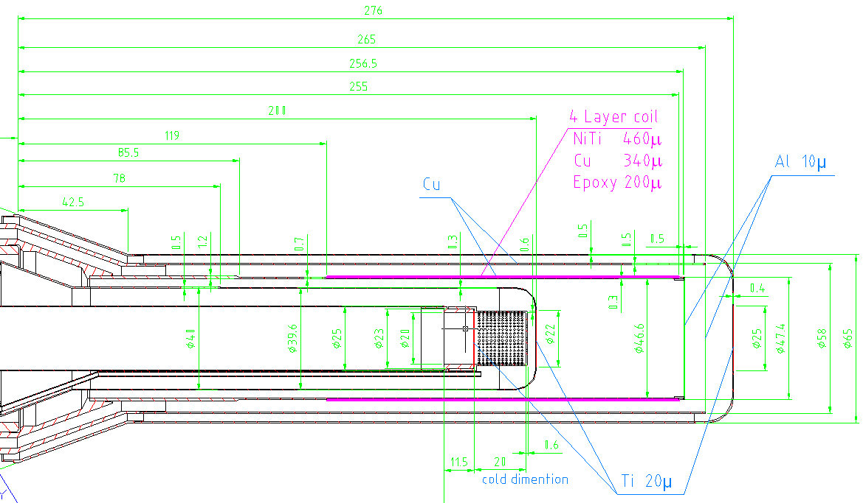
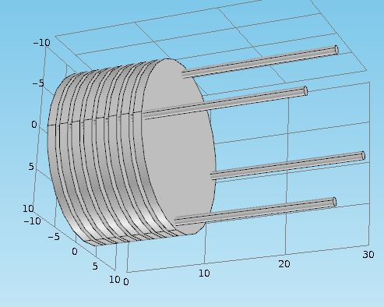
Perspectives: Active Polarised Target
Vacuum
3He/4He – 6%
!!! T=25mKelvin

Slide 34
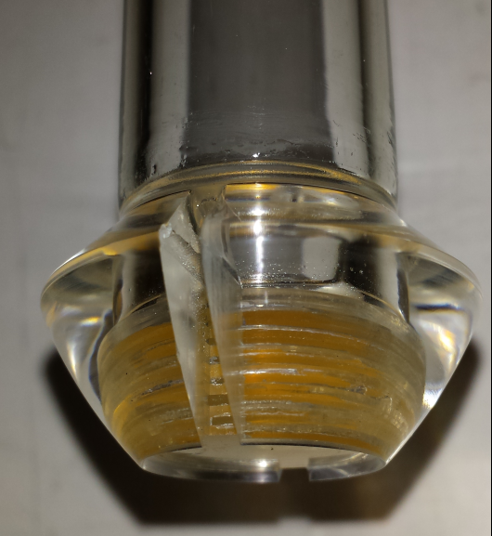
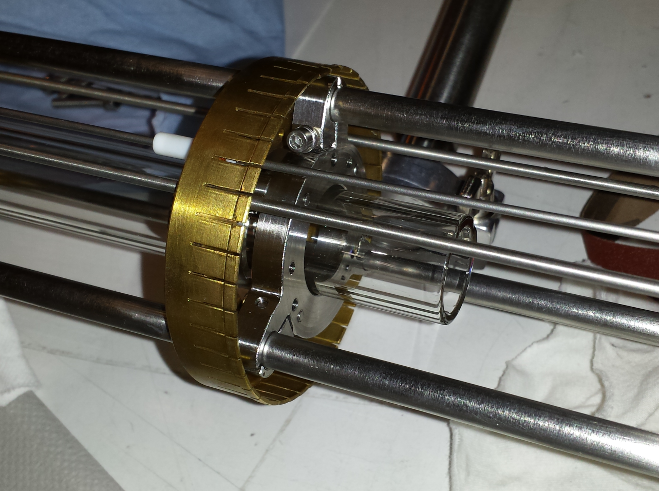
Insert for the May 2016 Beamtime.

Slide 35
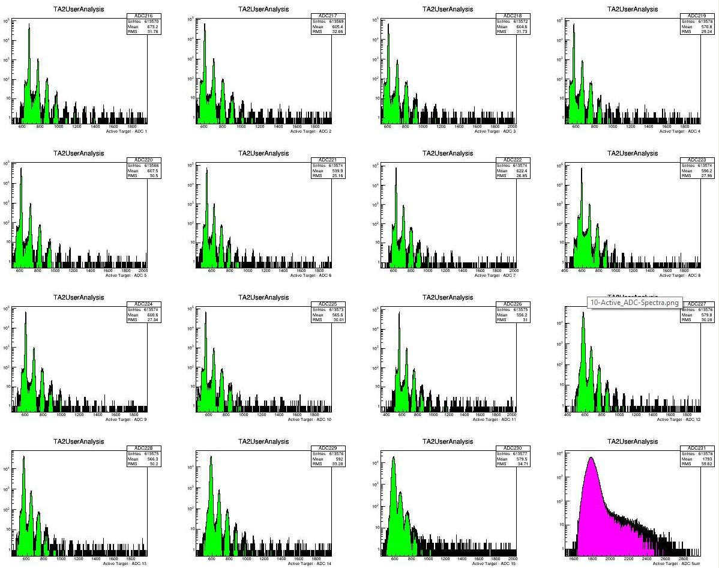
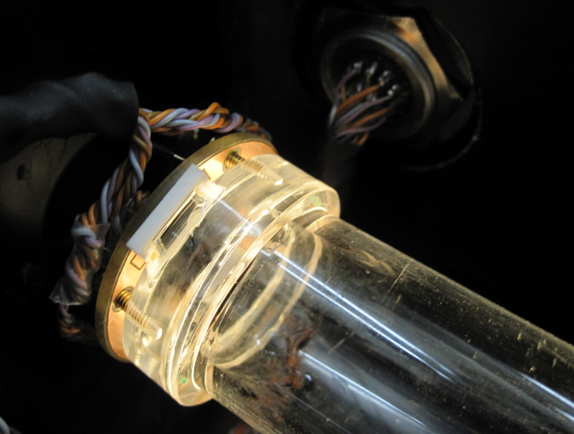
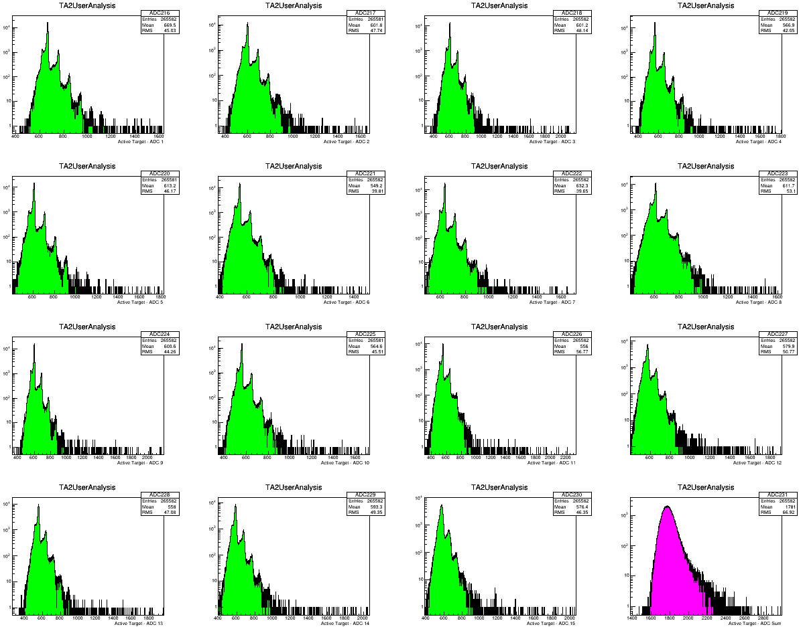
ADC Spectra
at 150Kelvin
ADC Spectra
at 300Kelvin

Slide 36
Conclusions
New Frozen Spin Target in a collaboration KPH Mainz-JINR Dubna.
Data taking with CBall TAPS detector system started 2010 at MAMI C.
All directions of polarization.
With a variety of new measurements of spin observables it comes to a convergence of the multipoles in the region of leading resonances.
Outlook
R&D for polarised active szintillator target for threshold production and Compton.
Measurement of 4 Vector Spin Polarisabilities in Compton process.
Measurement of T in π-threshold region.

Slide 37
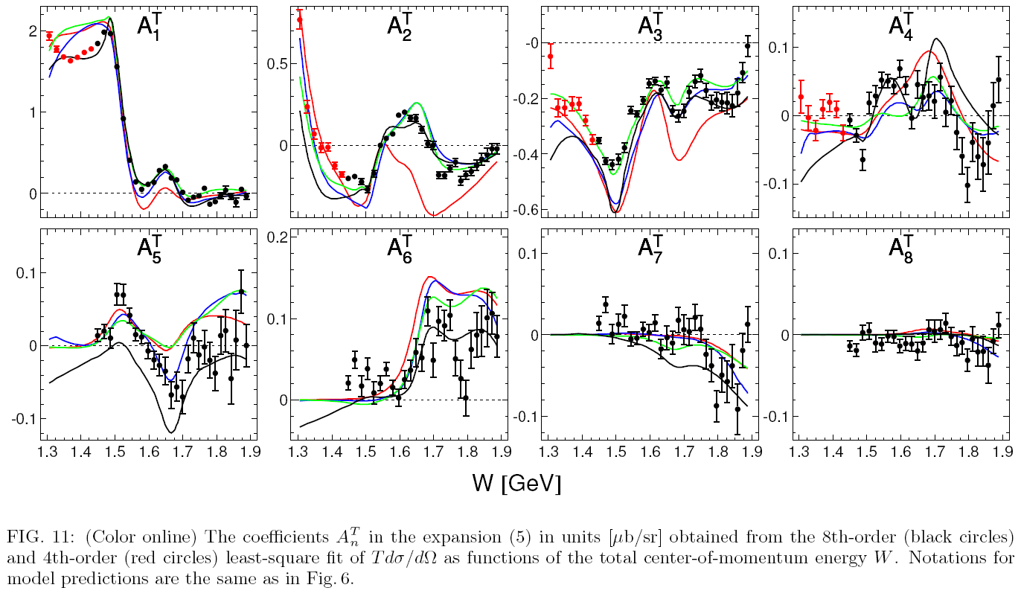
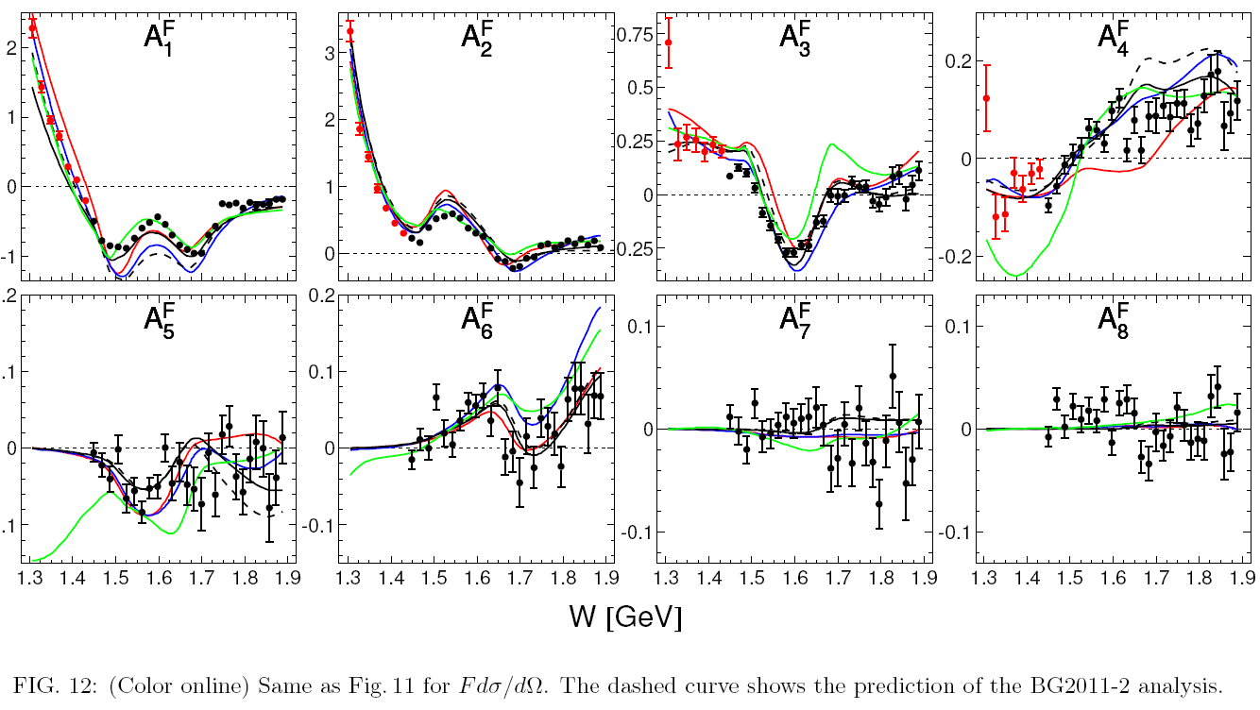
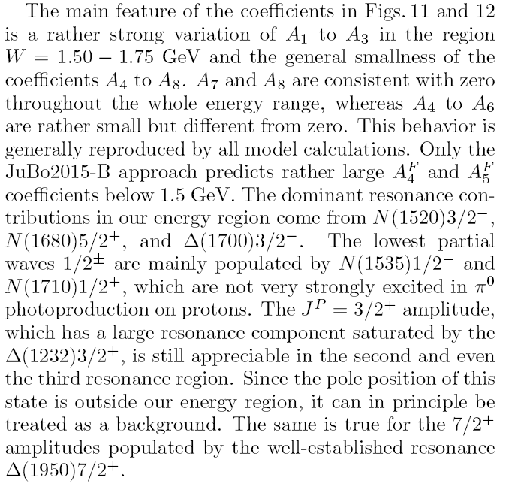
T
F

Slide 38
Polarisabilities
Polarisabilities are fundamental structure constants of the nucleon
Scalar polarisabilities (α, β) describe spin response to static EM field
Scalar polarisabilities measured in real Compton Scattering for the proton [M.Schumacher, Prog.Part. and Nucl.Phys.55, 567 (2005).] :
Real compton scattering with polarized beam and polarized target
α,β,γ₁,γ₂,γ₃,γ₄
Dispersion relation, χPT, lattice QCD..?

Slide 39
Spin Polarizabilities
Spin Vector polarizabilities describe spin response to an incident photon
Four vector pol. (γ_{E1E1} γ_{M1M1} γ_{E1M2} γ_{M1E2}) appear at 3rd order in eff. Hamiltonian
Only two linear combinations of vector polarizabilities measured:
The Forward S.P. γ₀ was determined in GDH-Experiment at ELSA and MAMI (DAPHNE) :
The Backward S.P. γ_{π} was determined from dispersive analysis of backward angle Compton scattering. [B. Pasquini et al., Proton Spin Polarizabilities from Polarized Compton Scattering (2007).]

Slide 40
Theory: Nucleon Vector Spin Polarisibilities
G. Gellas, T. Hemmert, and Ulf-G. Meißner, Phys. Rev. Lett. 85, 14 (2000).
K.B. Vijaya Kumar, J.A. McGovern, M.C. Birse, Phys. Lett. B 479, 167 (2000).
D. Djukanovic, Ph.D. Thesis, University of Mainz, 2008.
R.P. Hildebrant et al., Eur. Phys. J. A 20, 293 (2004).
D. Babusci et al., Phys. Rev. C 58, 1013 (1998).
B. Holstein, D. Drechsel, B. Pasquini, and M. Vanderhaeghen, Phys. Rev. C 61, 034316 (2000).
S. Kondratyuk and O. Scholten, Phys. Rev. C 64, 024005 (2001).
B. Pasquini, D. Drechsel, and M. Vanderhaeghen, Phys. Rev. C 76, 015203 (2007).
J. Ahrens et al., Phys. Rev. Lett. 87, 022003 (2001).
M. Schumacher, Prog. Part. Nucl. Phys. 55, 567 (2005).

Slide 41
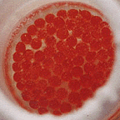
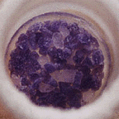
Target material
Saturated electrons of target material not polarized (Pauli principle)
Free electrons
Radicals in material by
chemical or
radiative doping
30mm
Butanol
Ammonia
LiD
N
Dilution factor (e.g. f_{Butanol}=10/74)
determines quality of target material
CH₃
CH₃
Tempo
CH₃
N
CH₃
H
H
O
H

Slide 42
First onle results from last Thursday night: ADC Spectra at 300Kelvin

Slide 43
First results from last Thursday night: TDC Spectra at 300Kelvin, Cball trigger

Slide 44
First results from last Friday night: ADC Spectra at 150Kelvin

