Slide 1
Building Nucleons and Nuclei from Quarks and Glue: Highlights of Nuclear Physics Research with CEBAF in the “6 GeV Era”
L. Cardman
Thomas Jefferson National Accelerator Facility and
University of Virginia

Slide 2
The Laboratory We Now Call JLab Has a Long History
The first proposal for a CW, multi-GeV electron accelerator was made by Hofstadter and his colleagues at Stanford in 1965 and 1969
The first formal recommendation for the facility by a government panel was made in 1975 by the NAS/NRC Friedlander Panel
The very first (1979) NSAC Long Range Plan included it
Construction began in October, 1986
Physics began in 1995 (at 4 GeV), and continued (with the initial machine, ultimately upgraded to 6 GeV) through 2012
Today as the 12 GeV Upgrade of CEBAF is just beginning its physics program, it is appropriate to look back at what was accomplished in the 18 year run of the original facility

Slide 3
So Looking Back at Two Decades of Research:
How Well Have We Succeeded In Realizing the Science Goals That Motivated Building CEBAF?
Review them by broad physics topic:
  QCD and the Structure of Hadrons
  Nuclear Structure, Nuclear Dynamics, and Nuclear Astrophysics
  Fundamental Symmetries
  Given the time, only a few examples from the 173 experiments run are possible – I’ve picked ones I particularly liked, with an emphasis on experiments that were made feasible by the unique capabilities of the accelerator and its experimental equipment and are most relevant to this conference

Slide 4
So Looking Back at Two Decades of Research:
How Well Have We Succeeded In Realizing the Science Goals That Motivated Building CEBAF?
Review them by broad physics topic:
  QCD and the Structure of Hadrons
  Nuclear Structure, Nuclear Dynamics, and Nuclear Astrophysics
  Fundamental Symmetries
  Given the time, only a few examples from the 173 experiments run are possible – I’ve picked ones I particularly liked, with an emphasis on experiments that were made feasible by the unique capabilities of the accelerator and its experimental equipment and are most relevant to this conference

Slide 5
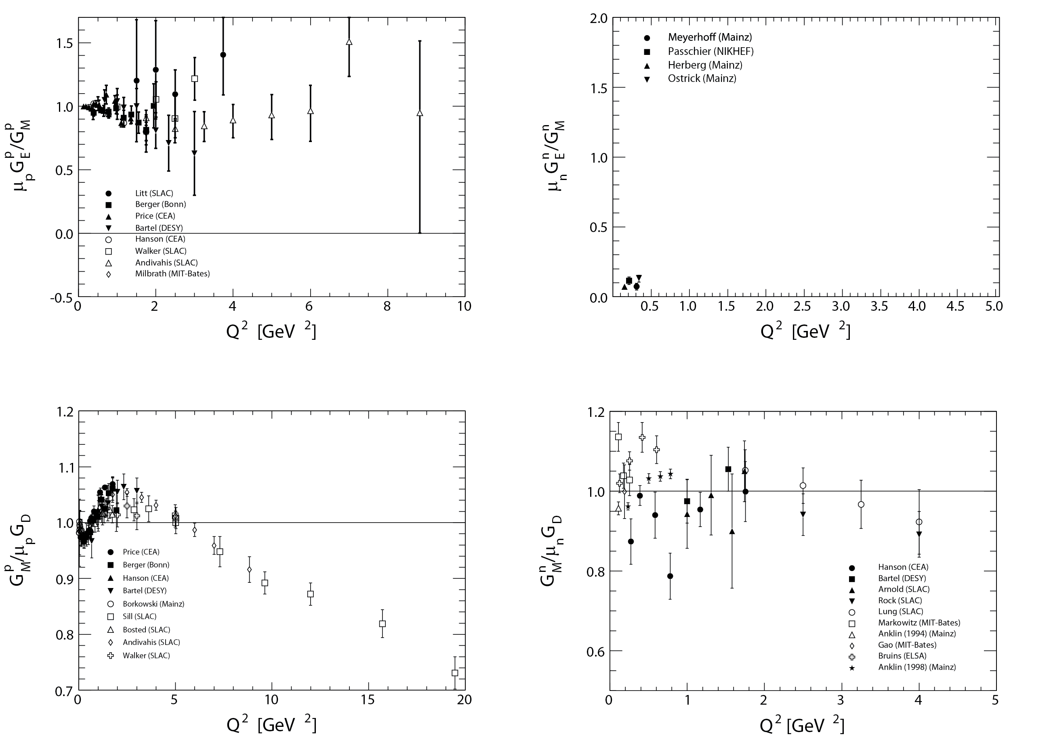
JLab data on the EM form factors provide a testing ground for theories constructing nucleons from quarks and glue
Before JLab and Recent non-JLab Data
S. Riordan

Slide 6
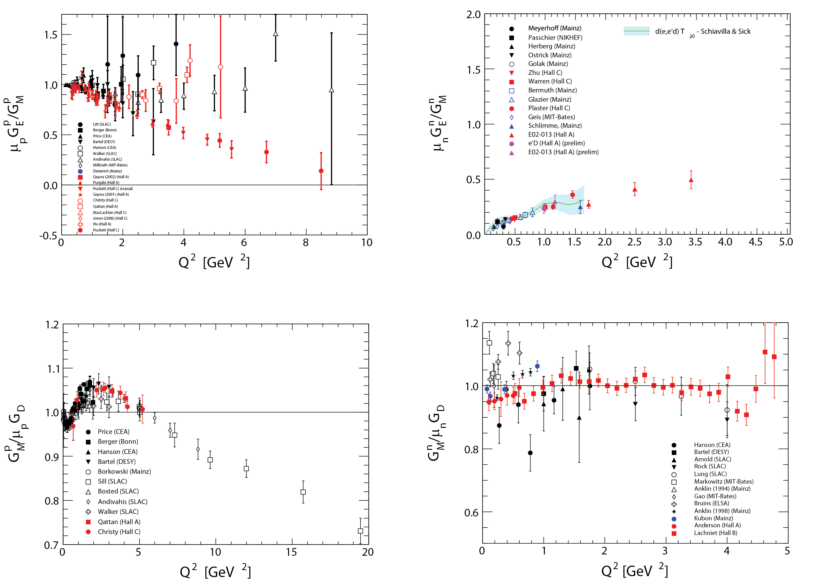
JLab data on the EM form factors provide a testing ground for theories constructing nucleons from quarks and glue
Today, with Available JLab Data
S. Riordan

Slide 7
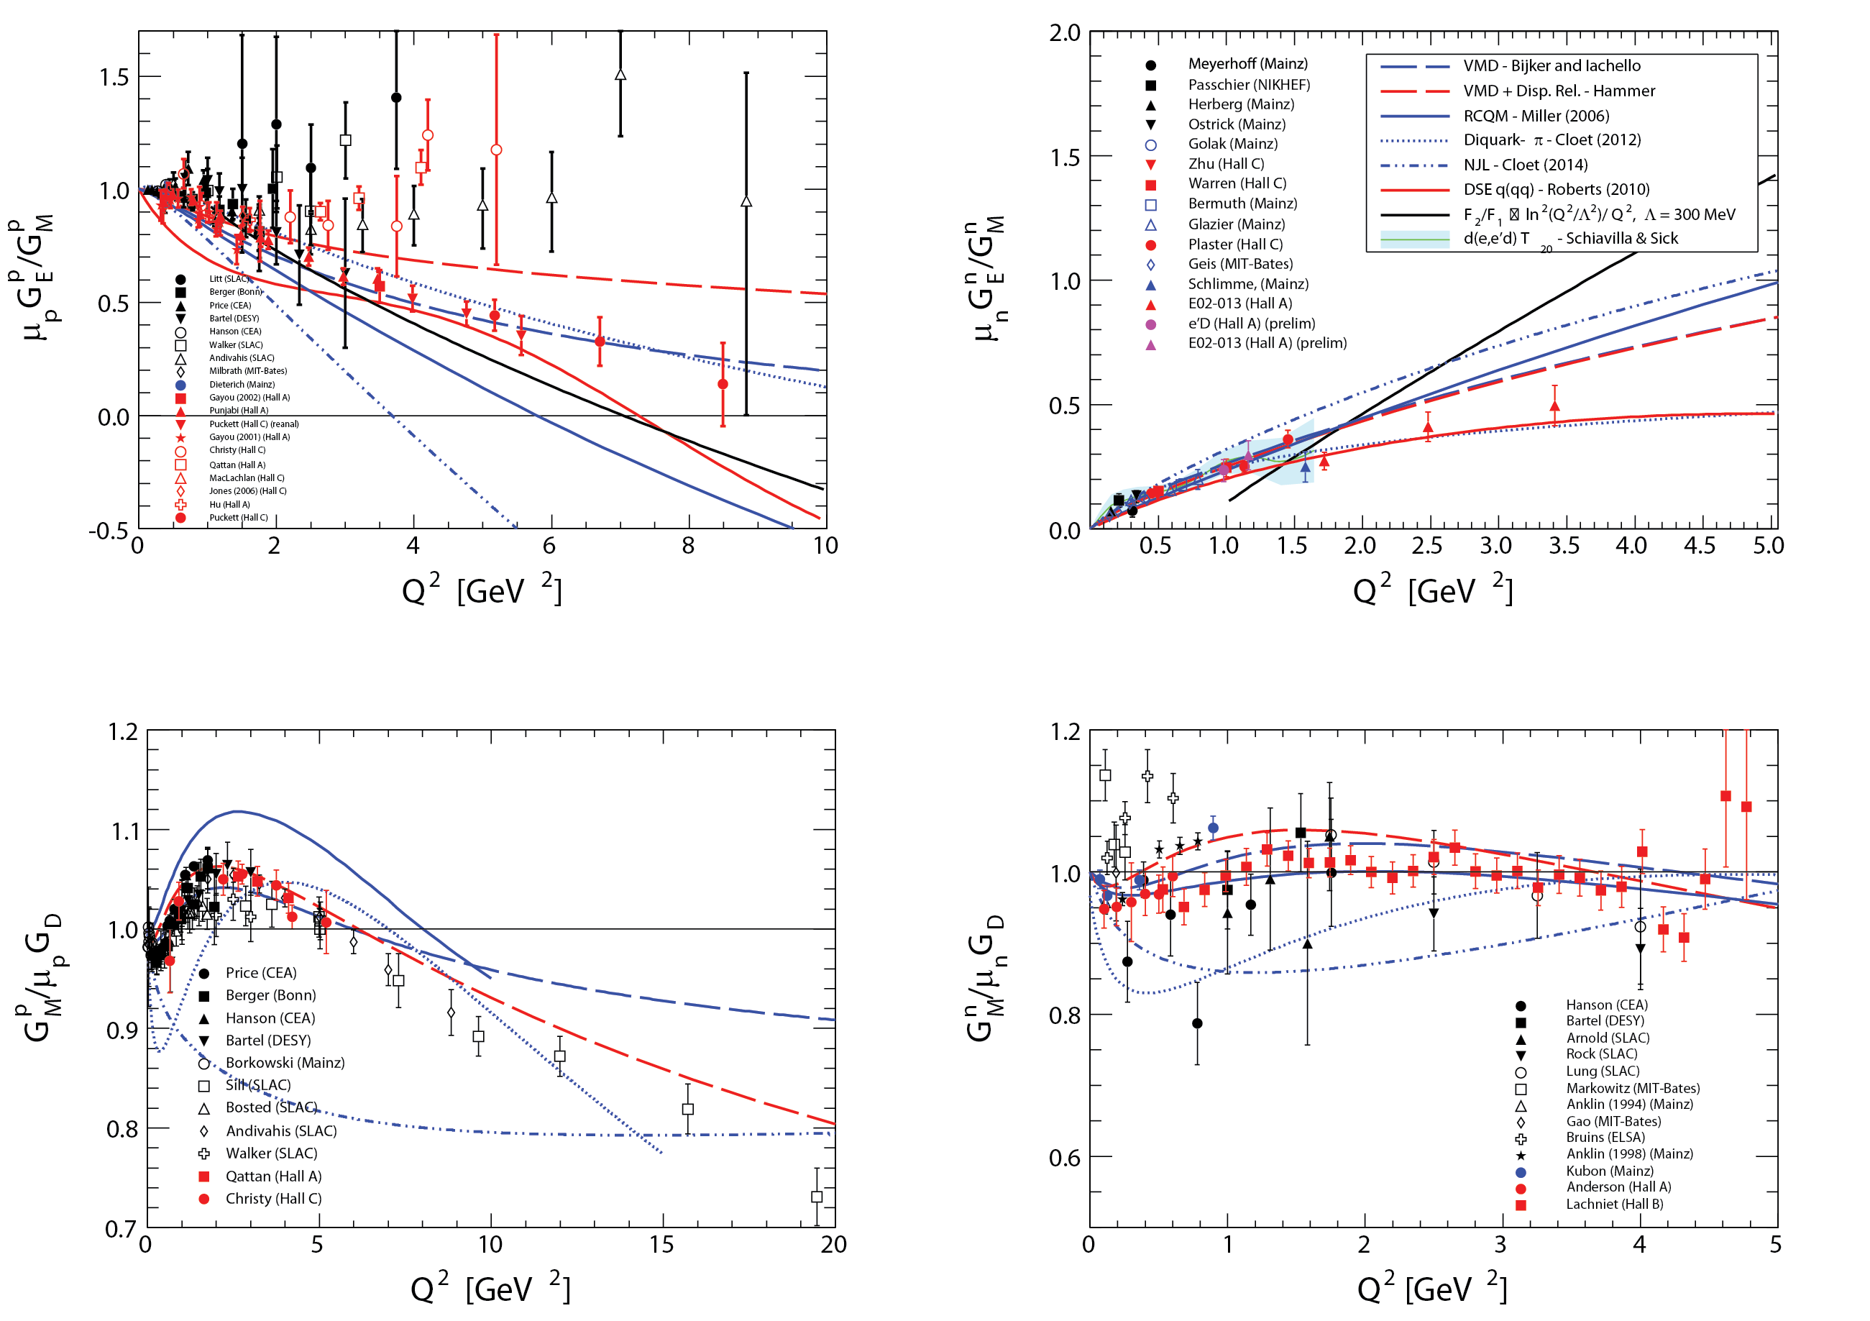
JLab data on the EM form factors provide a testing ground for theories constructing nucleons from quarks and glue
Today, with Available JLab Data, Compared w/ Theory
Inferences to date:
Relativity essential
Pion cloud makes critical contributions
Quark Angular Momentum important
……..
S. Riordan

Slide 8
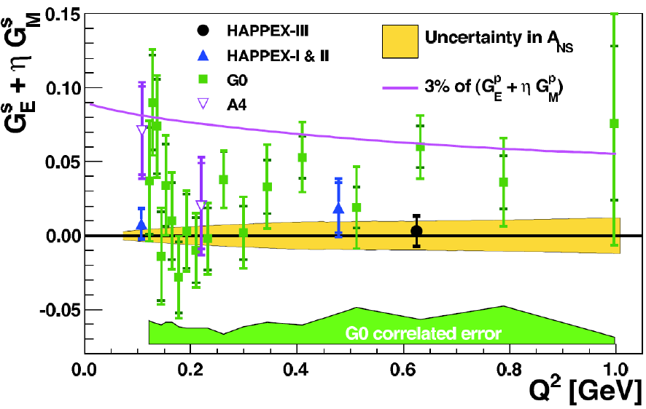
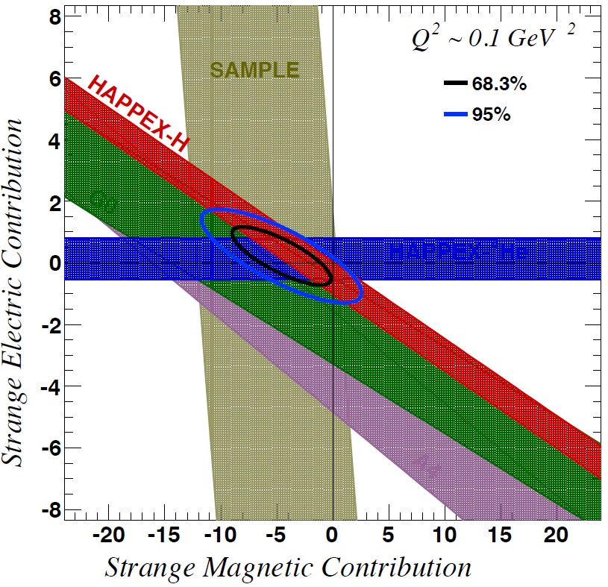
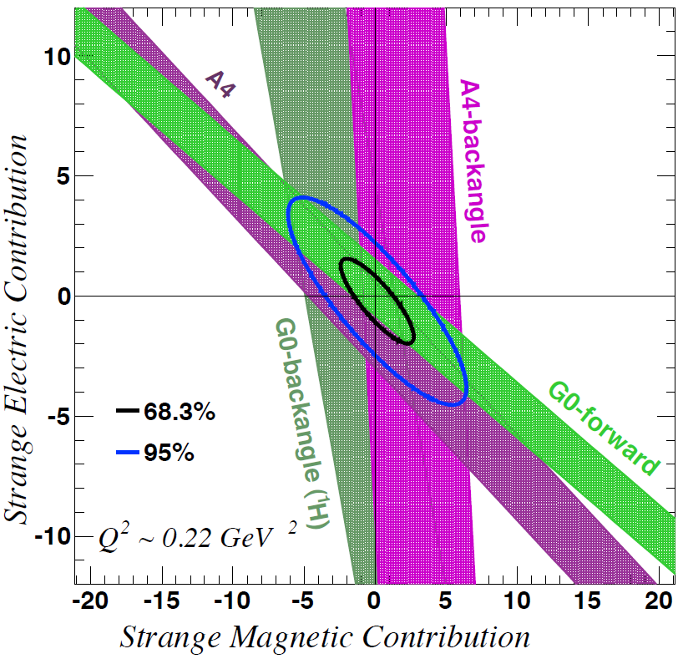
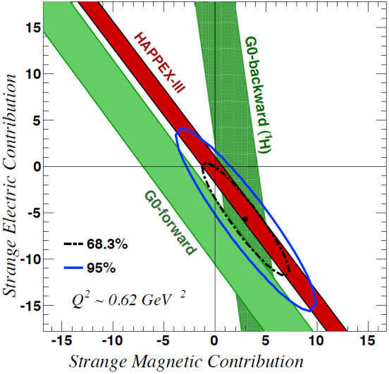
Strangeness Contribution to Nucleon Form Factors
From Parity Violating Elastic
Electron Scattering
HAPPEx-3: PRL 108 (2012) 102001
G0-Backward: PRL 104 (2010) 012001
G0-Forward: PRL 95 (2005) 09201
Purple line represents 3% of the proton form factors
→ strange quarks do not play a substantial role in the long-range electromagnetic structure of nucleons
Idea from R. D. McKeown, Phys. Lett. B219, 140 (1989), and
D. H. Beck, Phys. Rev. D39, 3248 (1989).

Slide 9
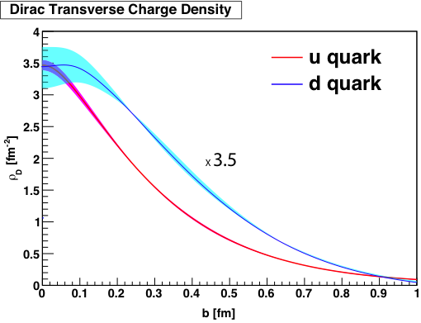
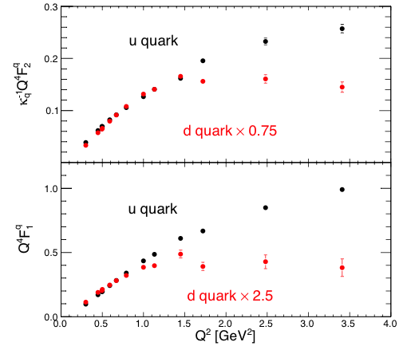
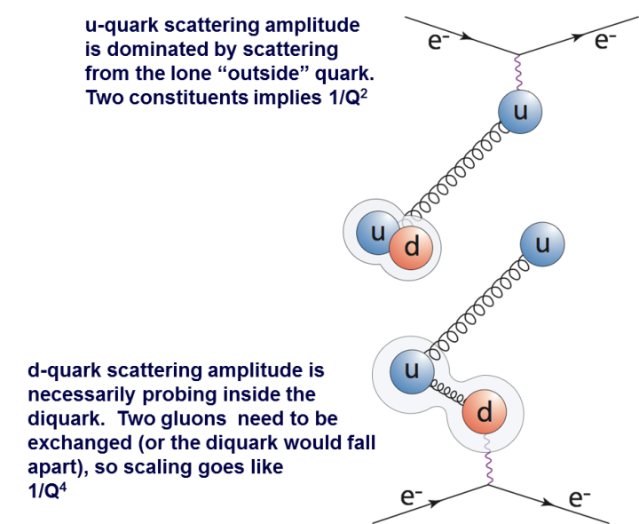
Gs≈0 So Do a Flavor Separation of the Form Factors
We see very different behavior for the
up and down quarks!
F_{d} seems to scale like 1/Q⁴ whereas
F_{u} seems to scale more like 1/Q²
in proton
Why is the d-quark so much wider?
Cates, de Jager, Riordan, and Wojtsekhowski,
PRL 106, 252003 (2010)
Does the di-quark explain the scaling?

Slide 10
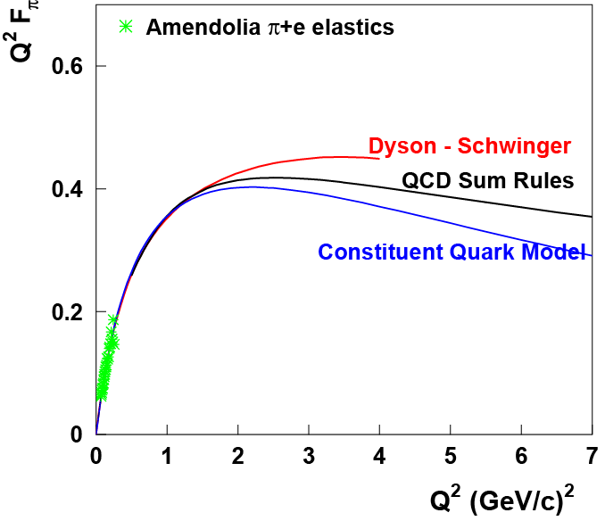
Charged Pion Electromagnetic Form Factor
Where does the dynamics of the q-q interaction make a transition from
the strong (confinement) to the perturbative (QED-like) QCD regime?
Pre-JLab data from
pion scattering
from atomic electrons
Initial F_{π}(Q²) from
πe elastic scattering
Notes:
It will occur earliest in the simplest systems
→ the pion form factor F_{π}(Q²) provides our best chance to
determine the relevant distance scale experimentally

Slide 11
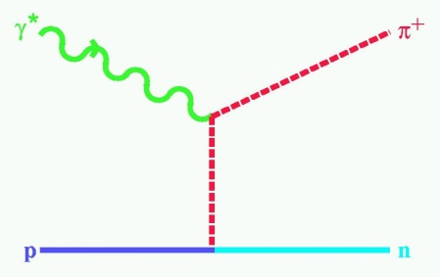
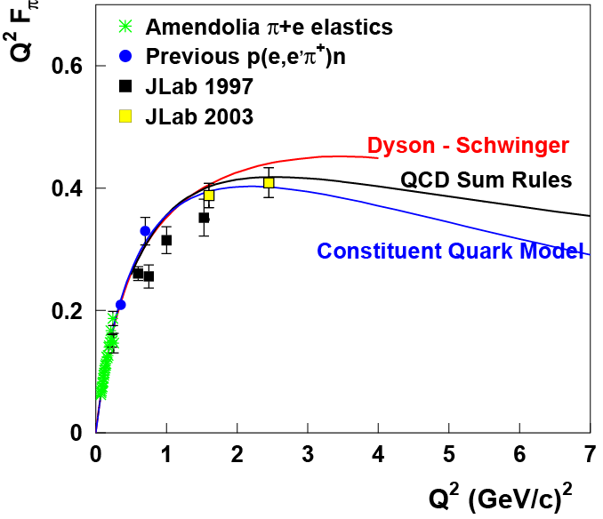
Charged Pion Electromagnetic Form Factor
Where does the dynamics of the q-q interaction make a transition from
the strong (confinement) to the perturbative (QED-like) QCD regime?
To extend F_{π}(Q²) :
At low Q² (< 0.3 (GeV/c)²): use p + e
scattering → R_{rms} = 0.66 fm
At higher Q²: use ¹H(e,e’π⁺)n,
measure σ_{L}
“Extrapolate” σ_{L} to t = +m_{π}² using a realistic pion electroproduction (Regge-type) model to extract F_{π}
t = (p_{π}-q)² < 0
See recent review: T. Horn and C. D. Roberts, Journal of Physics G: Nuclear and Particle Physics 43, 073001 (2016)
F_{π}(Q²) Today
Notes:
It will occur earliest in the simplest systems
→ the pion form factor F_{π}(Q²) provides our best chance to
determine the relevant distance scale experimentally

Slide 12
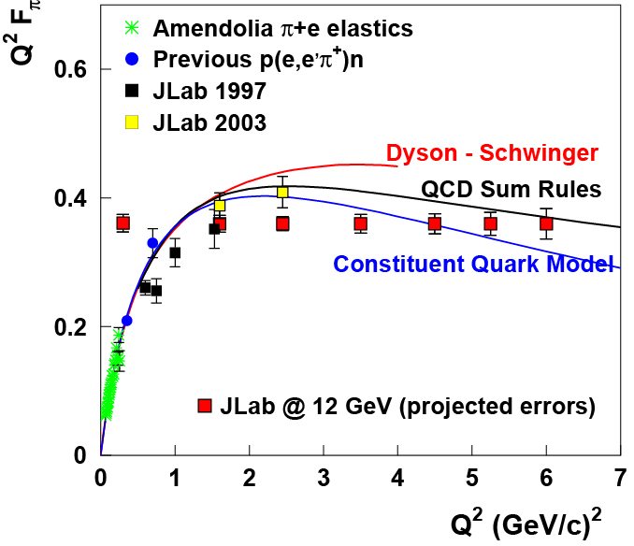
Charged Pion Form Factor – 12 GeV
Plan to Further extend
F_{π}(Q²) w/ 12 GeV
Measure F_{π} up to 6 (GeV/c)² to probe onset of pQCD
π⁺/π⁻ measurements to test t-channel dominance of σ_{L}
Q² = 0.30 (GeV/c)² close to pion pole to compare to π+e elastic
F_{π}(Q²) 12 GeV Plans

Slide 13
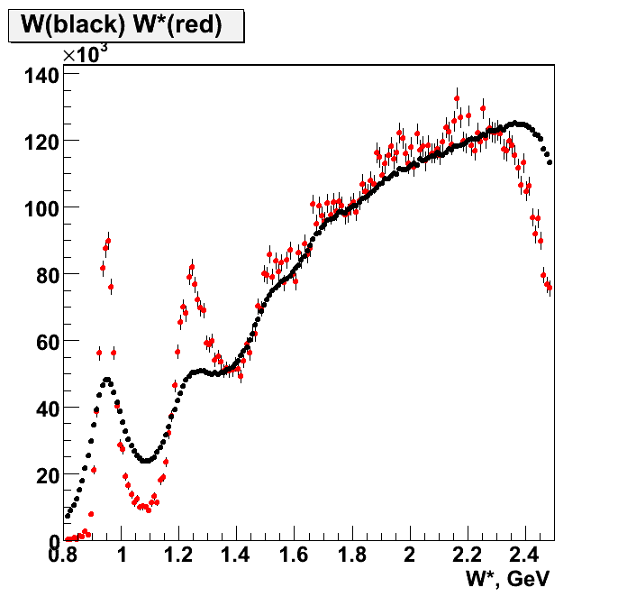
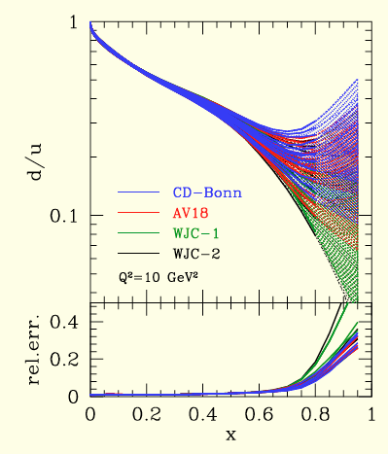
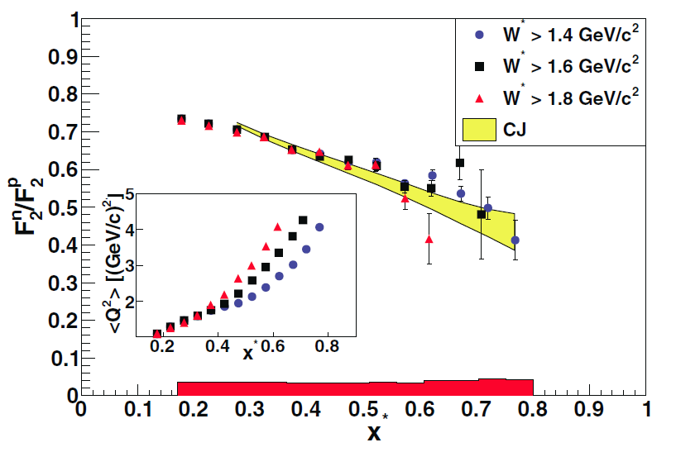
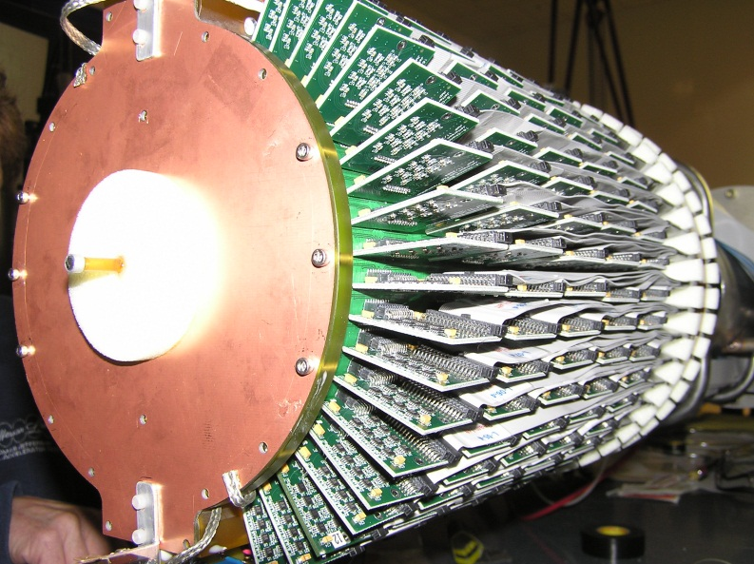
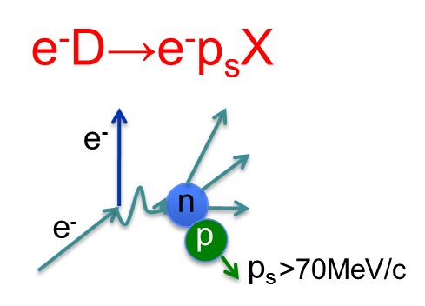
Neutron Structure and Quark Distributions (BONuS Experiment w/ CLAS)
CTEQ-JLab Fits of world data.
No free neutron target; complications using deuterium
w/ tagging
w/o tagging
The solution? Tag the spectator proton
6 mm diameter target
S. Tkachenko et al. (CLAS Collaboration)
Phys. Rev. C 89, 045206 (2014)

Slide 14
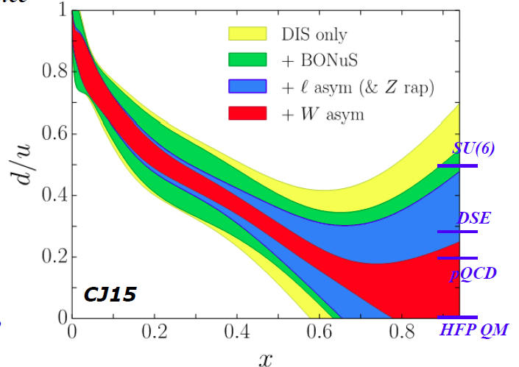
Down Quarks at Large-x: the Elusive d/u Ratio
The uncertainty of the d parton distribution function (PDF) has been a longstanding issue
Significant reduction in the PDF uncertainty has recently achieved by “CJ” (CTEQ-Jefferson Lab) Collaboration
CJ global PDF fit includes Hall C DIS and Hall B BONuS neutron data and results from the Tevatron. The ability of BONuS to impact the extraction was limited by the (x,Q²) range available
Continued reduction planned for 12 GeV era – will be a solved problem

Slide 15
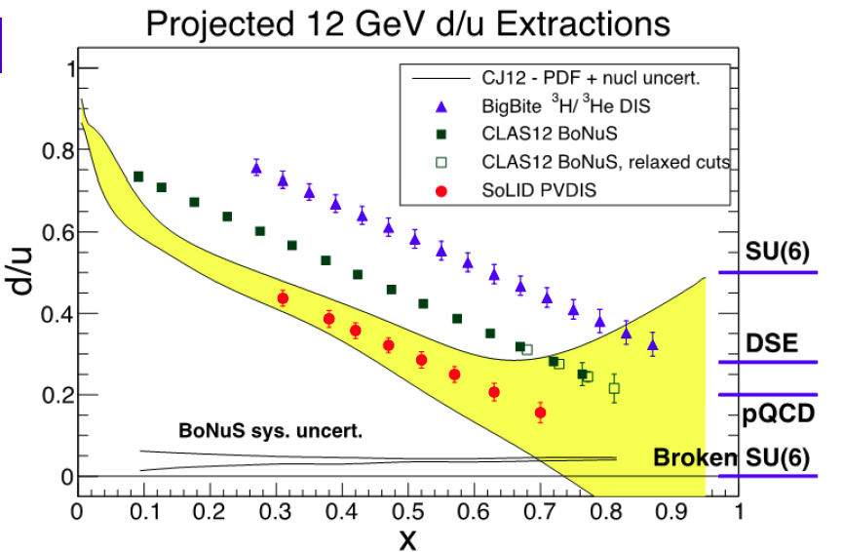
Further Improvements in Our Knowledge of the d/u Ratio
Are Anticipated from Multiple Experiments at 12 GeV

Slide 16
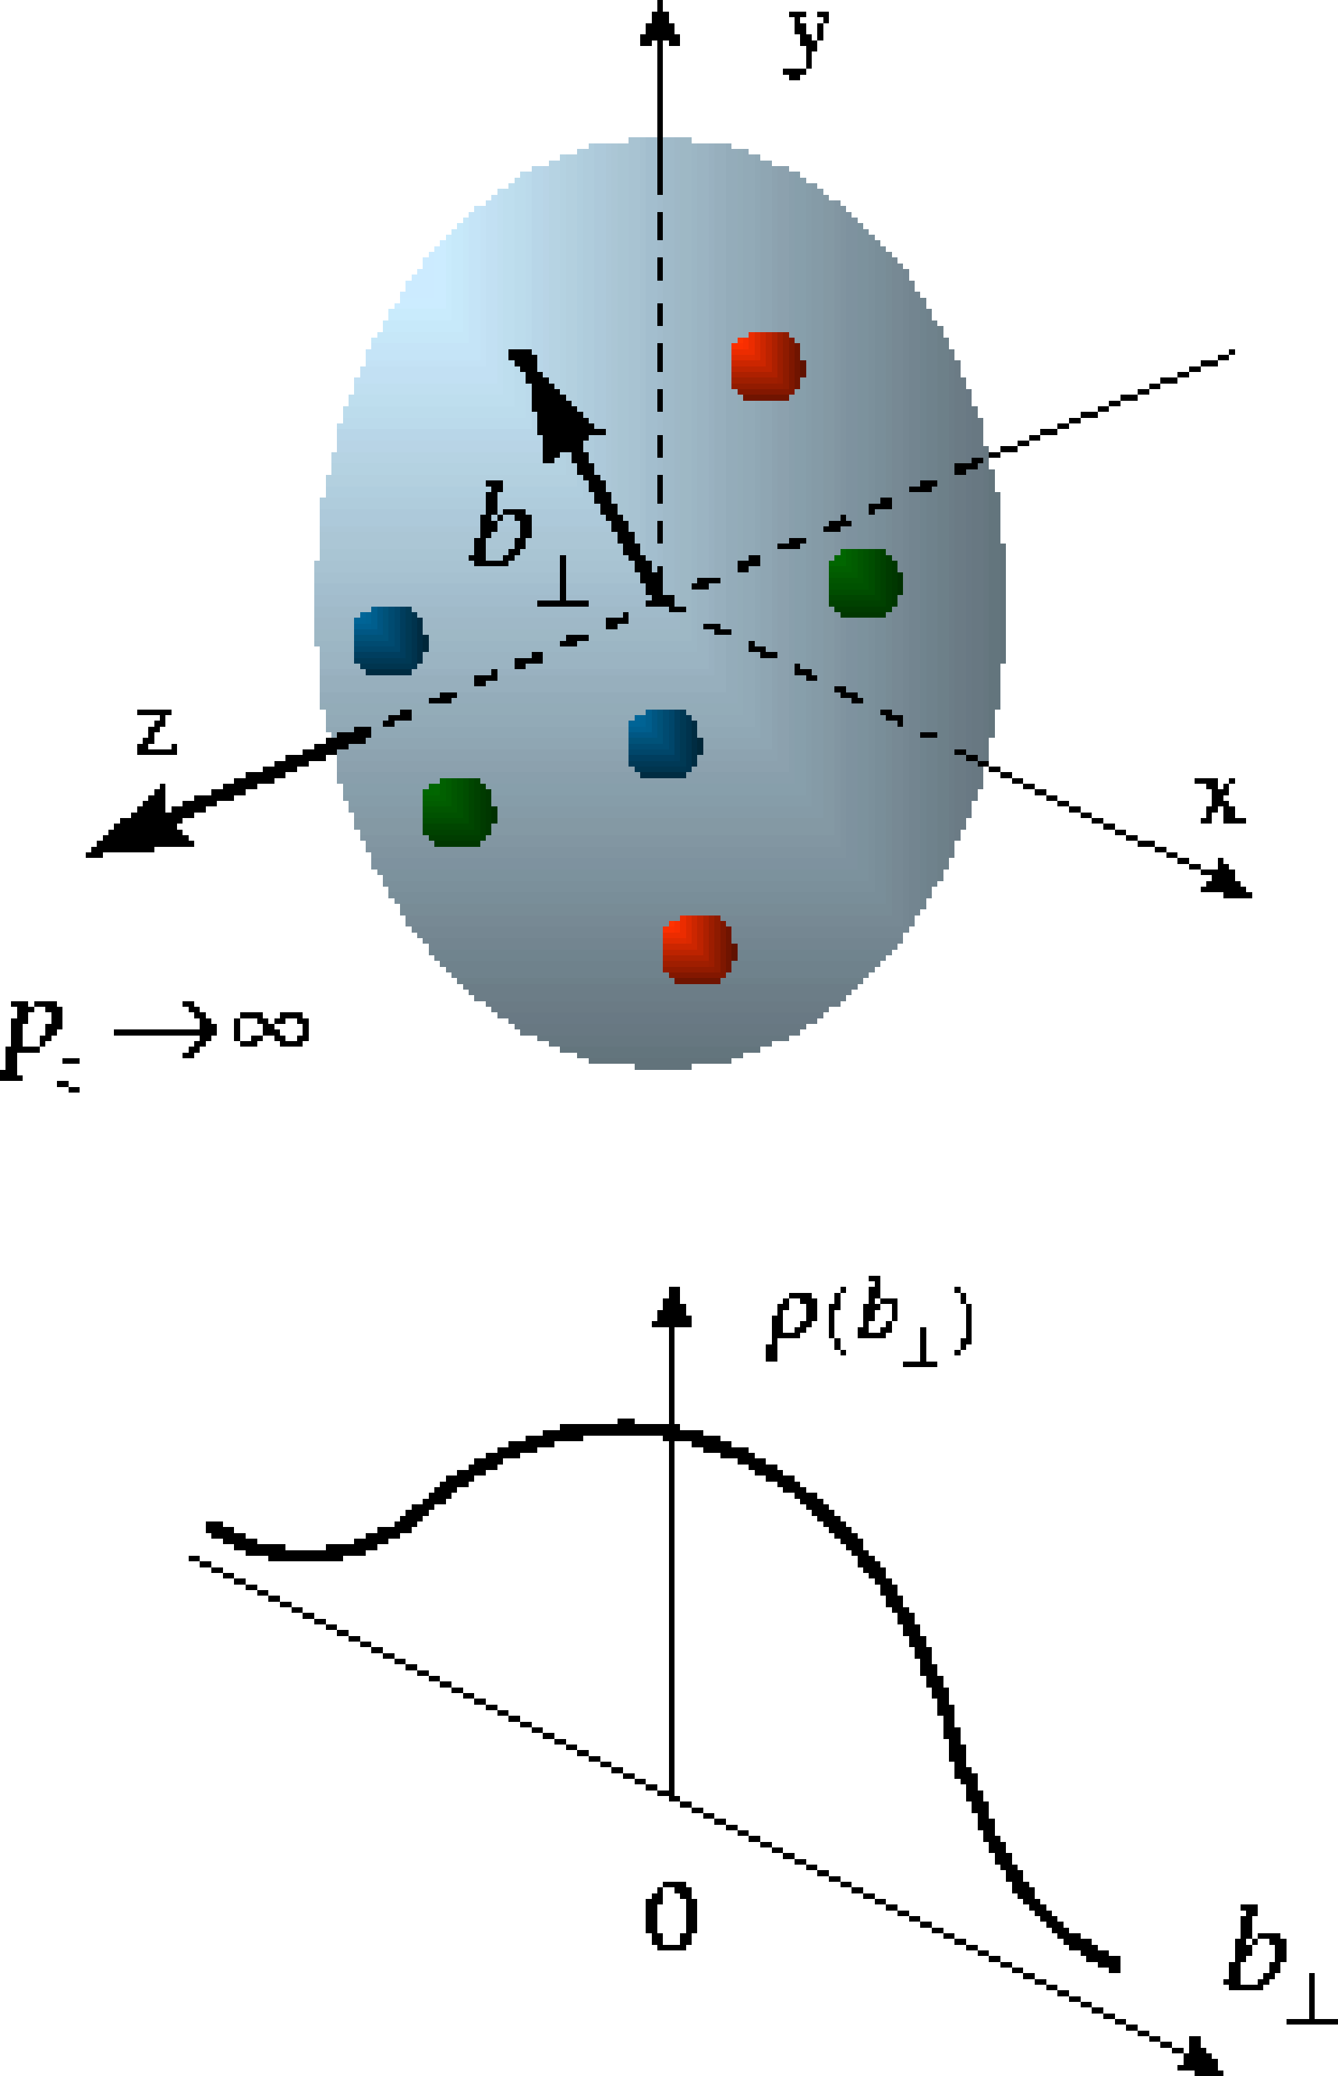
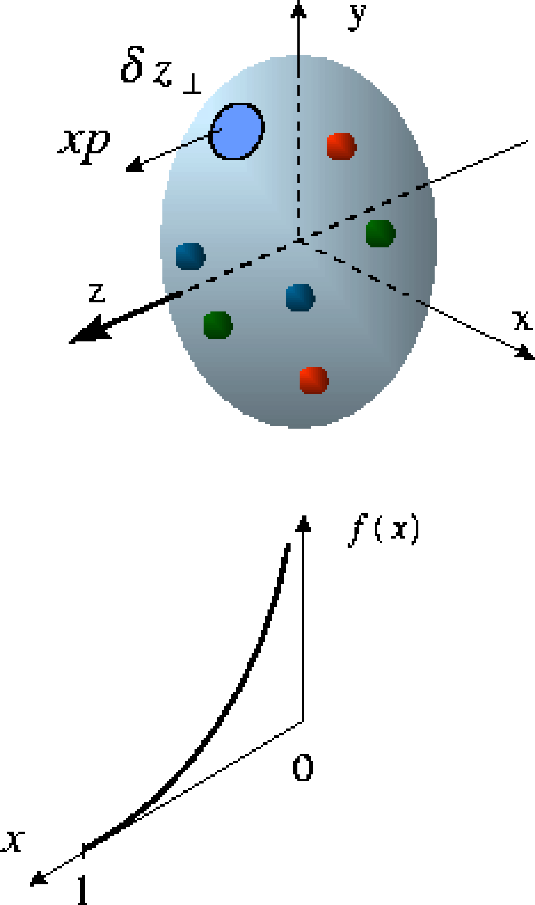
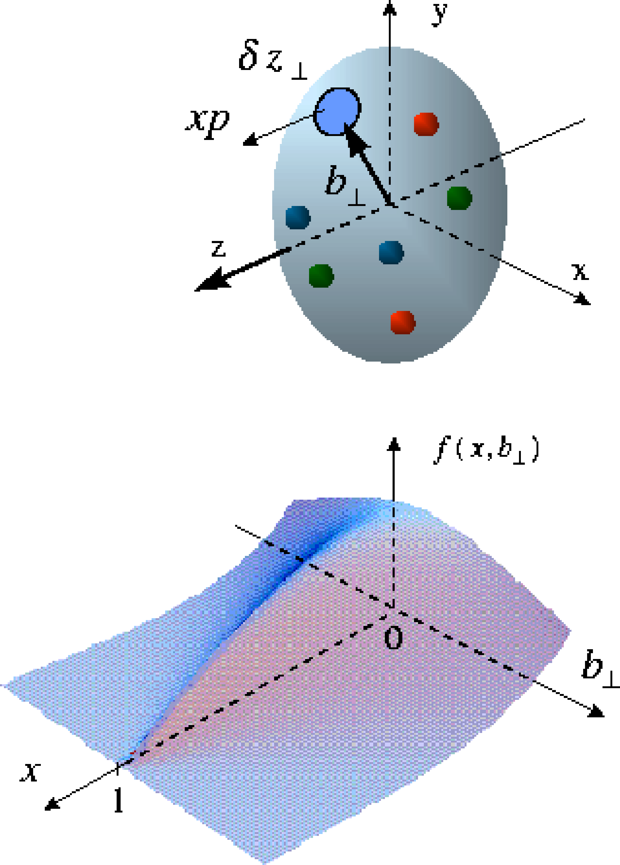
Laying the Groundwork for a Deeper Understanding Nucleon Structure:
From Form Factors and PDFs to Generalized Parton Distributions (GPDs)
Elastic Scattering & Form Factors:
Transverse charge & current densities in coordinate space
DIS & Structure
Functions:
Quark longitudinal
& helicity distributions
in momentum space
DES & GPDs:
Correlated quark distributions
In transverse coordinate
and longitudinal momentum
space

Slide 17
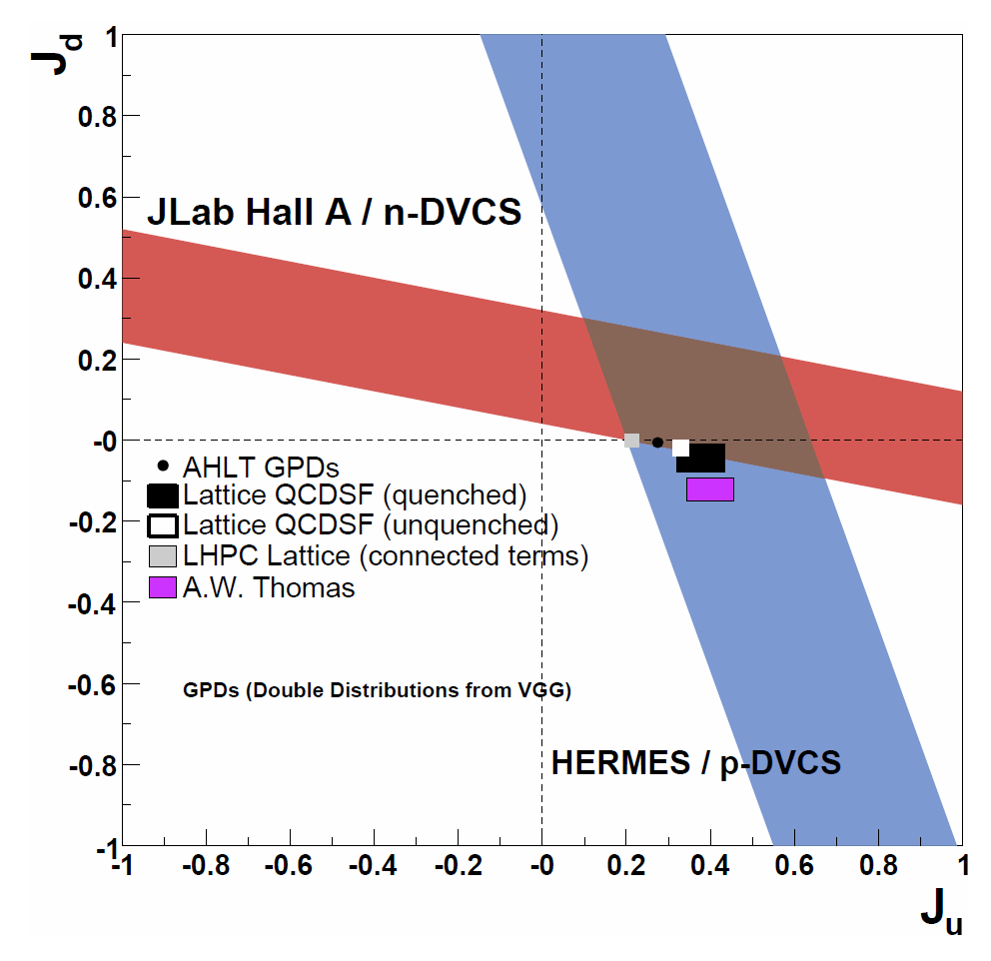
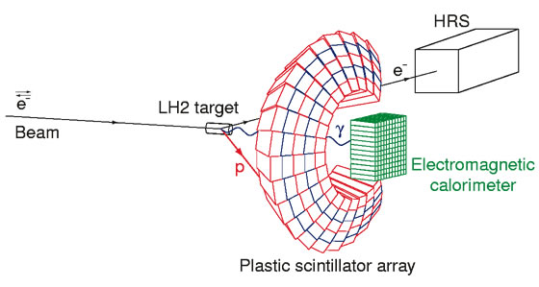
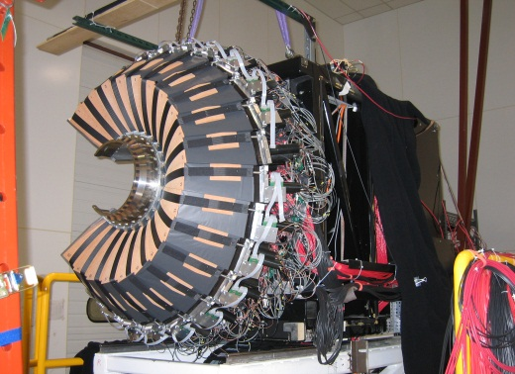
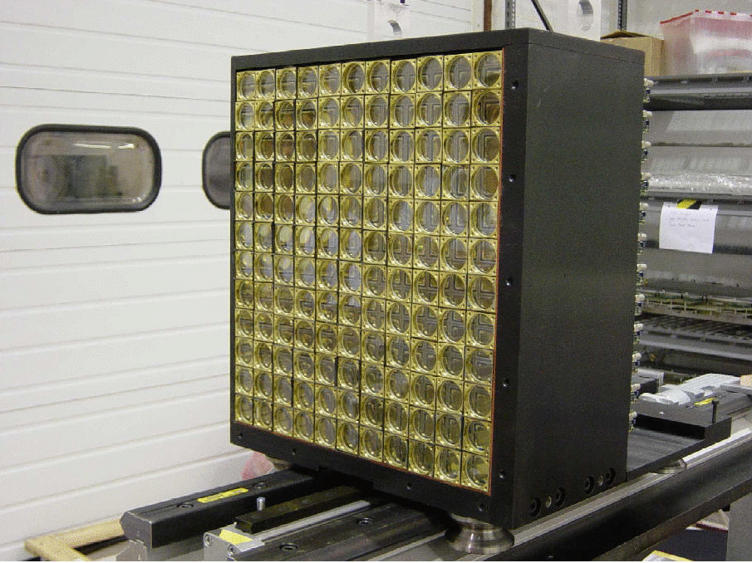
GPD Experiments in CLAS & Hall A
Experimental constraints on the total up and down quark contributions to the proton spin from Jeﬀerson Lab Hall A neutron and HERMES transversely polarized proton results.

Slide 18
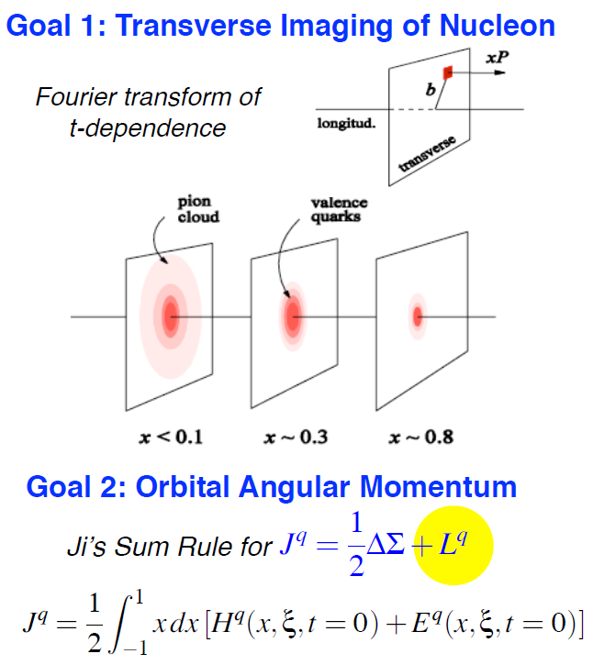
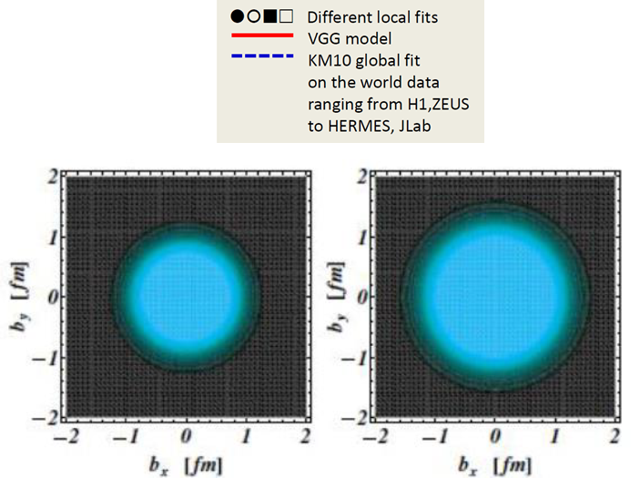
Hard Exclusive Processes → GPDs
The First Crude Images - the GPD H in Im DVCS
Simplest process:
e + p → e’ + p + γ (DVCS)

Slide 19
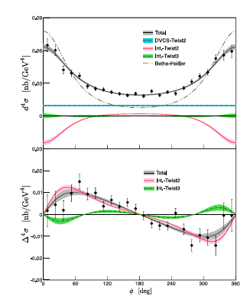
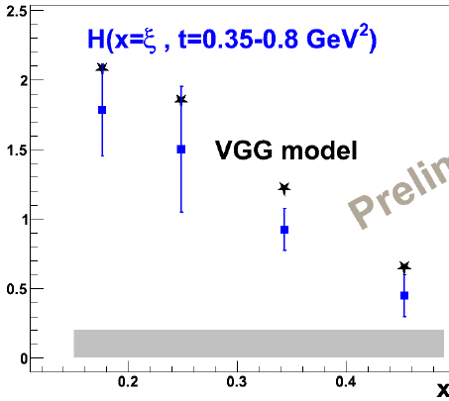
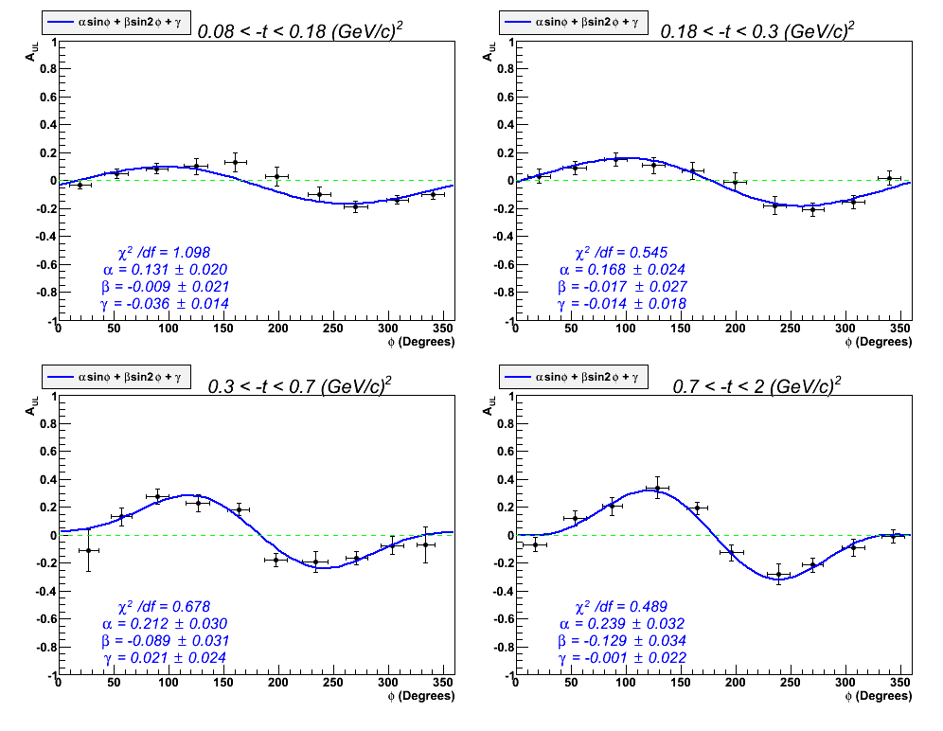
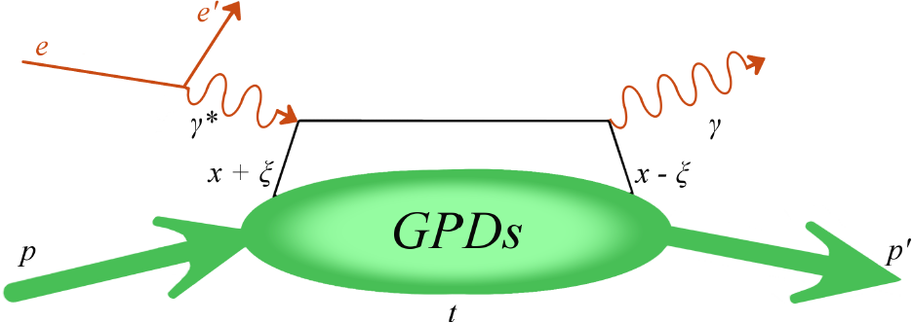
Extracting GPD H from DVCS
New precision data from Hall A and CLAS
E. Seder et al., Phys. Rev. Lett. 114, 032001 (2015)
H. S. Jo et al., Phys. Rev. Lett. 115, 212003 (2015)
M. Defume et. al., Phys. Rev. C 92, 055202 (2015)
Extraction of GPD H(x=ξ,t) in LO/twist-2 from:
Preliminary results of A_{UL}, A_{LL} w/ polarized target
Absolute DCVS cross sections σ
DVCS cross section (Hall A)
VGG model
We anticipate that the study of the GPDs
will be a major focus of both the 12 GeV Upgrade (for high-x) and an eventual Electron Ion Collider (for low-x)
DVCS/BH target asymmetry A_{UL}(CLAS)

Slide 20
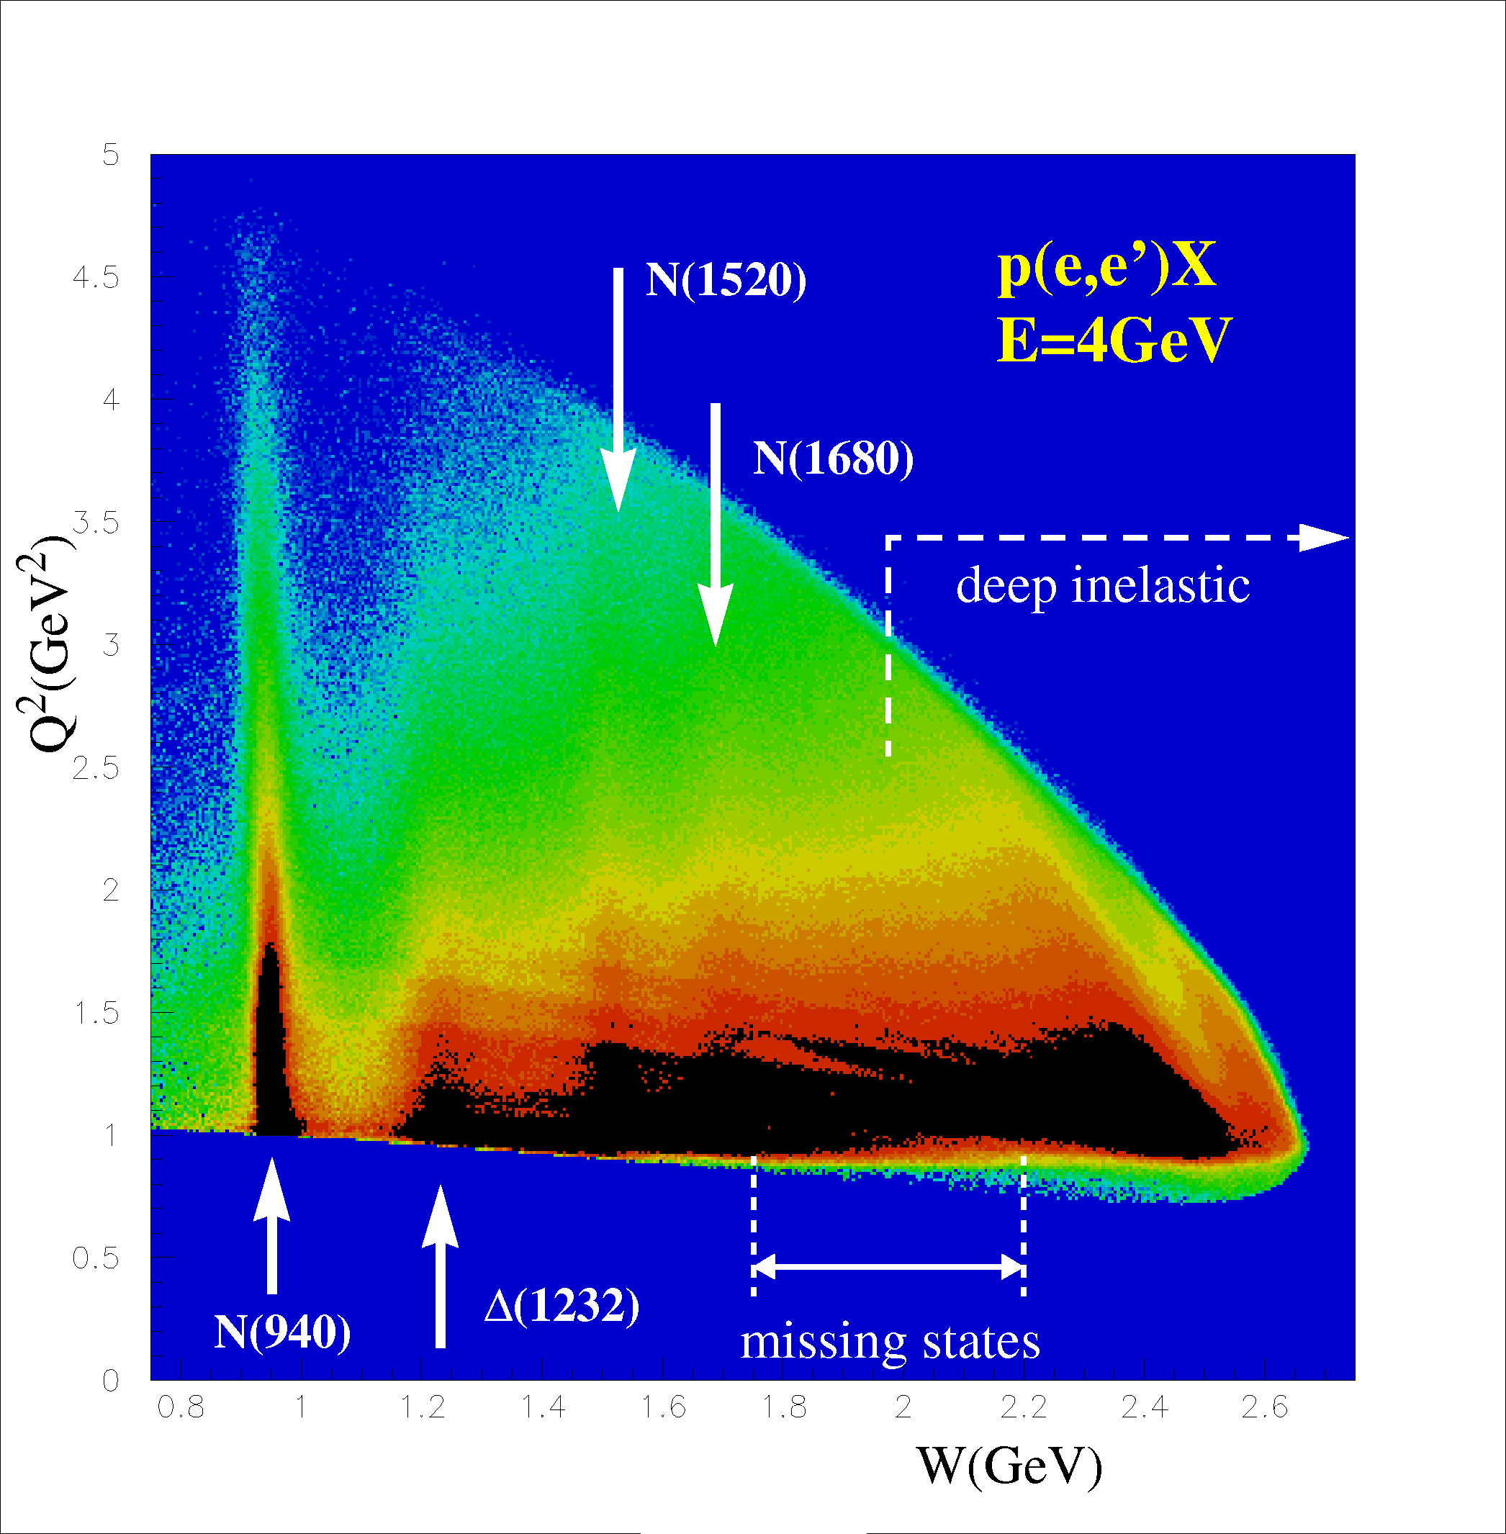
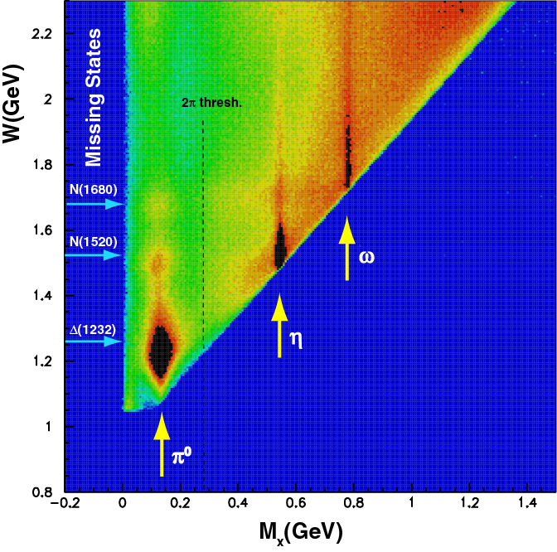
CLAS Measures: a Broad Range of Q² and W Simultaneously, and Excited State Decay
CLAS Coverage for E = 4 GeV
Note: Also studied over this same M_{x} range with tagged real photons
e p → e’ X
e p → e′ p X
5
4
3
2
1
0
1
1.5
2
2.5
Notes:
CLAS measures a broad range of Q**2 and W simultaneously (left figure)
And
CLAS can simultaneously (via coincidence) see decay of state excited at known W
Note, for example, missing stat region has omega decay – not seen (not surprisingly) in pion excitation

Slide 21
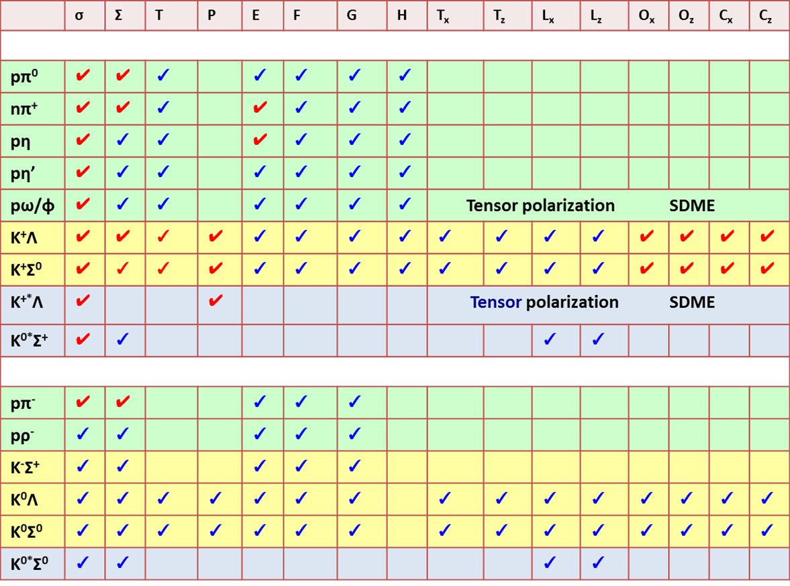

Search for excited baryons with CLAS – some reaction channels
✔ - acquired ✔ - analyzed/published
Proton targets
γp → X
Neutron targets
Note that much of the data is still under analysis ( all ✔), so there is much more about nucleon structure still to come; I anticipate that the double-polarization data will be particularly informative
γn → X
To repeat some of the comments made by
Jan Hartmann in his talk Saturday…….
SDME = Spin Density Matrix Elements

Slide 22
Evidence for new Baryons and Decays
State N((mass)J^{P} | PDG pre 2010 | PDG 2016 | KΛ | KΣ | Nγ
N(1710)1/2⁺ | *** | **** | **** | ** | ****
N(1880)1/2⁺ |  | ** | ** |  | **
N(1895)1/2⁻ |  | ** | ** | * | **
N(1900)3/2⁺ | ** | *** | *** | ** | ***
N(1875)3/2⁻ |  | *** | *** | ** | ***
N(2150)3/2⁻ |  | ** | ** |  | **
N(2000)5/2⁺ | * | ** | ** | * | **
N(2060)5/2⁻ |  | ** |  | ** | **
(Bonn/Gatchina: First coupled-channel analysis that includes nearly all new photoproduction data)
Notes:
This slides shows a summary of the results in this analysis. The green column shows the rating by the PDG. The two columns show the importance of the strangeness channel in this results.

Slide 23
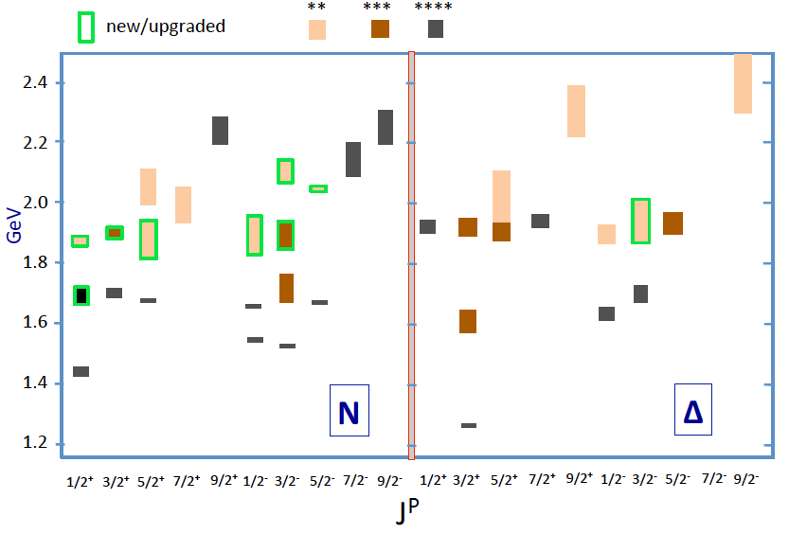
Lower mass N*/Δ* states in 2016
?
Are we seeing mass degenerate spin multiplets and parity duplets?
Do new states fit into the SU(6) spin-flavor symmetry?
Notes:
This shows the status of states with masses below 2.4 GeV and minimum of 2* rating. The newly observed states, or states that have been upgraded due to the new data are shown with the green frames. Out of the 8 new N* states 5 fall within a narrow mass range, that may indicate a mass degenerate spin multiplet at 1.9 GeV that nearly repeats a similar set of states at 1.7GeV, and a set of now 7 Delta states, also near 1.9 GeV. The mechanism for such multiplets is not understood and is not predicted within the quark model. Channel coupling might have something to do with it, but no quantitative evaluation has been done.
The other important question is if these new states fit within the symmetry underlying the constituent quark model.

Slide 24
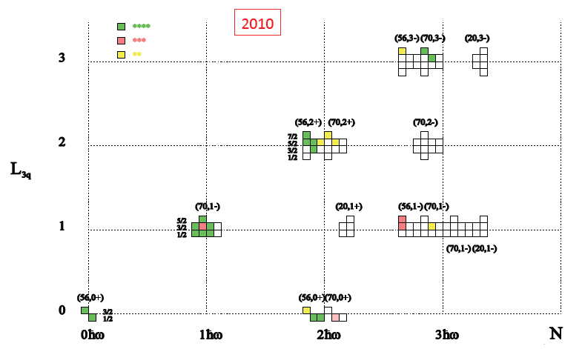
Do new states fit into CQM?
SU(6)×O(3)
15
4
6
Notes:
This shows the 2010 status of baryon states that have been associated with quark model states shown in this SU(6)xO(3) symmetry scheme. The color code indicating the confidence level in their existence. Clearly there are many open boxes where states are predicted but have not observed.

Slide 25
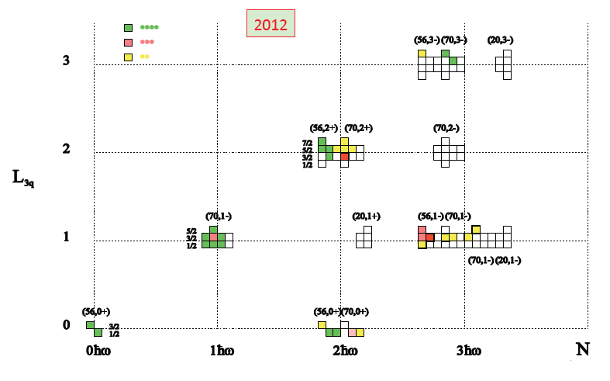
Do new states fit into CQM?
SU(6)×O(3)
15 →
16
2016
4 →
5
6 →
12
Notes:
This shows the status of 2016 with 8 additional states included that fit into the open boxes. One of them is upgraded to 4-stars.

Slide 26
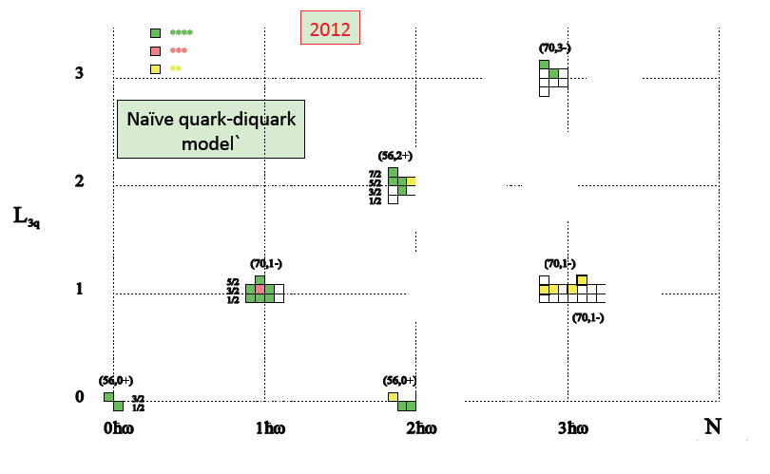
Are they compatible with the quark-diquark model?
16
>15
2016
5
> 1
12
> 6
Notes:
It is clear that the new states are incompatible with the naïve quark-diquark model predictions with a frozen, pointlike di-quark. Note, that this does not eliminate models with dynamical di-quarks such as predicted in the DSE approach.

Slide 27
Are they compatible with the quark-diquark model?
SU(6)×O(3)
15 →
16
2016
4 →
5
6 →
12
But the naïve version of quark-diquark model (point-like diquarks) is ruled out
Notes:
This shows the status of 2016 with 8 additional states included that fit into the open boxes. One of them is upgraded to 4-stars.

Slide 28
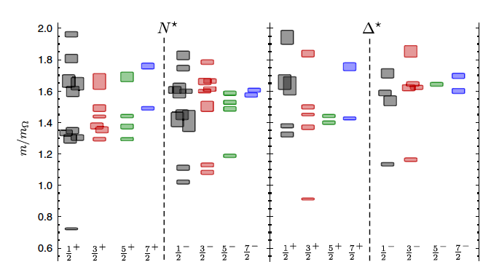
Do new states fit with LQCD projections?
R. Edwards et al., Phys.Rev. D84 (2011) 074508
m_{π}=396MeV
M/M_{Ω}
N(2060)5/2⁻
N(2120)3/2⁻
N(1875)3/2⁻
N(1895)1/2⁻
N(1860)5/2⁺
N(1900)3/2⁺
N(1880)1/2⁺
Known states:
N(1675)5/2⁻
N(1700)3/2⁻
N(1520)3/2⁻
N(1650)1/2⁻
N(1535)1/2⁻
Lowest J⁺ states 500 -700 MeV high
Lowest J⁻ states 200-300 MeV high
Ignoring the mass scale, new states fit with the J^{P} values predicted from LQCD
Notes:
We can also ask if the new states can be accommodated within LQCD. For orientation I highlight some of the well known negative parity states. Ignoring the mass assignments, it is not difficult to find Lattice states with the correct spin-parity to accommodate the newly found candidate states. But as a warning, the masses of all lattice states are too high, especially for positive parity states. The Roper mass is 700MeV too high. Coupling to open channels is suppressed due to the large pion mass of 400MeV.
We may see the effect of coupling to open inelastic channels from a dynamically coupled channel calculations ……

Slide 29
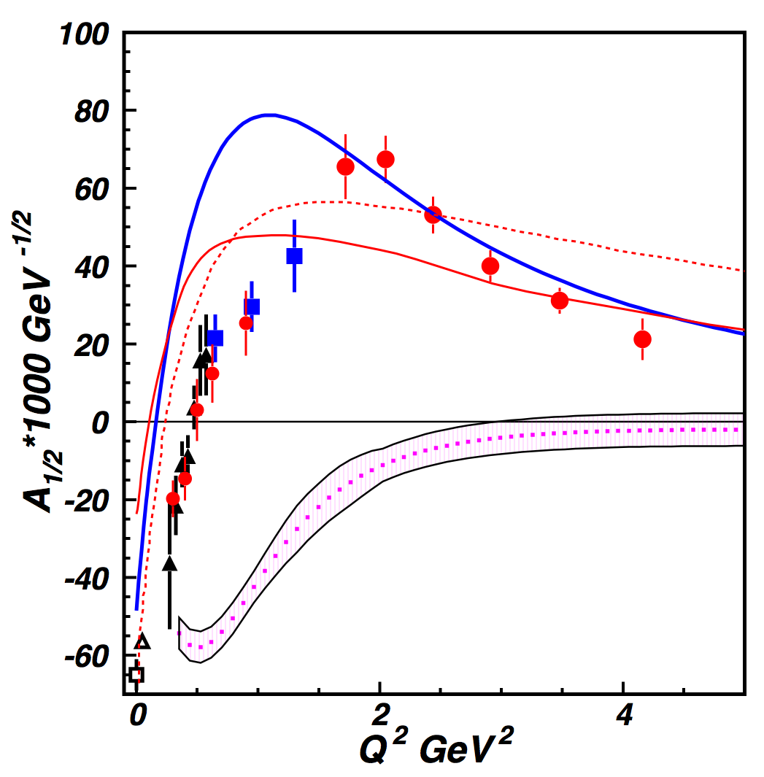

Transition Form Factors are Elucidating Nucleon Structure
The “Roper” Resonance in 2015
Nπ loops to model MB cloud; running quark mass, in LF RQM. I.G. Aznauryan, V. D. Burkert, Phys. Rev. C85, 055202 (2012).
Ns loops to model MB cloud in LF RQM; frozen constituent quark mass. I.T. Obukhovsky, et al., Phys. Rev. D89, 014032 (2014).
Quark core contributions from DSE/QCD
J. Segovia et al., arXiv:1504.04386
MB cloud inferred from the CLAS data
as the difference between the data and quark core
evaluated in DSE/QCD, V. Mokeev et al., arXiv:1509.05460
EFT employing π, ρ, N, N’. T. Bauer,
S. Scherer, L. Tiator, PR C90 (2014) 1, 015201
The structure of the Roper is driven by the interplay of the core of three dressed quarks in the 1st radial excitation and the external meson-baryon cloud.
Notes:
In 2015 we now have a more quantitative understanding of the high Q2 behavior in QCD incorporating the running quark mass in DSE/QCD and LF RQM approaches so that this statement is valid. However, a fully consistent treatment of both the low and the high Q2 region is still lacking.

Slide 30
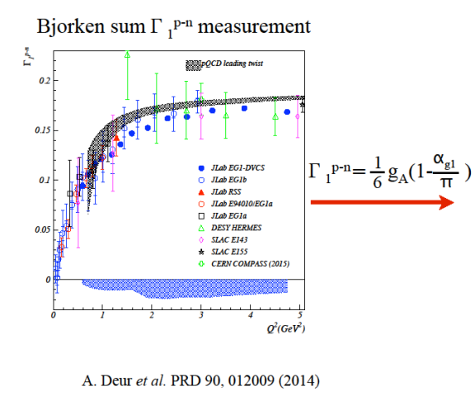
Γ₁^{p-n} Together with the Bjorken Sum Rule Lets Us Measure the Evolution of QCD with Distance (α_{s}^{eff}/π)

Slide 31
Γ₁^{p-n} Together with the Bjorken Sum Rule Lets Us Measure the Evolution of QCD with Distance (α_{s}^{eff}/π)
As Q²→0, the Gerasimov-Drell-Hearn (GDH) Sum Rule Applies
As Q²→∞, the Bjorken Sum Rule defines the Q² behavior

Slide 32
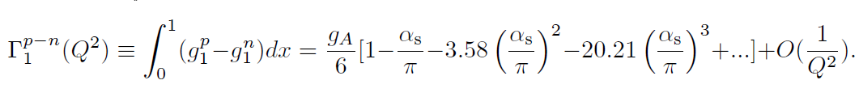
Γ₁^{p-n} Together with the Bjorken Sum Rule Lets Us Measure the Evolution of QCD with Distance (α_{s}^{eff}/π)
As Q²→0, the Gerasimov-Drell-Hearn (GDH) Sum Rule Applies
Anti de Sitter / Conformal Field Theory (AdS/CFT) with no free parameters agrees well with the α_{s} extracted for all but the highest Q² (where it shouldn’t be valid)
Anti de Sitter space: ~space with constant negative curvature
Conformal Field Theory: ~ field theory without scale dependence
As Q²→∞, the Bjorken Sum Rule defines the Q² behavior
A. Deur, S. J.Brodsky, and G. F. de Teramond, Phys. Lett B, 750, 528 (2015)

Slide 33
So Looking Back at Two Decades of Research:
How Well Have We Succeeded In Realizing the Science Goals That Motivated Building CEBAF?
Review them by broad physics topic:
  QCD and the Structure of Hadrons
  Nuclear Structure, Nuclear Dynamics, and Nuclear Astrophysics (of great interest and value, but mostly omitted for this particular audience)
  Fundamental Symmetries
  Given the time, only a few examples from the 173 experiments run are possible – I’ve picked ones I particularly liked, with an emphasis on experiments that were made feasible by the unique capabilities of the accelerator and its experimental equipment and are most relevant to this conference

Slide 34
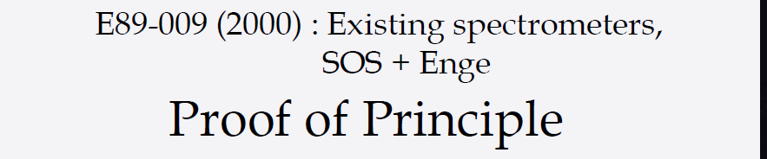
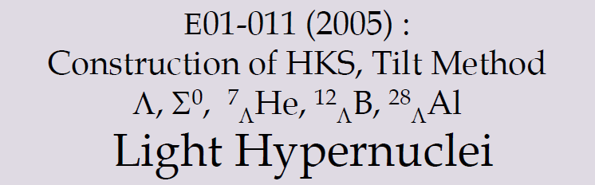
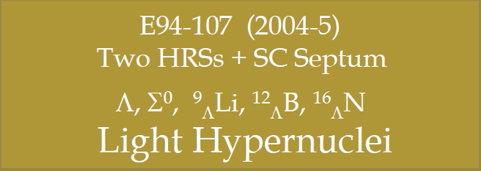
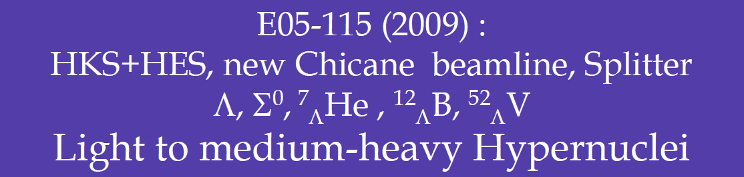
Hypernuclear Experiments at JLab
Publications:
T. Miyoshi, et al., PRL 90, 232502 (2003); L. Yuan, et al., PRC 73, 044607 (2006)
M. Iodice, et al., PRL 99, 052501 (2007); F. Cussano, et al., PRL 103, 202501 (2009)
S. N. Nakamura, et al., PRL 110, 012502 (2013)‘ L. Tang, et al., PRC 90, 034320 (2014)
G. M. bUrciuoli, et al., PRC 91, 034308 (2014)‘ T. Gogami, et al., PRC 93, 034314 (2016)

Slide 35
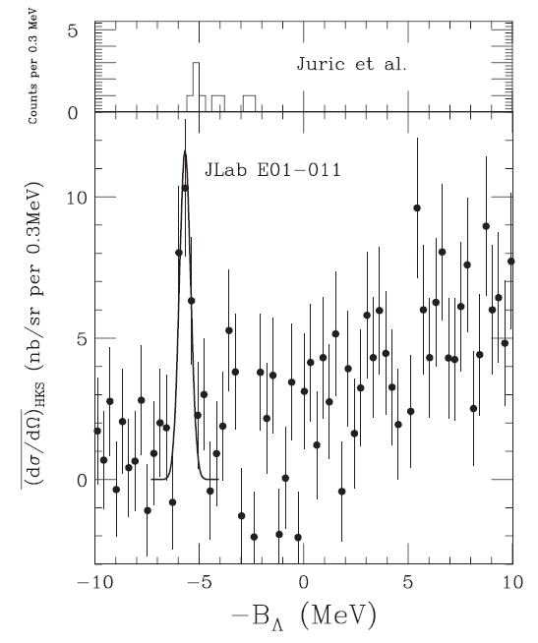


















CSB Interaction Test in A=7 Iso-triplet Comparison
SNN et al., PRL 110, 012502 (2013)
E01-011 (2005)
E05-115 (2009)
T.Gogami, Doctor Thesis (2014) Tohoku Univ.

Slide 36
CSB Interaction Test in A=7 Iso-triplet Comparison
CSB potential is not necessary for A=7
Assumed CSB potential is too naïve or
a problem for A=4 data
⇒ New expts. at MAMI and J-PARC
SNN et al., PRL 110, 012502 (2013)
E01-011 (2005)
E05-115 (2009)
T.Gogami, Doctor Thesis (2014) Tohoku Univ.

Slide 37
Other Examples (if I had time) Would Have Included
Pushing few body (²H, ³H, ³He) elastic form factors and photodisintegration to high-Q² and identifying the distance scale at which our description of nuclei must transition from nucleons interacting via the NN-force and QCD
Using Parity-violating electron scattering to determine the neutron radius in ²⁰⁸Pb
Identifying the link between the EMC effect and local, rather than average densities in the nucleus, and the correlation between the EMC effect and Short Range Correlations in nuclei

Slide 38
So Looking Back at Two Decades of Research:
How Well Have We Succeeded In Realizing the Science Goals That Motivated Building CEBAF?
Review them by broad physics topic:
  QCD and the Structure of Hadrons
  Nuclear Structure, Nuclear Dynamics, and Nuclear Astrophysics
  Fundamental Symmetries
  Given the time, only a few examples from the 173 experiments run are possible – I’ve picked ones I particularly liked, with an emphasis on experiments that were made feasible by the unique capabilities of the accelerator and its experimental equipment and are most relevant to this conference

Slide 39

PrimEx
Precision Measurement of π⁰ Lifetime
Chiral anomaly of QCD predicts exact value of decay width for massless quarks
γ
Γ(π⁰→γγ) = 7.74 ± 0.06(stat.) ± 0.12(syst.) eV
1.7% total uncertainty
π⁰
E02-103, E08-023
Primakoff effect
Primex I: I. Larin et al., Phys. Rev. Lett. 106: 162303 (2011).
Analysis by ITEPMoscow/China Group
Independent analysis by Duke Group expected soon

Slide 40

The Strange Quark Experiments Have Impact Beyond
Our Understanding of Nucleon Structure:
e.g. for C1q couplings and Q_{Weak} in the Standard Model
Qweak Commissioning Run PRL 111,141803 (2013)
Instrumentation paper: NIM A781, 105 (2015)
APV + PVES
Combined Result
SM
C_{1u} = -0.184 ± 0.005
C_{1d} = 0.336 ± 0.005
Correlation. coef. -0.98
(only 1/25th of data)
Q_{W}(p) = -2(2C_{1u} + C_{1d}) = 0.063 ± 0.012
(only 1/25th of data)
SM value = 0.0710(7)
Experimental constraints from
earlier electron scattering
experiments (SLAC D DIS,
Bates C, Mainz Be) roughly fill
the space on this plot
HAPPEx: H, He
G⁰: H,
PVA4: H
SAMPLE: H, D
Q_{W}(n) = -2(C_{1u} + 2C_{1d}) = -0.975 ± 0.010
(only 1/25th of data)
SM value = -0.9890(7)
25x more production data still being analyzed; final result in 2016 (we hope)
Should reduce the PVES ellipse width by about a factor of 5

Slide 41
Q_{Weak} Will Also Test the Running of Sin²θ_{W}
Q^{p}_{W}(p) JLab
(Commissioning;
4% of Qweak Data plus PVES)
Erler Msbar
Recent
Older
Anticipated
Q_{W}(Cs)
APV
Q_{W}(Cs)
APV
Q_{W}(p) JLab
(anticipated final precision)
PVDIS 6 GeV Jlab
(evolved to Z pole)
PVDIS Jlab
(evolved to
Z pole)

Slide 42

Further Precision Tests of Electro-Weak Theory
Are Planned for 12 GeV
MS Theory Curve : J. Erler,
M. J. Ramsey-Musolf et al.,
See Particle Data Group 2010

Slide 43

Many More Results in JPhysG Volume
Published in 2011
Foreword: A Long Decade of Physics
Making the case for Jefferson Lab
Nucleon Form Factors
Strange Vector Form Factors
Unpolarized Structure Functions
Spin Structure Functions
Deeply Virtual Exclusive Processes
Lattice QCD
Results from the N* Program
Transition to Perturbative QCD
Short-Distance Structure of Nuclei
Medium Modifications of Hadrons & Partons
Searches for Physics Beyond the SM
Hypernuclear Spectroscopy
The Free Electron Laser Program
CEBAF Accelerator Achievements
and even more in the published
(and to be published) literature

Slide 44
Key Reasons for the Success of JLab
The novel CEBAF accelerator and its experimental equipment provided a new research tool with dramatically expanded “reach” over its predecessors (New Eyes…..)
The Beam Quality was simply outstanding
The International User community and laboratory staff has been innovative and committed to exploiting CEBAF to the fullest extent possible (and I’m delighted to see that this is continuing with the 12 GeV Upgrade Program)
We have enjoyed strong support from DOE for running the facility and from DOE, from NSF, and from many other agencies around the world supporting the user community and its activities here
A remarkable cadre of graduate students and postdocs
Thoughtful advice on the science program from our PACs, the theory group, reviews, and many others over the years

Slide 45
What Lessons Can We Take from This Experience?
Carefully work through what is needed to carry out the identifiable essential science before you start building
  But flexibility matters, as you cannot predict where the science will take you! A large fraction of the 173 experiments run were not foreseen in the initial planning for the accelerator and experimental equipment
  This was done in planning for 12 GeV (we’ll soon see if we got it right)
  It is in process now for a future EIC – don’t stint on the effort
Stand up for what we believe is essential for our science and be prepared to explain it fully to your colleagues in nuclear physics, to the larger science community, and to the public
Remember it takes a long time to go from dreams to reality on this cost scale; the younger generation must be enthusiastic and patient, and the older generation must prepare the way for their successors

Slide 46






Coming Next: The JLab 12 GeV Upgrade
Major Programs in Six Areas
The End
(which is, of course, the beginning of
12 GeV and beyond)
The Hadron spectra as probes of QCD
(GluEx and heavy baryon and meson spectroscopy)
The transverse structure of the hadrons
(Elastic and transition Form Factors)
The longitudinal structure of the hadrons
(Unpolarized and polarized parton distribution functions)
The 3D structure of the hadrons
(Generalized Parton Distributions and Transverse Momentum Distributions)
Hadrons and cold nuclear matter
(Medium modification of the nucleons, quark hadronization, N-N correlations, hypernuclear spectroscopy, few-body experiments)
Low-energy tests of the Standard Model and Fundamental Symmetries
(Møller, PVDIS, PRIMEX, …..)
And other science
we can’t foresee

Slide 47
Coming Next: The JLab 12 GeV Upgrade
Major Programs in Six Areas
The Hadron spectra as probes of QCD
(GluEx and heavy baryon and meson spectroscopy)
The transverse structure of the hadrons
(Elastic and transition Form Factors)
The longitudinal structure of the hadrons
(Unpolarized and polarized parton distribution functions)
The 3D structure of the hadrons
(Generalized Parton Distributions and Transverse Momentum Distributions)
Hadrons and cold nuclear matter
(Medium modification of the nucleons, quark hadronization, N-N correlations, hypernuclear spectroscopy, few-body experiments)
Low-energy tests of the Standard Model and Fundamental Symmetries
(Møller, PVDIS, PRIMEX, …..)
And other science
we can’t foresee

Slide 49




An Early Result: eD Elastic Scattering
Calculations by Van Orden,
Devine, and Gross describe
the data well to Q² ~2 (GeV/c)²
(i.e. describe the deuteron to
distance scales of ~0.5 fm)
Combined data ⇒ Deuteron’s
Intrinsic Shape

Slide 50

JLab d(γ,p) Data Identified the Transition to the Quark-Gluon Description
Conventional
Nuclear Theory
Deuteron Photodisintegration probes momenta well beyond those accessible in (e,e’) (at 90º, E_{γ}=1 GeV ⇔ Q²= 4 GeV²/c²)
Conventional nuclear theory ( ‒ ‒ ‒ ‒ ) unable to reproduce the data above ~1 GeV
Scaling behavior (dσ/dt ∝ s⁻¹¹) sets in at a consistent t = − 1.37 (GeV/c)² (see ↑ )
⇒ seeing underlying quark-gluon description for scales below ~0.1 fm
dσ/dt ~ f(θ_{cm})/s^{n-2}
Where n=n_{A} + n_{B} + n_{C} + n_{D}
s=(p_{A}+p_{B})², t=(p_{A}-p_{C})²
γd → pn ⇔ n=13
p_{A}
p_{C}
p_{B}
p_{D}
QCD inspired models provide a reasonable
description of the high Eγ behaviour.
Transition confirmed in follow-on higher
accuracy experiment w/ CLAS that studied
this region in more detail

Slide 51



Data Now Includes 3- and 4-Body Elastic Scattering
²H
³H and ³He
Isoscalar Isovector
Calculations in Covariant Spectator Theory (CST) by Marcucci, et al., J. Phys. G: Nucl. Part. Phys. 43 (2016) 023002 and references therein give a good description of the charge form factor data to
~2½ (GeV/c)² (i.e. to distance scales of ~0.4 fm)

Slide 52


Lead (²⁰⁸Pb) Radius Experiment : PREx
Elastic Scattering Parity-Violating Asymmetry
Z⁰ : Clean Probe Couples Mainly to Neutrons
Applications : Nuclear Physics, Neutron Stars,
Atomic Parity, Heavy Ion Collisions
PREX
Anticipated error bar
(12 GeV experiment)
PREX
Relativistic mean field
Nonrelativistic skyrme
A neutron skin of 0.2 fm or more has implications for our understanding of neutron stars and their ultimate fate
The Lead (²⁰⁸Pb) Radius Experiment (PREX) finds neutron radius larger than proton radius by +0.35 fm (+0.15, -0.17).
This result provides model-independent confirmation of the existence of a neutron skin relevant for neutron star calculations.
Follow-up experiment to reduce uncertainties by factor of 3 and pin down symmetry energy in EOS.

Slide 53



JLab Data on the EMC Effect in Very Light Nuclei
EMC effect scales with average nuclear density if we ignore Be
?
Be = 2 α clusters (⁴He nuclei) + “extra” neutron
Suggests EMC effect depends on local nuclear environment
dR/dx = slope of line fit to A/D ratio over region x=0.3 to 0.7
Nuclear density extracted from ab initio GFMC calculation – scaled by (A-1)/A to remove contribution to density from “struck” nucleon
C. Seely, A. Daniel, et al, PRL 103, 202301 (2009)

Slide 54

Extend DIS from Quarks in Nuclei to x_{B}>1 to Access Short Range Correlations
and
then
r(A,³He) = a_{2n}(A)/a_{2n}(³He)
a_{2n} 2N-probability above k_{Fermi}
The observed scaling means that the electrons probe the high-momentum nucleons in the 2N-SRC phase, and the scaling factors determine the per-nucleon probability of the 2N-SRC phase in nuclei with A>3 relative to ³He
Analysis shows that 3-N SRC
are 10 times smaller than 2-N SRC.
K. Sh. Egiyan et al., PRC 68 (2003) 014313; PRL 96 (2006) 082501
At any moment, the number of 2-nucleon SRC
are 0.3, 1.2 and 6.7 in ⁴He, ¹²C and ⁵⁶Fe, respectively
Originally done with SLAC data
by D.B. Day et al., PRL 59 (1987) 427

Slide 55

Higher Precision, Higher Q² Follow-on Experiment
E02-019: 2N correlations in A/D ratios
18° data
<Q²>=2.72GeV²
R(A, D)
w/ further effort (E08-014) in x>2 region
to resolve apparent differences
³He | 2.14(4) | 1.93(10)
⁴He | 3.66(7) | 3.02(17)
Be | 4.00(8) | 3.37(17)
C | 4.88(10) | 4.00(24)
Cu | 5.37(11) | 4.33(28)
Au | 5.34(11) | 4.26(29)
Correct for inelastics and high p_{M} tail due to pair motion to get relative 2N-SRC contribution . Ratios are in excellent agreement with CLAS results for 2N correlations
Raw cross
section ratio
N. Fomin, et al, Phys. Rev. Lett. 108, 092502 (2012)

Slide 56


Short-Range Correlations (SRC) and European Muon Collaboration (EMC) Effect Are Correlated
EMC Slopes
0.35 ≤ X_{B} ≤ 0.7
Fomin et al, PRL 108, 092502 (2012)
SRC Scaling factors X_{B} ≥ 1.4
SRC: nucleons see strong repulsive core at short distances
EMC effect: quark momentum in nucleus is altered
Weinstein et al, PRL 106, 052301 (2011)

Slide 58
This Success Also Owes a Great Deal to Some Early Decisions
4 GeV vs 2 GeV (Barnes Panel) and Upgradable (Bromley Panel) (both with a lot of community input)
  Access to DIS regime, increased kinematic reach, higher excitation (and form factors) in N* physics, higher counting rates at moderate Q², …..
  Evolved from 4 → 6 GeV simply and has permitted the upgrade to 12 GeV to be done at a very small fraction of the cost of a 12 GeV accelerator
The switch from the original linac-stretcher ring design to the SRF recyclotron we have today (HG).
  Superb beam quality, supported parity experiments, multiple energies simultaneously w/ large dynamic range and no sacrifice in beam quality, ,,,,,,,,,
The inclusion of a third hall w/ the CLAS detector, resisting pressure for only 2 halls (HG), and
The addition of polarized electrons to the arsenal (JDW)

