Slide 1

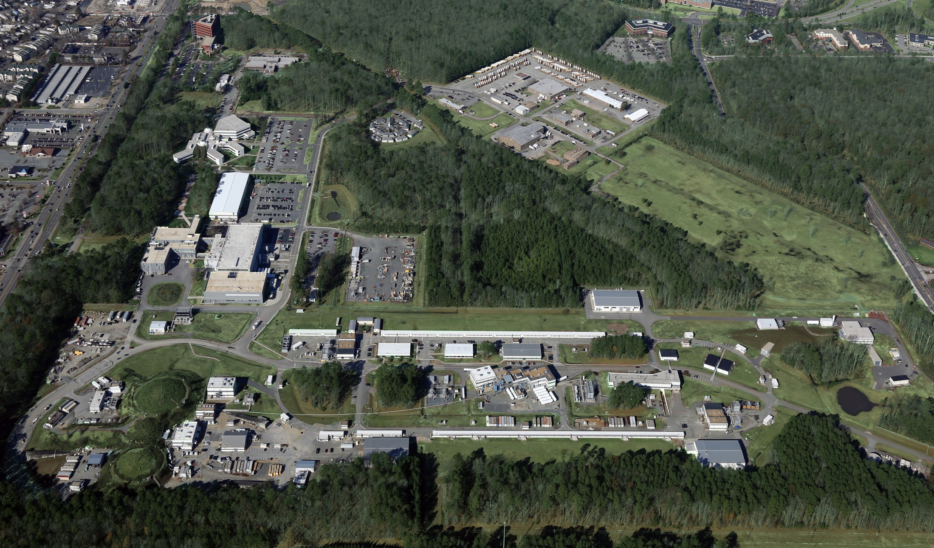
CLAS12 at Jefferson Lab
Latifa Elouadrhiri
June 4, 2016

Slide 2
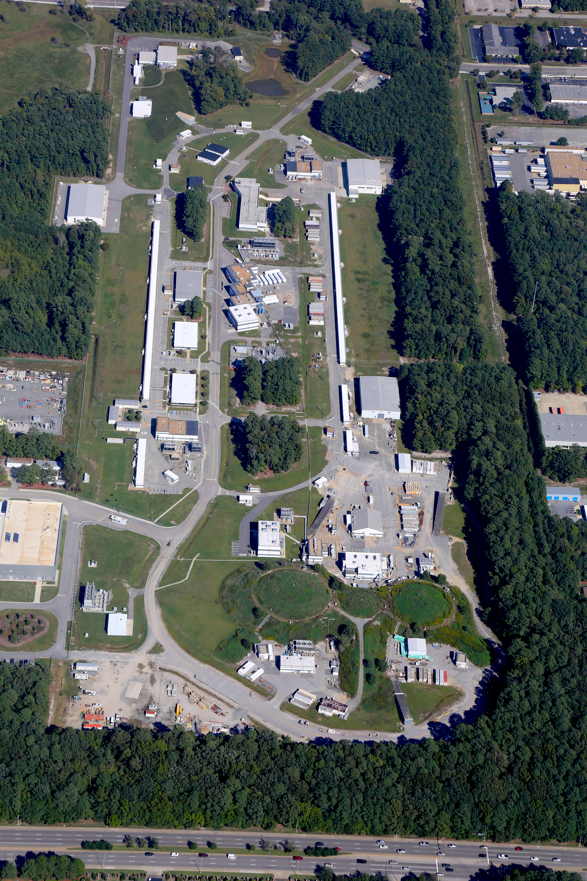
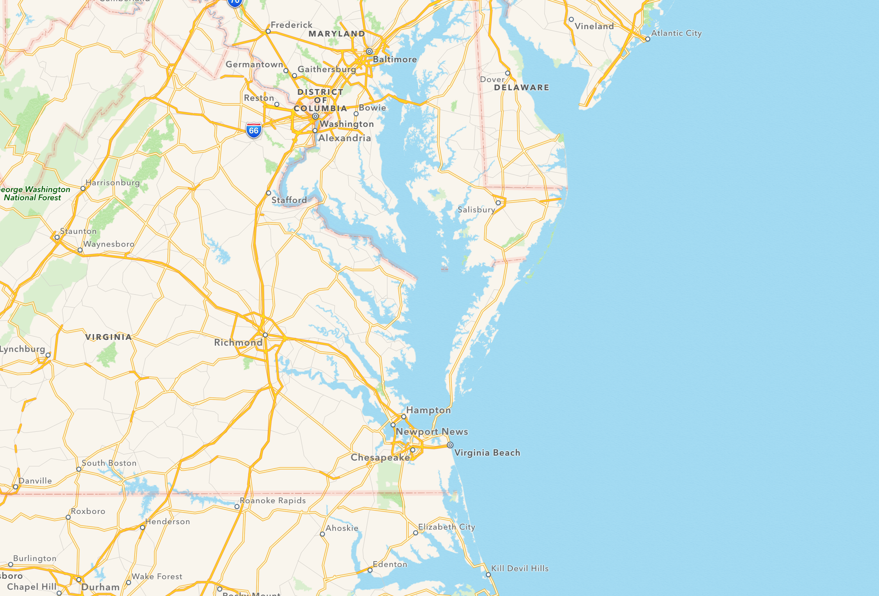
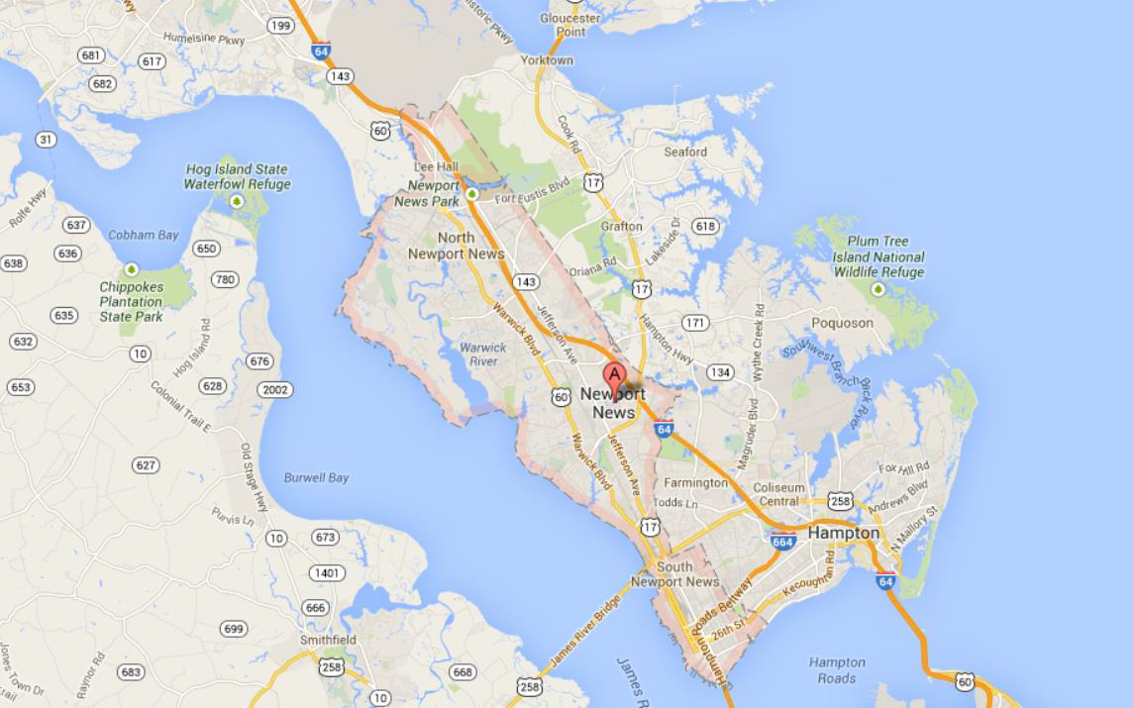
JLab Electron Accelerator Site
Continuous Electron Beam Accelerator:
- Continuous wave electron beam
Simultaneous beam in all halls
Beam energy up to 11 & 12 GeV
Beam current I_{B} = 100pA – 100μA
- Electron beam polarization > 85%

Slide 3
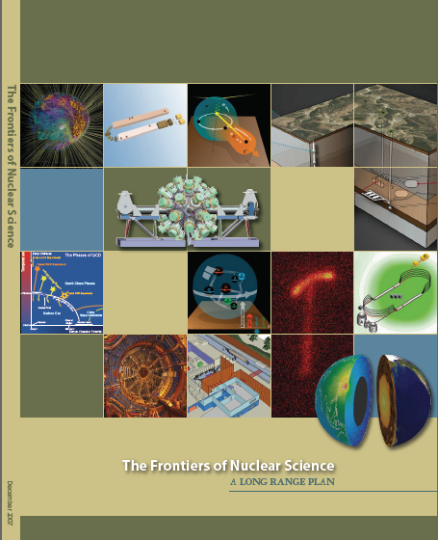
12 GeV Upgrade Project
Completion of the
12 GeV CEBAF Upgrade was ranked the highest priority in the 2007 NSAC Long Range Plan.
Upgrade is designed to build on existing facility: vast majority of accelerator and experimental equipment have continued use.
New Hall
Upgrade arc magnets
and supplies
Add 5 cryomodules
20 cryomodules
CHL upgrade
Add arc
20 cryomodules
TPC = $338M
ETC = ~$8M
Add 5 cryomodules
Project Scope (~98% complete):
Doubling the accelerator beam energy - DONE
New experimental Hall D and beam line - DONE
Civil construction including Utilities - DONE
Upgrades to Experimental Halls B & C - ~96%
Enhanced capabilities
in existing Halls
Maintain capability to deliver lower pass beam energies: 2.2, 4.4, 6.6….

Slide 4

2015 NSAC Long Range Plan
NSAC = Nuclear Science Advisory Committee
Advise DOE and NSF on future of Nuclear Physics program every 5-7 years
Four recommendations
Two initiatives
Recommend modest budget growth at 4.5% per year

Slide 5
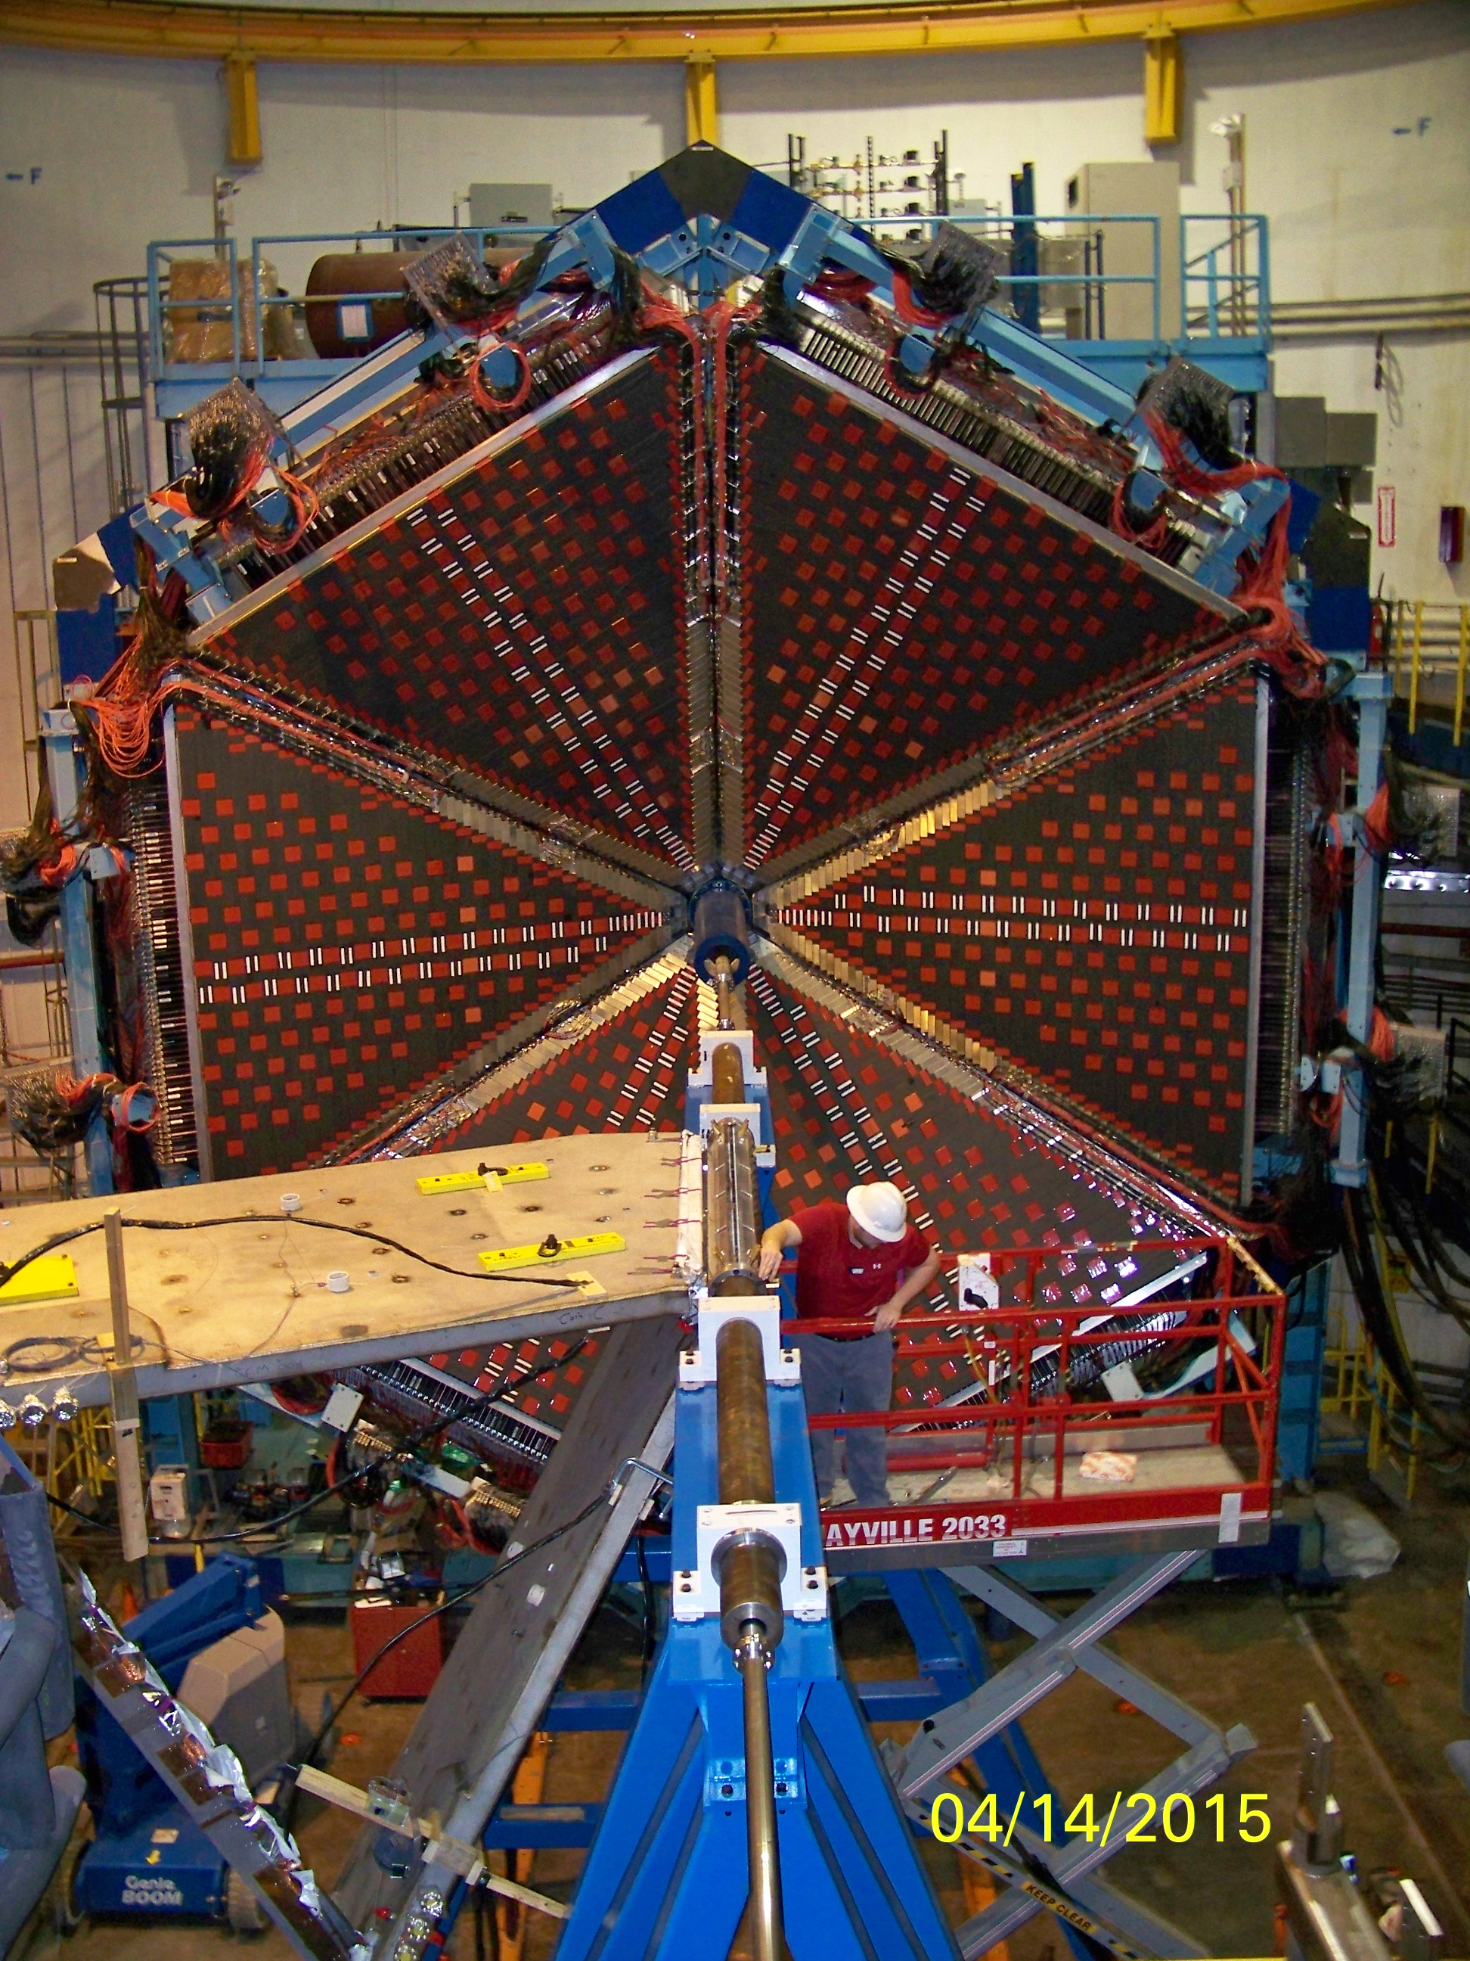
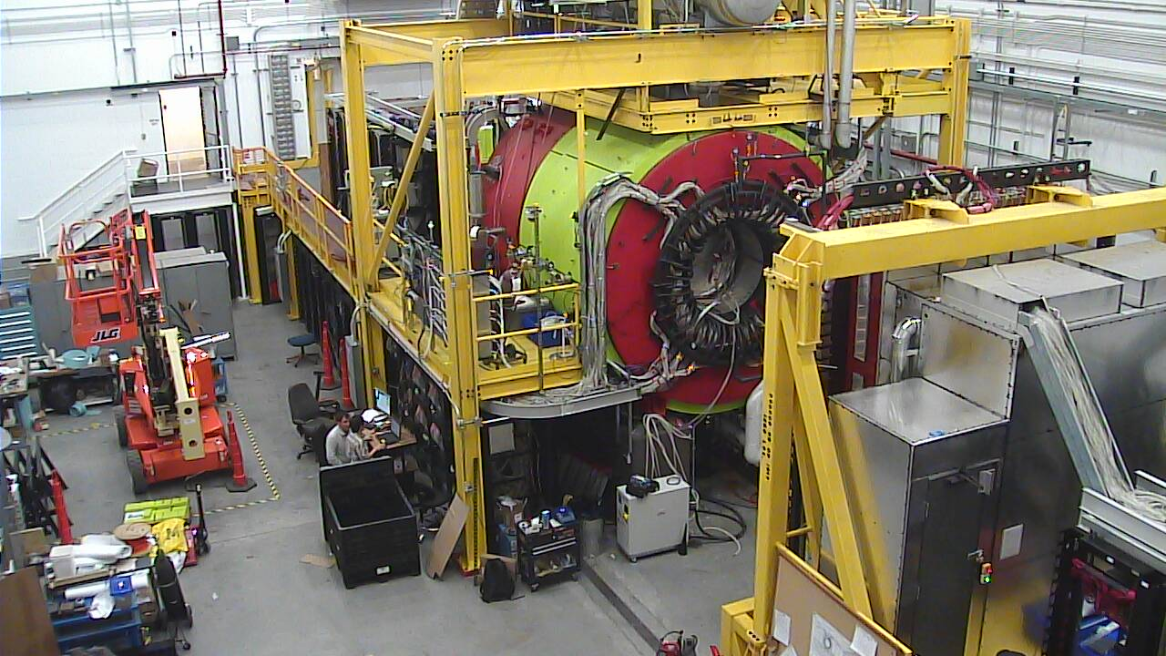
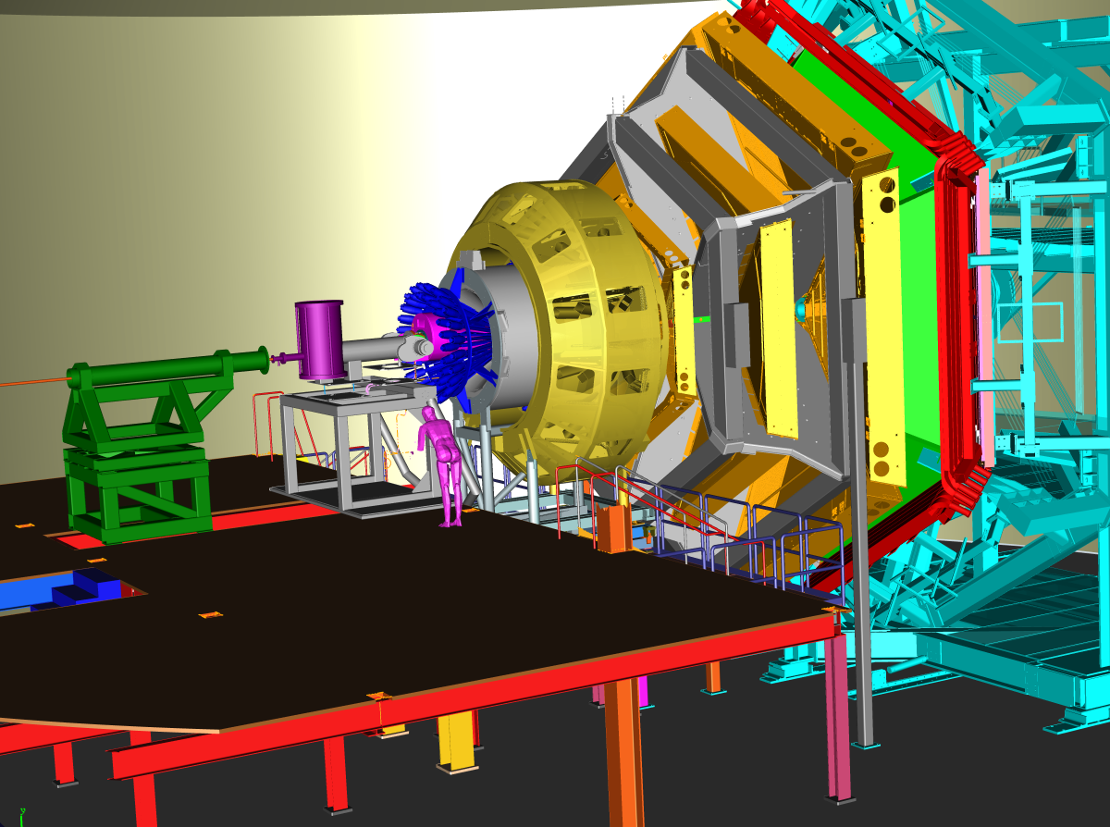
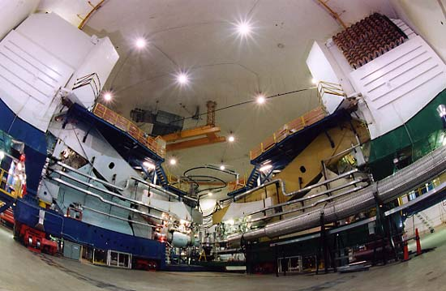
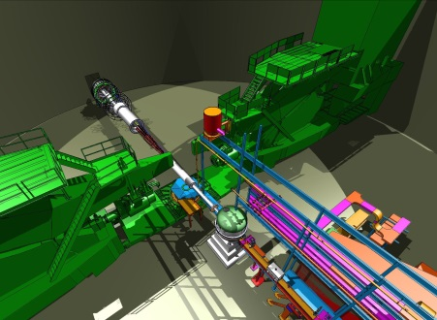
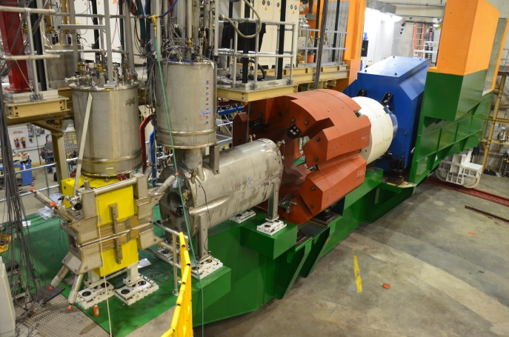
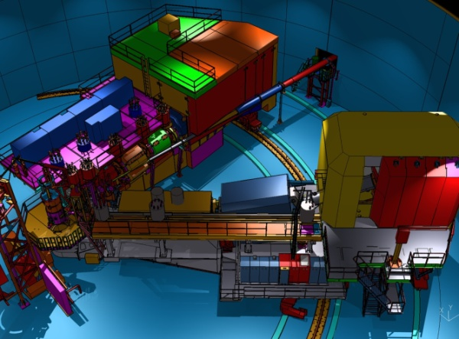
12 GeV Scientific Capabilities
Hall B – understanding nucleon structure via generalized parton distributions
Hall D – exploring origin of confinement by studying exotic mesons
Hall A – form factors, future new experiments (e.g., SoLID and MOLLER)
Hall C – precision determination of valence quark properties in nucleons/nuclei
Notes:
5
Note BSM not included in project

Slide 6



The CLAS12
Science Program
Outline
Overview
Gluonic hadrons
Nucleon structure
Nucleon tomography
Summary

Slide 7
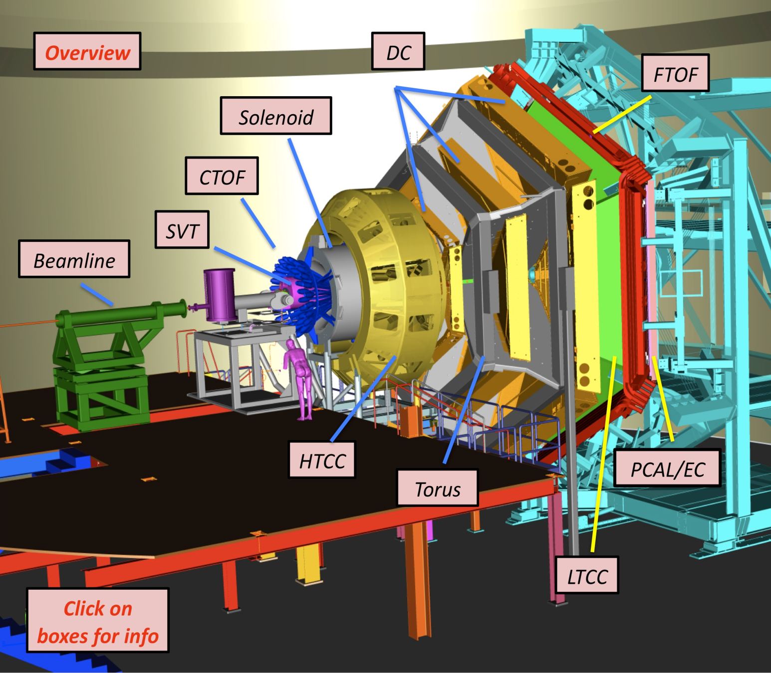
CLAS12 Technical Scope
Forward Detector (FD)
  - TORUS magnet (6 coils)
  HT Cherenkov Counter
  Drift Chamber System
  LT Cherenkov Counter
  Forward ToF System
  Pre-Shower Calorimeter
  E.M. Calorimeter
Central Detector (CD)
  SOLENOID Magnet
  Barrel Silicon Tracker
  Central Time-of-Flight
Beamline
  Targets
  Moller Polarimeter
  Photon Energy Tagger
Upgrades to the baseline
- MicroMegas
  Central Neutron Detector
  Forward Tagger
  RICH Detector (2 sectors)
  Polarized Target (long.)

Slide 8
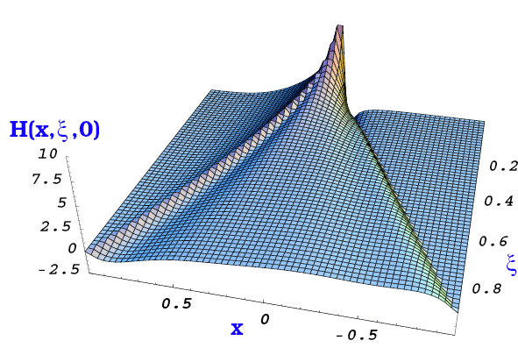
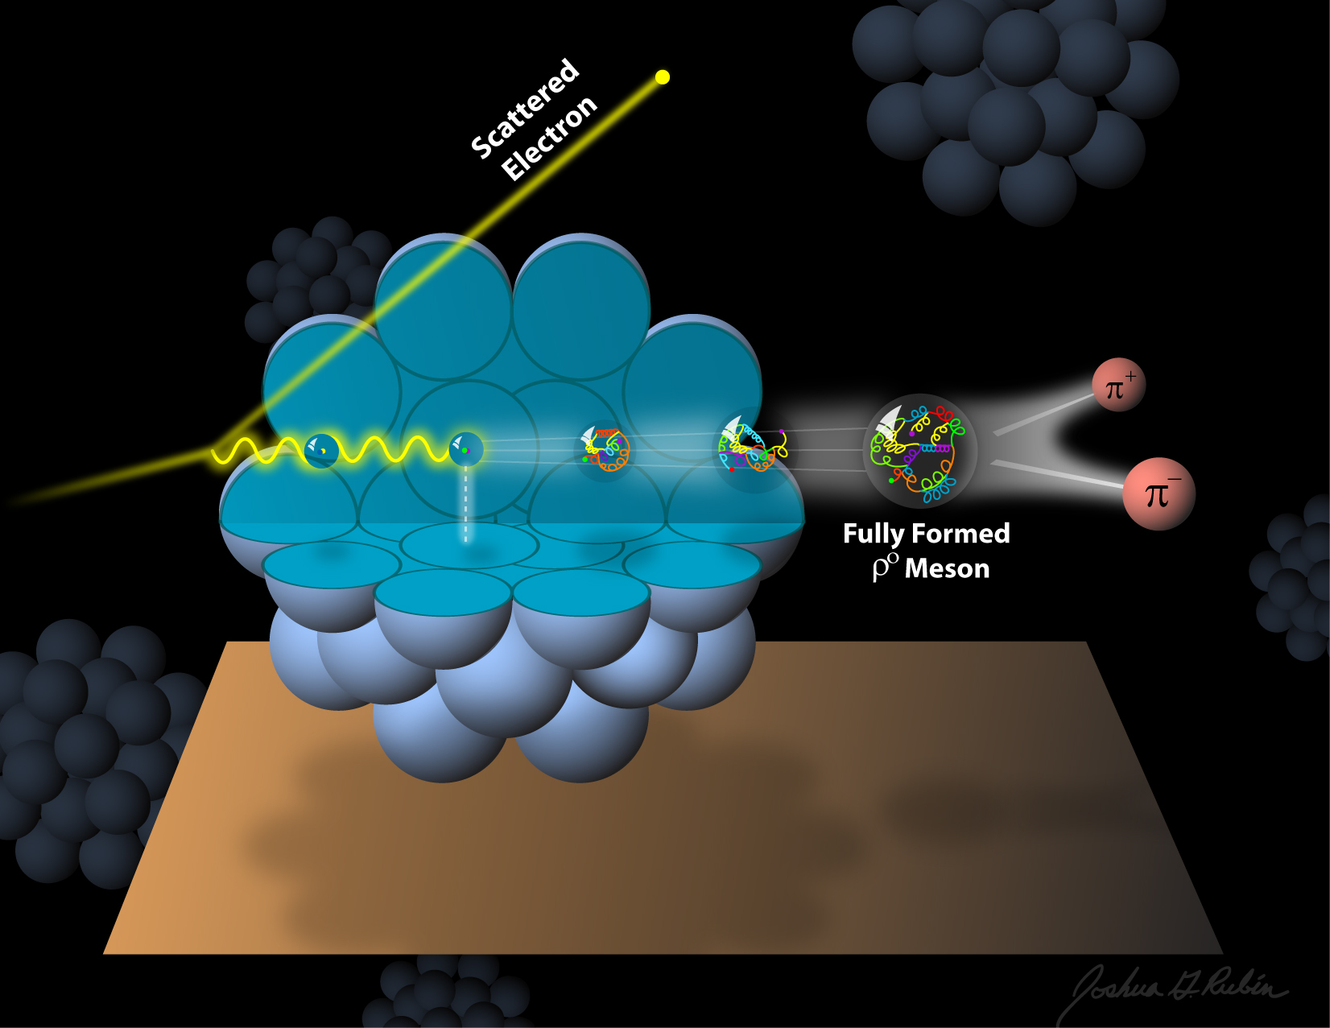
The science program with CLAS12
The 3D structure of the nucleon – from form factors and PDFs to GPDs and TMDs
The strong interaction in nuclei – evolution of quark hadronization, nuclear transparency of hadrons
Quark confinement and the role of the glue in meson and baryon spectroscopy

Slide 9
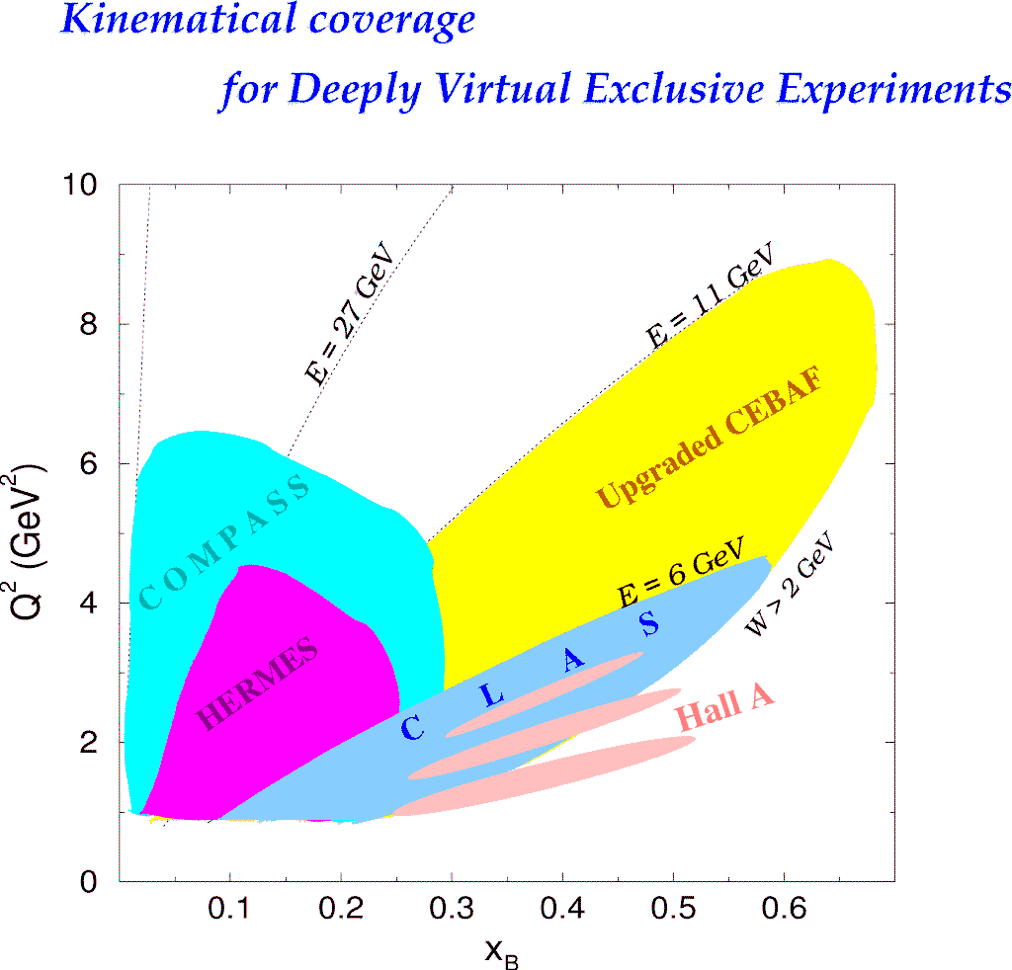
Kinematic coverage of DVCS
H1, ZEUS
Study of high x_{B} domain
requires high luminosity
H1, ZEUS
27 GeV
11 GeV
200 GeV
11 GeV
JLab Upgrade
JLab @ 12 GeV
COMPASS
W = 2 GeV
HERMES
The 12 GeV Upgrade is well matched to studies in the valence quark regime.
0.7
Notes:
The kinematics range that can be covered in exclusive processes with high precision data is shown with this yellow area. This will be the only accelerator where rhe valence quark regime can be fully covered with high precision data. other existing machines, even at much higher energies can not cover this regime due to the much lower luminosity at HERA or COMPASS.
My own personal view is that several experiments, in some of which I participated, eg EMC and E665, but also HERA, the physics, especially at high x was limited by the lack of luminosity.
Jefferson Lab has luminosity, also good spin control in both beam and targets.
So high x is (still) there for the taking and given 12 GeV, it is accessible kinematically.

Slide 10
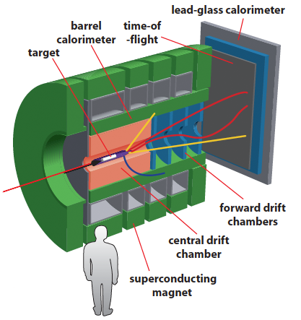
CLAS12 and GlueX
Meson spectroscopy is one of the main topics that will be studied with the Jlab 12 GeV upgrade. Key elements are:
High intensity tagged photon beams
Detectors with large acceptance and good particle identification capabilities
GlueX in Hall D CLAS12 in Hall B

Slide 11
Meson Spectroscopy with CLAS12
Quasi-real photoproduction on proton target:
Detection of multiparticle final state from meson decay in the large acceptance spectrometer CLAS12
Detection of the scattered electron for the tagging of the quasi-real photon in the novel Forward Tagger
Electromagnetic calorimeter (PbWO)
Physics goals:
Detailed mapping of the meson spectrum up to 2.5 GeV
Search for exotics
Micromegas Tracker
Scintillation Hodoscope

Slide 12
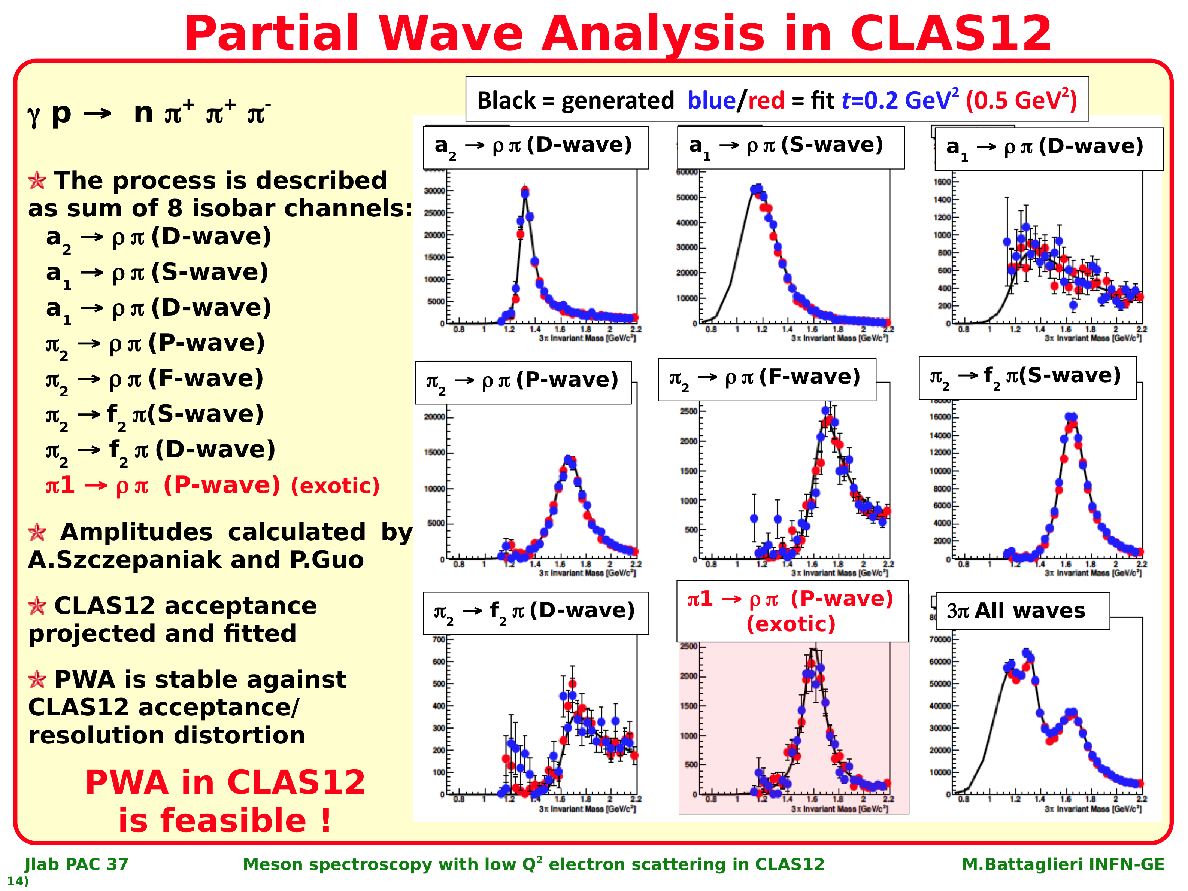
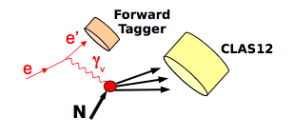
Meson spectroscopy & Forward Photon Tagger
Generated/reconstructed waves
High luminosity – equivalent flux N_{γ}~5*10⁸s⁻¹ on 5cm lH₂ target L=10³⁵cm⁻²s⁻¹
Events generated in specific partial waves, tracked through detector system and reconstructed, retain their initial partial wave contents..

Slide 13
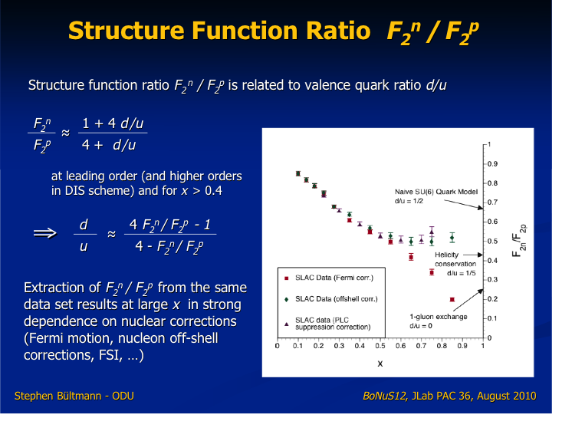
DIS structure functions and d_{v}(x)/u_{v}(x)
d(x)/u(x) poorly constrained at x > 0.5 due to uncertainty in nuclear corrections
F₂^{n}
1+4d/u
F₂^{p}
≈
4+ d/u

Slide 14
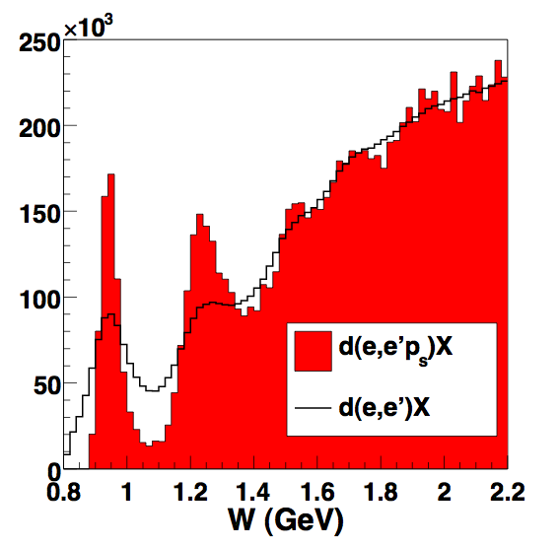
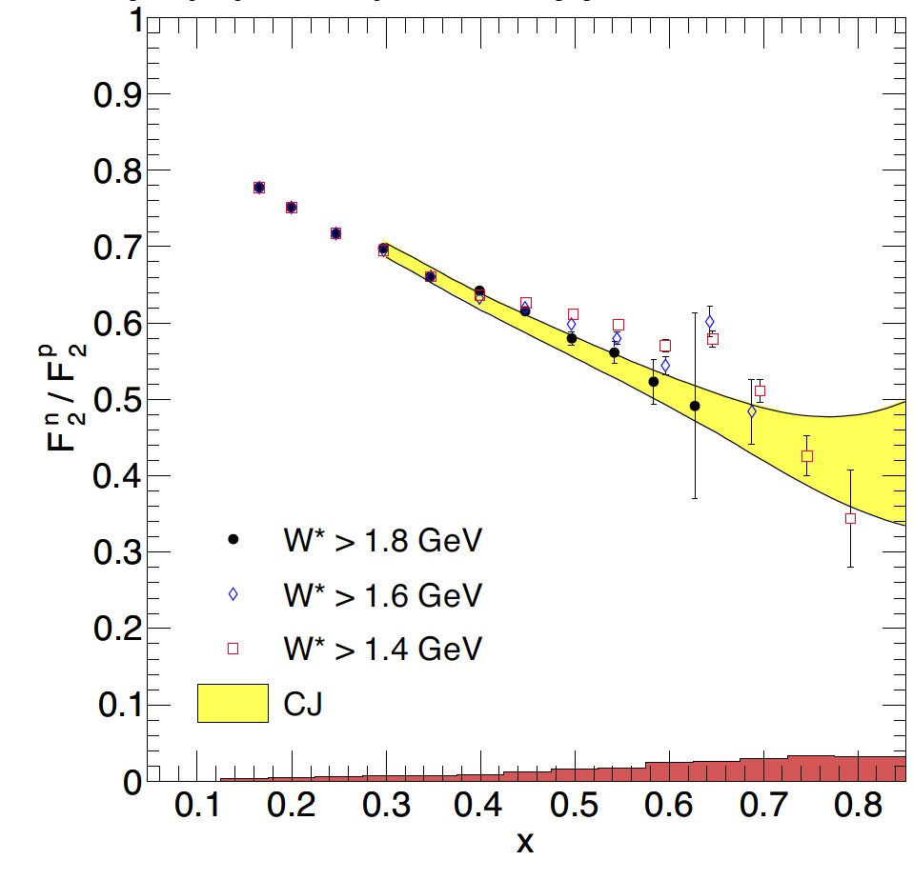
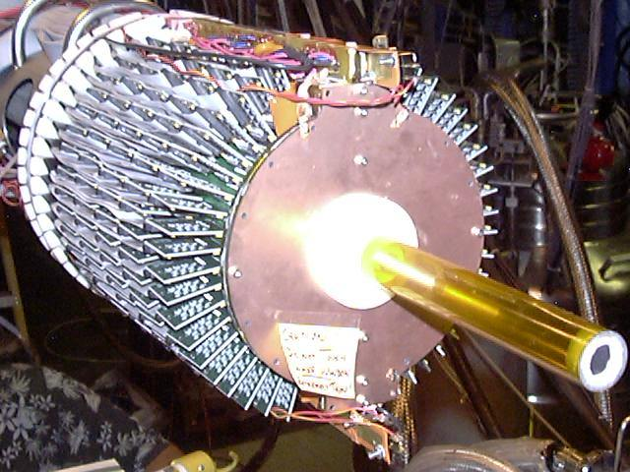
Neutron structure and quark distributions
F₂^{n}/F₂^{p} ratio by tagging almost unbound neutrons using detection of low momentum protons in a radial TPC.
E12-10-102
e⁻D→e⁻p_{s}X
N(1680)
n
N(1520)
Δ
e⁻
n
e⁻
p
p_{s}
>70MeV/c
BONUS Detector
5 Tesla
mag. field
First model-independent measurement of F₂^{n}/F₂^{p}
Projected results for d(x)/u(x) for 12 GeV experiment.
Notes:
One of the unresolved issues in neutron structure functions studies at high Bjorken x is the correction for the nuclear binding effect in deuteron. Different corrections have resulted in vastly different results. A model-independent way is to tag the neutron by measuring the spectator proton to very low momentum using, e.g. a gas target and a low density tracking detector. Protons with momentum down to 70 MeV/c (T=2.5MeV) must be detected. The corrections for the neutron momentum in deuteron is shown in this graph. The elastic peak and the resonance structure show up clearly. The corrected ratio F2n/F2p is shown with the red points. The ratio of d-quark to u-quark distribution functions is shown here. The maximum xB is limited by the beam energy of 5.2 GeV. However, the trend is to rule out the scalar diquark model. Future experiments at the 12GeV upgrade will extend this range up to 0.9.

Slide 15
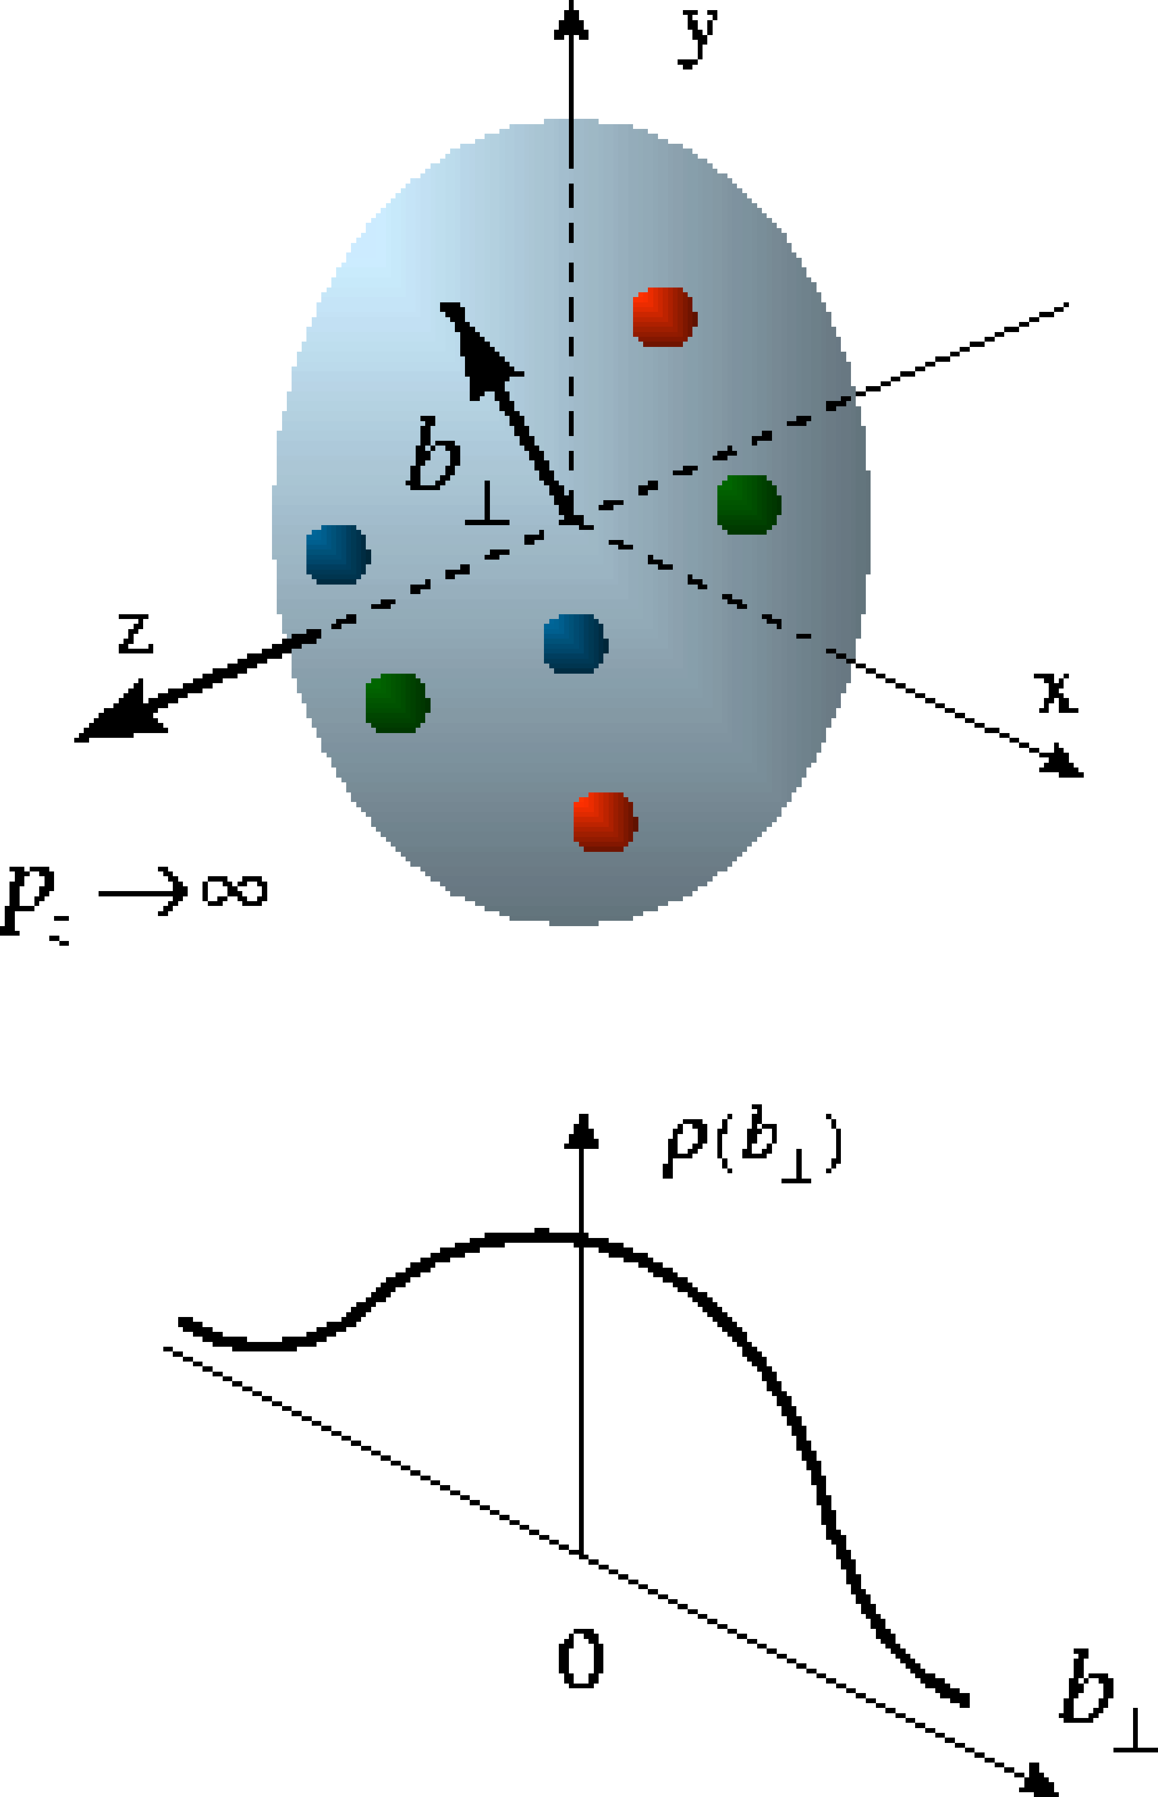
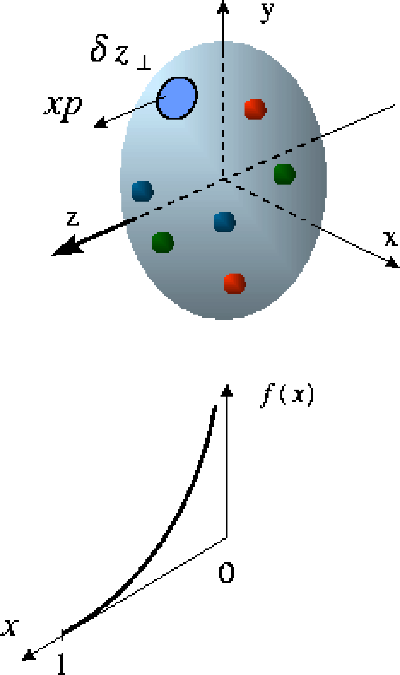
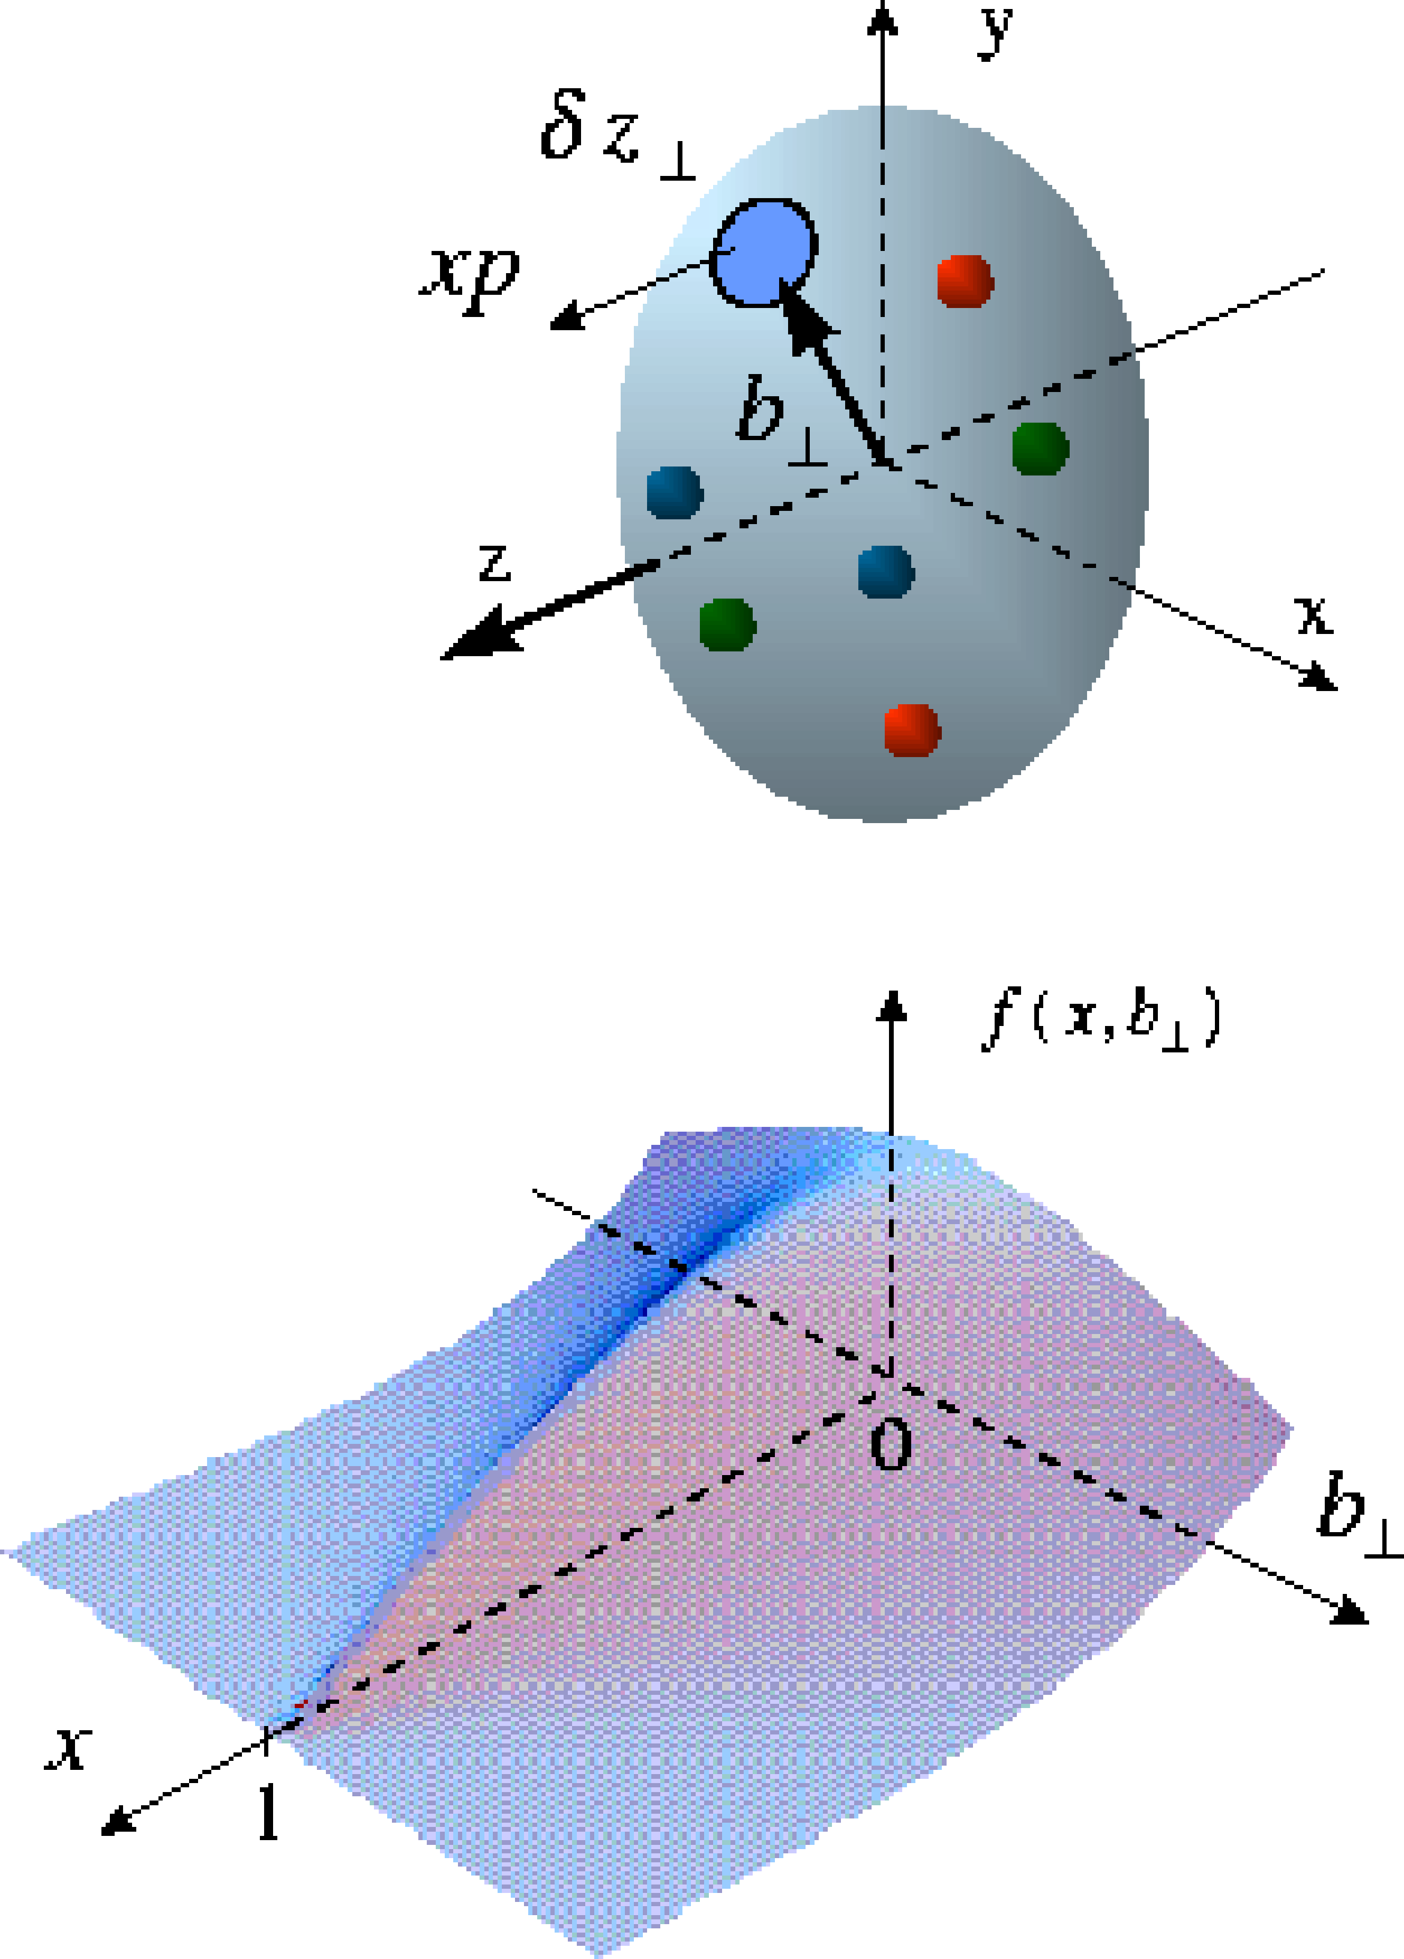
Generalized Parton Distributions (GPDs)
D. Mueller, X. Ji, A. Radyushkin,(1994-1997),…
M. Burkardt, A. Belitsky (2000)…
The size and structure of proton.
Proton form factors, transverse charge and current distributions
Nobel prize 1961- R. Hofstadter
Internal constituents of the nucleon
Quark longitudinal momentum and helicity distributions
Nobel prize 1990 - J. Friedman,
H. Kendall, R. Taylor
GPDs connect the quark distribution in transverse space and longitudinal momentum

Slide 16
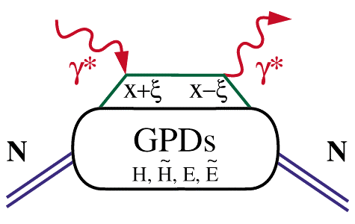
Deeply Virtual Compton Scattering & GPDs
Deeply Virtual Compton Scattering (DVCS)
hard vertices
γ
x – longitudinal quark
momentum fraction
x+ξ
x-ξ
2ξ – longitudinal
momentum transfer
–t – Fourier conjugate
to transverse impact
parameter
t
GPDs depend on 3 variables, e.g. H(x, ξ, t). They describe
the internal nucleon dynamics.

Slide 17
Link to DIS and Elastic Form Factors
Form factors (sum rules)
1
∑
[
]
∫
dx
H
q
(
x
,
ξ
,
t
)
=
F₁
(
t
) Dirac f.f.
DIS at
ξ
=t=0
q
1
∑
[
]
∫
dx
E
q
(
x
,
ξ
,
t
)
=
F₂
(
t
) Pauli f.f.
H
q
(
x
,
0
,
0
)
=
q
(
x
)
q
~
1
~
1
~
H
q
(
x
,
0
,
0
)
=
Δ
q
(
x
)
∫
dx
H
q
(
x
,
ξ
,
t
)
=
G
(
t
)
,
∫
dx
E
q
(
x
,
ξ
,
t
)
=
G
(
t
)
A
,
q
P
,
q
−
1
−
1
~
~
ξ
H
q
,
E
q
,
H
q
,
E
q
(
x
,
,
t
)
Angular Momentum Sum Rule
1
1
1
[
]
=
− J ^{G} =
∫
ξ
+
ξ
J ^{q}
xdx
H
^{q}(
x
,
,
0
)
E
^{q}(
x
,
,
0
)
2
2
−
1
X. Ji, Phy.Rev.Lett.78,610(1997)

Slide 18
Generalized Parton Distributions
(Quantum phase-space quark distribution in the nucleon)
Polarized DVCS directly probes GPDs
Integrate over momentum space
Sensitivity to GPD
~
Generalized Parton Distributions (GPD) H, H, E, E
UP
LP
TP
H, H, E
~
~
Nucleon polarization
~
H, H, E
3D nucleon imaging in transverse coordinate and longitudinal momentum space
E, H

Slide 19
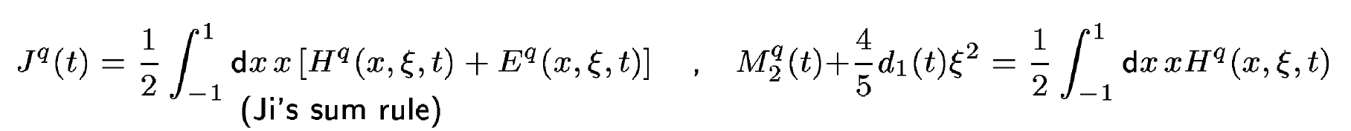
Physical content of GPD E & H
Nucleon matrix element of the Energy-Momentum Tensor of QCD contains 3 scalar form factor:
M₂(t) : Mass distribution inside the nucleon
J (t) : Angular momentum distribution
d₁(t) : Forces and pressure distribution
Directly measured in elastic
graviton-proton scattering!
GPDs are related to these form factors through 2nd moments
Notes:
The nucleon matrix element of the energy-momentum tensor is known to contain 3 form factors (R. Pagels, 1965). For a long time they were of little interest as the only known process where they could be directly measured is elastic scattering of gravitons off the nucleon. However, these form factors appear as moments of the unpolarized GPDs as shown here. The quark angular momentum in the nucleon is given by the 2nd moment of the sum of GPD H and E. The mass and pressure distribution of the quarks are given by the 2nd moment of H where the pressure is probed by parameter xi.

Slide 20
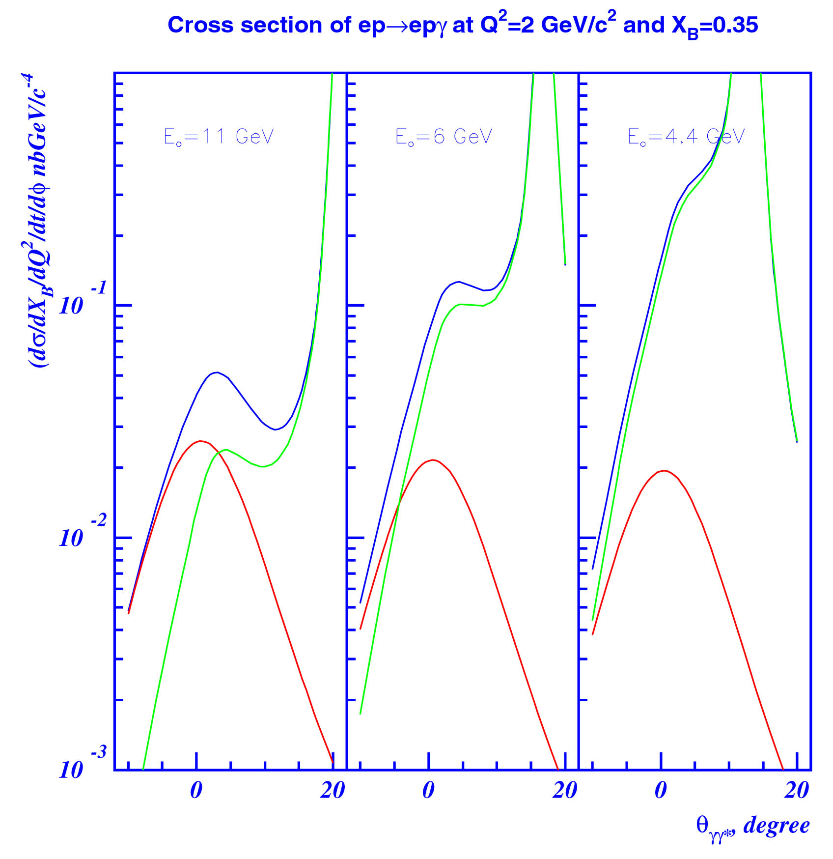
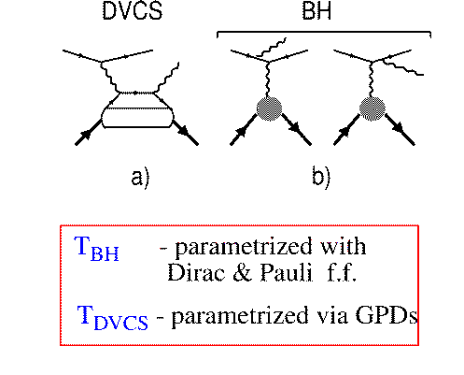
Accessing GPDs Through DVCS
GPDs are universal, they can be
determined in any suitable process
d⁴σ
~ |T^{DVCS} + T^{BH}|²
E_{o} = 11 GeV
dQ²dx_{B}dtdφ
E_{o} = 6 GeV
E_{o} = 4 GeV
DVCS
BH
BH
T^{BH :} given by elastic form factors
T^{DVCS}: determined by GPDs
DVCS
BH-DVCS interference generates
beam and target asymmetries that carry the nucleon structure information.

Slide 21
Accessing GPDs through polarization
σ⁺ − σ⁻
σ⁺ + σ⁻
Δσ
2σ
A =
=
Polarized beam, unpolarized target:
~
H
Δσ_{LU} ~ sinφIm{F₁H + ξ(F₁+F₂)H +kF₂E}dφ
Kinematically suppressed
ξ = x_{B}/(2-x_{B})
k = t/4M²
Unpolarized beam, longitudinal target:
~
~
Δσ_{UL} ~ sinφIm{F₁H+ξ(F₁+F₂)(H +ξ/(1+ξ)E) -.. }dφ
H
Kinematically suppressed
Unpolarized beam, transverse target:
Δσ_{UT} ~ cosφIm{k(F₂H – F₁E) + ….. }dφ
H, E
Kinematically suppressed

Slide 22
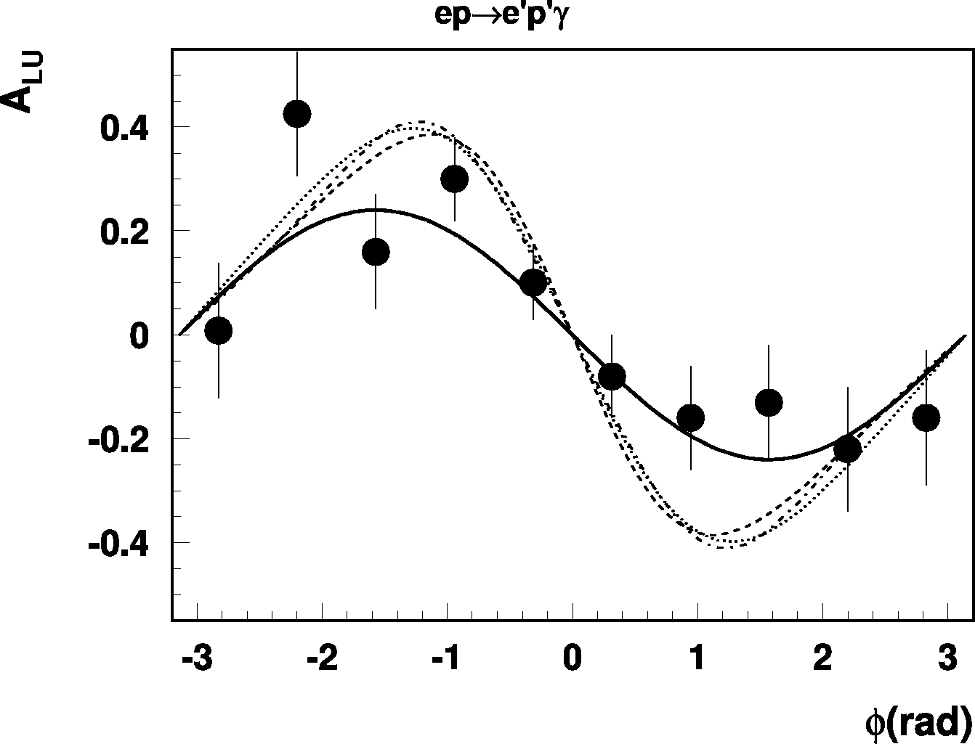
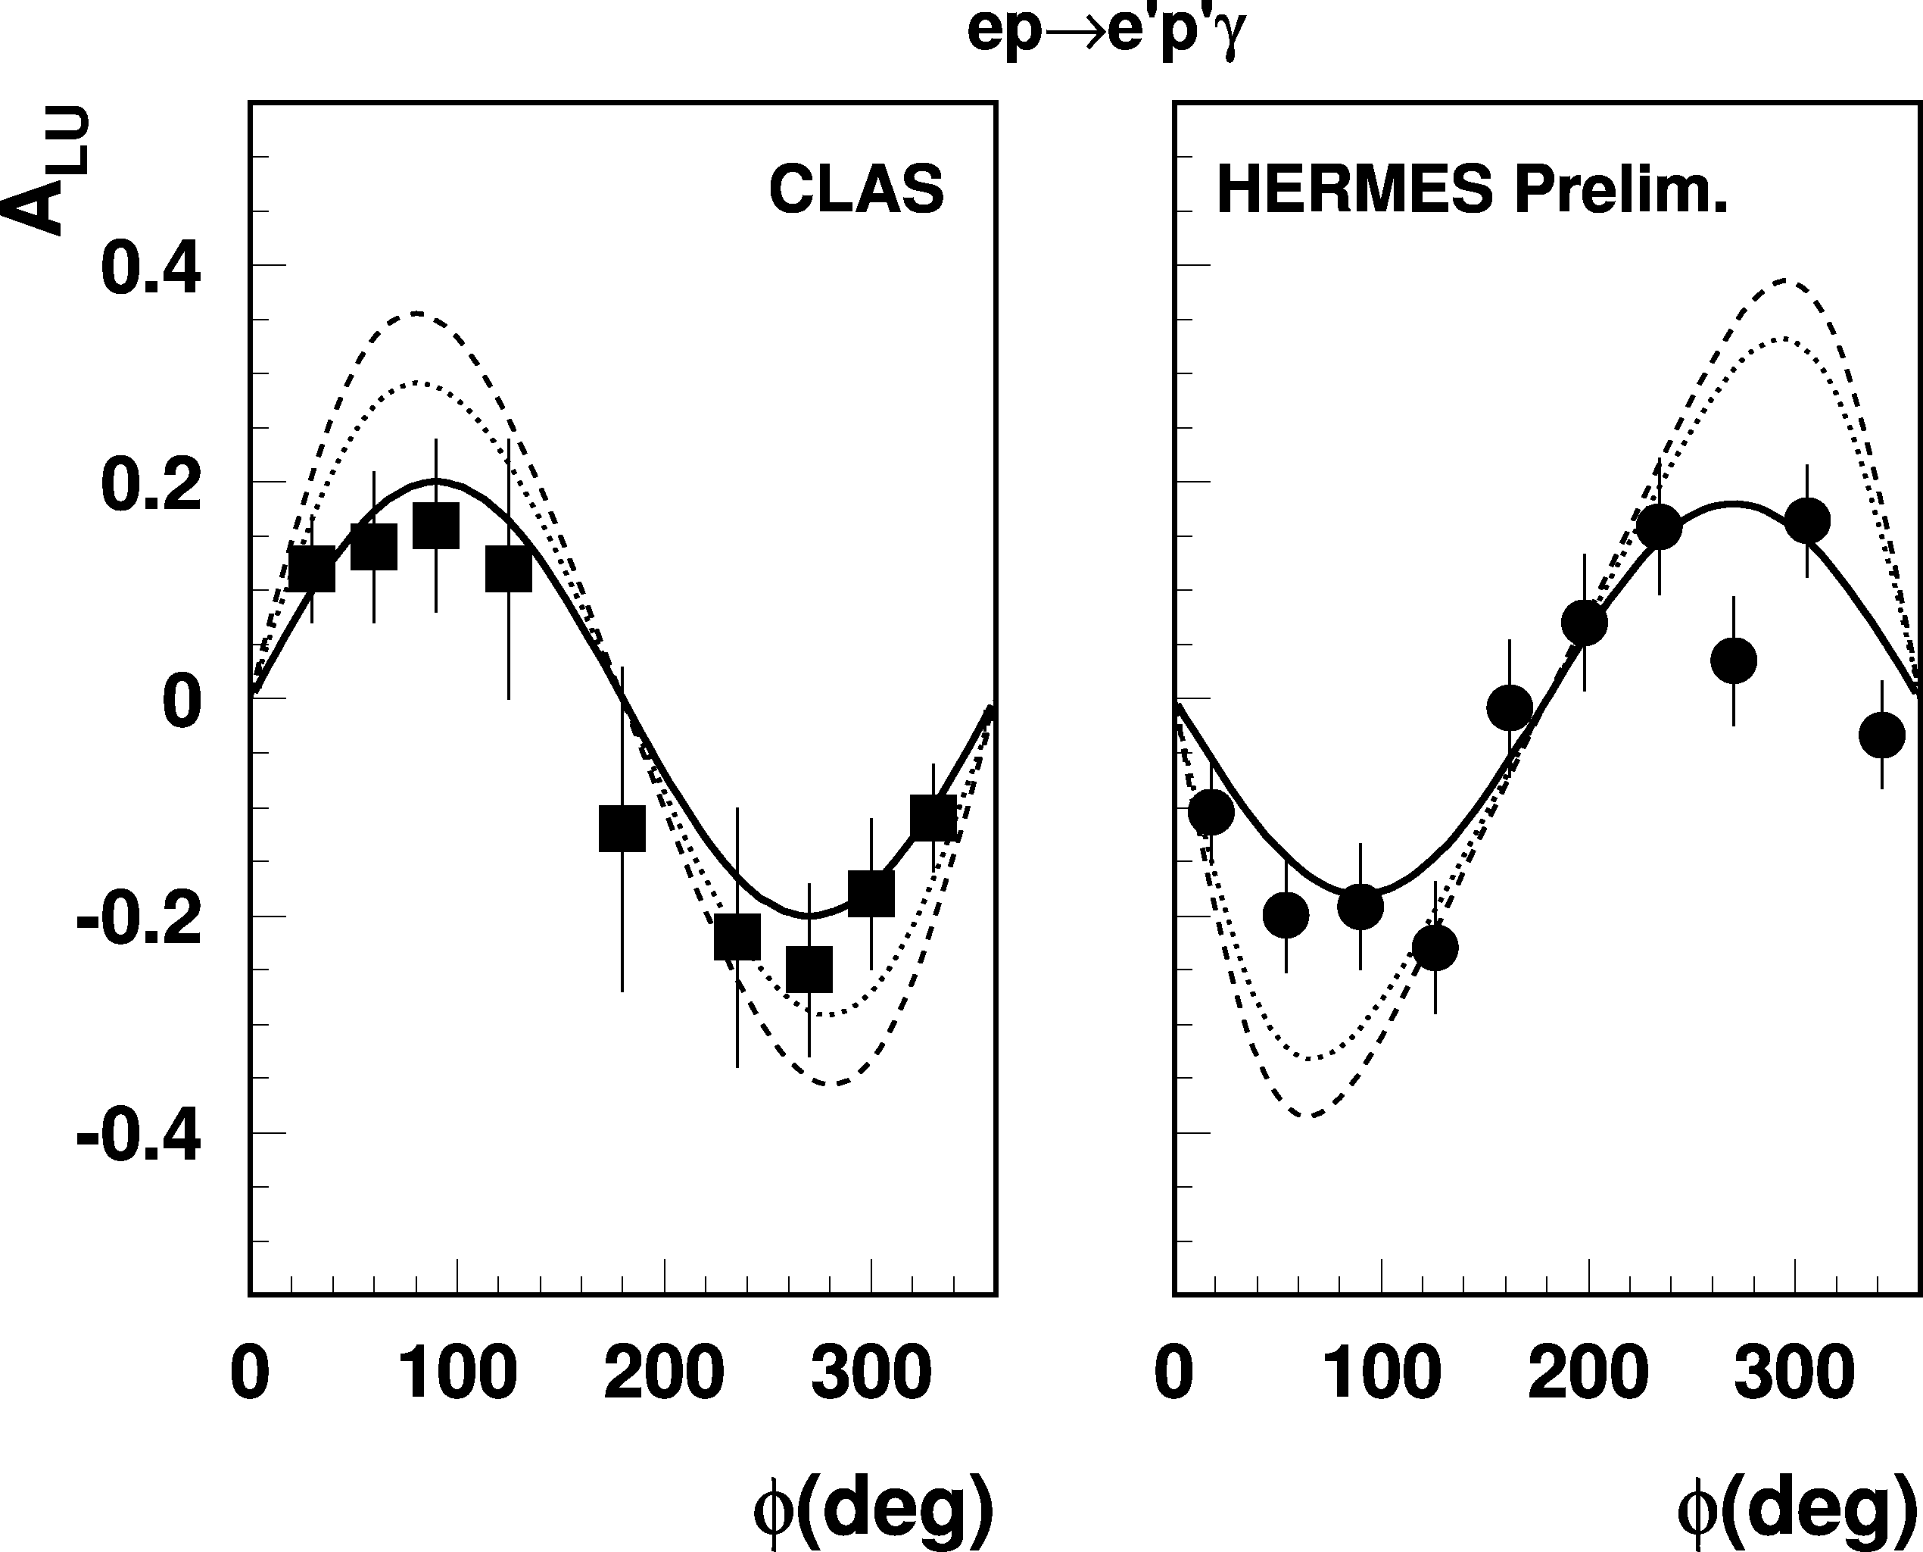
First observation of DVCS/BH beam asymmetry
e⁺p e⁺γX
2001
e⁻p e⁻pX
HERMES
27 GeV
CLAS
4.3 GeV
Q²=2.5 GeV²
0
Q²=1.5 GeV²
-180
φ(deg)
+180
Early GPD analysis of CLAS/HERMES/HERA data in LO/ NLO shows results consistent with handbag mechanism and lowest order pQCD. A. Freund (2003), A. Belitsky, et al. (2003)
Α(φ) = αsinφ + βsin2φ
β/α << 1 twist-3 << twist-2

Slide 23
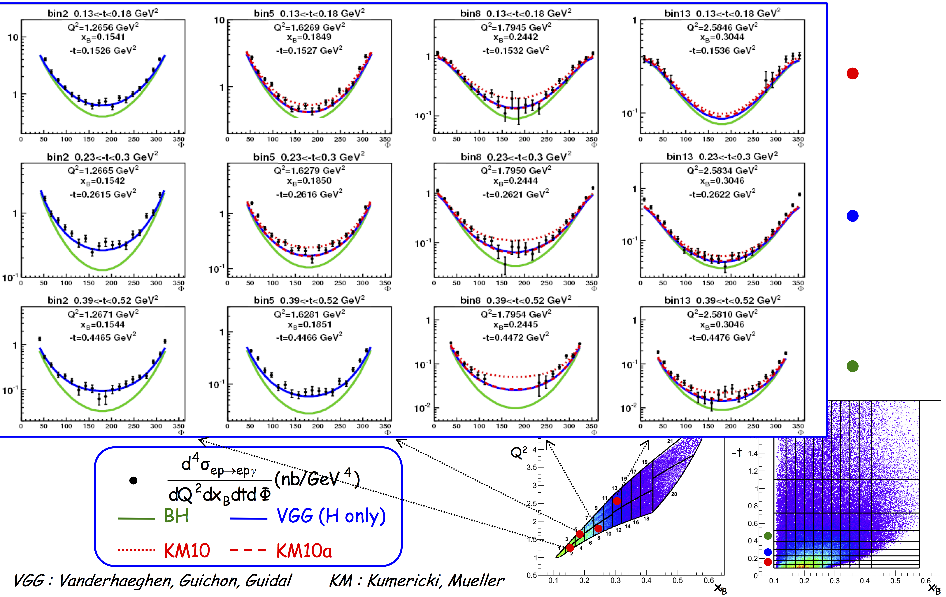
DVCS Unpolarized Cross-Sections (6GeV)

Slide 24


DVCS Longitundinal Target (6GeV)

Slide 25
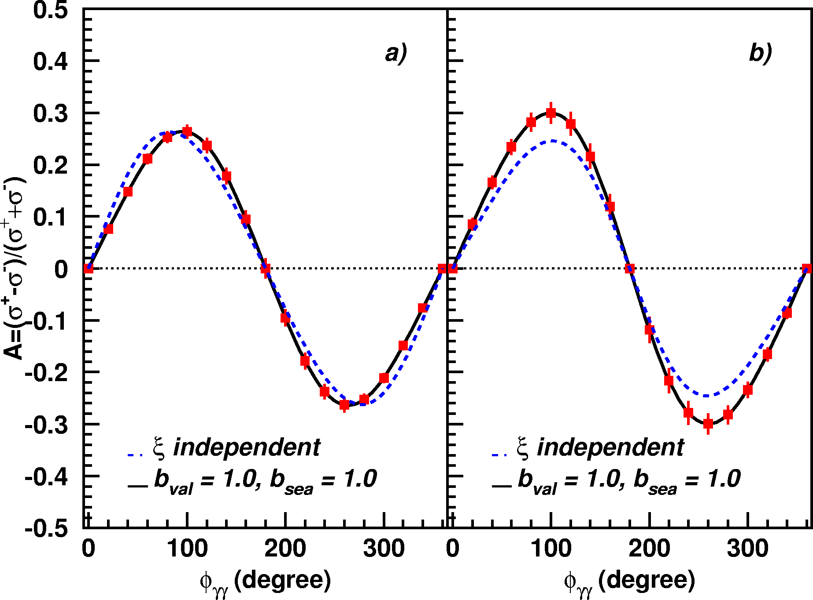
A_{LU} projections for JLab@12GeV
~
ep --> epγ
Δσ_{LU} ~ sinφ {F₁H + ξ(F₁+F₂)H +kF₂E}dφ
A_{LU}
E12-06-114
E12-06-119

Slide 26
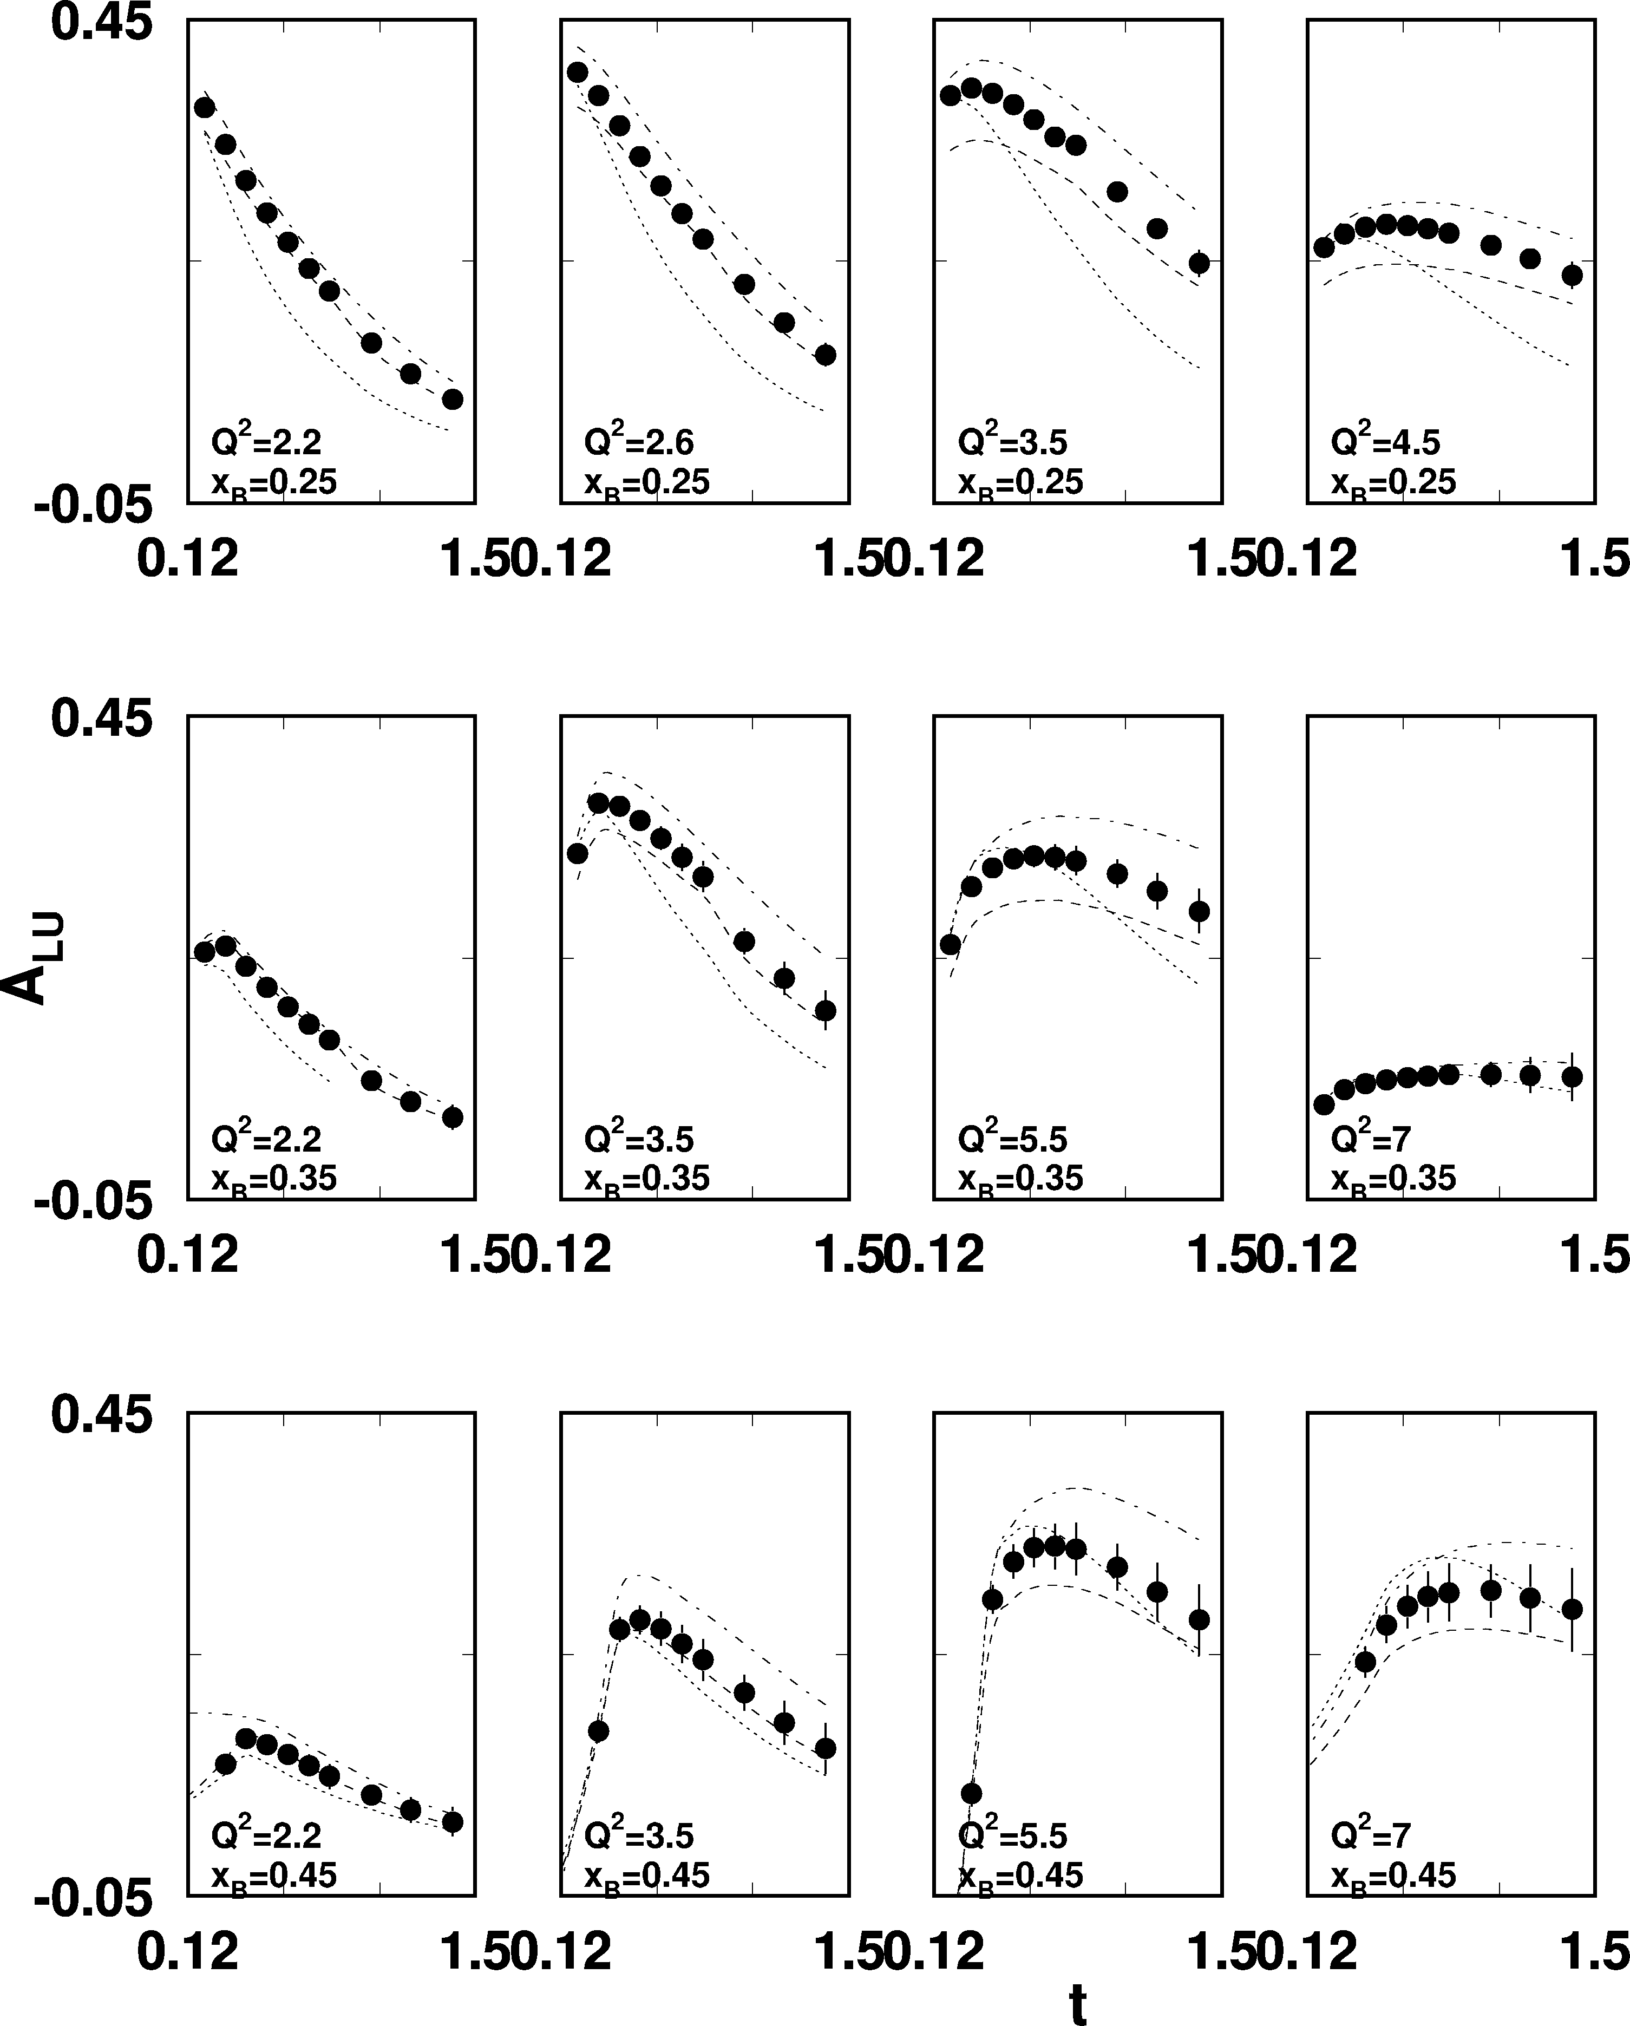
A_{LU} projections for protons
e p epγ
~
Δσ_{LU} ~ sinφ {F₁H + ξ(F₁+F₂)H +kF₂E}dφ
E_{e}=11GeV
sinφ
, GeV²

Slide 27
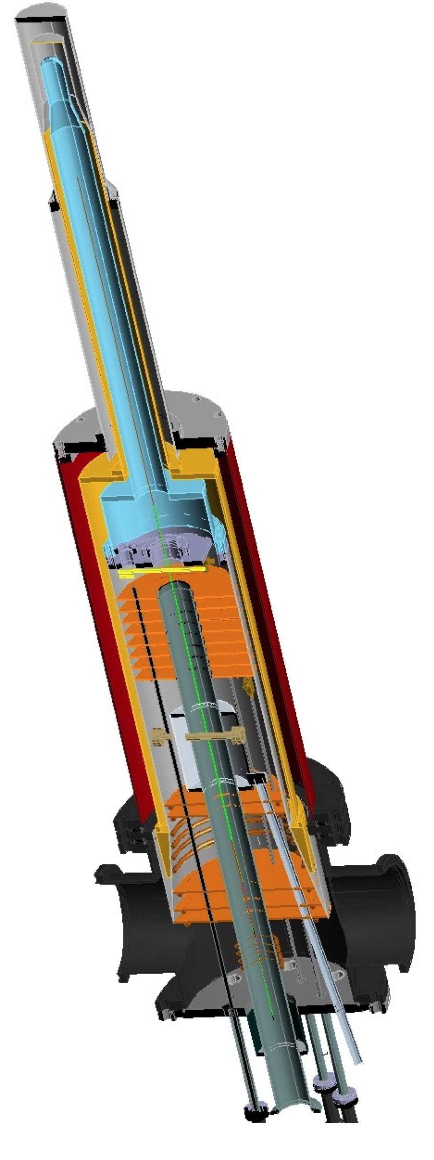
A_{UL} projections for protons
e p epγ
~
Δσ_{UL} ~ sinφ {F₁H+ξ(F₁+F₂)(H +ξ/(1+ξ)E)}dφ
~
Dynamically polarized target NH₃, ND₃
L = 1x10³⁵ cm⁻²s⁻¹
T = 2000 hrs
ΔQ² = 1GeV²
Δx = 0.05
A_{UL}
E12-06-119

Slide 28
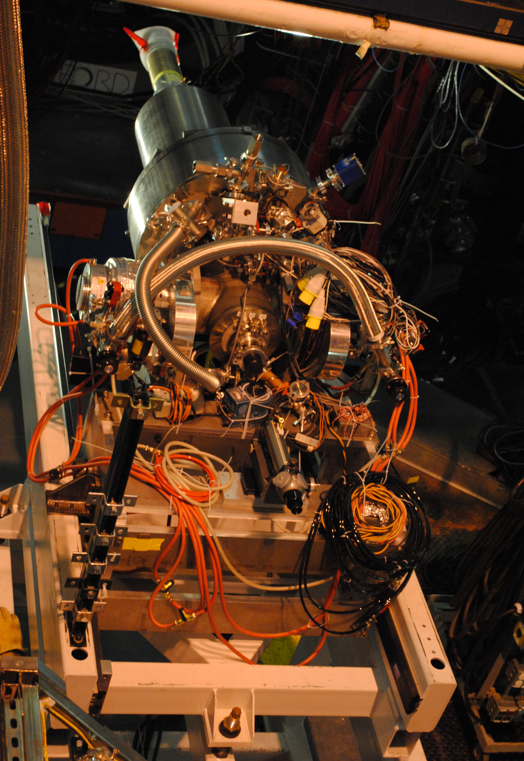
A_{UT} projections for 12GeV
ep epγ
Δσ_{UT} ~ cosφsin(φ_{s}-φ){k(F₂H – F₁E)}dφ
polarized HD
P_{p}=0.60
Dilution = 0.8
C12-12-010
cosφ
x=0.25,
Q²=2 GeV² t=-0.55 GeV²
A_{UT} and A_{LT} are sensitive to the u and d-quark helicity content of the proton spin

Slide 29
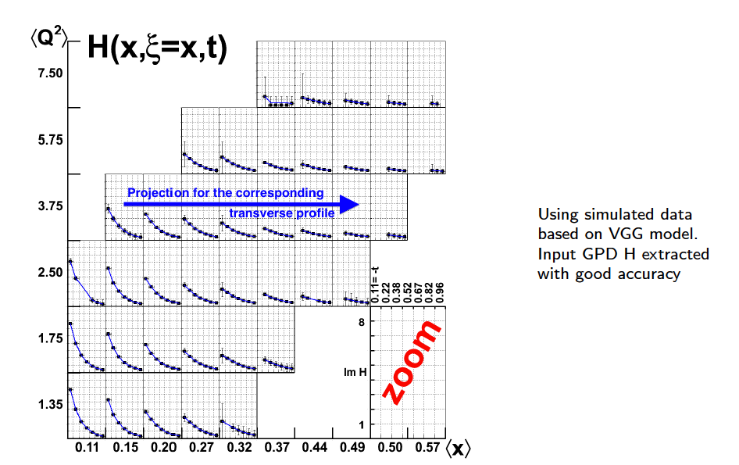
GPD H from projected CLAS12 data
Review article: M. Guidal, H. Moutarde, M. Vanderhaeghen, Rept.Prog.Phys. 76 (2013) 066202
LO fit to all observables: σ, A_{LU}, A_{UL}, A_{LL}, A_{Ux}, A_{Uy}, A_{Lx}, A_{Ly}
For corrections see
talk by H. Moutarde

Slide 30
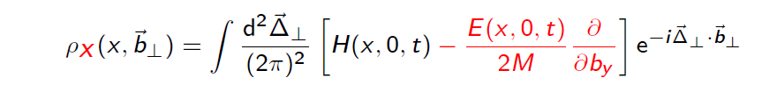
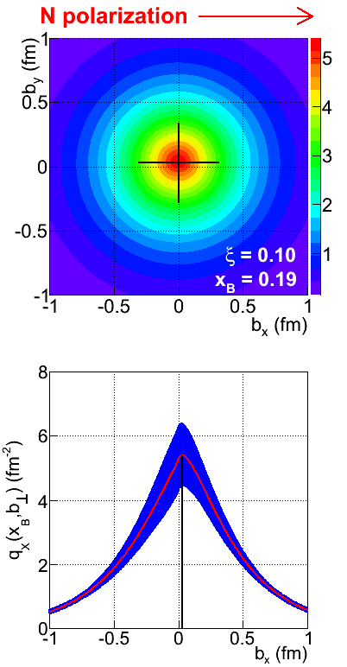
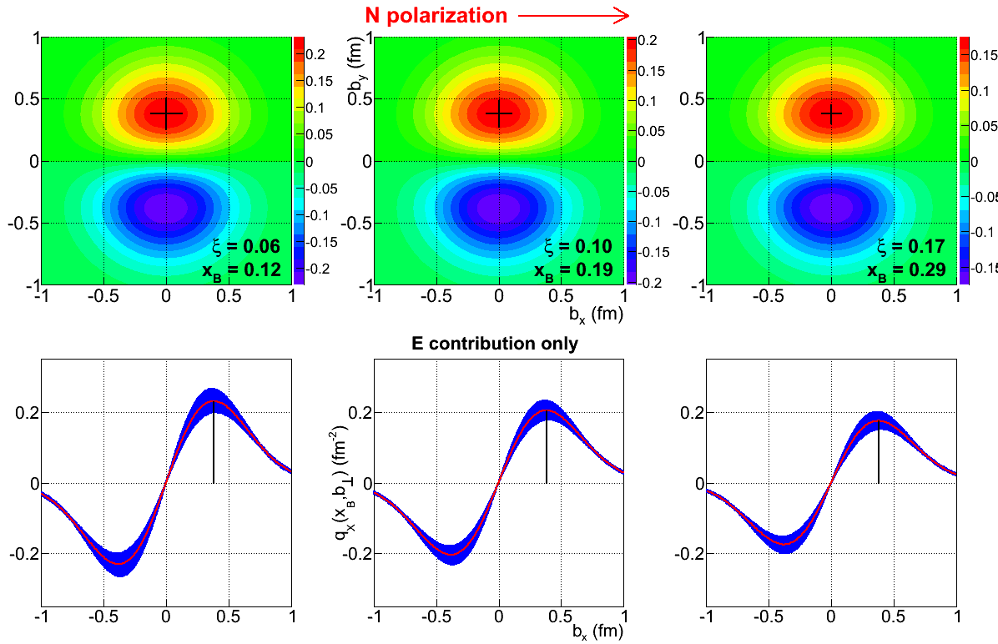
Projected quark densities in impact parameter
Fourier transform of GPDs give access to the quark densities distribution in impact parameter space.
GPD E probes the u- and d-quark separation in impact parameter space. Transversely polarized proton shows flavor dipole.
Contribution of H+E
Contribution of E

Slide 31
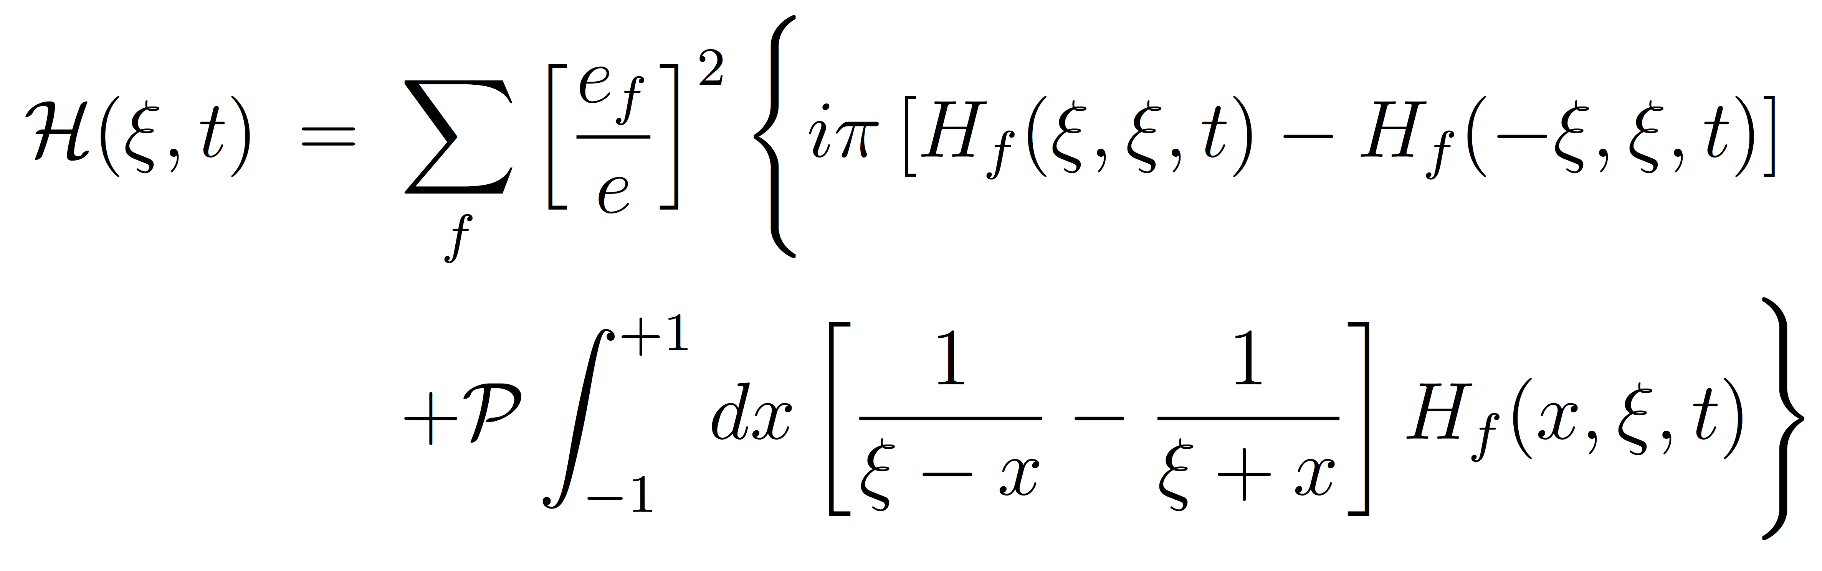
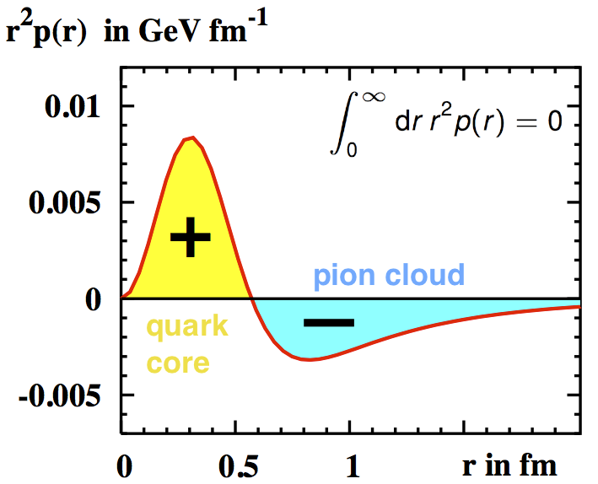
DVCS with CLAS12 at various beam energies
Imaginary Part of CFF
Real Part of CFF
The D-term is the least known part of the conventional GPD H
t-dependence of the D-term encodes the form factor associated with the distributions of forces on partons inside hadrons
May shed light on the mechanism of confinement

Slide 32
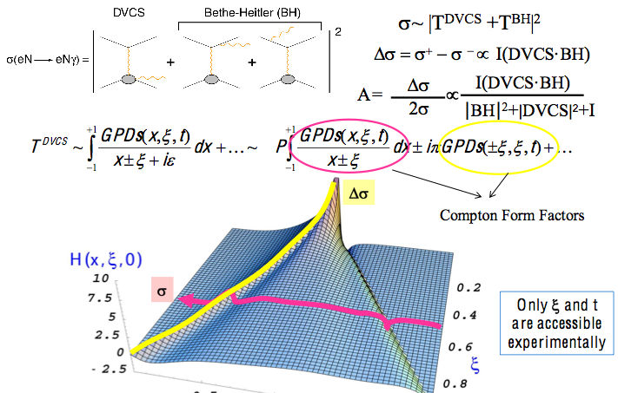
Accessing GPDs through DVCS

Slide 33
DDVCS with CLAS12 in Hall-B – LOI
Two main challenges in DDVCS measurements:
cross section is two to three orders of magnitude smaller than the DVCS cross section
decay leptons of the outgoing virtual photon must be distinguishable from the incoming-scattered lepton
Both challenges can be solved with by studying di-muon electroproduciton,
CLAS12 FD will be blocked with heavy shielding/absorber from electromagnetic and hadronic backgrounds to be able to run at luminosities ~10³⁷ cm⁻² s⁻¹, and will be used as muon detector
Scattered electrons will be detected in a compact PbWO₄ calorimeter that is part of the shielding
Electron calorimeter and shield/absorber
30º
Location of HTCC mirrors
30º
7º
500
W shield
S
7º
5º
17
PbWO₄
13
200
500
PbWO₄ modules with APD readout - ~ 1500 modules

Slide 34
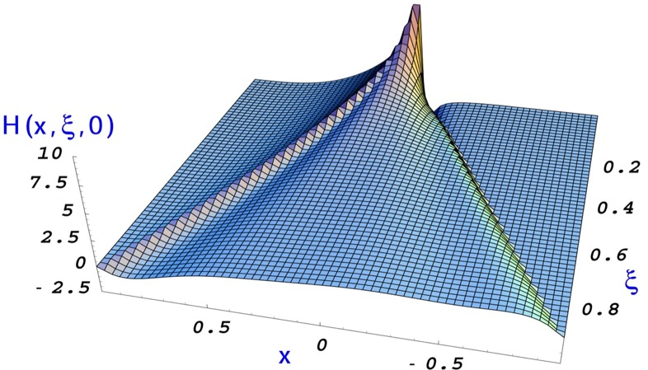
Expected results on beam spin of DDVCS asymmetry
The beam spin asymmetry (BSA) in DDVCS is proportional to the imaginary part the, i.e. in a concise notation:
DVCS BSA (Im, x=ξ)
DVCS Cross sections |Re|²
This allows the mapping of GPDs along each of the three axis ( , ξ and t) independently
Prediction of the “handbag” formalism is the sign change of BSA in transitioning from “space-like dominated” to “time-like dominated” regime
DDVCS ( )
BSA for 100 days of running with CLAS12 at luminosity of 10³⁷ cm⁻² s⁻¹
Electron kinematics:
Space-like dominance
Time-like dominance
BSA
Transferred momentum squared:
From Boer, Paremuzyan

Slide 35
Extraction and Validation Framework
The main goal is to develop a framework for extraction and validation of 3 D PDFs from experimental measurements of hard exclusive and semi-inclusive production of photons and mesons through:
  Developing multidimensional MC-simulation
  Implementing self consistent QED radiative corrections in the cross sections for a complete set of structure functions needed for the extraction framework and MC simulations
  Developing capabilities, within the extraction and validation framework, to provide persistence and data visualization tools
  Robust strategy to propagate and control uncertainties to the extracted 3D PDFs
The analysis framework to be used in 2 ways: from measured observables to 3D PDFs, and from models of 3D PDFs to predictions of observables.

Slide 36
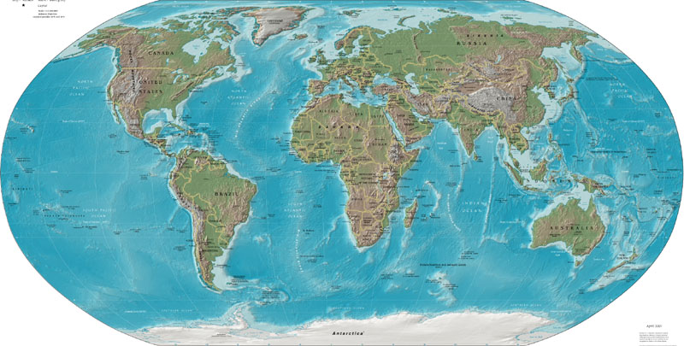












CLAS Collaboration Collaborai Collaboration
Arizona State University, Tempe, AZ
University Bari, Bari, Italy
University of California, Los Angeles, CA
California State University, Dominguez Hills, CA
Carnegie Mellon University, Pittsburgh, PA
Catholic University of America
CEA-Saclay, Gif-sur-Yvette, France
Christopher Newport University, Newport News, VA
University of Connecticut, Storrs, CT
Edinburgh University, Edinburgh, UK
University Ferrara, Ferrara, Italy
Florida International University, Miami, FL
Florida State University, Tallahassee, FL
George Washington University, Washington, DC
University of Glasgow, Glasgow, UK
University of Grenoble, Grenoble, France
Idaho State University, Pocatello, Idaho
INFN, Laboratori Nazionali di Frascati, Frascati, Italy
INFN, Sezione di Genova, Genova, Italy
Institut de Physique Nucléaire, Orsay, France
ITEP, Moscow, Russia
James Madison University, Harrisonburg, VA
Kyungpook University, Daegu, South Korea
University of Massachusetts, Amherst, MA
Moscow State University, Moscow, Russia
University of New Hampshire, Durham, NH
Norfolk State University, Norfolk, VA
Ohio University, Athens, OH
Old Dominion University, Norfolk, VA
Rensselaer Polytechnic Institute, Troy, NY
Rice University, Houston, TX
University of Richmond, Richmond, VA
University of Rome Tor Vergata, Italy
University of South Carolina, Columbia, SC
Thomas Jefferson National Accelerator Facility, Newport News, VA
Union College, Schenectady, NY
University Santa Maria, Valparaiso, Chile
Virginia Polytechnic Institute, Blacksburg, VA
University of Virginia, Charlottesville, VA
College of William and Mary, Williamsburg, VA
Yerevan Institute of Physics, Yerevan, Armenia
Brazil, Germany, Morocco and Ukraine,
, have individuals or groups involved with CLAS,
but with no formal collaboration at this stage.

Slide 37
Summary
CLAS12 with JLab 12 GeV upgrade has a broad science program covering many facets of hadron physics.
Extending knowledge of PDFs to high x in measurements of (un)polarized structure functions using tagging. Addresses part of the nucleon “spin-puzzle” and extend knowledge of quark density distribution at high x.
Precision studies of DVCS in polarization measurements give access to GPDs and enable quark spatial imaging. They relate to the quark spin, mass and force distributions in the nucleon (confinement?).
Precise measurements of SIDIS improve access to TMDs and quark momentum tomography, and relate to the quark orbital angular momentum.
Many topics not discussed, hadron spectroscopy, nucleon e.m. form factors, dark matter searches, QCD and nuclei, ….

Slide 38
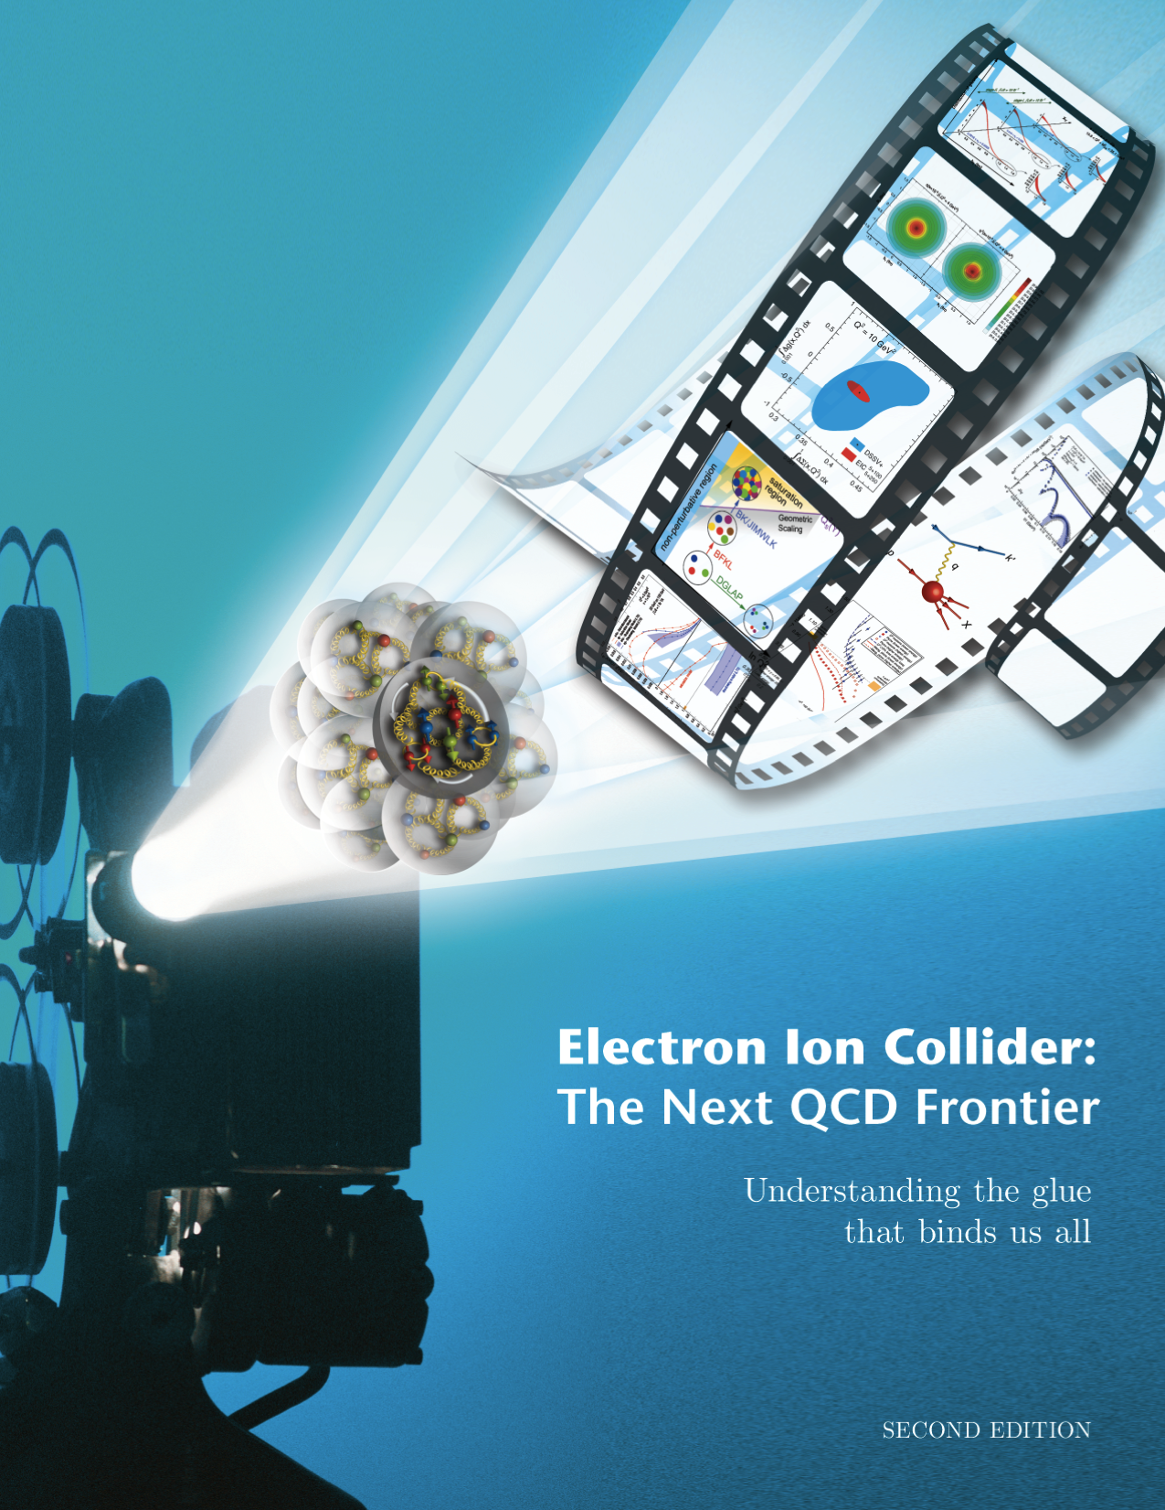
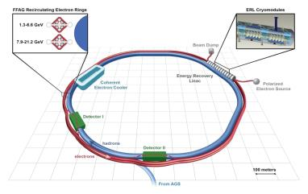
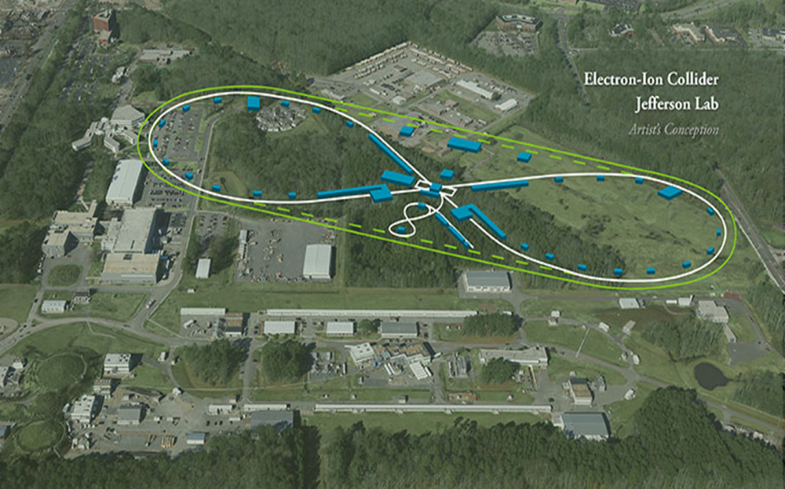
Electron Ion Collider
1212.1701.v3
A. Accardi et al
For e-N collisions at the EIC:
Polarized beams: e, p, d/³He
e beam 5-10(20) GeV
Luminosity L_{ep} ~ 10³³⁻³⁴ cm⁻²sec⁻¹
  100-1000 times HERA
20-100 (140) GeV Variable CoM
For e-A collisions at the EIC:
Wide range in nuclei
Luminosity per nucleon same as e-p
Variable center of mass energy
AGS
World’s first
Polarized electron-proton/light ion
and electron-Nucleus collider
Both designs use DOE’s significant investments in infrastructure
Notes:
Contrast with HERA could be made more explicit. Table/column presentation.

