Slide 1
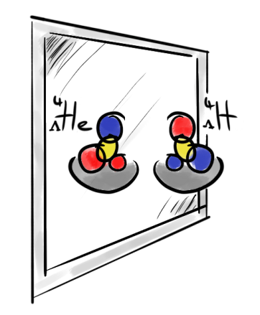
Charge Symmetry Breaking in Light Hypernuclei
Patrick Achenbach
U Mainz
June 2o16

Slide 2

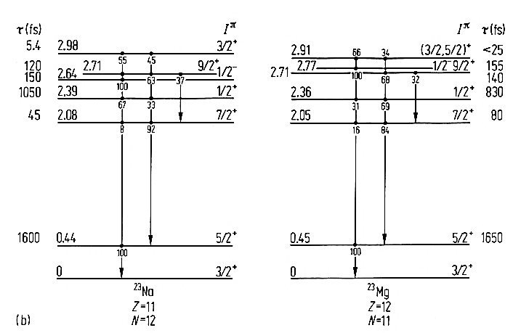
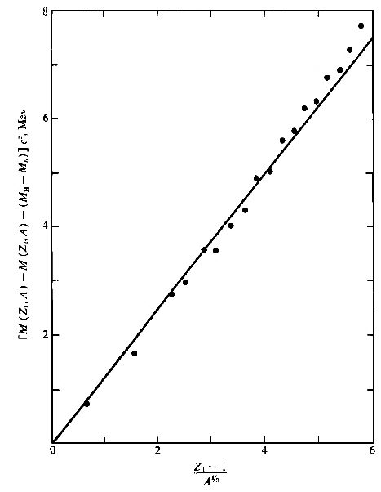
Historical introduction
ΔM
- no magnetic interaction
- no neutron halo/skins
- no radius difference
- no shell effects
- …
ΔM
[Endt & van der Leun, NPA 310 (1978), 67]
⁷Li ↔ ⁷Be
Charge independence: strong force independent of isospin (F_{p-p} = F_{n-n} = F_{p-n})
Charge symmetry: strong force independent of I₃ flip (F_{p-p} = F_{n-n})
³He ↔ ³H
(Z-1)/A^{1/3}
[Gleit et al. Nuclear Data Sheets 5 (1963)]

Slide 3
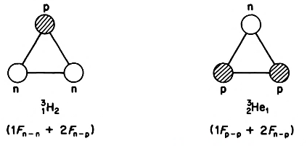
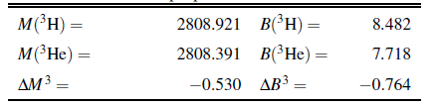
Charge symmetry in light nuclei
Charge-symmetry breaking in nuclear two-body force…
… is studied in mirror nuclei after correcting for Coulomb effects
… is very small, ~ 80 keV in case of ³H - ³He
… is well understood and reproduced by theory
³H
³He
Binding energy
³H
³He
0.76 MeV
[R. Machleit et al., PRC 63, 034005 (2001)]

Slide 4
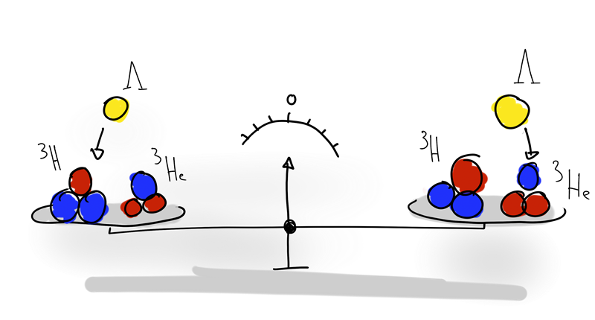
Charge symmetry in light hypernuclei
Opportunity to study strong force symmetries with Λ as neutral probe
Λ hyperon has no isospin and no charge →
Λ binding in mirror hypernuclei directly tests charge symmetry
F_{Λ-p} = F_{Λ-n} → B_{Λ} (_{Λ}^{A}Z) = B_{Λ}(_{Λ}^{A}Z+1)

Slide 5
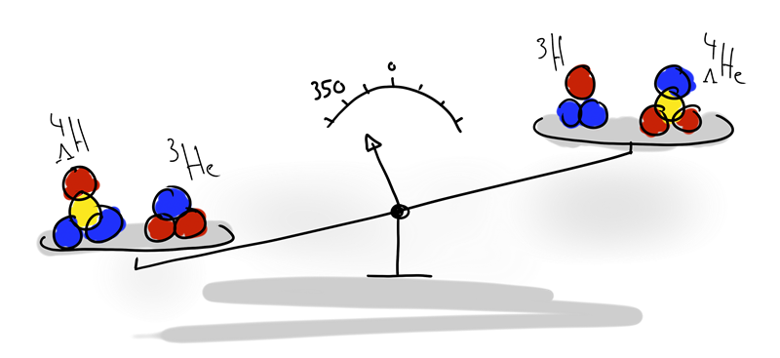
Large charge symmetry breaking in A = 4
⁴_{Λ}H - ⁴_{Λ}He ground state mass difference exceptionally large > 300 keV
[M. Juric et al. NP B52 (1973)]
CSB effect resists consistent reproduction by theory up to 2015
⁴_{Λ}H - ⁴_{Λ}He coulomb corrections < 50 keV contribute in opposite direction
[A. Nogga, NP A 914,140 (2013)]
[A. R. Bodmer and Q. N. Usmani, PRC 31, 1400 (1985)]

Slide 6
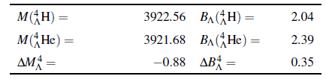
Large charge symmetry breaking in A = 4
[M. Juric et al. NP B52 (1973)]

Slide 7
How to solve the puzzle?
1.
check experimental data consistency, accuracy and systematic errors
study other aspects or components of the puzzle
perform measurements with independent experimental technique
combine information from steps 1. – 3.
2.
3.
4.

Slide 8
How to solve the puzzle?
1.
check experimental data consistency, accuracy and systematic errors

Slide 9
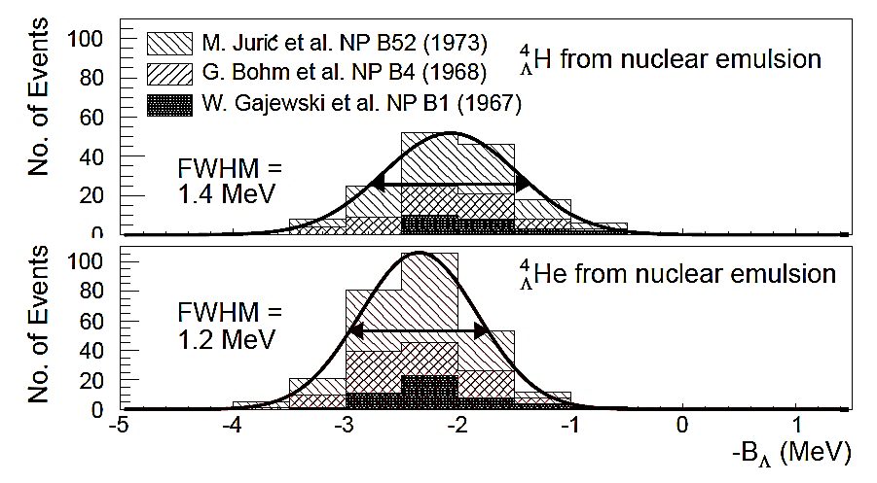
Emulsion results on _{Λ}⁴H and _{Λ}⁴He
ΔB_{Λ} = 0.35±0.06
δB = ±0.04 MeV
δB = ±0.03 MeV
only three-body decay modes used for hyperhydrogen
155 events for hyperhydrogen, 279 events for hyperhelium

Slide 10
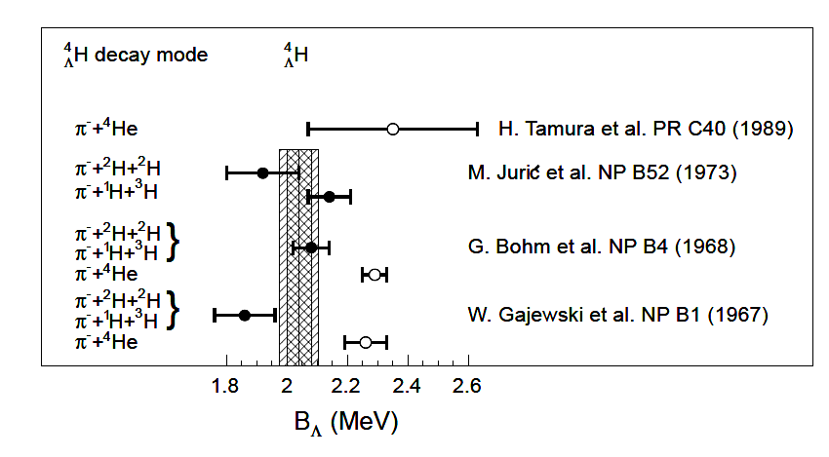
World data on _{Λ}⁴H
KEK
emulsion
⁴H
decay
→ π⁻+¹H+³H: B = 2.14 ±0.07 MeV
Λ
0.22 MeV difference
decay
⁴H
→ π⁻+²H+²H: B = 1.92 ±0.12 MeV
Λ
Total: B = 2.08 ±0.06 MeV
[M. Juric et al. NP B52 (1973)]

Slide 11
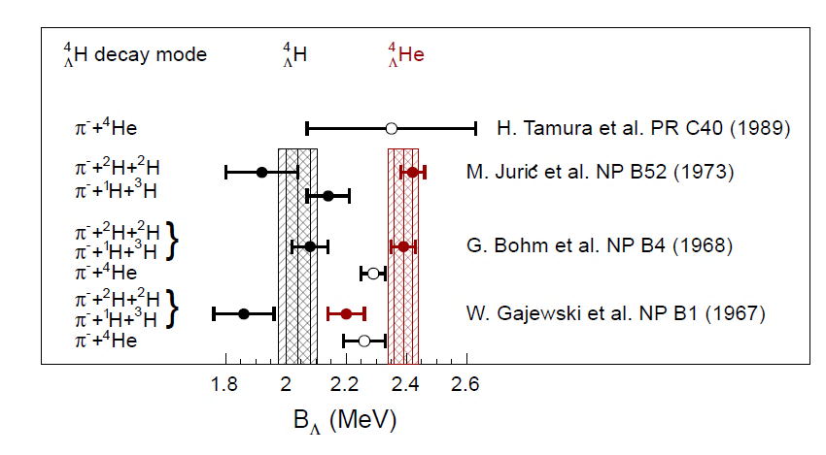
World data on A = 4 system
KEK
emulsion
Λ
⁴He
decay
→ π⁻+¹H+³He: B = 2.42 ±0.05 MeV
Λ
0.02 MeV difference
decay
→ π⁻+2¹H+²H: B = 2.44 ±0.09 MeV
⁴He
Λ
Total: B = 2.42 ±0.04 MeV
[M. Juric et al. NP B52 (1973)]

Slide 12
How to solve the puzzle?
study other aspects or components of the puzzle
2.

Slide 13
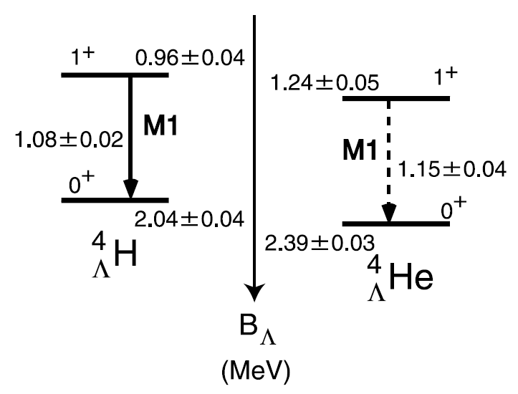
The A = 4 level schemes (before 2015)
ΔB_{Λ} (ex. st.) = 0.28±0.06
ΔB_{Λ} (gr. st.) = 0.35±0.06
[H. Tamura, NPA 914 (2013) 99]
charge symmetry breaking only if emulsion data is correct
spin-independent charge symmetry breaking

Slide 14
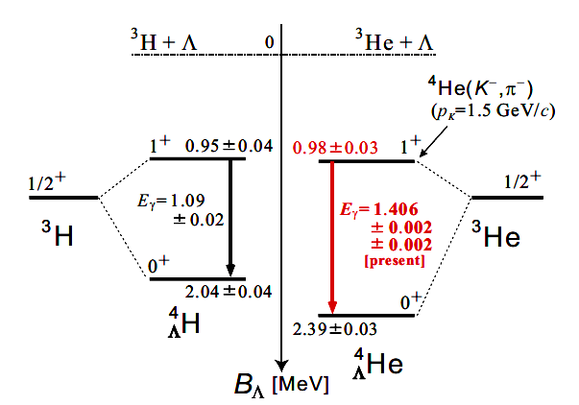
The A = 4 level schemes
ΔB_{Λ} (ex. st.) = 0.03±0.05
ΔB_{Λ} (gr. st.) = 0.35±0.06
[T. O. Yamamoto, PRL 115 (2015) 222501]
observation of charge symmetry breaking in γ-ray spectroscopy
spin-dependent charge symmetry breaking

Slide 15
How to solve the puzzle?
perform measurements with independent experimental technique
3.

Slide 16
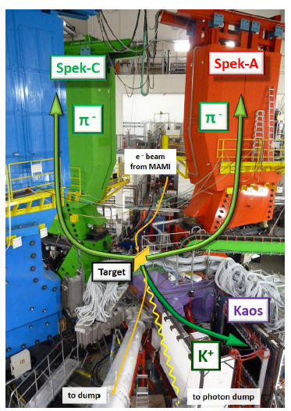
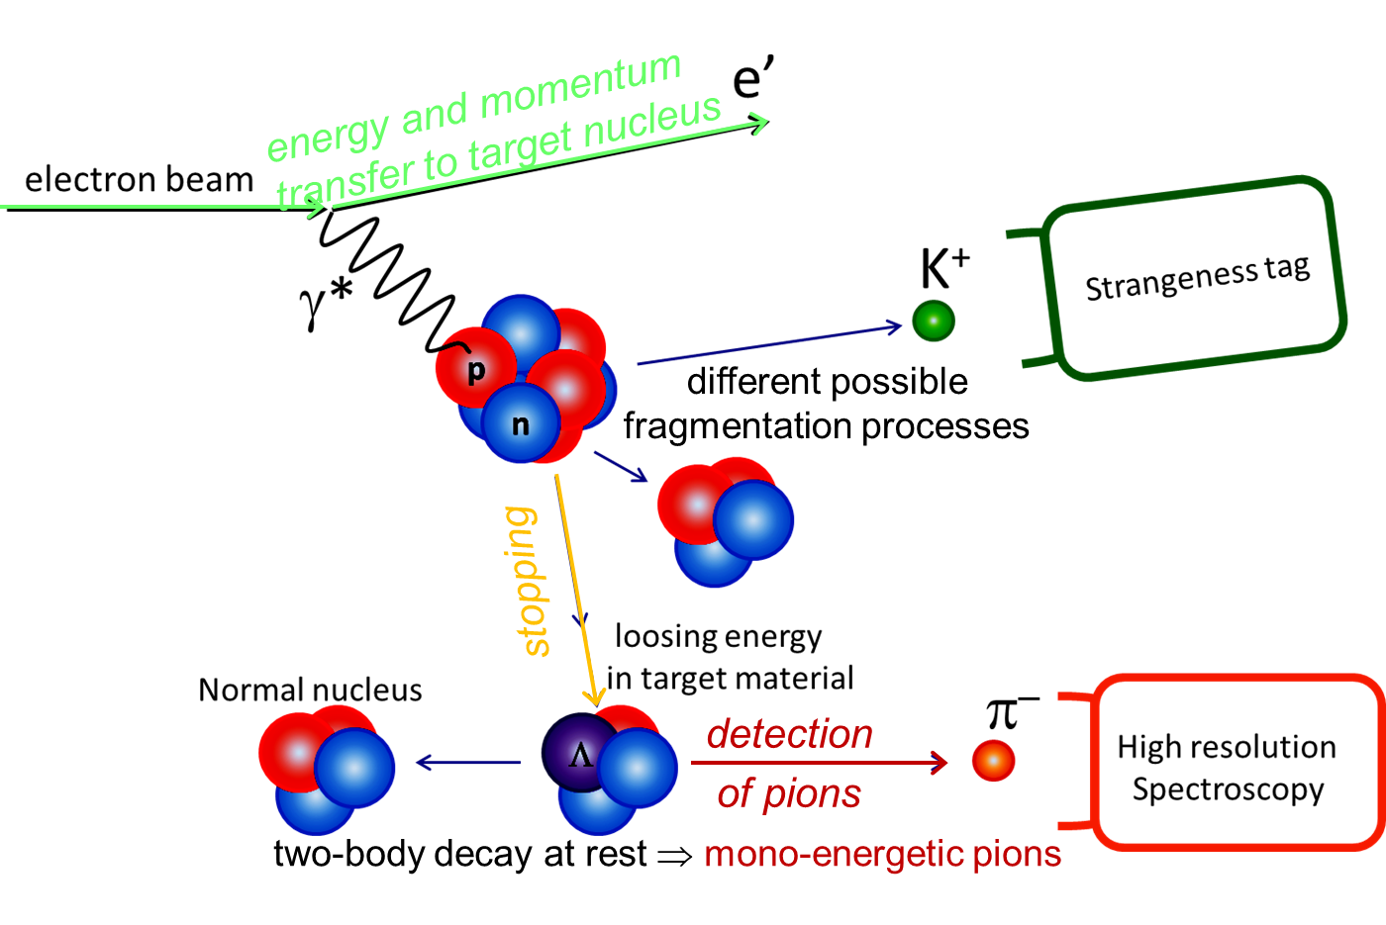

Hyperfragment decay-pion spectroscopy with electron beams

Slide 17
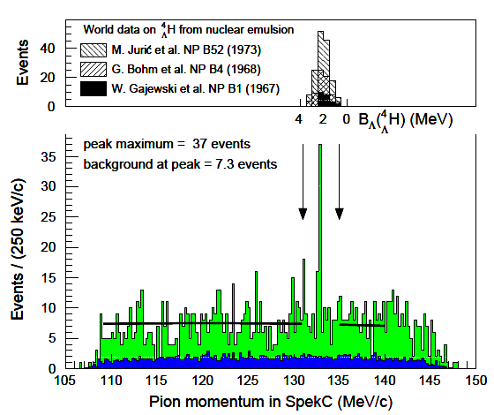
Decay-pion spectrum
Emulsion data on binding energy scale
mono-energetic pions
decays of quasi-free produced hyperon
accidental background reactions

Slide 18
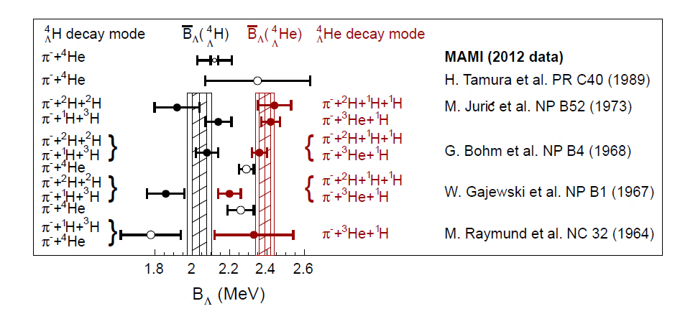
World data on A = 4 system
MAMI 2012 experiment Λ binding energy of _{Λ}⁴H:
B_{Λ} = 2.12 ± 0.01 (stat.) ± 0.09 (syst.) MeV
A. Esser et al. (A1 Collaboration), PRL 114, 232501 (2015)

Slide 19
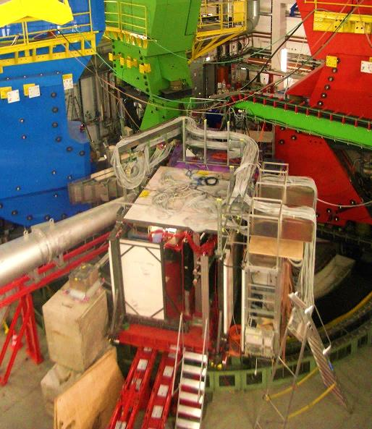
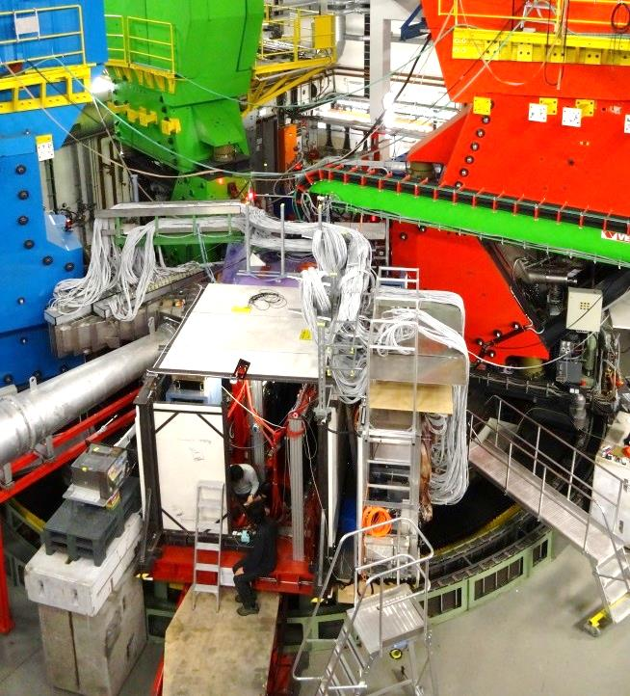
Continuation of experiment in 2o14
2o12
2o14
improved background
&
systematics
better pion rejection by improved aerogel
suppression of background by improved shielding
suppression of background by trigger upgrade in SpekA & C
suppression of background by beam-line upgrade
dedicated collimator for decay region
better control of magnet field variations
full overlap of SpekA and SpekC momentum acceptances

Slide 20
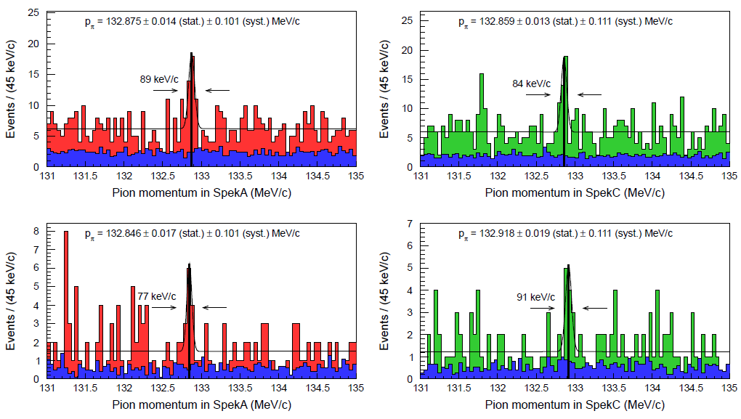
Systematic studies of the decay-pion line
consistent result for B_{Λ}(⁴_{Λ}H) from MAMI 2012 and MAMI 2014 independent measurement in two specs, two targets, two beam-times

Slide 21
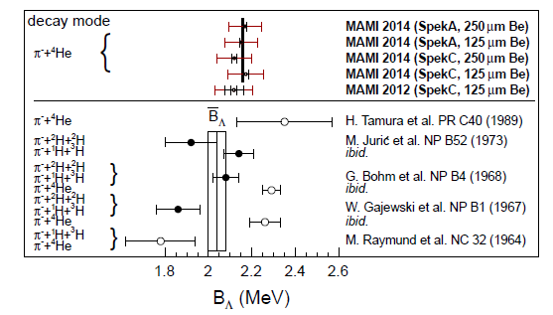
World data on ⁴_{Λ}H mass
outer error bars correlated from calibration
MAMI
emulsion
B_{Λ}(⁴_{Λ}H) (stat.) (syst.)
emulsion: 2.04 ± 0.04 ± 0.05 MeV [M. Juric et al. NP B52 (1973)]
MAMI 2012: 2.12 ± 0.01 ± 0.08 ± 0.03 MeV [A. Esser et al., PRL 114 (2015)]
MAMI 2012: 2.12 ± 0.01 ± 0.08 ± 0.03 MeV [P. Achenbach et al., JPS (2016)]
MAMI 2014: 2.16 ± 0.01 ± 0.08 MeV [F. Schulz et al., NPA (2016)]

Slide 22
How to solve the puzzle?
combine information from steps 1. – 3.
4.

Slide 23
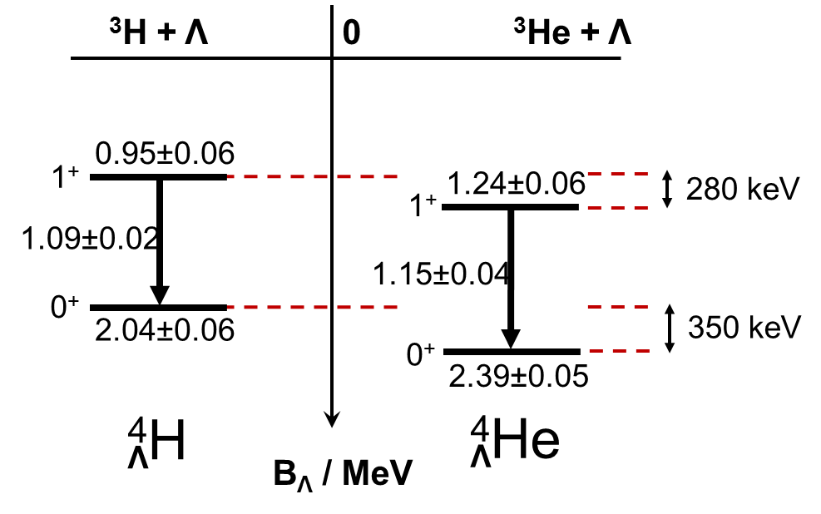
Current knowledge on CSB in the A = 4 system

Slide 24
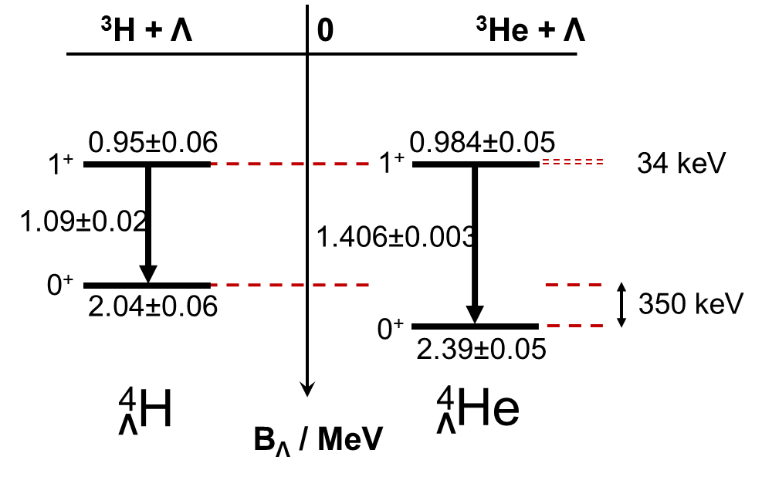
Current knowledge on CSB in the A = 4 system

Slide 25
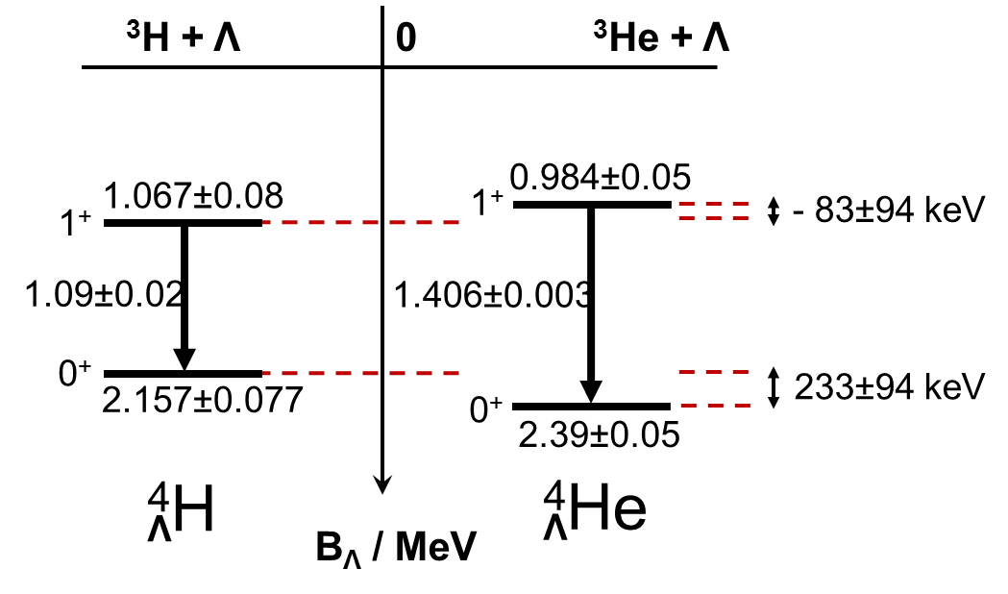
ΔB_{Λ} (1+ ex. st.) = 280 ± 5 keV (emulsion + old γ-ray data)
34 ± 5 keV (emulsion + new γ-ray data)
−83 ± 9 keV (MAMI + emulsion + new γ-ray data)
ΔB_{Λ} (0+ gr. st.) = 350 ± 5 keV (emulsion data)
233 ± 9 keV (MAMI + emulsion data)
↨ + → -
↨ ~ 2/3

Slide 26
New precision era in hypernuclear physics
CSB in A = 4 system is strongly spin-dependent …
...and possibly changing sign between ground and excited states
CSB still appears considerably stronger in hyper- than in ordinary nuclei
for the first time positive CSB for gr. st. and negative CSB for ex. st.
cf. latest chiral effective models with central force ΛN-ΣN coupling
based on charge symmetric Bonn-Jülich YN potential
→ mixing of Λ and Σ hyperons leads to isovector meson exchanges
ΔB_{Λ} (0+ gr. st.) = +180 ± 130 keV
ΔB_{Λ} (1+ ex. st.) = −200 ± 30 keV
[D. Gazda & A. Gal, PRL 116, 122501 (2016)]
[D. Gazda & A. Gal, arXiv:1604.03434]

Slide 27
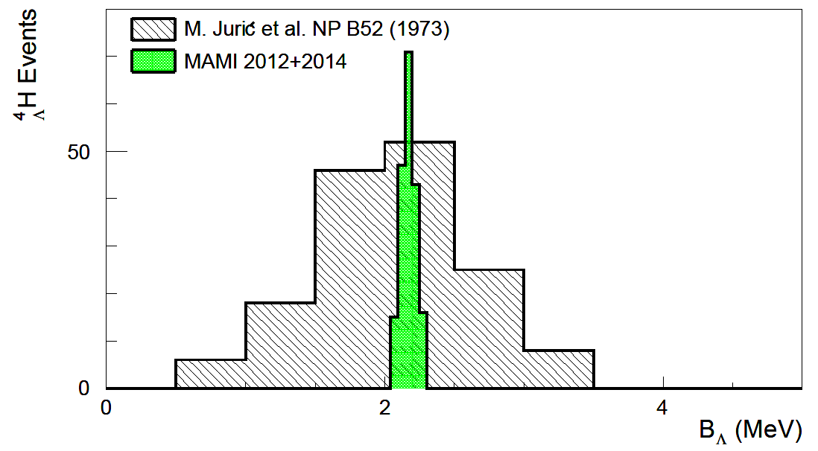
New precision era in hypernuclear physics
High-resolution pion spectroscopy has replaced emulsion technique
High-purity germanium spectroscopy has replaced NaJ detectors
MAMI
emulsion
various binding energies of light hyperisotopes could be measured with improved precision by these techniques!

Slide 28
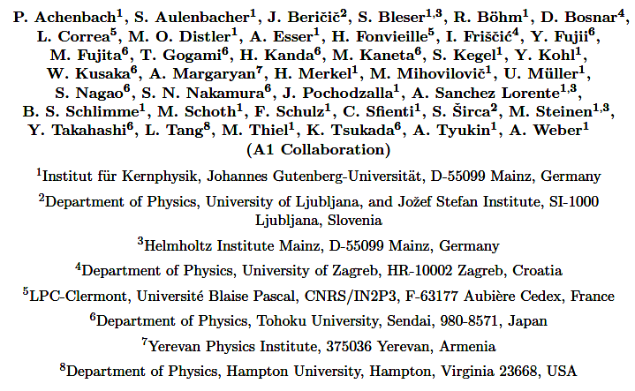
A1 Collaboration 2o15

Slide 29
BACKUP

Slide 30
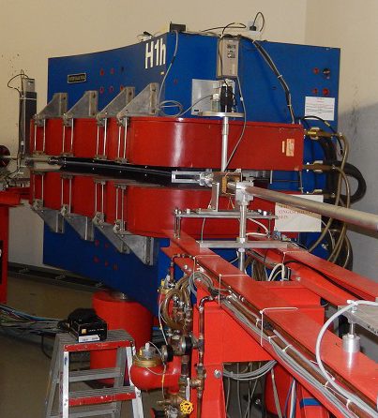
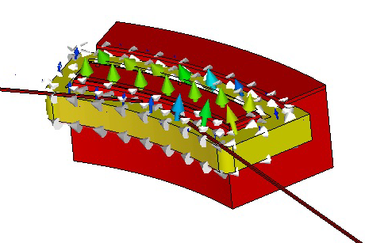
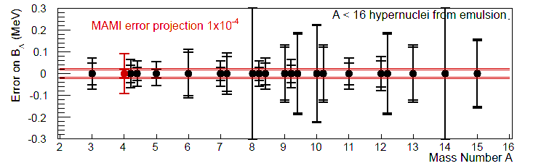
Future possibilities
MAMI energy measurement with 10⁻⁴ precision in a dipole used as
beam-line spectrometer:
projected error at MAMI compared to emulsion errors:

Slide 31
The A = 4 CSB puzzle
Calculation | Interaction | B_{Λ}(⁴_{Λ}H_{gs}) | B_{Λ}(⁴_{Λ}He_{gs}) | ΔB_{Λ} (⁴_{Λ}He-⁴_{Λ}H)
A. Nogga, H. Kamada and W. Gloeckle, PRL 88, 172501 (2002) | SC97e | 1.47 | 1.54 | 0.07
 | SC89 | 2.14 | 1.80 | 0.34
H. Nemura. Y. Akaishi and Y. Suzuki, PRL 89, 142504 (2002) | SC97d | 1.67 | 1.62 | -0.05
 | SC97e | 2.06 | 2.02 | -0.04
 | SC97f | 2.16 | 2.11 | -0.05
 | SC89 | 2.55 | 2.47 | -0.08
E. Hiyama, M. Kamimura, T. Motoba, T. Yamada and Y. Yama PRC 65, 011301 (R) (2001) | AV8 | 2.33 | 2.28 | -0.05
world data average |  | 2.04±0.04 | 2.39±0.03 | 0.35±0.06
calculations have been made since decades but fail to explain large ΔB_{Λ}
coupled channel calculation using interaction SC89 fails to bind excited state

Slide 32
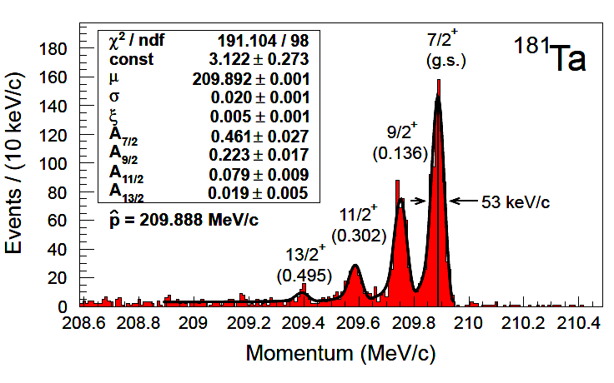
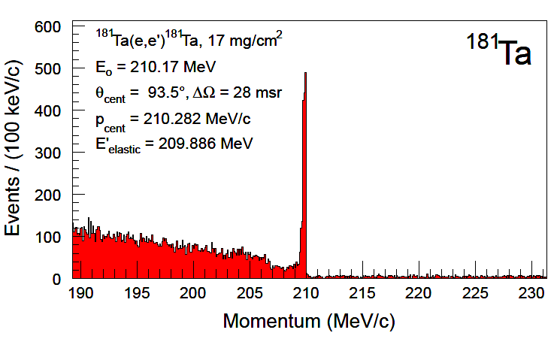
Absolute momentum calibration
scattering off thin tantalum foil
spectrometer FWHM of 53 keV/c → δp/p ~ 2∙10⁻⁴
beam energy absolute accuracy δp_{beam} ± 160 keV/c → δE/E ~ 7∙10⁻⁴
repeated calibrations at different momenta reveal δp_{syst} ~ 5 keV/c

