Slide 1




Thermal Dileptons and Hadrons in Medium
Ralf Rapp
Cyclotron Institute +
Dept of Phys & Astro
Texas A&M University
College Station, TX, USA
+
EMMI (GSI, Darmstadt, GER)
15th International Workshop on
“Meson Physics”
Krakow (Poland), 07.-12.06.18

Slide 2
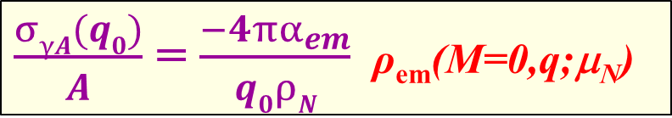
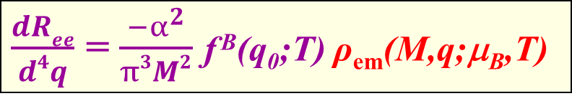
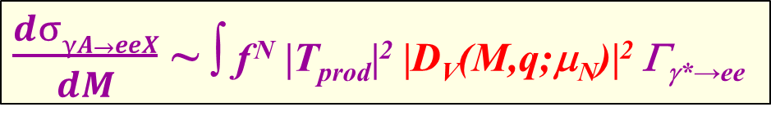
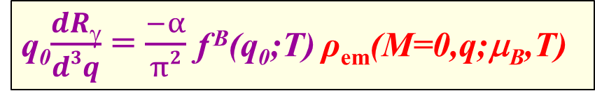
1.) Intro: Electromagnetic Probes of QCD Matter
→ penetrating probe
Photon Scattering off Nuclei
- Total Photo-
Absorption
- Dilepton Photo-/Hadro-Production
Thermal Radiation in HICs
- Dileptons
- Photons
γ
$\frac{σγA(q0)}{A}$ = $\frac{−4πα_{em}^{}}{q0ρN}$ ρ_{em}(M=0,q;μ_{N})
ρ
e⁺
e⁻
$\frac{dσγA→eeX}{dM}$ ~ ∫ f ^{N} |T_{prod}|² |D_{V}(M,q;μ_{N})|² Γ_{γ*→ee}
γ,h
ρ
e⁺
e⁻
$\frac{dRee}{d4q}$ = $\frac{−α_{}^{2}}{π3M2}$ f ^{B}(q₀;T) ρ_{em}(M,q;μ_{B},T)
γ
q₀$\frac{dRγ}{d3q}$ = $\frac{−α}{π2}$ f ^{B}(q₀;T) ρ_{em}(M=0,q;μ_{B},T)

Slide 3
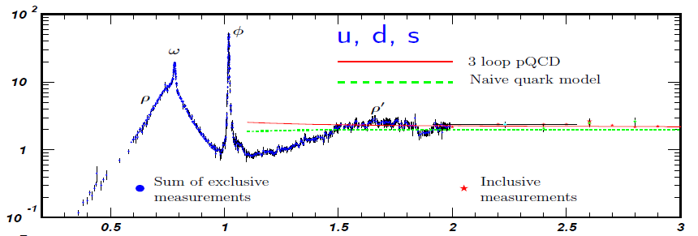
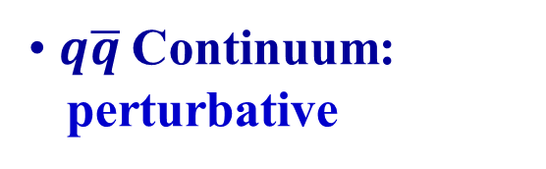
1.2 Intro II: EM Spectral Function
e⁺e⁻ → hadrons
ρ
ρ_{em}(M) / M²
e⁺ e⁻
e⁺ e⁻
M [GeV]
Hadronic Resonances:
massive, confined degrees of freedom
$q\overline{q}$Continuum:
perturbative
In Medium:
- change in spectral shape, dofs? - corrections o(T²/M²)
- restoration of chiral symmetry? - measure temperature

Slide 4
Outline
1.) Introduction
2.) In-Medium Spectral Functions
• Hadronic Many-Body Theory + Constraints
3.) Cold Nuclear Matter
• Dilepton Photo-Production off Nuclei
4.) Hot and Dense Matter
• Thermal Dileptons in Heavy-Ion Collisions
5.) Chiral Symmetry Restoration
• QCD +Weinberg Sum Rules
• Baryons
6.) Conclusions

Slide 5
2.1 ρ-Meson in Matter: Many-Body Theory
interactions with hadrons from heat bath
⇒ In-Medium ρ-Propagator
ρ
D_{ρ}(M,q;μ_{B},T) = [M² – (m_{ρ}⁽⁰⁾)² - Σ_{ρππ} - Σ_{ρB} - Σ_{ρM} ]⁻¹
ρ
Σ_{π}
Σ_{π}
In-Medium
Pion Cloud
Σ_{ρππ} = +
[Chanfray et al, Herrmann et al,
Urban et al, Weise et al, Koch et al, …]
Σ_{π}
Direct ρ-Hadron
Scattering
ρ
>
R=Δ, N(1520), a₁, K₁, …
Σ_{ρΒ,Μ} =
>
[Haglin, Friman et al,
RR et al, Post et al, …]
h=N, π, K, …
estimate couplings from R→ ρh, γh
comprehensively: scattering data (πN→ρN, γN/A,…)

Slide 6
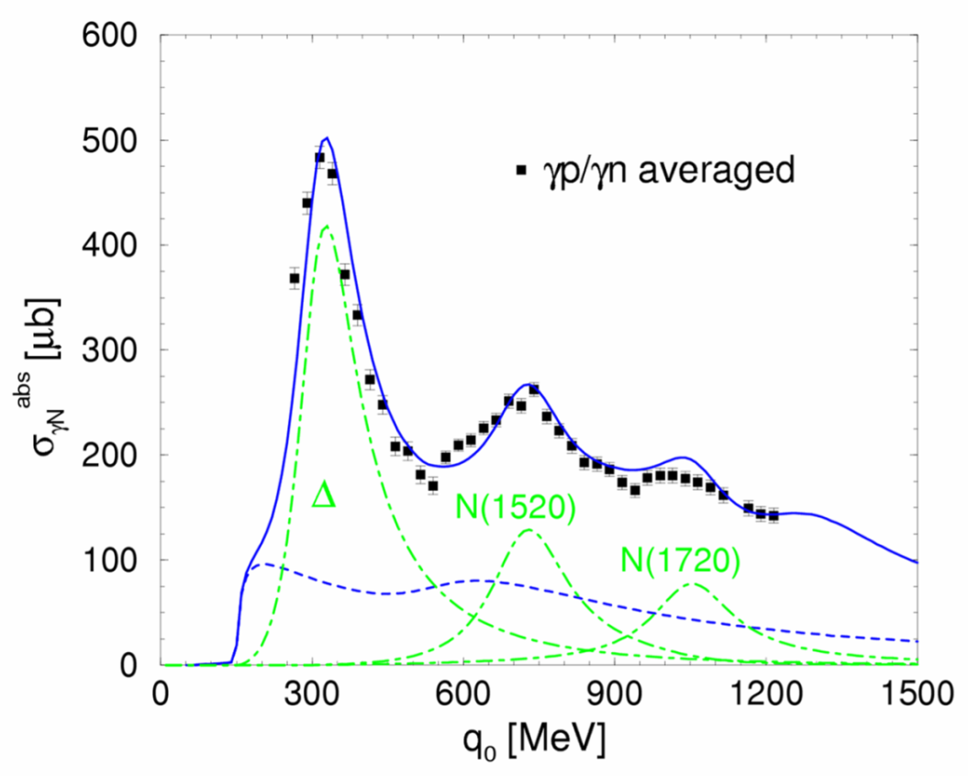
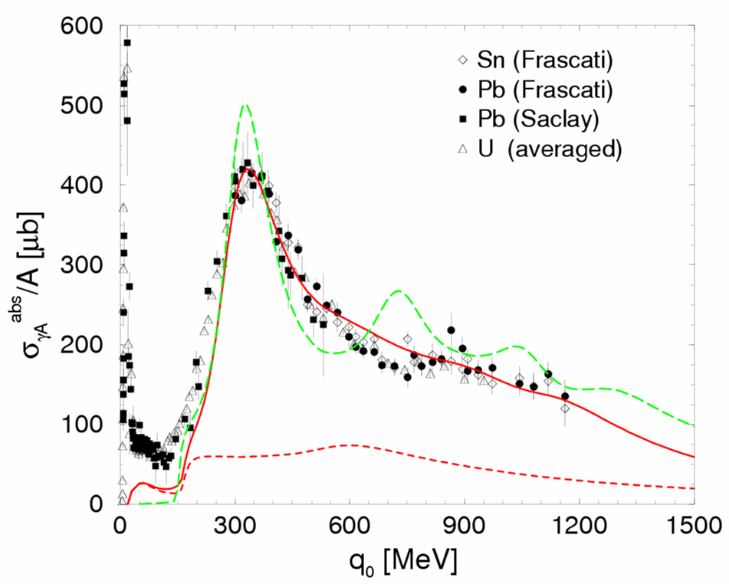
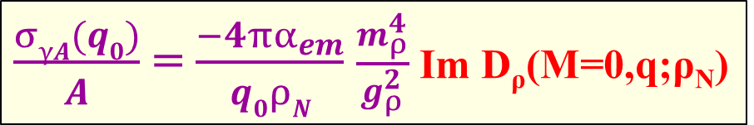
2.2 Constraints from Nuclear Photo-Absorption
$\frac{σγA(q0)}{A}$ = $\frac{−4πα_{em}^{}}{q0ρN}$ $\frac{m_{ρ}^{4}}{g_{ρ}^{2}}$ Im D_{ρ}(M=0,q;ρ_{N})
γ
ρ
On the Nucleon On Nuclei
γN
γA
π-ex
constrain ρNB couplings + non-resonant pion cloud
2nd + 3rd resonances melt
[Urban et al. ’98]

Slide 7
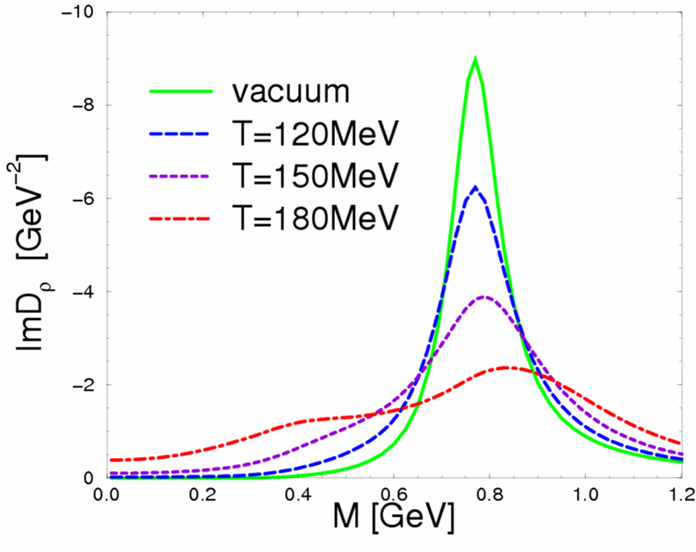
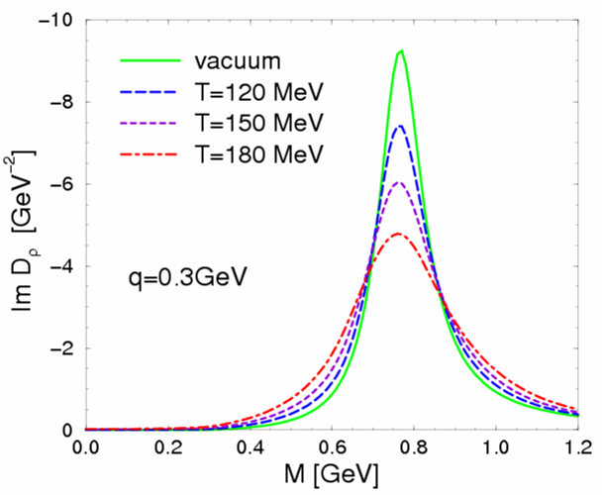
2.3 In-Medium ρ-Meson Spectral Functions
D_{ρ} (M,q;μ_{B},T) = 1 / [M² – (m_{ρ}⁽⁰⁾)² - Σ_{ρππ} - Σ_{ρB} - Σ_{ρM} ]
Hot + Dense Matter
Meson Gas only
ρ_{B}/ρ₀
0
0.1
0.7
2.6
μ_{B} =330MeV
[RR+Wambach ’99]
[RR+Gale ’99]
ρ-meson strongly broadens in hadronic matter
baryon density ρ_{B} dominant effect

Slide 8
Outline
1.) Introduction
2.) In-Medium Spectral Functions
• Hadronic Many-Body Theory + Constraints
3.) Cold Nuclear Matter
• Dilepton Photo-Production off Nuclei
4.) Hot and Dense Matter
• Thermal Dileptons in Heavy-Ion Collisions
5.) Chiral Symmetry Restoration
• QCD +Weinberg Sum Rules
• Baryons
6.) Conclusions

Slide 9
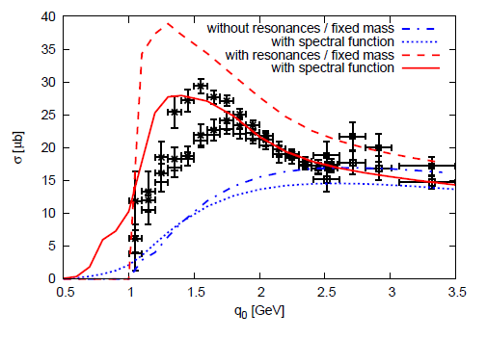
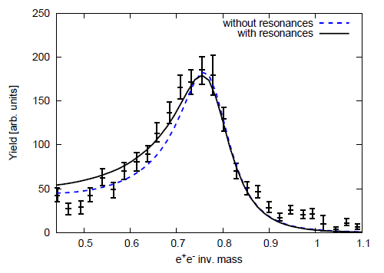
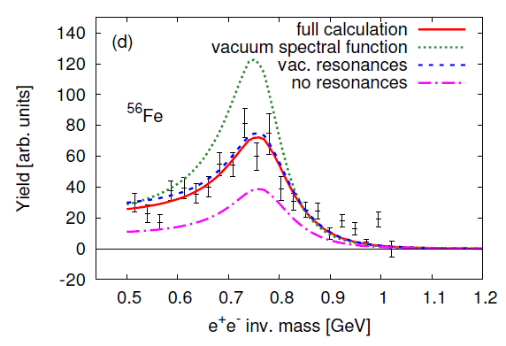
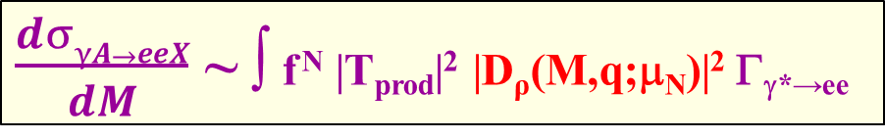
3.1 Nuclear ρ and e⁺e⁻ Photoproduction
(a) Production Amplitude: t-channel + resonances (ρ spectr. fct.!)
γ d → e⁺e⁻ X
γ
ρ
+ CLAS
N
γ N→ ρN
[Oh+Lee ‘04,
Riek et al ’08, ‘10]
(b) Medium Effects:
ρ propagator in cold nuclear matter
$\frac{dσγA→eeX}{dM}$ ~ ∫ f ^{N} |T_{prod}|² |D_{ρ}(M,q;μ_{N})|² Γ_{γ*→ee}
Avg. in-medium ρ-width Γ_{ρ} ≈ 220 MeV

Slide 10
Outline
1.) Introduction
2.) In-Medium Spectral Functions
• Hadronic Many-Body Theory + Constraints
3.) Cold Nuclear Matter
• Dilepton Photo-Production off Nuclei
4.) Hot and Dense Matter
• Thermal Dileptons in Heavy-Ion Collisions
5.) Chiral Symmetry Restoration
• QCD +Weinberg Sum Rules
• Baryons
6.) Conclusions

Slide 11
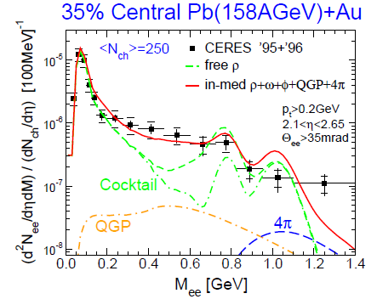
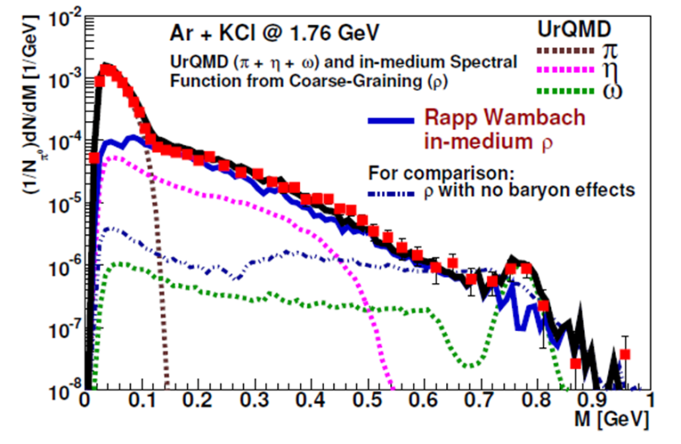
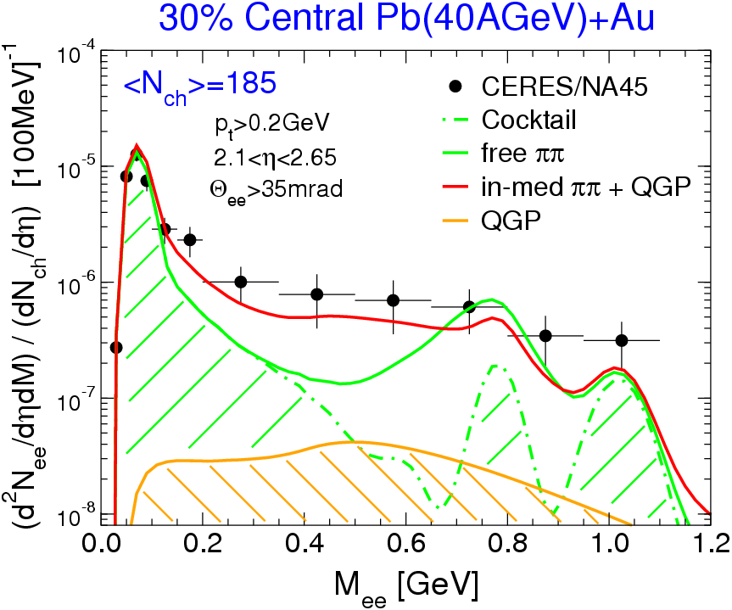
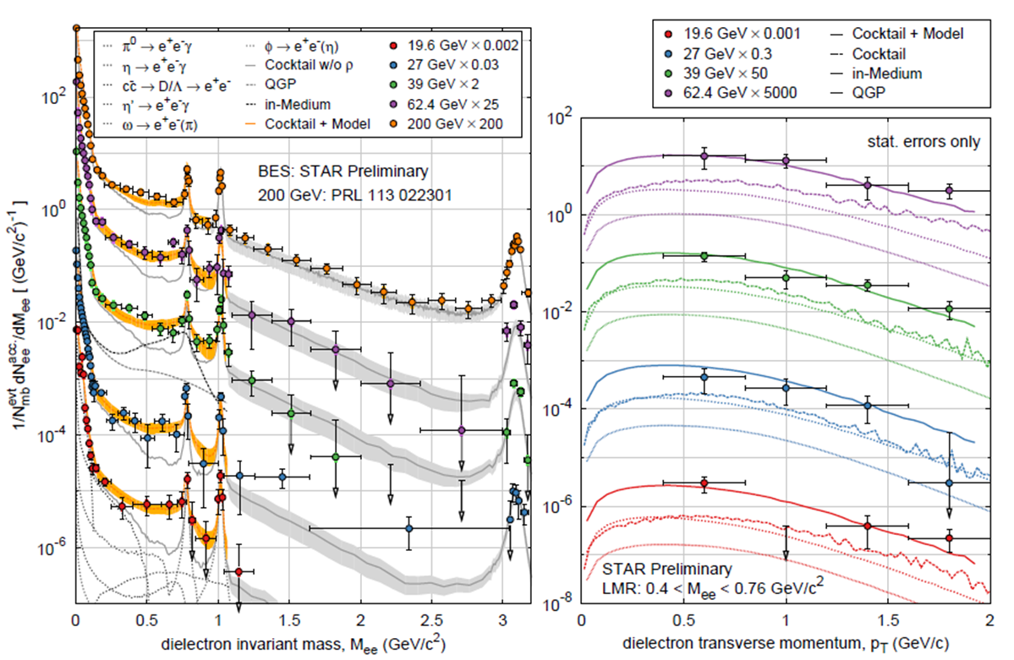
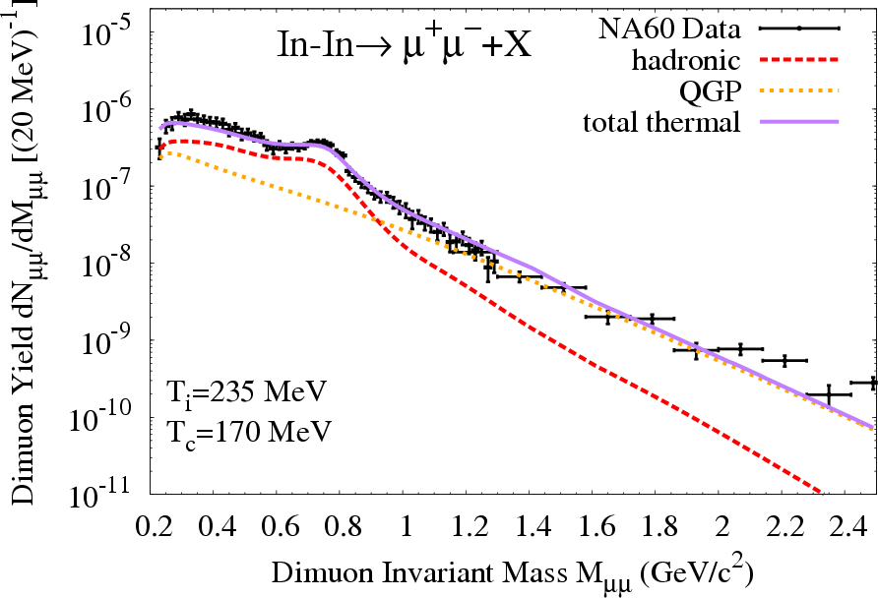
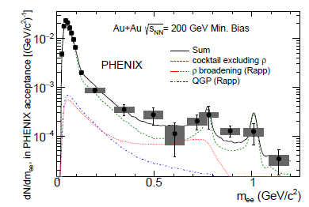
4.1 30 Years of Dileptons in Heavy-Ion Collisions
<N_{ch}>=120
Robust understanding across QCD phase diagram:
QGP + hadronic radiation with melting ρ resonance

Slide 12

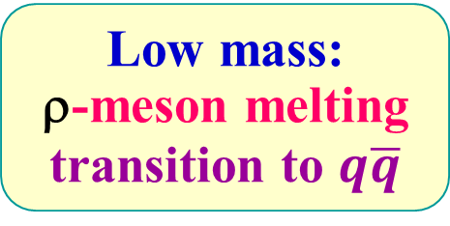
4.2 NA60 Dimuons at SPS (√s=17.3 GeV)
Integrate rates over evolving fireball:
Excess Radiation Spectrum
e⁺
e⁻
-
High mass:
QGP thermometer
T_{avg} ~ 200 MeV
q q
ρ
Low mass:
ρ-meson melting
transition to $q\overline{q}$

Slide 13
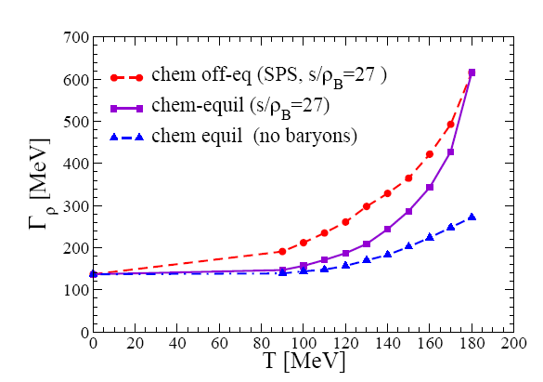
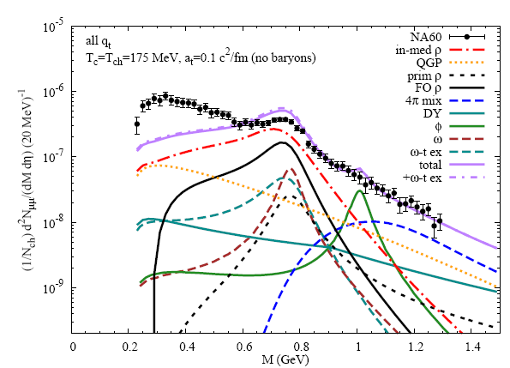
4.3 Sensitivity to Spectral Function
In-Medium ρ-Meson Width
M_{μμ} [GeV]
avg. Γ_{ρ} (T~150MeV) ~ 370 MeV ⇒ Γ_{ρ} (T~T_{c}) ≈ 600 MeV → m_{ρ}
driven by (anti-) baryons

Slide 14
Outline
1.) Introduction
2.) In-Medium Spectral Functions
• Hadronic Many-Body Theory + Constraints
3.) Cold Nuclear Matter
• Dilepton Photo-Production off Nuclei
4.) Hot and Dense Matter
• Thermal Dileptons in Heavy-Ion Collisions
5.) Chiral Symmetry Restoration
• QCD +Weinberg Sum Rules
• Baryons
6.) Conclusions

Slide 15
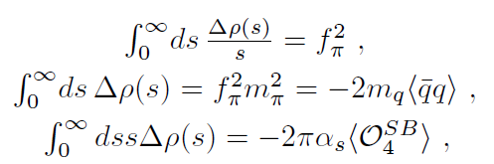
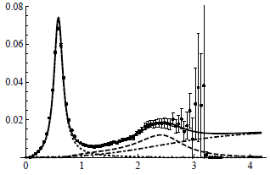
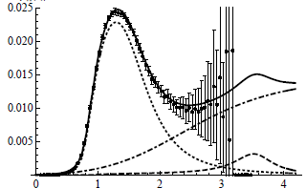
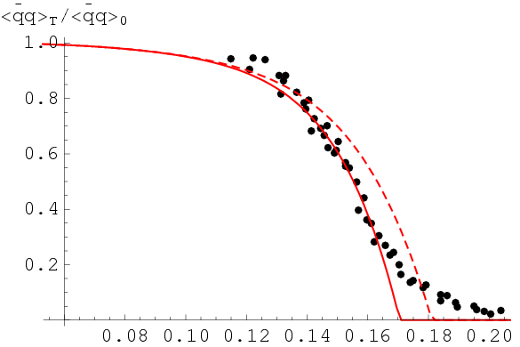

5.1 QCD + Weinberg Sum Rules
[Hatsuda+Lee’91,
Asakawa+Ko ’93,
Leupold et al ’98, …]
ρ
a₁
Δρ = ρ_{V} -ρ_{A}
[Weinberg ’67, Das et al ’67;
Kapusta+Shuryak ‘94]
accurately satisfied in vacuum
In Medium:
condensates from hadron resonance gas,
constrained by lattice-QCD
T [GeV]

Slide 16
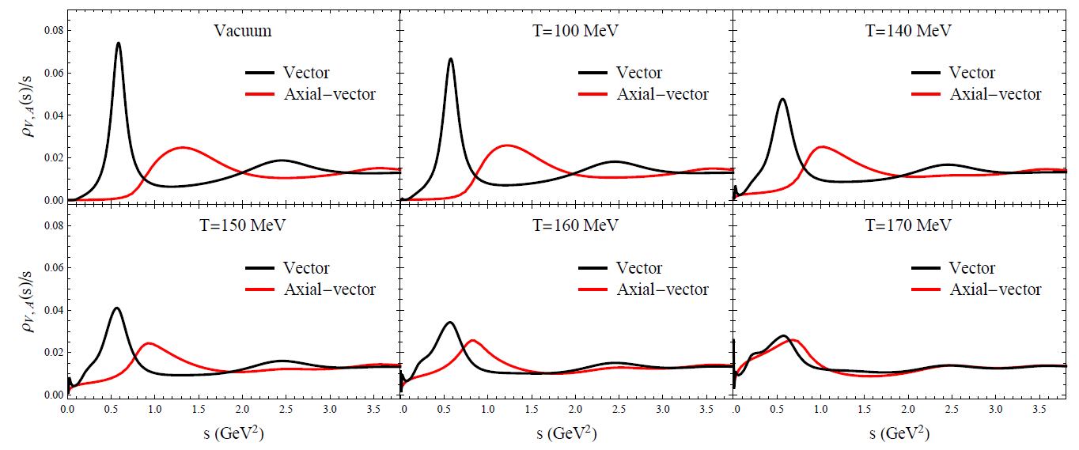
5.2 QCD + Weinberg Sum Rules in Medium
→ Search for solution for axial-vector spectral function
[Hohler +RR ‘13]
quantitatively compatible with (approach to) chiral restoration
strong constraints by combining SRs
Chiral mass splitting “burns off”, resonances melt

Slide 17
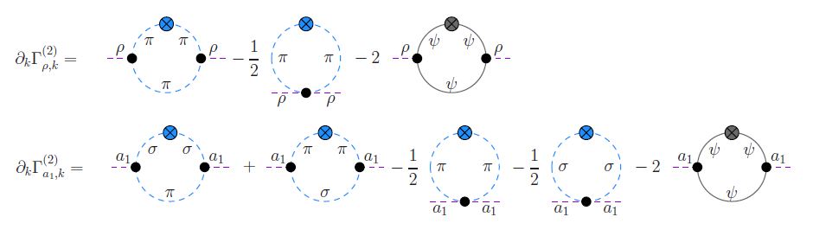
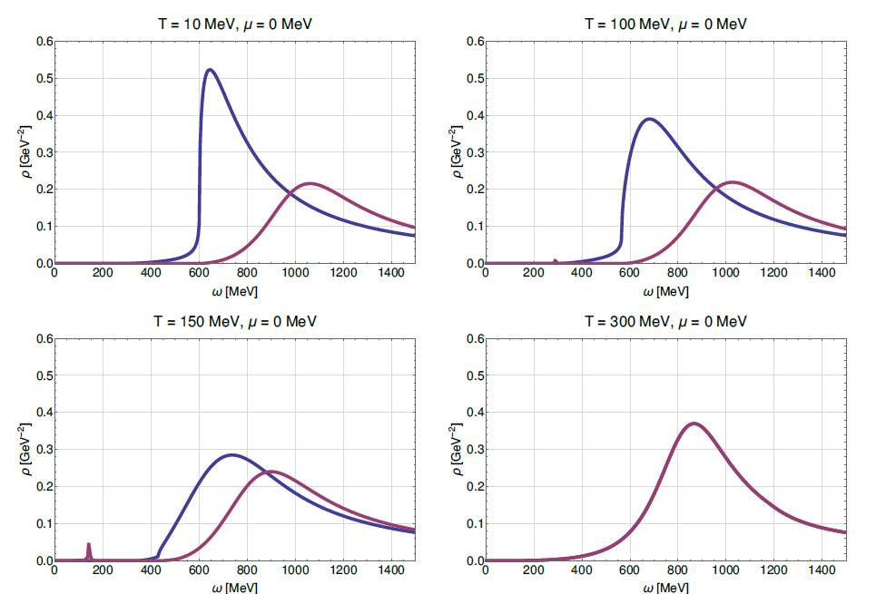
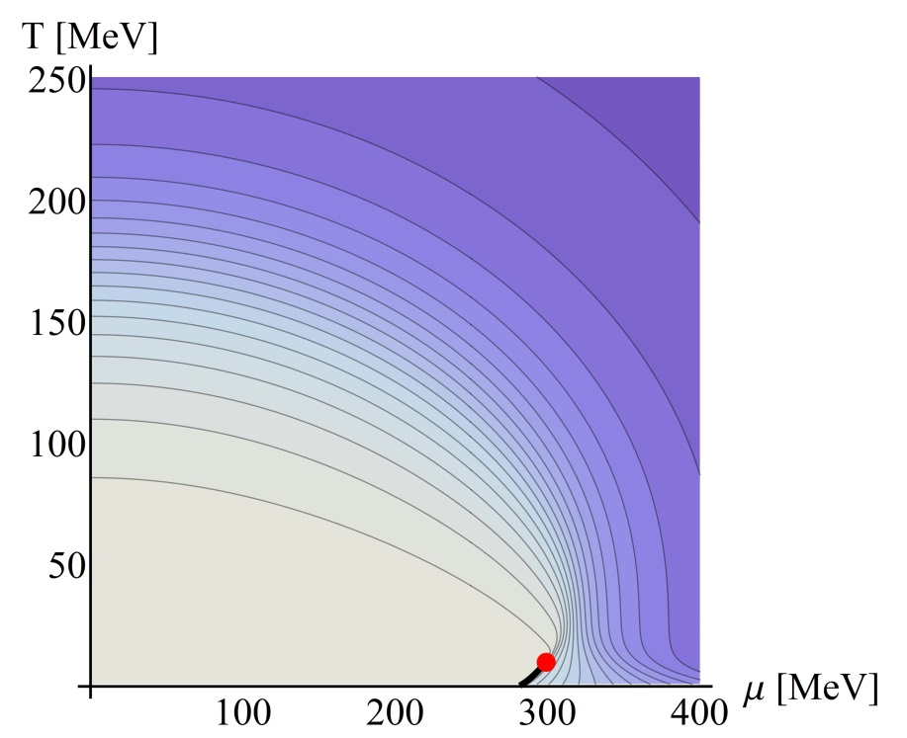
5.3 Functional Renormalization Group Approach
Quark-Meson model:
Phase Diagram
ρ
a₁
qualitatively similar to hadronic many-body calculations!
[Tripolt
et al ‘17]

Slide 18
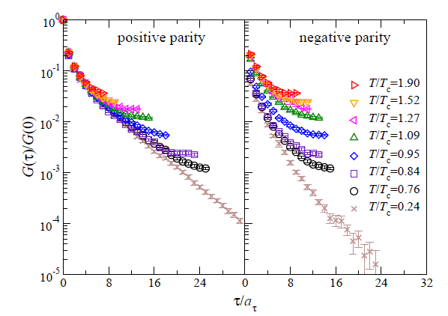
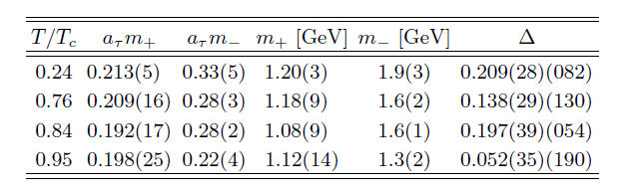
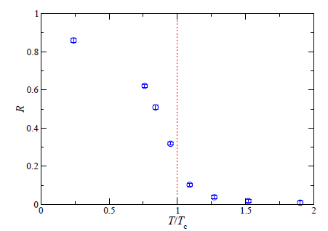
5.4 Lattice-QCD Results for N(940)-N(1535)
Euclidean Correlator Ratios Exponential Mass Extraction
“Nucleon”
“N(1535)”
R = ∫(G⁺-G⁻)/(G⁺+G⁻)
[Aarts et al ‘15]
also indicates M_{N*}(T) → M_{N} (T) ≈ M_{N}^{vac}

Slide 19
6.) Conclusions
In-medium ρ spectral function:
- rooted in vacuum spectroscopy and reactions
- strongly broadened via interactions w/ baryons (“core” + “cloud”)
Explicit evidence for parton-hadron transition:
- ρ melting describes dilepton spectra in heavy-ion collisions
Progress in understanding mechanisms of chiral restoration:
- evaporation of chiral ρ-a₁ mass splitting (sum rules, MYM, FRG)
- similar behavior for π-σ, N(940)-N(1535), …

Slide 20
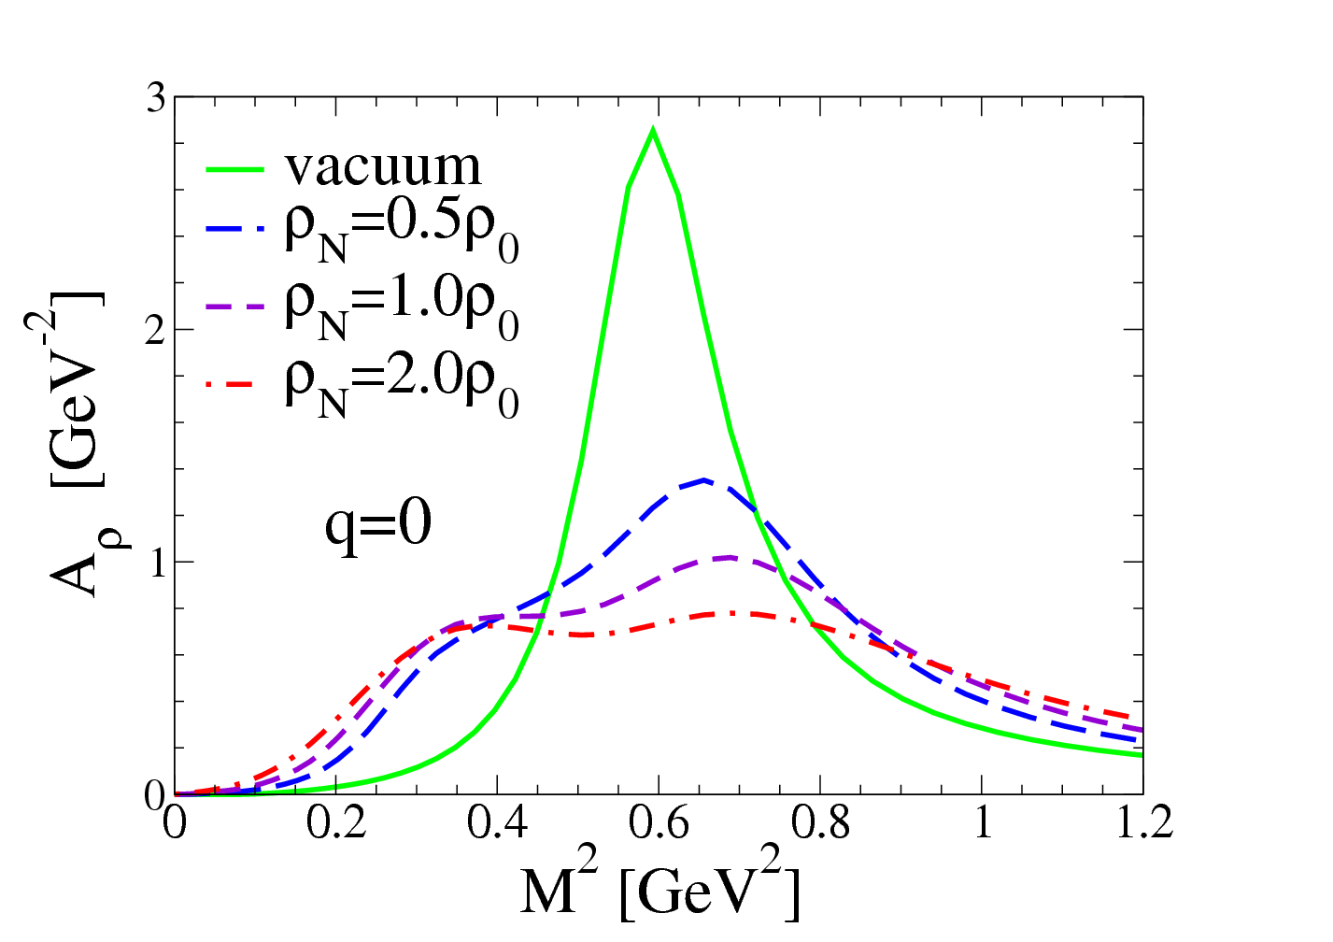
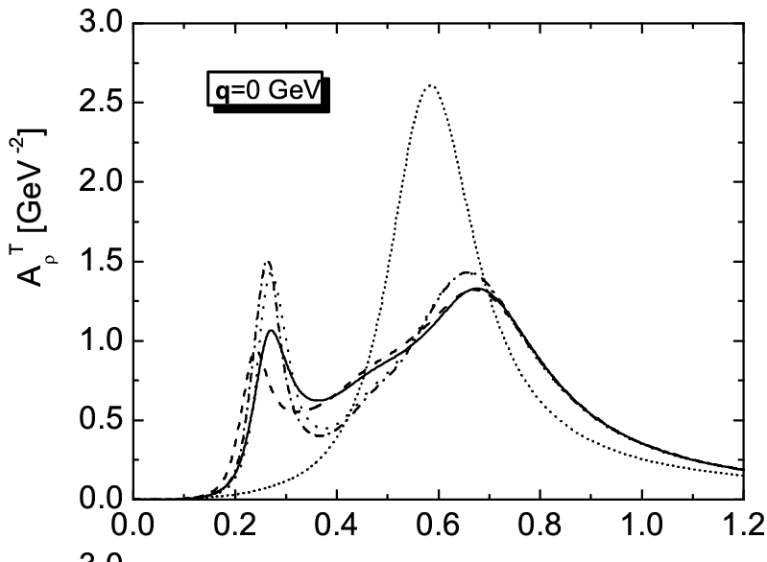
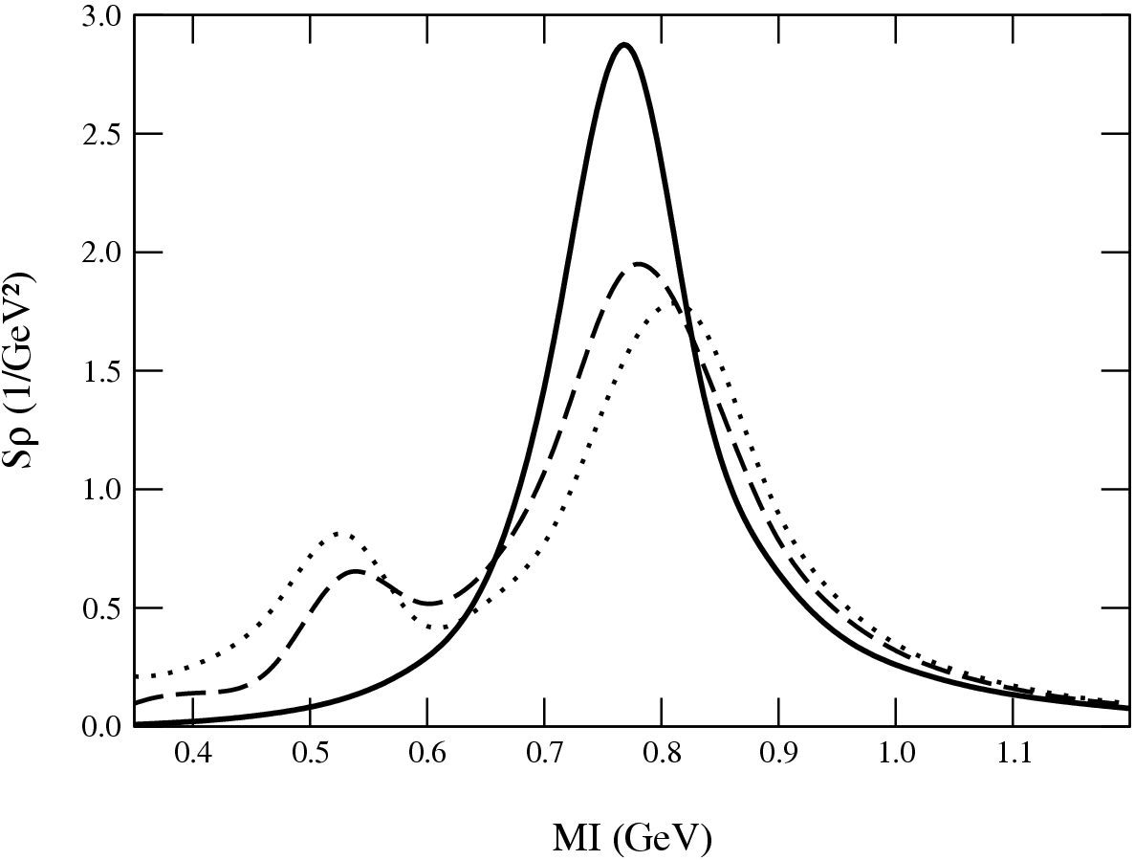
4.4 ρ-Meson Spectral Function in Nuclear Matter
In-med. π-cloud +
ρ+N→B* resonances
ρ+N→B* resonances
(low-density approx.)
In-med. π-cloud +
ρ+N → N(1520)
[Urban
et al ’98]
[Post
et al ’02]
[Cabrera
et al ’02]
ρ_{N}=0.5ρ₀
ρ_{N}=ρ₀
ρ_{N}=ρ₀
Constraints: γ N , γ A
π N →ρ N PWA
Consensus: strong broadening + slight upward mass-shift
Constraints from (vacuum) data important quantitatively

Slide 21
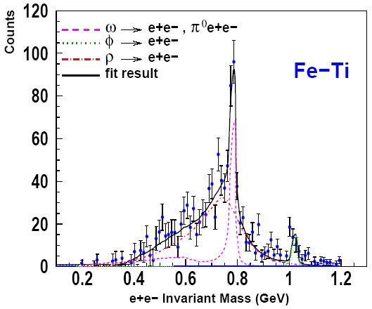
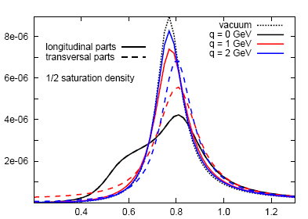
3.2 Nuclear Photoproduction: ρ Meson in Cold Matter
γ + A → e⁺e⁻ X
extracted
“in-med” ρ-width
Γ_{ρ} ≈ 220 MeV
e⁺
e⁻
E_{γ}≈1.5-3 GeV
γ
ρ
[CLAS+GiBUU ‘08]
Microscopic Approach:
production amplitude + in-med. ρ spectral fct.
ρ
γ
N
[Riek et al ’08, ‘10]
M [GeV]
M [GeV]
ρ-broadening reduced at high 3-momentum; need low momentum cut

Slide 22
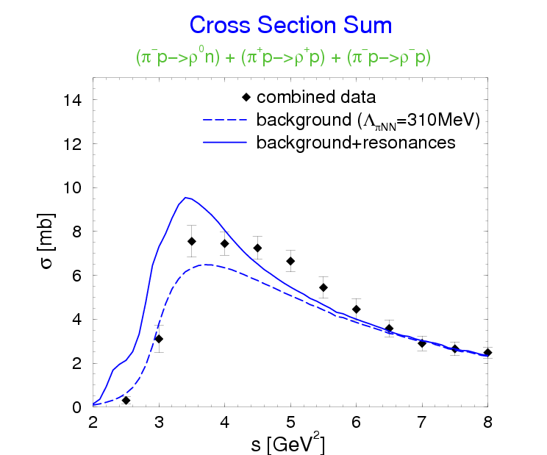
2.3 Constraints II: πN→ ρΝ Scattering
HADES
π⁻ p→π⁻π⁰ p
background (Λ_{πNN}=400MeV)
ρp - total
3/2⁻ (D13+…)
1/2⁻ (S11+…)
[Urban,Buballa,
RR+Wambach ’98]
strong constraint on pion cloud coupling to nucleons
similarly small cutoff in πN → Δ → πN scattering!

Slide 23
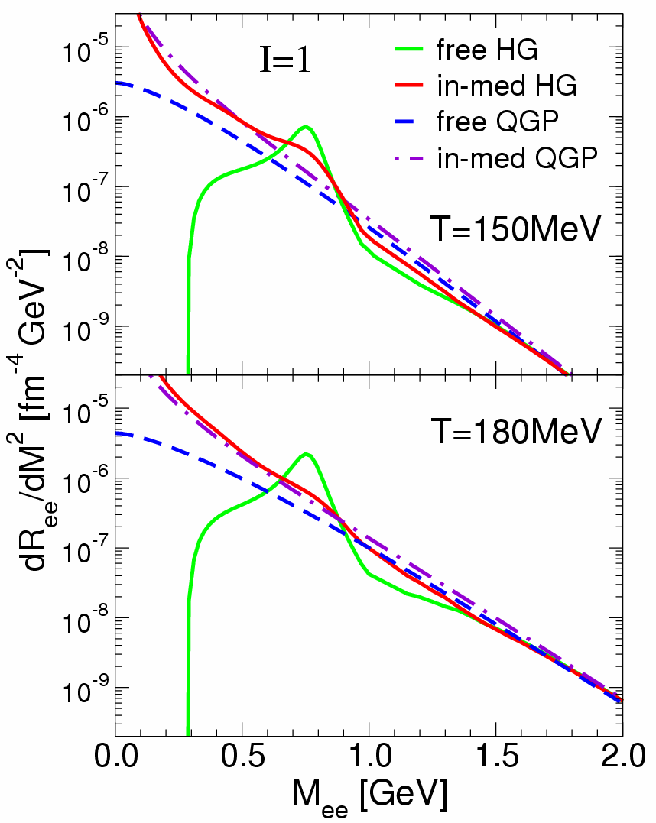
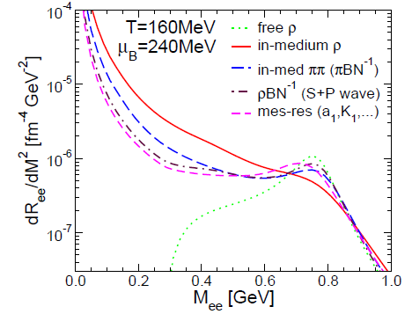
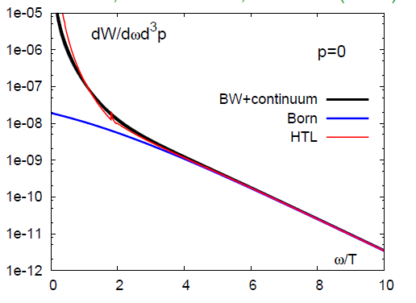
2.5 Dilepton Rates and Degrees of Freedom dR_{ee} /dM² ~ ∫d³q/q₀ f ^{B}(q₀;T) Im Π_{em} /M²
ρ-meson resonance “melts”
spectral function merges into
QGP description
Direct evidence for transition
hadrons → quarks + gluons
-
[qq→ee]
[HTL]
dR_{ee}/d⁴q 1.4T_{c} (quenched) q=0
[Ding et al ’10]
[RR,Wambach et al ’99]

Slide 24
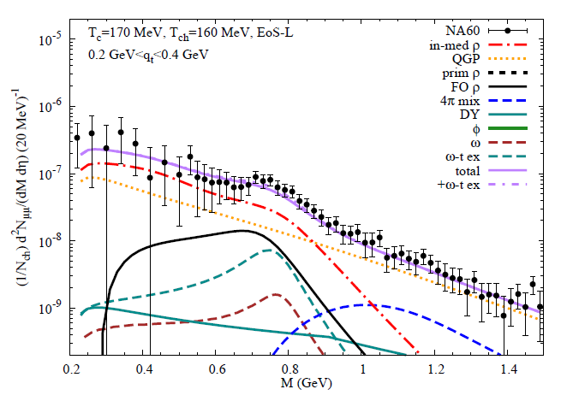
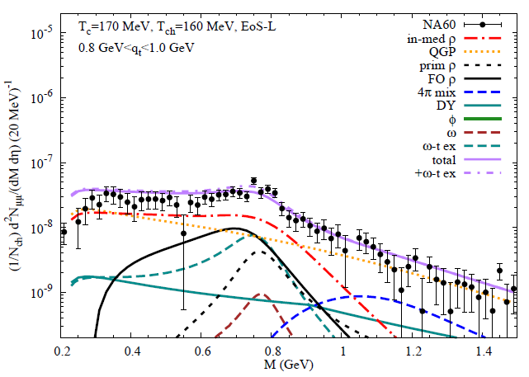
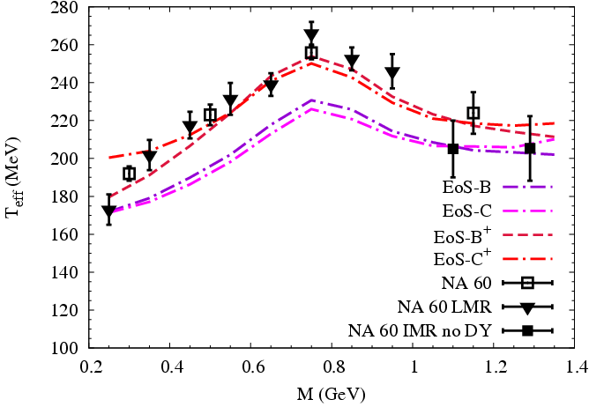
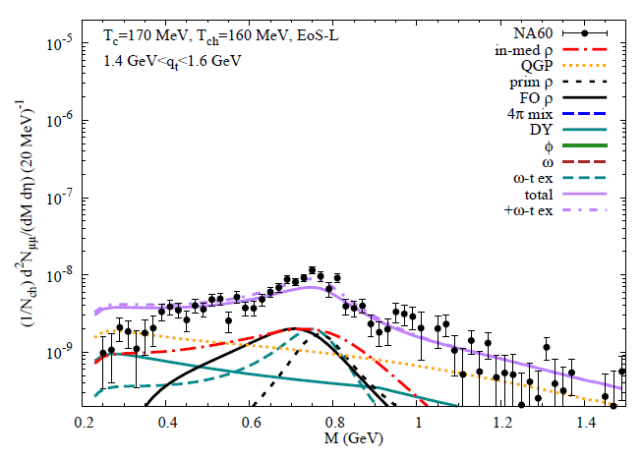
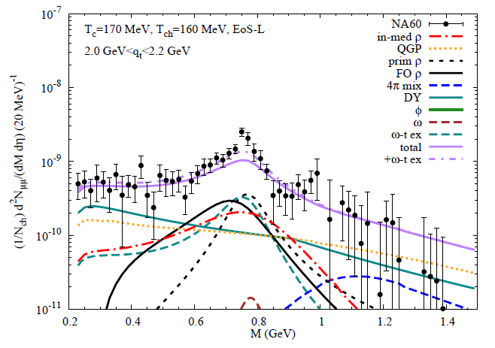
2.2 Transverse-Momentum Dependence
p_{T} -Sliced Mass Spectra
m_{T} -Slopes
x 100
spectral shape as function of pair-p_{T}
entangled with transverse flow (barometer)

Slide 25
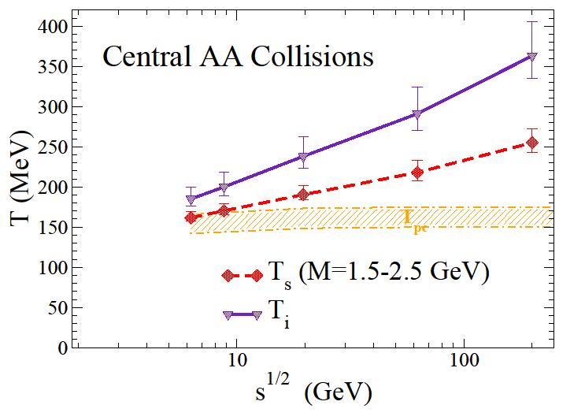
4.2 Fireball Temperature
Slope of Intermediate-Mass Excess Dileptons
unique ``early” temperature measurement (no blue-shift!)
T_{s} approaches T_{i} toward lower energies
first-order “plateau” at BES-II/CBM/NICA?

Slide 26


4.3 Fireball Lifetime
Excitation Function of Low-Mass Dilepton Excess Yield
1000
[RR+van Hees ‘14]
[STAR ‘15]
Low-mass excess tracks lifetime well (medium effects!)
Tool for critical point search?

Slide 27



2.2 Chiral Condensate + ρ-Meson Broadening
- -
⟨⟨qq⟩⟩ / ⟨qq⟩₀
effective hadronic theory
-
Σ_{h} = m_{q} ⟨h|qq|h⟩ > 0 contains quark core + pion cloud
= Σ_{h}^{core} + Σ_{h}^{cloud} ~ + +
matches spectral medium effects: resonances + pion cloud
resonances + chiral mixing drive ρ-SF toward chiral restoration
>
ρ
Σ_{π}
>
Σ_{π}

Slide 28


2.1 In-Medium Vector Mesons at RHIC + LHC
Anti-/baryon effects melt the ρ meson
ω also melts, φ more robust ↔ OZI

Slide 29



4.3 Comparison to Data: RHIC
Ideal Hydro Viscous Hydro
[van Hees et al, ‘11, ’14]
[Paquet et al ’16]
same rates + intial flow ⇒ similar results from various evolution models

Slide 30


3.2 Massive Yang-Mills in Hot Pion Gas
Temperature progression of vector + axialvector spectral functions
supports “burning” of chiral-mass splitting
as mechanism for chiral restoration
[as found in sum rule analysis]

Slide 31





3.2 Massive Yang-Mills Approach in Vaccum
Gauge ρ + a₁ into chiral pion lagrangian:
problems with vacuum phenomenology
→ global gauge?
Recent progress:
- full ρ propagator in a₁ selfenergy
- vertex corrections to preserve
PCAC:
[Urban et al ‘02,
Rischke et al ‘10]
[Hohler +RR ‘14]
enables fit to τ-decay data!
local-gauge approach viable
starting point for addressing
chiral restoration in medium

Slide 32


5.2 Chiral Restoration Window at LHC
low-mass spectral shape in chiral restoration window:
~60% of thermal low-mass yield in “chiral transition region”
(T=125-180MeV)
enrich with (low-) p_{t} cuts

Slide 33

3.3.2 Fireball vs. Viscous Hydro Evolution
[van Hees,
Gale+RR ’11]
[S.Chen
et al ‘13]
very similar!

