Slide 1

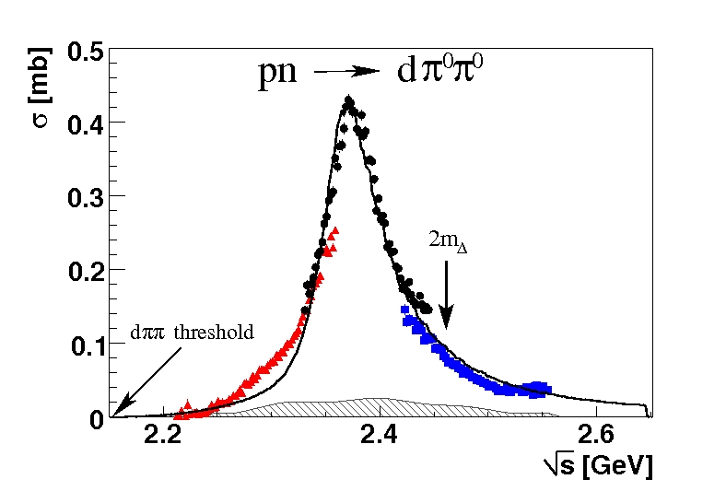
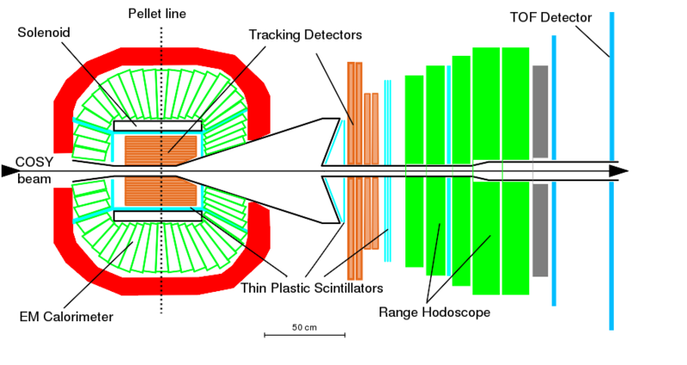


Pion production in NN collisions and the issue of dibaryons
MESON 2018
Tatiana Skorodko
for WASA-at-COSY Collaboration

Slide 2
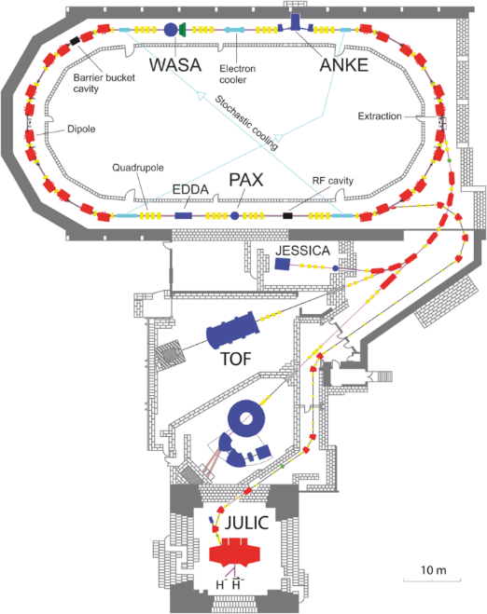
COoler SYnchrotron
Experimental setup
polarized/unpolarized p/d beam
up to p = 3.7 Gev/c
Δp/p ≈ 10⁻³ − 10⁻⁴ (cooling)
luminocity 10³¹ − 10³² cm⁻²s⁻¹

Slide 3
Experimental setup
Forward Detector
angular resolution 0.2°
energy resolution
stopped ≈ 3%
punch trough 3-10%

Slide 4
Experimental setup
Central Detector
angular resolution
charged ≈ 1.2°
neutral ≈ 5°
energy resolution
charged ≈ 3%
photons ≈ 8%
Target
p/d pellets ∅ 25-35 μm

Slide 5
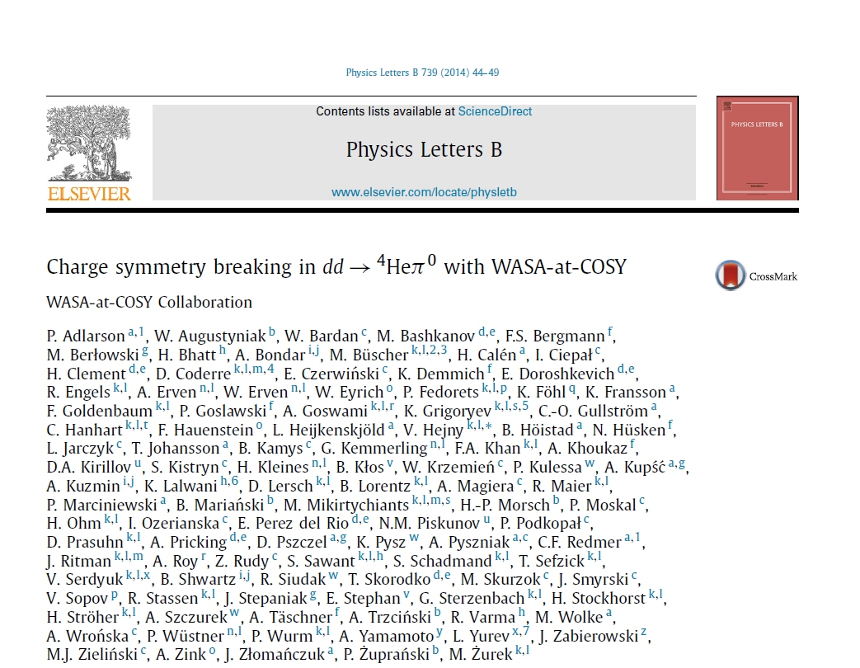
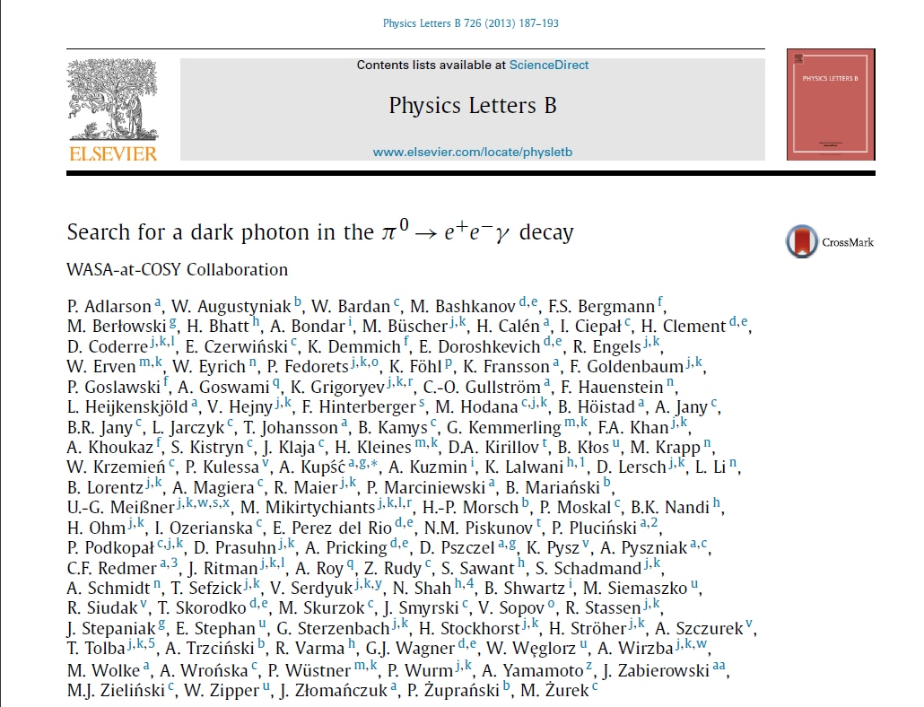
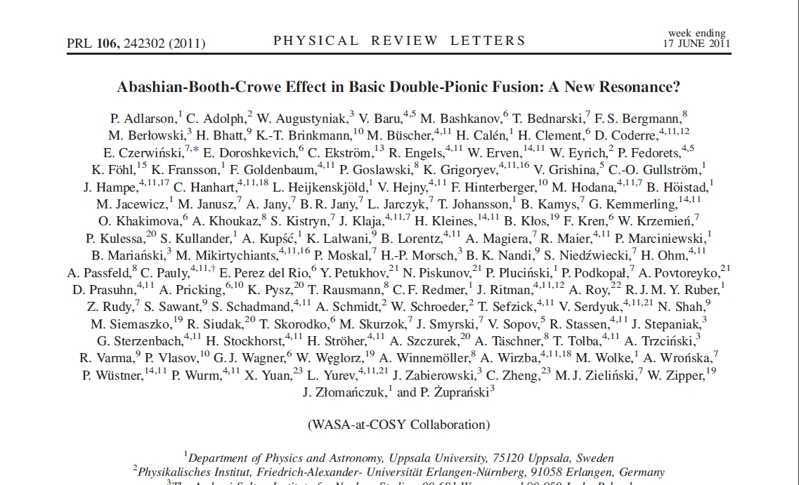
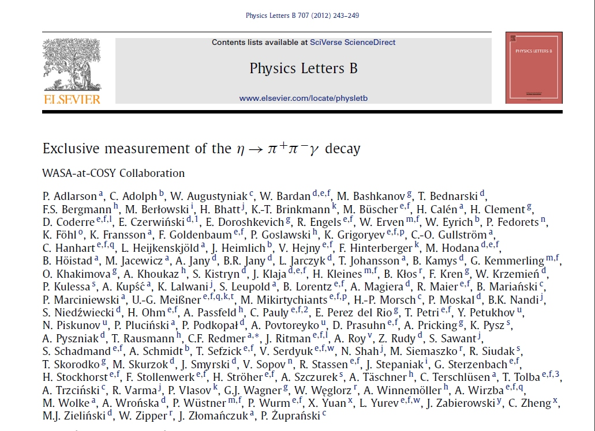
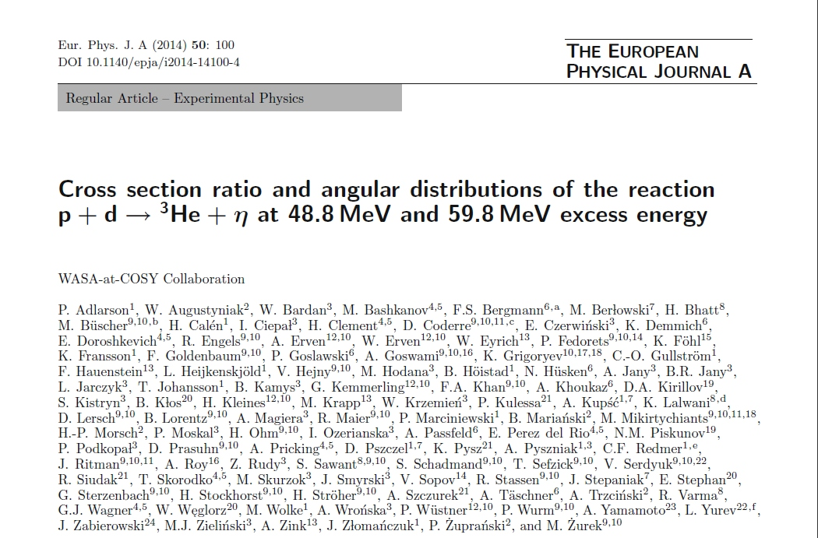
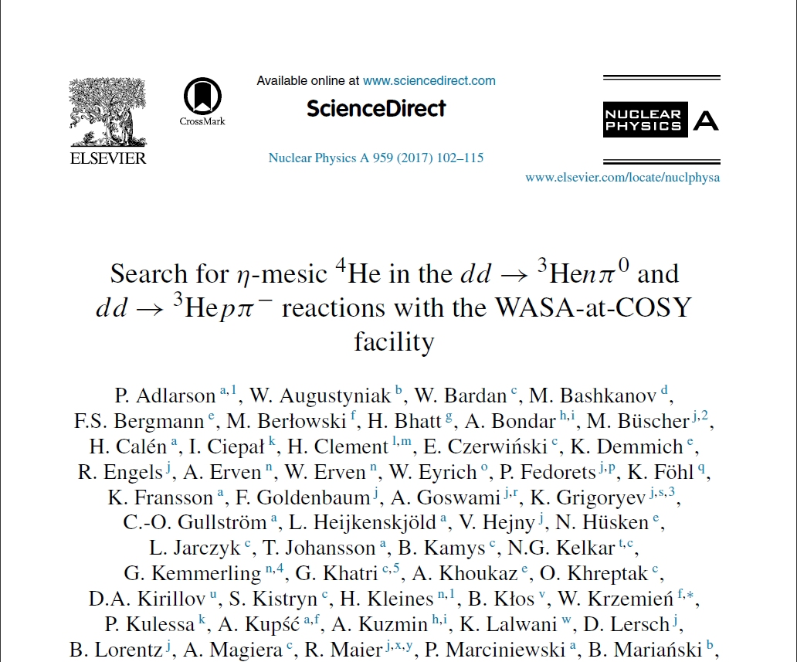
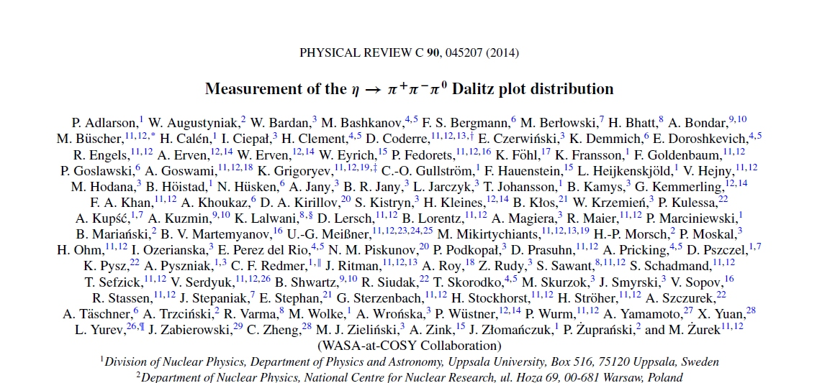
Physics program

Slide 6
Dyson & Xuong‘s Prediction
Family of non strange dibaryons
State I J Asymptotic Configuration m_{theor} [MeV] m_{exp} [MeV] G_{exp} [MeV]
---------------------------------------------------------------------------------------------------------------------------------
D₀₁ 0 1 Deuteron 1876 1876
D₁₀ 1 0 virtual ¹S₀ 1876 1878
D₁₂ 1 2 NN(¹D₂) ↔ ΔN ↔ NNπ 2160 ΔN threshold
D₂₁ 2 1 2160
D₀₃ 0 3 2350
D₃₀ 3 0 2350
---------------------------------------------------------------------------------------------------------------------------------

Slide 7
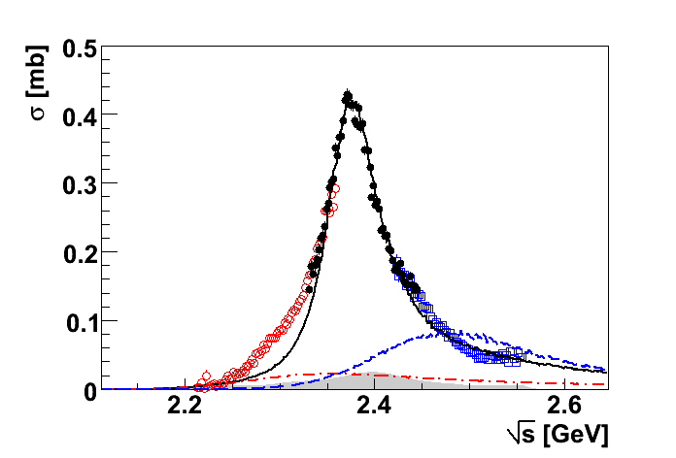
pn → d* → pn
pn → d* → dπ⁰π⁰
Argand diagram:
M ≈ 2.37 GeV
G ≈ 70 MeV
Pole in ³D₃ at
2380±10 - i 40±5 MeV
PRL 106 (2011) 242302
PRC 90 (2014) 035204

Slide 8
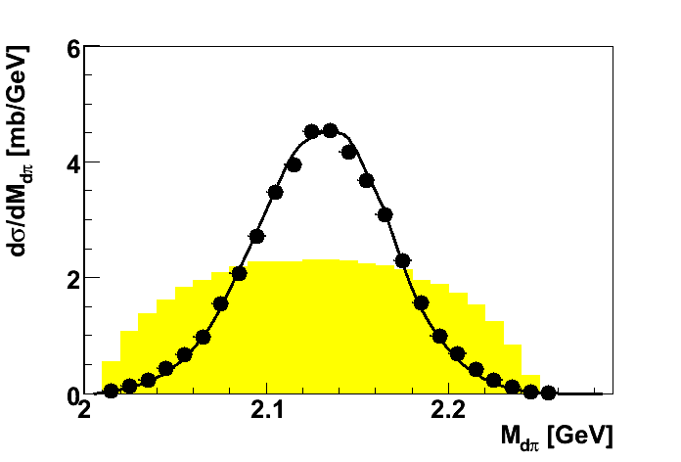
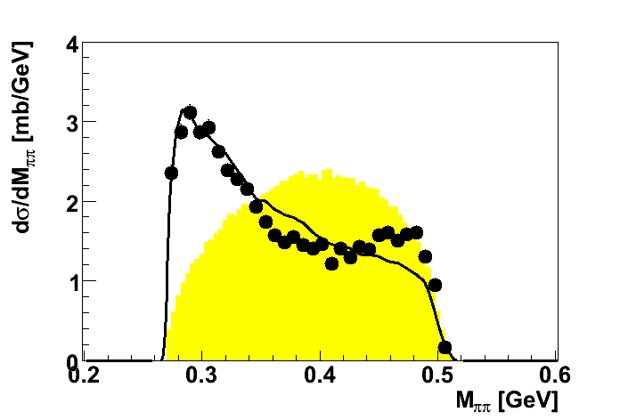
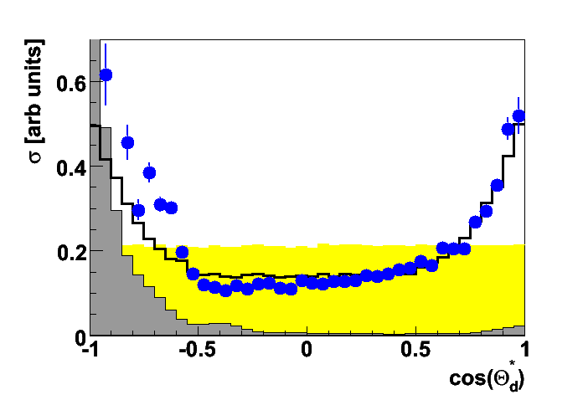
pn → d* → ΔΔ → dπ⁰π⁰
M ≈ 2.37 GeV
G ≈ 70 MeV
M_{dπ}0
M_{ππ}
ABC effect
model
n
Δ
π
Θ_{d}*
I (J^{P}) = 0 (3⁺)
d
p
π
Δ
Phys.Rev.Lett.106, 242302 (2011)

Slide 9
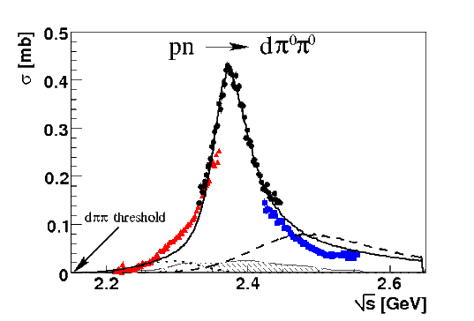
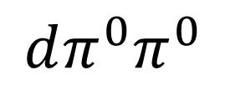
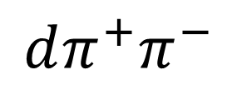
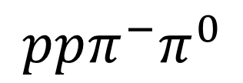
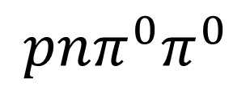
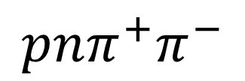
Hadronic decay
PLB 721 (2013) 229
PRL 106 (2011) 242302
I = 0+1
I = 1
I = 0
dπ⁺π⁻
½ dπ⁺π⁰
2 dπ⁰π⁰
WASA data
pn → d*(2380)
PRC 88 (2013) 055208
PLB 743 (2015) 325
Phys. Scr. T 166 (2015) 014016
d*
d*
d*
→ √s [GeV]

Slide 10
Theoretical description 1
Fei Huang, C1
d* has a compact structure and can have an exotic hexaquark component
Experiment SU(6) QDCSM ChQM RGM
6q ↔ ΔΔ (31.5%)ΔΔ + (68.5%)CC
Dyson & Xuong Goldman et al. Qi-Fang Lu et al. Yubing Dong et al.
PRL 13 (1964) 815 PRC 90 (2014) 064003 PRD 96(2017) 0114036 PRC 94 (2016) 014003
mass [MeV] 2380 2350 2360 2356 2380
Γ [MeV] 70 104 71.9

Slide 11
Theoretical description 1
Avraham Gal, C1
d* is a molecular-like hadronic state
Experiment Faddeev calculations
D₁₂π α[ΔΔ ]+(1-α)[D₁₂π] , α=5/7
A.Gal , H.Garcilazo A.Gal
PRL 111 (2013) 172301 PRL B769 (2017) 436
mass [MeV] 2380 2363 2380
Γ [MeV] 70 68 75

Slide 12
Branching Ratios for the Decay of d*(2380)
• hadronic decays
EPJA 51 (2015) 87
decay channel branching derived from
------------------------------------------------------------------------
d π⁰π⁰ 14 ± 1 % measurement
d π⁺π⁻ 23 ± 2 % measurement
ppπ⁰π⁻ 6 ± 1 % measurement
nnπ⁺π⁰ 6 ± 1 % isospin mirrored
npπ⁰π⁰ 12 ± 2 % measuremen
npπ⁺π⁻ 30 ± 4 % measurement (old data + HADES)
np 12 ± 3 % measurement
(NNπ)_{I=0} < 9 % measurement
{
consistent with
isospin coupling
for a ΔΔ and D₁₂π
intermediate
systems
ΔΔ D₁₂π
12% 0
0 18%

Slide 13
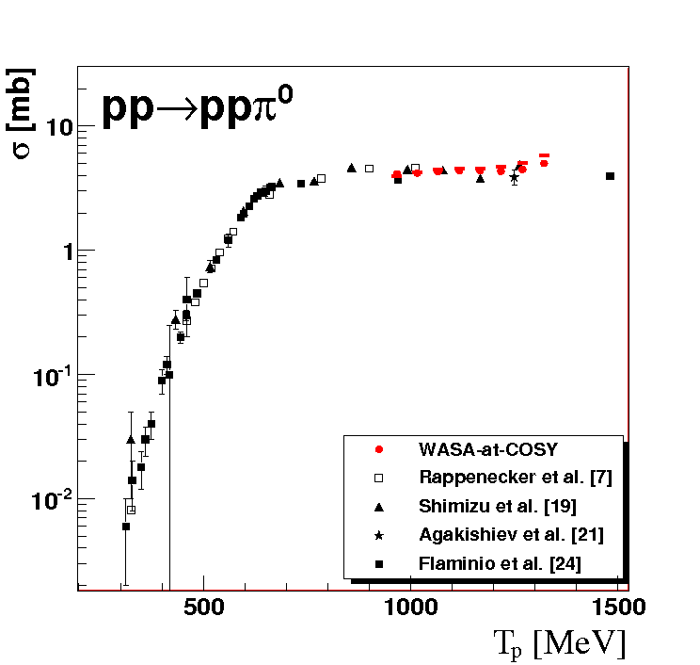
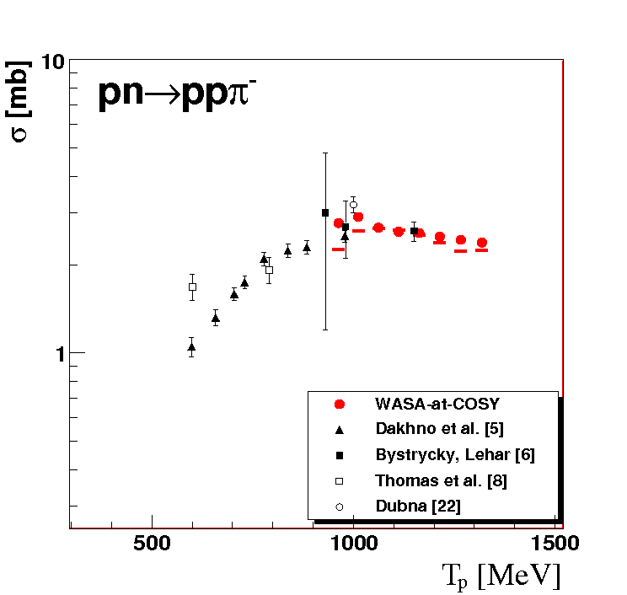
NN→NNπ
PL D774 (2017) 599
σ (I₀)=3(2σ(ppπ⁻) − σ(ppπ⁰))

Slide 14
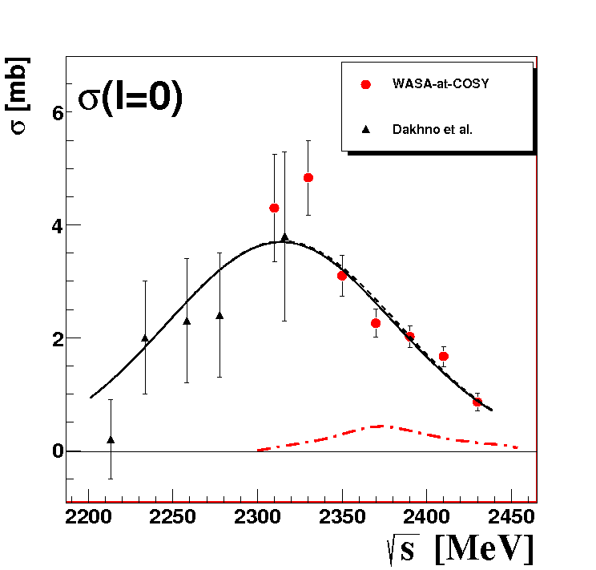
Isoscalar Single-Pion Production
d* → πD₁₂
→NN
⇒
18%
d* → πNN
experiment < 9% (90% CL)
d*

Slide 15
Conclusions 1: d* (D₀₃)
d*(2380) established as a genuine s-channel resonance
It is the first unambiguously detected non-trivial dibaryon state.
It could be a compact hexaquark state – but this needs experimental verification.

Slide 16
Established dibaryon states
⁰S₁ – deuteron ground state I(J^{P})=0(1⁺)
¹S₀ – virtual state (NN FSI) I(J^{P})=1(0⁺)
¹D₂ – resonance structure at ΔN threshold I(J^{P})=1(2⁺)
⁰D₃ – d*(2380) ΔΔ resonance I(J^{P})=0(3⁺)
Are there more states?
²D₁ I(J^{P})=2(1⁺), ³D₀ I(J^{P})=3(0⁺) ?

Slide 17
Where D₂₁ can be seen?
I=2 ⇒ only associated production
pp → ppπ⁺ π⁻
D₂₁

Slide 18
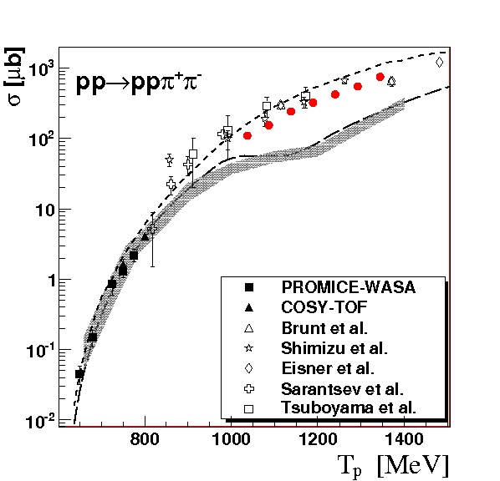
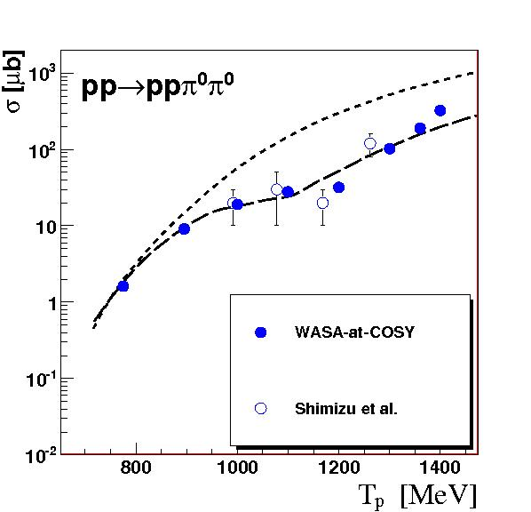
Model description
PLB 695 (2011) 115
Roper + ΔΔ
Roper + ΔΔ
original Valencia model (Roper + ΔΔ)
modified Valencia model (reduced Roper + ΔΔ )

Slide 19
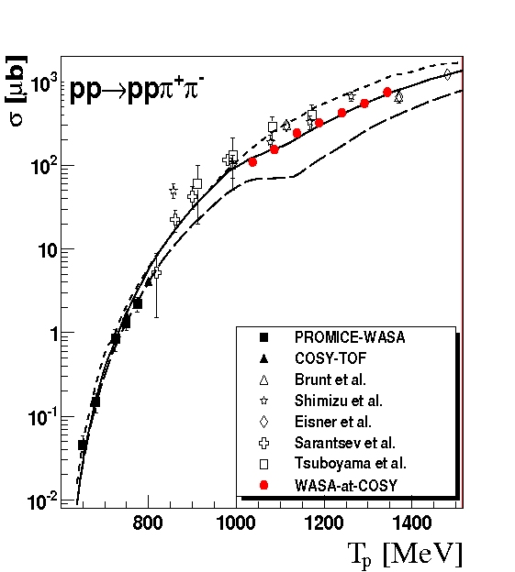
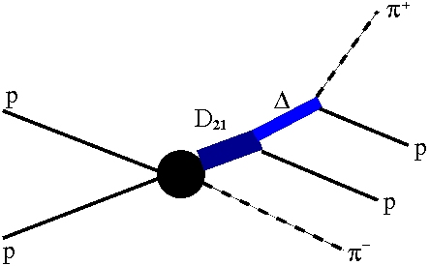
Results
original Valencia model
modified Valencia model
modified Valencia model +
D₂₁
M = 2140 MeV
Γ = 110 MeV

Slide 20
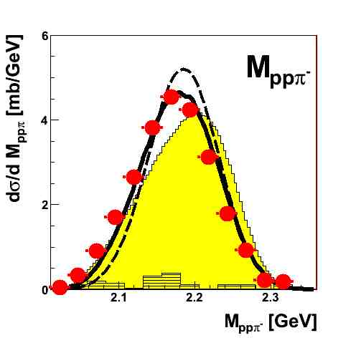
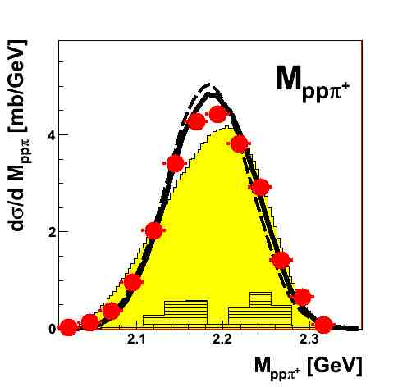
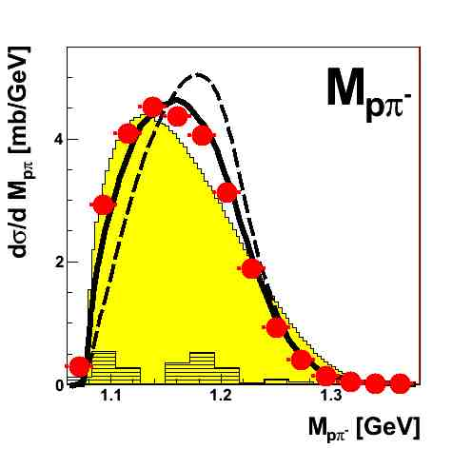
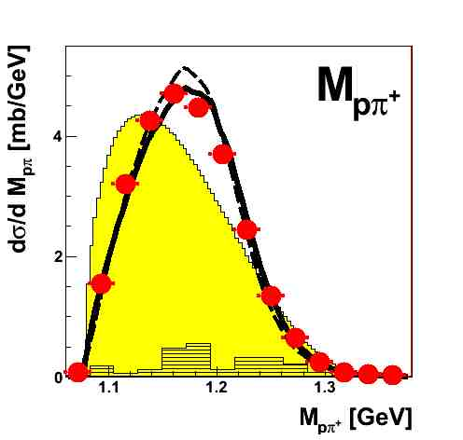
T_{p}=1.2 GeV
Results
modified Valencia model
modified Valencia model + D₂₁
If ΔΔ dominates
M_{pπ+} = M_{pπ−}
⇒

Slide 21
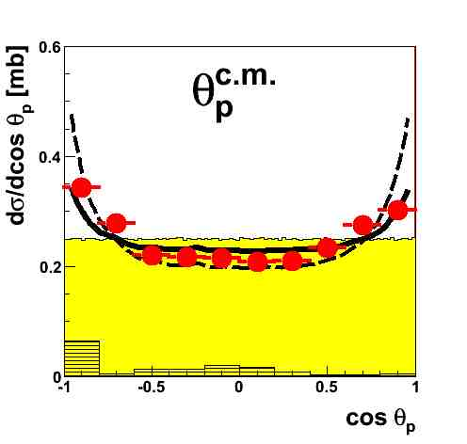
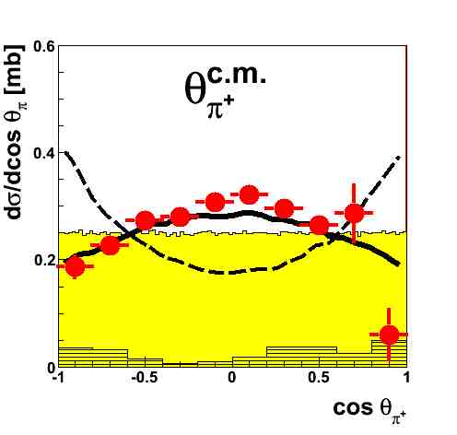
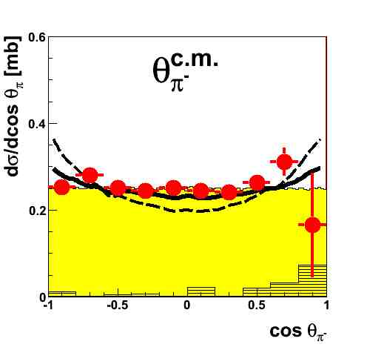
T_{p}=1.2 GeV
Results
modified Valencia model
modified Valencia model + D₂₁
If ΔΔ dominates
θ_{π+} = θ_{π−}
⇒

Slide 22
Conclusions 2: D₂₁
isospin relations for total cross sections demand the opening a new contribution in pp→ppπ⁺π⁻
differential M_{pπ−} and θ_{π+} distributions show a clear deviation from the modified Valencia model calculations
total and differential cross sections agree well with assumption that in case of pp→ppπ⁺π⁻ channel there is an additional production mechanism – the associated production of the isotensor ΔN state D₂₁
the strength of D₂₁ excitation in measured energy range is compatible with the strength of ΔΔ excitation

Slide 23
Where D₃₀ can be seen?
I=3 ⇒ only associated production
pp → ppπ⁺π⁺π⁻π⁻
D₃₀

Slide 24
pp → D₃₀ π⁻π⁻ → ppπ⁺π⁺π⁻π⁻
T_{p} = 2.541 GeV
Double-Roper
Phys.Lett. B762 (2016) 445
D₃₀

Slide 25
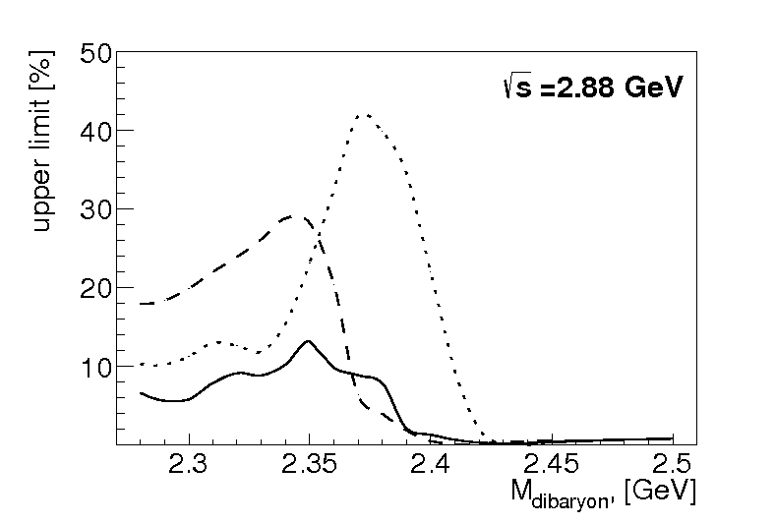
D₃₀ dibaryon upper limit
Phys.Lett. B762 (2016) 445
Γ = 100 MeV
Γ = 150 MeV
Γ = 50 MeV

Slide 26
Conclusions 3: D₃₀
obtained only upper limit
both model and statistics has to be improved
check associated production with d*(2380)

Slide 27
Outlook and open problem
Size of d*(2380) arXiv:1801.04700 [hep-ph]
      elm excitation of d*
    (?) Belle II: e⁺ e⁻ → d* d*
    (?) WASA-at-GSI : p n → d* e⁺ e⁻
  Observation at other installations
  ANKE p d → p d ππ Usikov B1, Tsirkov C3
  A2, FOREST γ d → d π⁰ π⁰ PoS Hadron2017, PL B772 (2017) 398
  HADES pp → ppππππ (D₃₀)
  P-wave dibaryons
  ANKE J^{p}= 0⁻, 2⁻ pp → (pp)_{s} π⁰ PR C93, 065206
Are there more (exotic) dibaryons?
H-dibaryon, πΣN, …

Slide 28
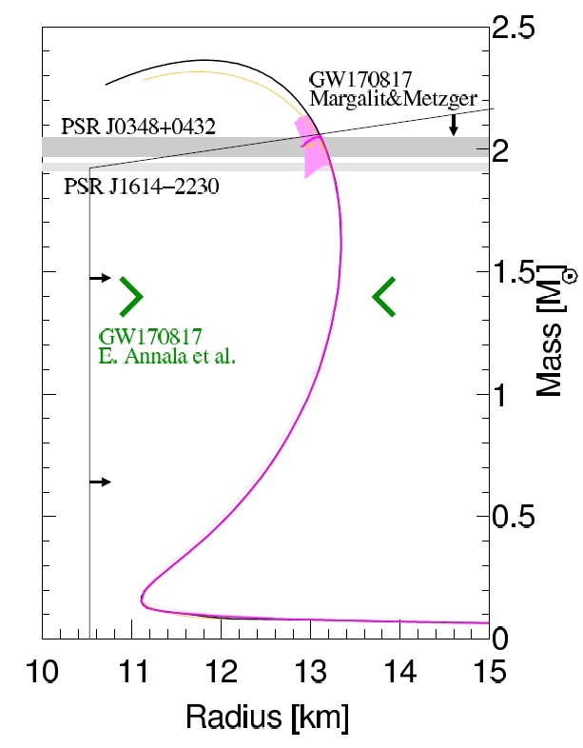
EoS for nuclear matter
EoS for nuclear matter + d*
d* in neutron stars
Phys. Lett. B781 (2018) 112

Slide 29
Thank you very much

Slide 30
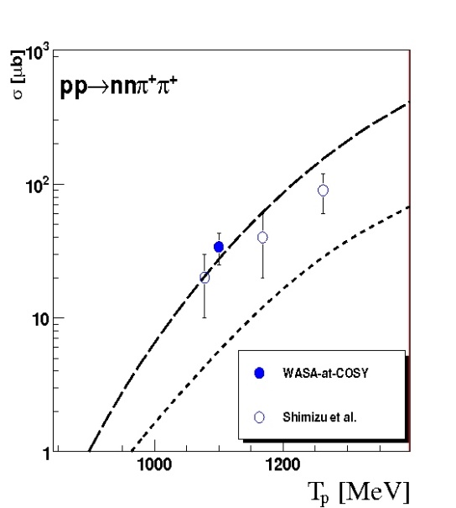
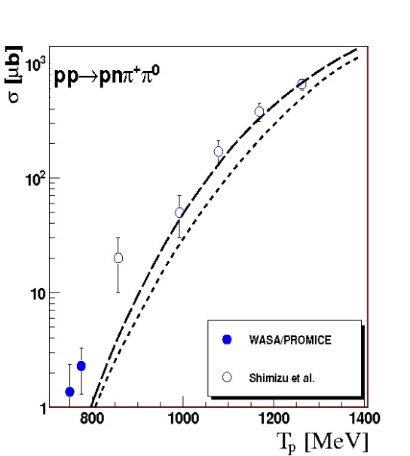
Model description
PLB 695 (2011) 115
ΔΔ + Δ(1600)
ΔΔ + Δ(1600)
Roper + ΔΔ
Roper + ΔΔ
original Valencia model (Roper + ΔΔ)
modified Valencia model (reduced Roper + ΔΔ + Δ1600)

Slide 31
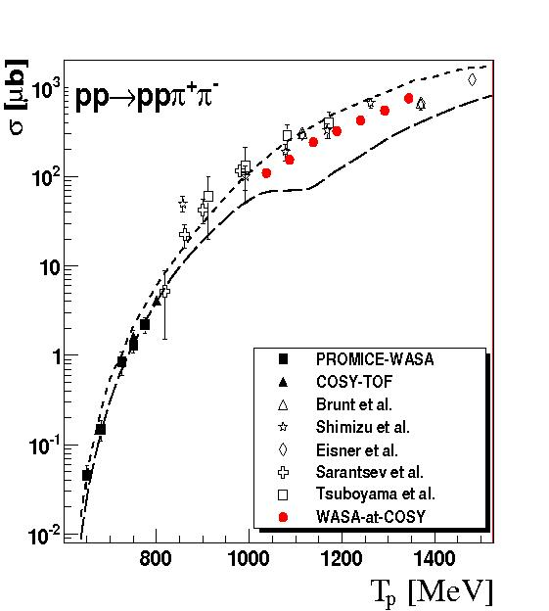
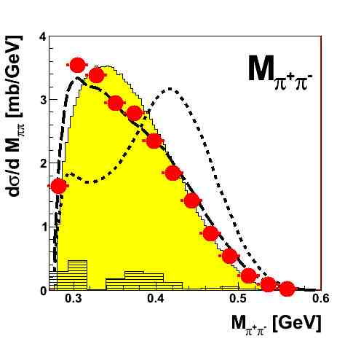
Model description
original Valencia model
modified Valencia model

Slide 32
Isospin decomposition
T. Skorodko et al., Phys. Lett. B 679(2009), 30

Slide 33
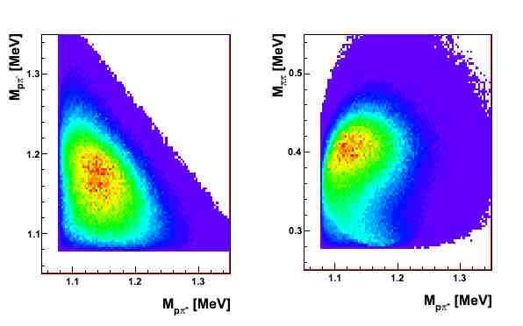
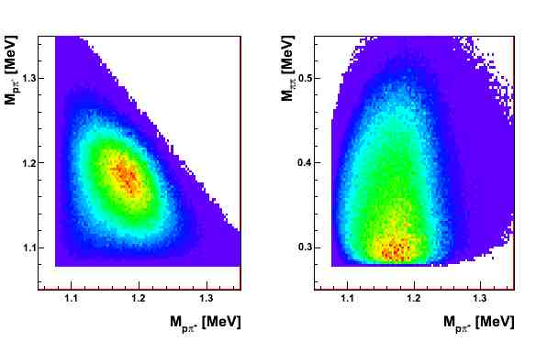
MC scenario
pp → Roper → ppπ⁺π⁻
pp → ΔΔ → ppπ⁺π⁻

