Slide 1



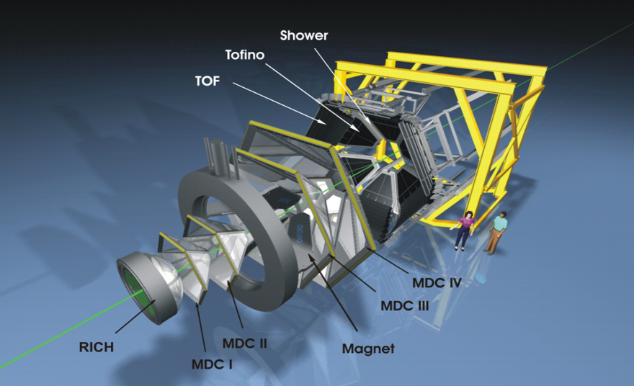
Time-Like Baryon Transitions studies with HADES
Béatrice Ramstein, IPN Orsay, France
for the HADES collaboration
MESON 2018, Cracow , June 7 — 12, 2018
N
R
e⁺
γ∗
e⁻

Slide 2
Outline
Introduction
General motivations of the HADES experiment
Access to time-like electromagnetic baryon transitions
Results from pp and pn reactions with HADES at GSI
Preliminary results with the GSI pion beam
Prospects for hyperon transitions
Conclusions
N
R
e⁺
γ∗
e⁻
Notes:
43’

Slide 3
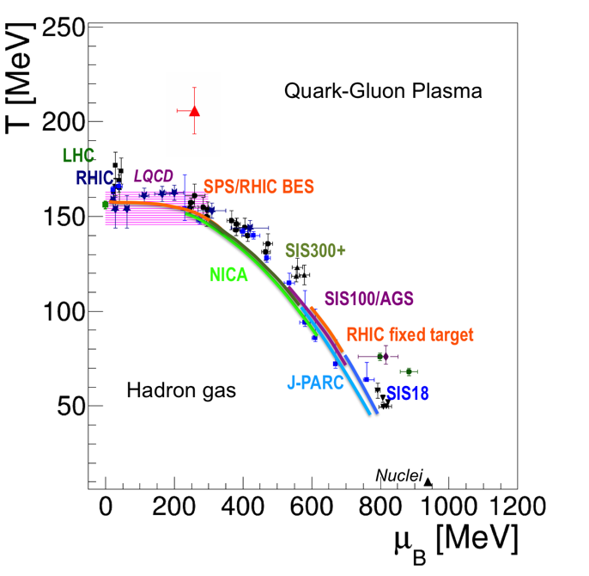
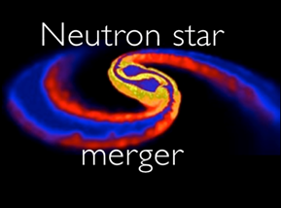
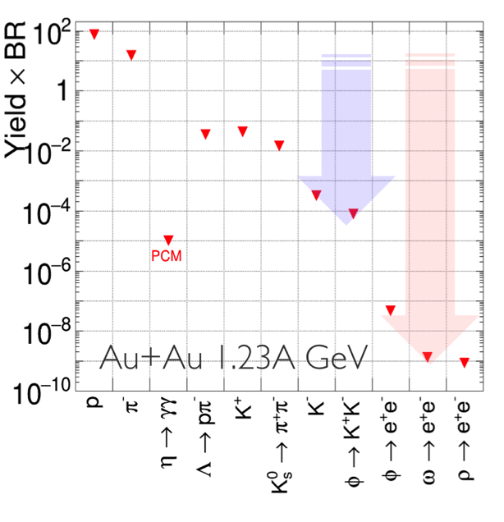

HADES: exploring dense QCD matter
Observables:
Correlations and fluctuations
Collective effects
Strangeness
Dileptons
Notes:
50’’

Slide 4
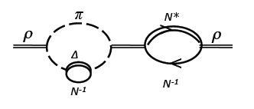
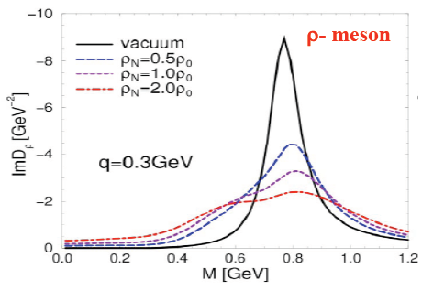

in-medium ρ meson
Strong broadening of the in-medium ρ
due to the coupling to baryon resonances
HADES data
Preliminary
Au+Au 1.25A GeV
medium contribution
ρN*N couplings
Rapp, Chanfray and Wambach NPA 617, (1997) 472
Rapp and Wambach EPJA 6 (1999) 415
Coarse-grained UrQMD:
CG FRA Phys. Rev. C 92, 014911 (2015)
CG GSI-Texas A&M Eur. Phys. J. A 52 5 (2016) 131
CG SMASH: arXiv: 1711.10297 [nucl-th]
HSD: Phys. ReV. C 87, 064907 (2013)
Global understanding of dilepton production from RHIC to SIS18 energies
Still to be better constrained by elementary reactions
Robust understanding across QCD phase diagram

Slide 5
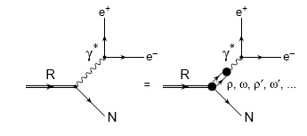
Role of baryonic resonances in e⁺e⁻ production at 1-3 AGeV
Mesonic decays: N/Δ→ πN, ηN, ρN
  π° Dalitz decay: π° → γe⁺e⁻ (BR ∼ 1.2 %)
  Δ (1232) → Nπ⁰ , N (1520) → Nπ⁰π,…
  η Dalitz decay: η → γe⁺e⁻ (BR ∼ 0.6 %)
  N(1535) → Nη ,….
  ω Dalitz decay ω→π⁰ e⁺e⁻ (BR∼ 7.7 10⁻⁴ )
  ρ/ω direct decay ρ/ω → e⁺e⁻ (BR ∼ 4-7 10⁻⁵)
Dalitz decay of baryonic resonances:
Δ/N*→ Ne⁺e⁻
not measured !
Vector Dominance
Time-like electromagnetic form factors

Slide 6
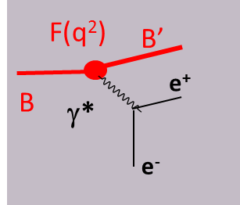
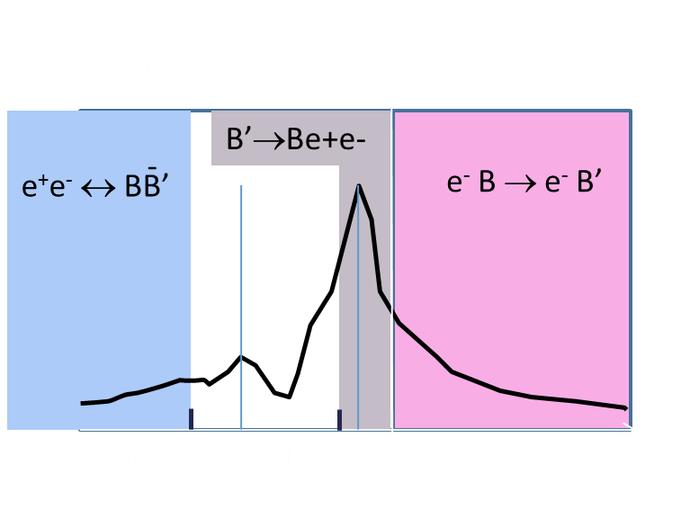
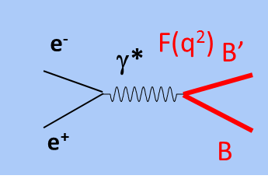
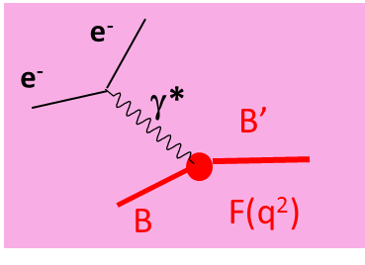
Dalitz decay of baryons:
A way to access electromagnetic structure of baryon transitions at low q² in the time like region
Most information comes from the space like (q²<0) region
Time like (q²> 0 ) region : analytically connected to space like
Dalitz decay
0< q² <(M_{B’}-M_{B})²
q²= M _{ee}²
Annihilation
q² > (M_{B}+M_{B’})²
Scattering q²<0
q²=0
B’↔γB

Slide 7
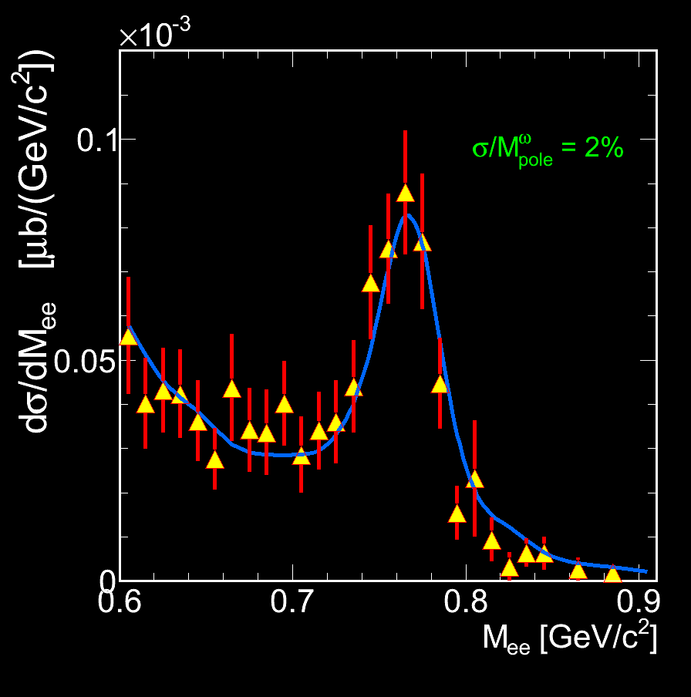
HADES
High Acceptance DiElectron
Spectrometer at GSI, Darmstadt
Acceptance: Full azimuth, polar angles 18º - 85º
Particle identification: e⁺/e⁻, π⁺/π⁻ , K⁺/K⁻, p
RICH, Time Of Flight, Pre-Shower (pad chambers & lead converter) ( also MDC (K±))
Trigger:
~ 50 kHz
Momentum measurement
  Magnet: ∫Bdl = 0.1- 0.34 Tm
  MDC: 24 Mini Drift Chambers
  Leptons: Δx~ 140 μ per cell, Δp/p ~ 1-2 %
  ΔM/M ~ 2% at ω peak
New Electromagnetic Calorimeter just installed
Forward Detector (0.5-7°)
to be ready end of 2018
7
Notes:
7
Consists of 6 sectors,

Slide 8



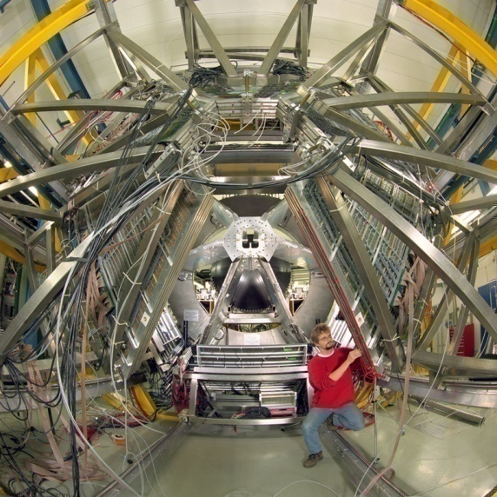
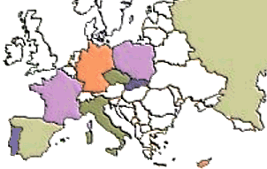
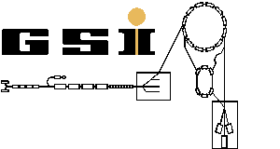
The Collaboration
  Cracow (Univ.), Poland
    Darmstadt (GSI), Germany
      Dresden (FZD), Germany
        Dubna (JINR), Russia
        Frankfurt (Univ.), Germany
        Giessen (Univ.), Germany
        Jülich (FZJ), Germany
        München (TUM), Germany
        Moscow (ITEP,MEPhI,RAS), Russia
        Nicosia (Univ.), Cyprus
        Orsay (IPN), France
      Rez (CAS, NPI), Czech Rep.
    Sant. de Compostela (Univ.), Spain
  Wuppertal (BUG), Germany
Coimbra (Univ.), LIP, Portugal
GSI
SIS
8
Notes:
8

Slide 9
Hades experimental program
dense and hot matter studies
C+C 1 and 2 GeV/nucleon, Ar+KCl 1.75 GeV/nucleon, Au+Au 1.25 GeV/nucleon
cold matter at normal nuclear density p+Nb 3.5 GeV, π⁻+W/C 1.7 GeV/c
Dilepton emission in elementary collisions pp, dp and π⁻p
  Reference to heavy-ion spectra
  Dalitz decays of baryon resonances
Simultaneous measurements of hadronic channels (inclusive and exclusive meson
production 1π, 2π, η, ρ, ω ,…)
  Production mechanism
  Baryon spectroscopy (baryonic resonance couplings,..)
  Partial Wave Analysis: pp→ppπ ⁰, pp→pnπ⁺ , π⁻p→n π⁺ π⁻, π⁻p→p π⁰ π⁻
…. strangeness measurement program: K⁻ , K⁰, φ, Σ(1385), Λ(1405), Λp correlations
( J. Wirth B4 Friday 18:20)

Slide 10
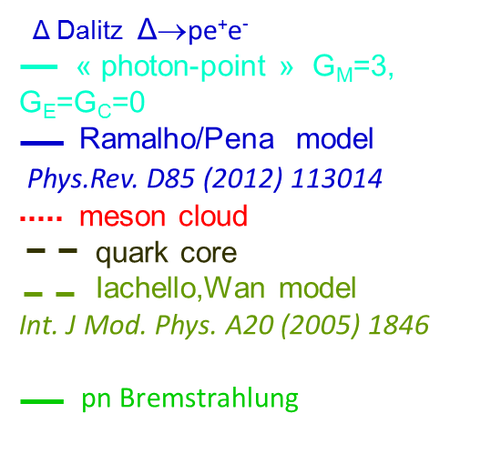
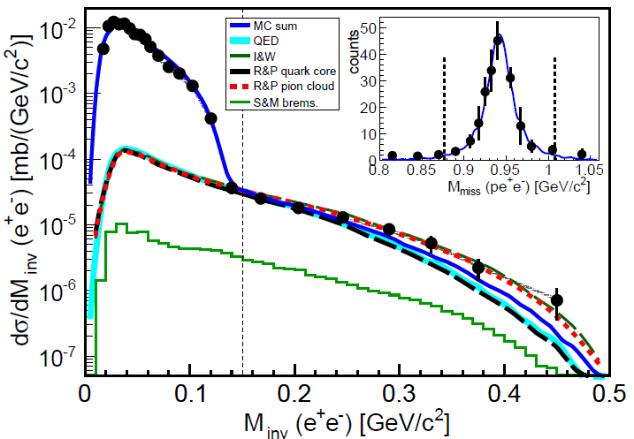

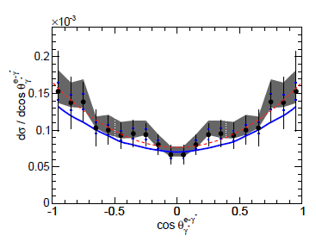
Δ(1232) Dalitz decay: branching ratio and form factors
pp→ppe⁺e⁻ E=1.25 GeV
and π⁰ production cross section deduced from PWA
of one pion production channels
HADES, Eur. Phys. J. A 51 (2015) 137
π° Dalitz: π° →γe⁺e⁻
pp Bremsstrahlung Shyam and Mosel, , PRC82 (2010)062201
Deviation from « point-like » transition
Helicity distributions γ* → e⁺e⁻
Consistent with transverse γ:
Fit result : dσ/dcosθ ~ 1 + B cos²θ
B=1.17±0.34
HADES, Phys.Rev. C95 (2017) 065205
first measurement of Δ(1232) Dalitz decay branching ratio
BR( Δ→ Ne⁺e⁻) = 4.19 ± 0.42 (model) ± 0.46 (syst.) ± 0.34 (stat.) 10⁻⁵.
HADES coll., Phys.Rev. C95 (2017) 065205
Notes:
Refqire le texte: photon-point

Slide 11
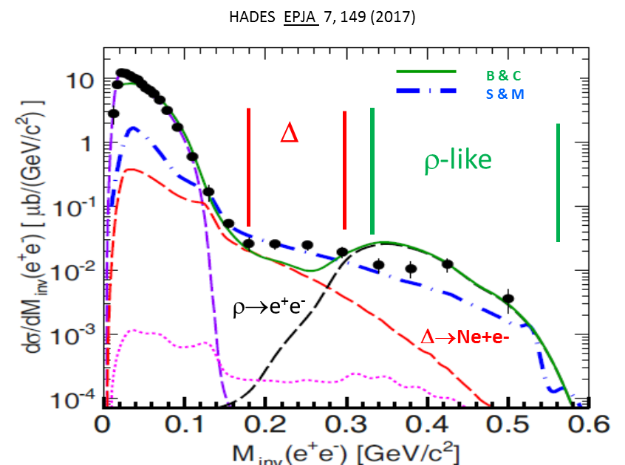
pn→pne⁺e⁻ : dilepton production from charged currents
Much larger production at large M_{ee}
than in pp
S&M: Shyam & Mosel Phys. Rev. C 82:062201, 2010
B&C Bashkanov & Clement Eur. Phys. J. A 50, 107 (2014)
Helicity angles
„Δ-like”
systematic studies (WASA and HADES)
pp →ppπ⁺π⁻ , nnπ⁺π⁺ , ppπ⁰π⁰
pn →dπ⁺π⁻ , dπ⁰π⁰ , pnπ⁺π⁻ , ppπ°π⁻
σ_{ΔΔ→ρ} ≅ 170 μb fixed from 2 pion data
„ρ-like”
cos(θ_{e} )
Reasonable description by both models
cos(θ_{e})

Slide 12
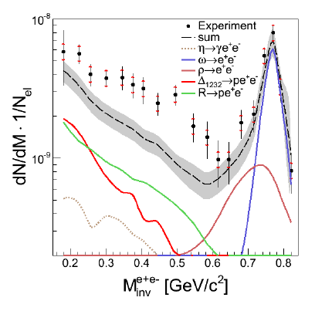
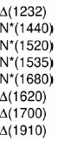
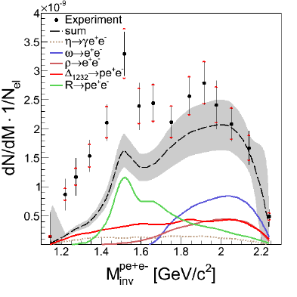
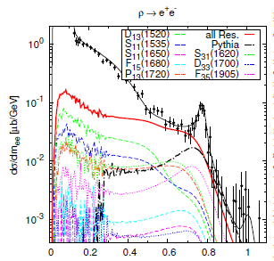
Dilepton production
from higher lying resonances
p+p →pp e⁺e ⁻ 3.5 GeV
ppe⁺e⁻
Effect of electromagnetic
transition FF for light
baryonic
resonances (N(1520),…)
R
ω
Δ
ρ
Dalitz decays of point-like
baryonic resonances
constrained by ppπ⁰ and pnπ⁺
channels
Inclusive e⁺e⁻ production
reproduced by resonance
model with ρNN* couplings
ppe⁺e⁻
+ “direct” ρ and ω
R
ω
Δ
G. Agakishiev et al.
Eur.Phys.J. A50 (2014) 8
J. Weil, et al., EPJA 48, 111 (2012)

Slide 13
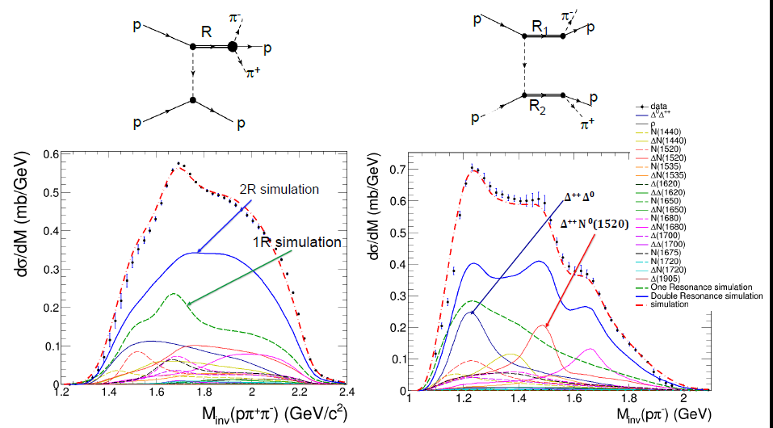
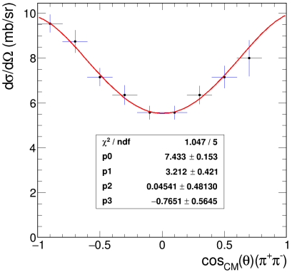
2π production channels
pp→ppπ⁺π⁻ E=3.5 GeV
Extraction of one and two baryon production cross sections
preliminary
ρ production angular distribution
A. Belounnas et al., HADES coll. , Pos(HADRON2017)213
Important constraints for dilepton production
More details in Amel Belounnas’s talk (B5 Monday 16:05 )

Slide 14
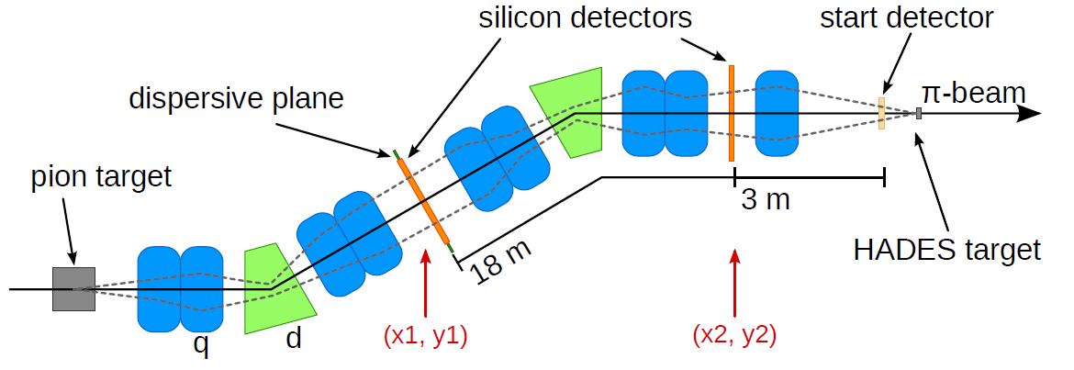
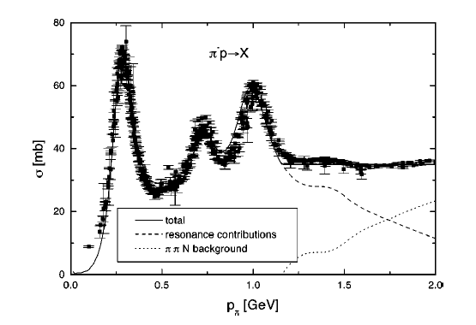
Pion beam at GSI
Pion beam tracker
Diamond detectors
HADES
GSI pion beam
momentum 0.6 < p <1.7 GeV/c
pion flux ~ 10⁶/s at 1 GeV/c
2 Double-Sided silicon sensors
100 x100mm², 300μm thick
2 x128 channels
Pion momentum acceptance σ=2%
Resolution Δp/p < 0.3%
η
ω

Slide 15
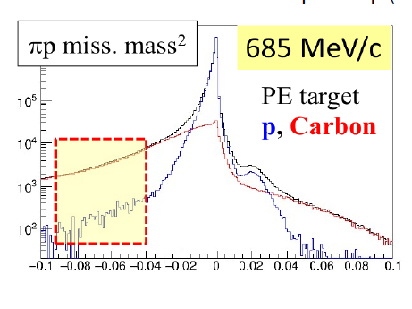
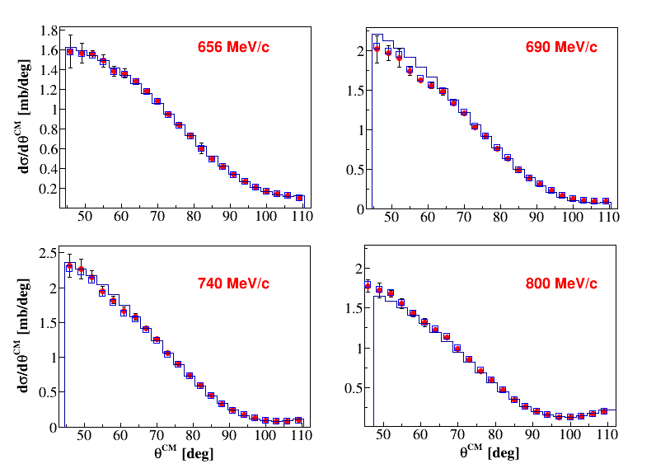
Pion beam experiment with HADES
2014 commissioning experiment
Use of Polyethylene (CH₂)_{n} and Carbon targets
Motivations: investigate the N(1520) region
π⁺ π ⁻ and π⁻π° production in an energy scan (4 measurements √s =1.46-1.55 GeV/c²)
Improve database for baryon spectroscopy: 2πN =ρN,σN, πΔ branchings
e⁺e⁻ production √s =1.49 GeV/c²
Resonance Dalitz decays R→Ne⁺e⁻
(Link to time-like transition electromagnetic structure)
No existing data
N
R
e⁺
γ∗
e⁻
Subtraction of C contribution
and
Normalisation using
π⁻+p elastic scattering
SAID
data
MM²(GeV²/c²)
θ(deg)

Slide 16
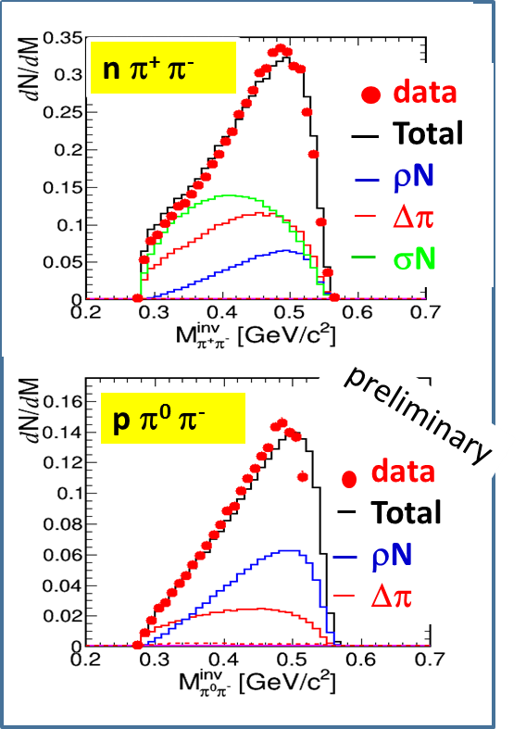
Bonn-Gatchina Partial Wave Analysis in
2π production channels
HADES data corrected for acceptance
collaboration with A. Sarantsev (see next talk)
HADES data (π⁻p→ nπ⁺π⁻ and π⁻p→ pπ⁰π⁻ at 4 energies )
+ photon (CB-ELSA,MAMI) and pion (Crystal Ball) data base
Extraction of ΔN, σN, ρN components in the different
partial waves
e.g. N(1520):
ρN coupling =12±2 %
PDG 2015 : 15-25%
PDG 2016 : no info
More details in Izabela Ciepal’s talk (B6 Monday 16:55 )
New HADES data are crucial for the determination of the ρ contribution
Still no data on ρ between 1.54 and 1.75 GeV/c² (part of HADES future program)
Notes:
HADES data crucial to determine the rho contribution
Calculate N(1520) to pi+pi-

Slide 17
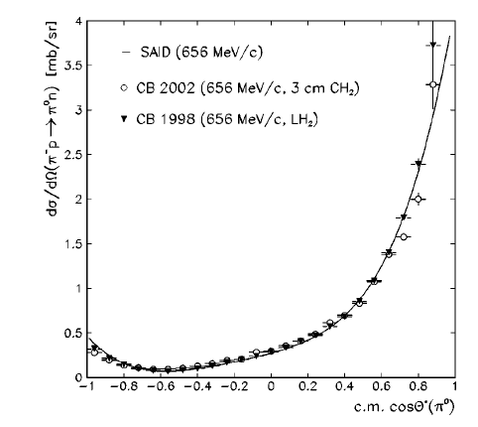
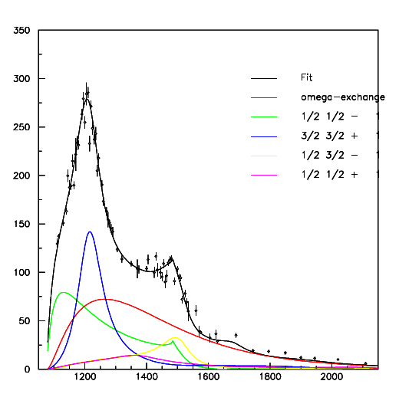
Inputs for π⁻p→Xe⁺e⁻ from PWA
HADES
preliminary
nρ - total
3/2⁻ (D13+..)
1/2⁻ (S11+..)
3/2⁺ (P33+..
π⁻p→π⁺π⁻ n
π⁻p→n π⁰
√s(MeV)
Meson exchange
π⁻p→π⁻π⁰ p
σ(μb)
γn→π⁻p
π⁰ production from PWA
π⁻p→n π⁰
π⁻p→n π⁰ π⁰
π⁻p→p π⁻ π⁰
√s(MeV)
Cross section for π⁻p →γn
(detailed balance)
input for π⁻p →e⁺e⁻n
off-shell ρ production in π⁻p
σ ∼1.3 mb at 0.69 GeV/c
t-channel contribution is small

Slide 18
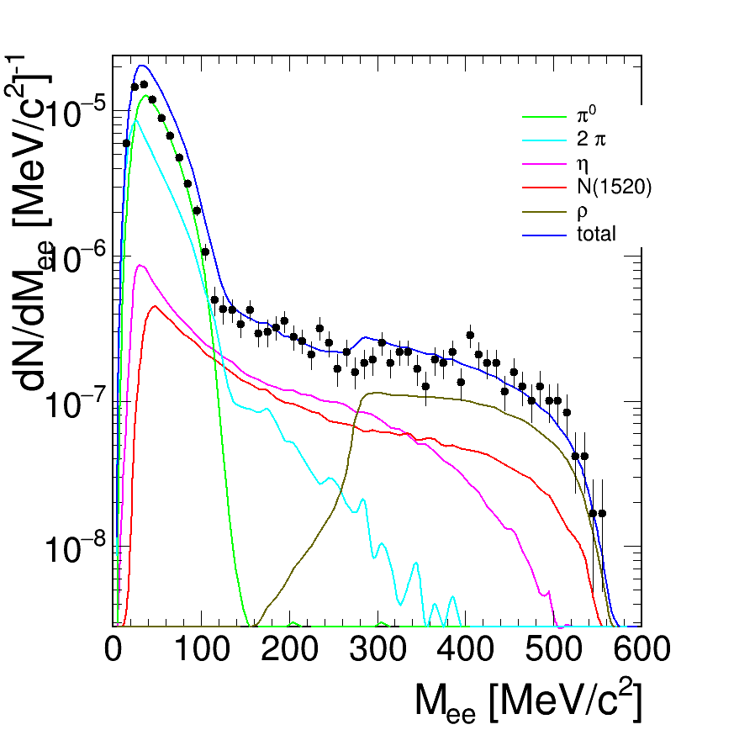
Inclusive e⁺e⁻ production
π⁰
π⁻+CH₂→e⁺e⁻X
p=0.69 GeV/c
PLUTO event generator Fröhlich et al, POS (2007) 076
π⁻p:
π⁰→γe⁺e⁻ (SAID) η→ γe⁺e⁻ (Landolt-Börnstein)
ρ contribution from PWA (π⁻p→nρ 1.3 mb)
effective point-like contribution deduced from
γn→π⁻p with e⁺e⁻ distribution as N(1520)⁰ → ne⁺e⁻
π⁻C:
quasi-free process (momentum distr. of
nucleons taken into account) scaled to σ_{C} /σ_{H} ∼4
Simulations filtered by acceptance
π⁰π
« N(1520) »
η
ρ
preliminary
Measurement on CH2 target:
(dσ/dM)_{H}+0.5 (dσ/dM)_{C}
σ_{C} ∼ 4 σ_{H}
Signal (M<140 MeV/c²) = 13138
Signal (M>140 MeV/c²) = 3300
Strong η contribution
Cocktail of point-like sources underestimates the e⁺e⁻ yield at high invariant mass
Satisfactory description adding off-shell ρ contribution

Slide 19
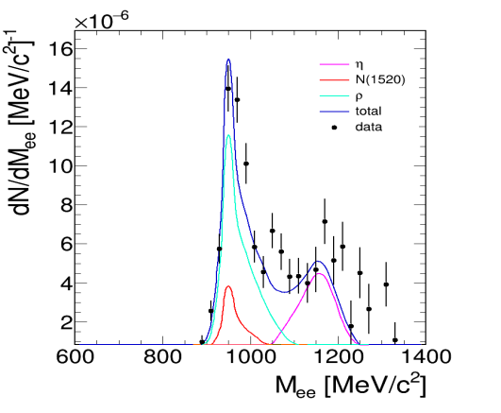
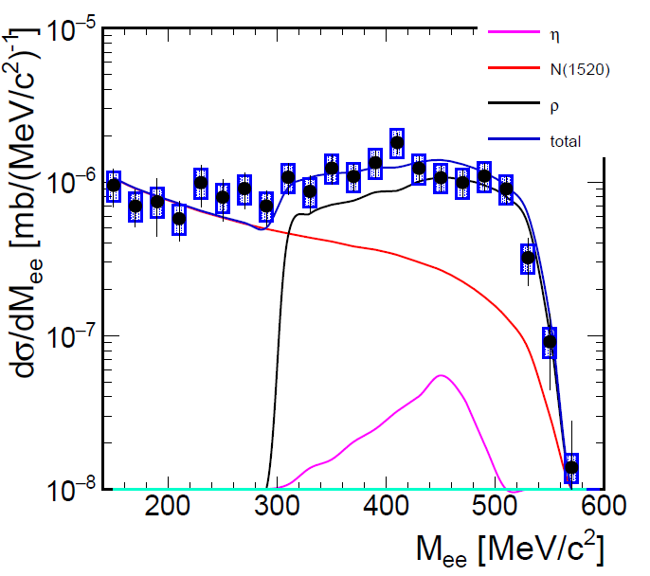
Exclusive e⁺e⁻ production with pion beams
0.9 <M^{miss}_{ee} < 1.03 GeV/c²
M^{inv}_{ee} > 0.12 GeV/c²
π⁻p→ne⁺e⁻
Total
π⁰ →e⁺e⁻γ
η→e⁺e⁻γ
N(1520)→ne⁺e⁻
preliminary
π⁻p→ne⁺e⁻
preliminary
π⁻p→nπ⁺π⁻
1500 events
preliminary
e⁺
PWA
ρ
γ∗
e⁻
Off-shell
ρ→e⁺e⁻
Off-shell
ρ→π⁺π⁻
I=1
Vector Dominance Model
(dσ/dM_{ee})= (dσ/dM_{ππ} )* BR(M_{ee}=M_{ρ}) * (M_{ρ}/M_{ee})³
M^{inv}_{ππ} ( GeV/c²)
Empirical way of taking into account VDM form factors for baryon electromagnetic decays

Slide 20
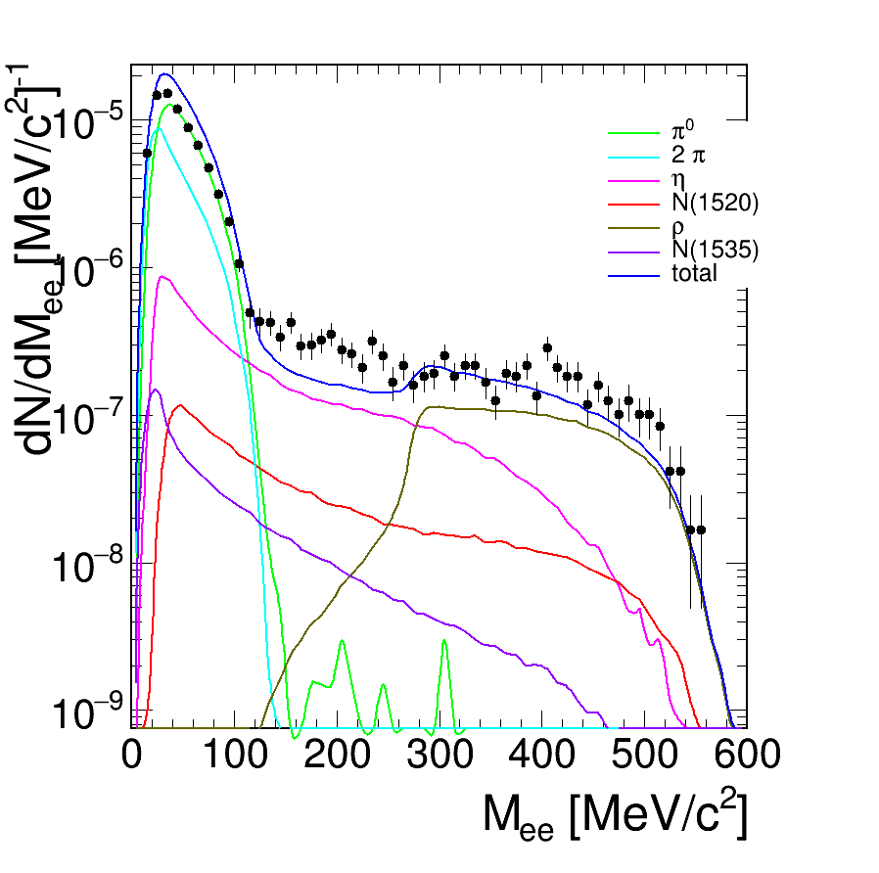
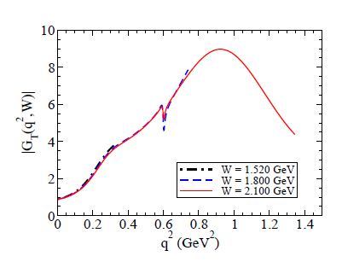
N(1520) and N(1535) contributions
PLUTO event generator Fröhlich et al, POS (2007) 076
π⁻p:
Meson production: Landolt-Börnstein
π⁰→γe⁺e⁻ η→ γe⁺e⁻
ρ contribution from PWA
N(1520) and N(1535) contributions from PWA
in π⁻p reactions + real γ couplings
Non-resonant contributions missing
preliminary
π⁰
π⁻+CH₂→e⁺e⁻X
p=0.69 GeV/c
π⁰π
η
N(1520)
ρ
On-going work to take into account
time-like electromagnetic form factor for
N(1520)→ N transition
N(1535)
G. Ramalho and T. Pena Phys. ReV. D 95014003

Slide 21
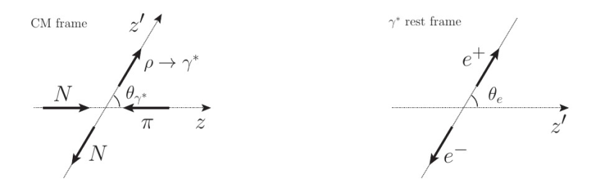


Information on time-like electromagnetic structure from angular distributions
Spin density matrix formalism:
E.Speranza et al. Phys.Lett. B764 (2017) 282-288
A. Sarantsev (ECT* meeting, May2017)
$\frac{d3σ}{dMeedΩγ∗dΩe}$ ∼ |A|²=
3 independent density matrix elements: ρ_{11 ,} ρ_{10,} ρ₁₋₁ depending on M_{ee} and θ_{γ}
contain information on electromagnetic structure
e.g. pure transverse (E/M): ρ₁₁ =1/2, ρ₁₀ =0
Related to helicity amplitudes and/or form factors
N
R
e⁺
γ∗
e⁻

Slide 22
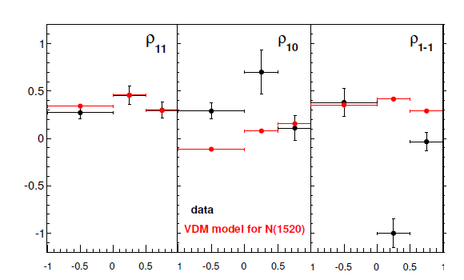
Very first results on density matrix elements
Quasi-free π⁻p→ne⁺e⁻
√s =1.49 GeV/c²
M_{ee}> 400 MeV/c²
Microscopic model s and u channels:
N(1440) and N(1520) with VDM form factors:
B. Friman, M. Zetenyi, E. Speranza Phys.Lett. B764 (2017) 282-288
Despite low statistics, significant information on the electromagnetic structure of the transition
Presence of longitudinal contribution
ρ₁₁ consistent with pure N(1520) in VDM model
preliminary
Transverse
Cos θ_{γ*} ^{CM}
Federico Scozzi et al. (HADES coll.)
EPJ Web Conf., 137 (2017) 05023
Exp. proposal at GSI/SIS18 (2018-2019) : explore the third resonance region (√s~1.7 GeV/c²)
channels: π⁻p→ ne⁺e⁻ , π⁻p→ ππN, ωn, ηn , K⁰Λ, KΣ,….+photons
(new electromagnetic calorimeter)
Possibly after 2019: √s~2 GeV/c² region (Λ(1405),…)

Slide 23
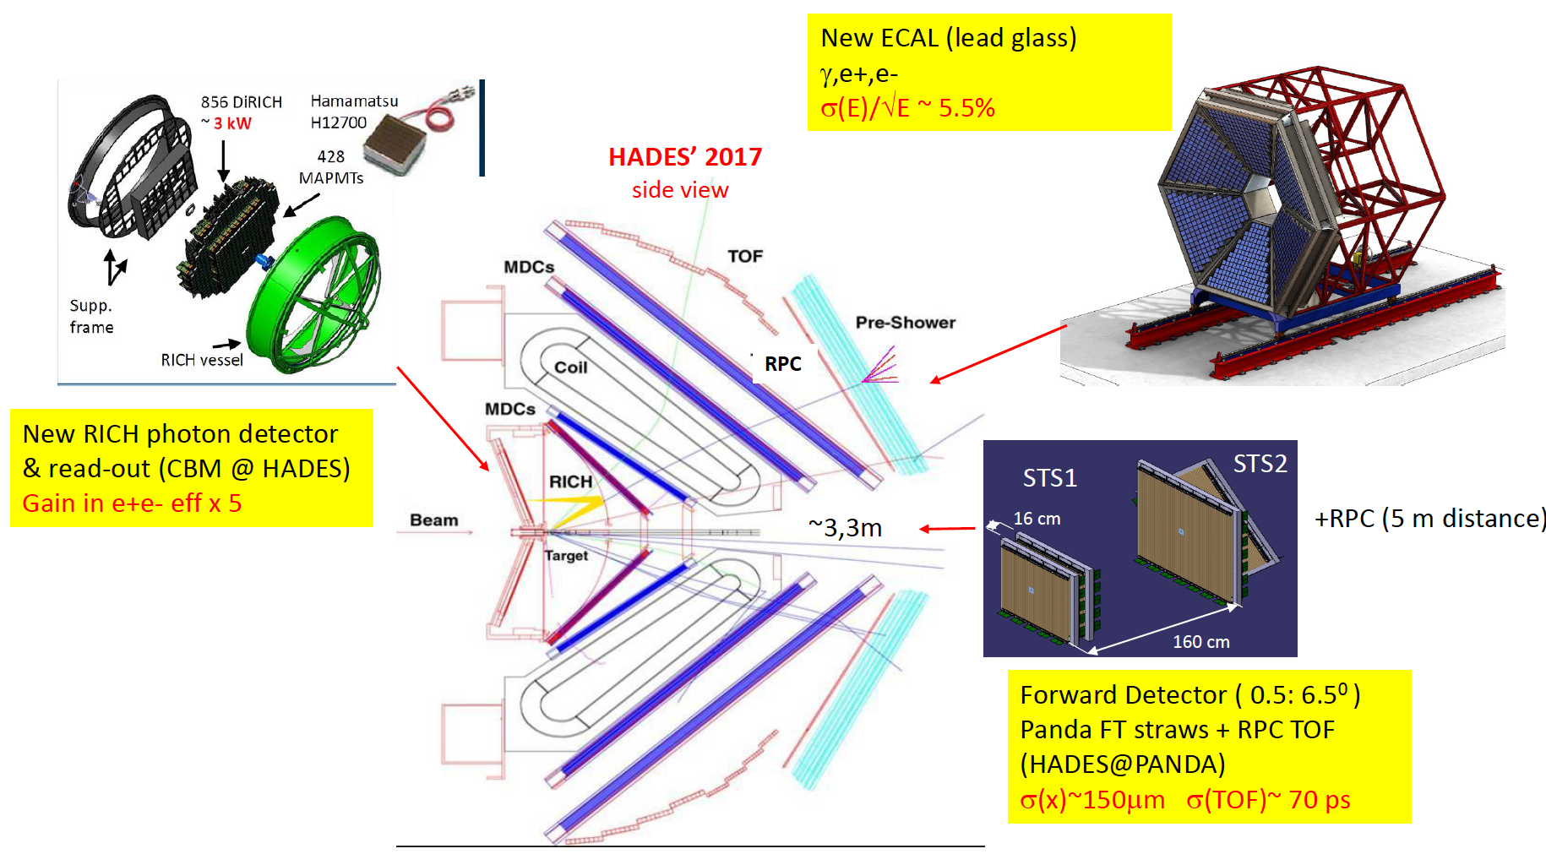
HADES upgrade
New ECAL (lead glass)
ΔE/E ~5%
γ and e⁺/e⁻ detection
New RICH photon detector
& read-out
(coll. with CBM@FAIR)
Gain in e⁺e⁻ efficiency x5
Forward detector (0.5-6.5°)
Straws + RPC TOF
(coll. with PANDA@FAIR)
σ(x)~150 μm σ(TOF)~70 ps

Slide 24
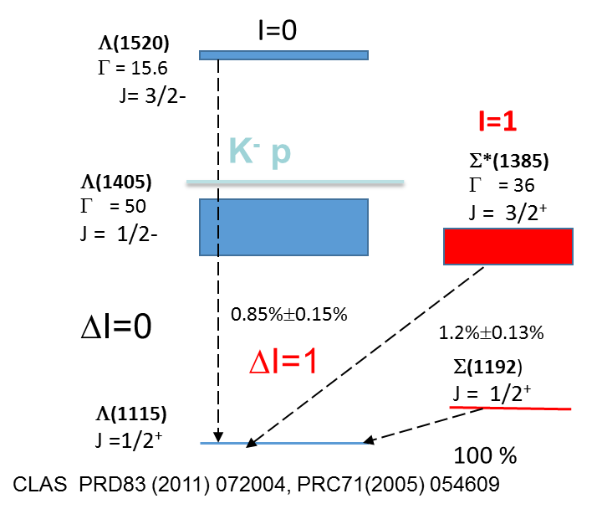
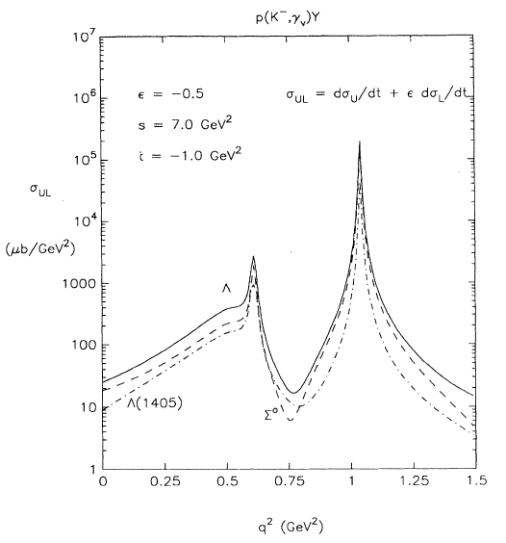
Future plans : hyperon Dalitz decays
Hyperons are narrow (Γ=15-40 MeV) : can be studied in pp, pA with HADES
(and later pp with PANDA at FAIR).
Radiative decays of hyperons Y →Λγ
Badly known
High sensitivity to internal structure (quark correlations )
Dalitz decays of hyperons Y →Λ e⁺e⁻ (BR~10⁻⁵)
No measurement.
Relevance of Vector Dominance in the hyperon sector?
-
e.g. Σ*(1385)→Λγ* is anologue of Δ(1232)→Nγ* transition (measured by HADES)
calculations C. Granados et al. Eur. Phys. J.A54(2018)1.
R. Williams et. al. PRC48(1993)1381
p+p →K⁺+Λ(1520)+p
|
K⁻p →Y γ*
→ Λ(1115)+γ (0.85%)
Λ(1115)+e⁺e⁻ (8 10⁻⁵)
Feasibility study: about 25 events/day in pp at 4.5 GeV
Λ (1520)→ Λe⁺e⁻
(M_{e+e-}) ²
(poster: K. Nowakowski)

Slide 25
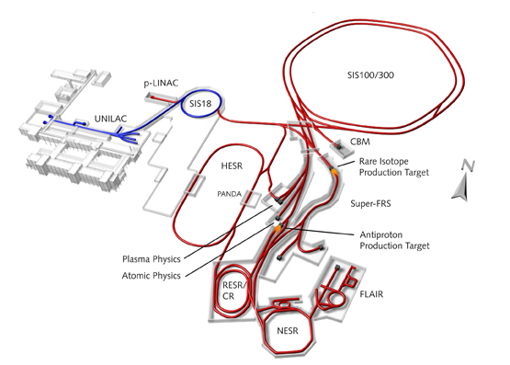
Conclusion and outlook
Pioneering studies for Time-Like electromagnetic baryon transitions
Δ Dalitz decay branching ratio and VDM effects (pp reactions),
N(1520) region ( pion beam)
2π channels: baryon spectroscopy
For mid-term future, in parallel to the program on medium effects
Investigate heavier resonances Δ(1620), N(1720),…
in e⁺e⁻ channels and many hadronic channels,
e.g. π⁻p→ηn , K⁰Λ, KΣ,….
Electromagnetic decays of hyperons in pp reactions : Y→Λγ, Y→Λe⁺e⁻
Higher acceptance (Forward Detector)+ Electromagnetic Calorimeter
Pave the way for future meson beam facilities
see W. J. Briscoe ‘s talk
After 2025: HADES experiments at FAIR
(p and ion beams, possibly pions in future….)

Slide 26
Thank you

Slide 27

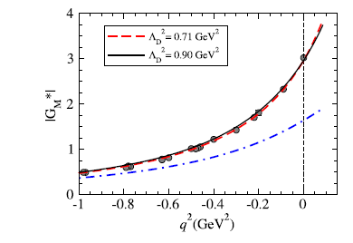
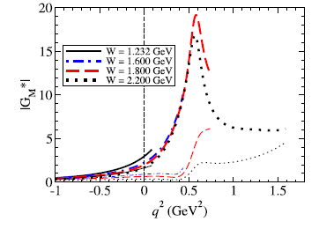
Time-like form factor models
e-VDM model (ρ,ρ’,ρ’’,…) M. Krivoruchenko, Ann. Phys. 296 (2002) 299
Currently being updated (work in progress) to recent data
- SL transition FF (CLAS)
- ρ/ωNN* couplings (PWA)
Two-component model (real photon +vector meson couplings)
Zetenyi and Wolf, Phys. Rev. C 86 (2012) 065209
constituent quark model
existing for N-Δ(1232)
Wan and Iachello, Int. J. Mod. Physics A20 (2005) 1846,
I. Fröhlich et al., Eur.Phys.J. A45 (2010) 401-411
N-Δ(1232)
Space Like
core
constituent quark-core+ meson cloud
existing for N-Δ(1232) and N-N(1520)
G. Ramalho, T. Pena Phys.Rev. D85 (2012), 113014
G. Ramalho et al., Phys. Rev. D93, 033004 (2016)
G. Ramalho, T. Pena Phys. Rev. D95 (2017), 014003
Time Like
core

Slide 28
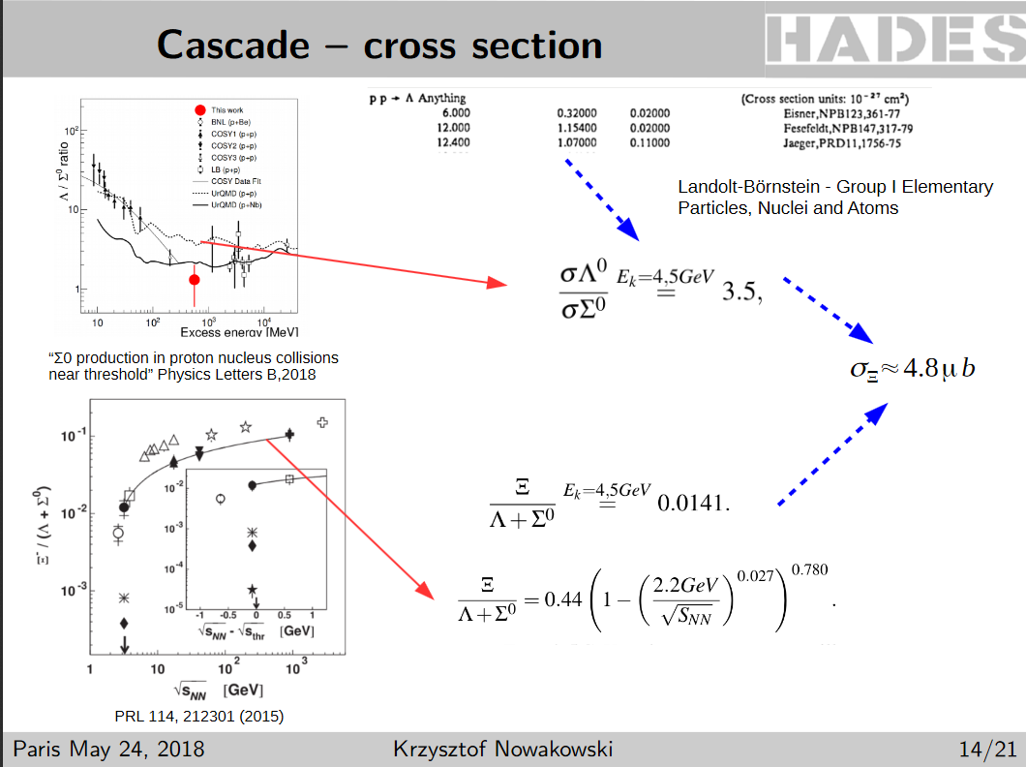

Slide 29
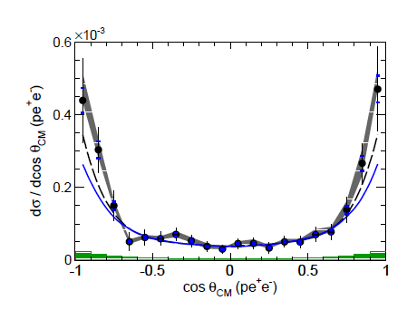
Δ(1232) Dalitz decay: angular distributions and branching ratio
pp→ppe⁺e⁻ E=1.25 GeV
Non-resonant Bremsstrahlung subtracted
Acceptance corrected
Δ Production
Helicity distributions γ* → e⁺e⁻
α
e⁻
γ*
e⁺
Δ
N
scaled Δ contribution from
pp→ppπ⁰ (PWA)
Δ Dalitz decay simulation (Ramalho&Pena form factor)
Only transverse γ: dσ/dΩ_{e}~ 1+cos²α
Fit result : dσ/dcosθ ~ 1 + B cos²θ B=1.17±0.34
HADES coll., Phys.Rev. C95 (2017) 065205

Slide 30
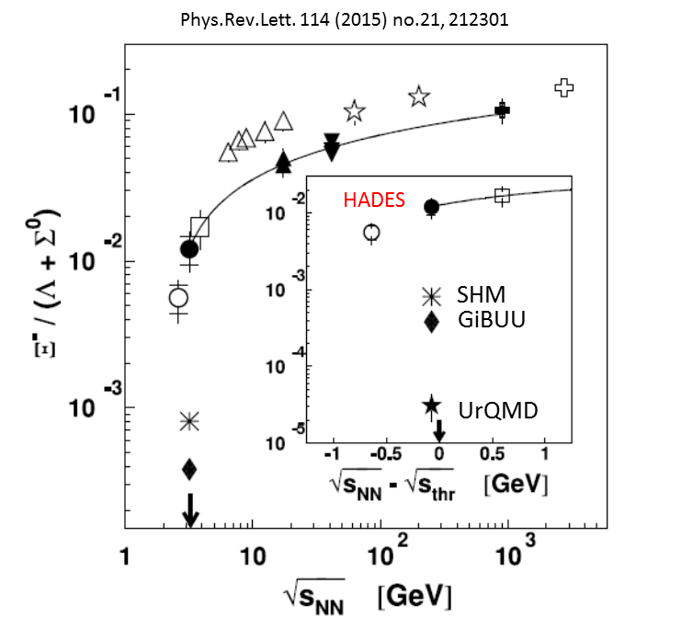
More about strangeness: understand the Ξ(1321) production
Doubly strange baryons (Ξ) (S= - 2)
Ξ⁻(1321)
unexpected high yield measured by HADES
below threshold ArKCl (-640 MeV) et pNb (-70 MeV)
→ Elementary mechanism to be understood
|
→Λ+ π⁻ (63%)
|
→π⁻+p
HADES collab PRL103(2009)132310
HADES collab PRL114(2015) 212301
Simulations: p+p 4.5 GeV σ=4.5μb
500 Ξ⁻(1321) reconstructed/ hour

Slide 31
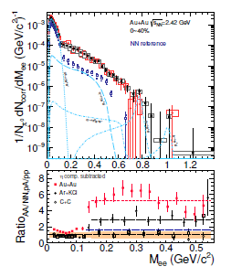
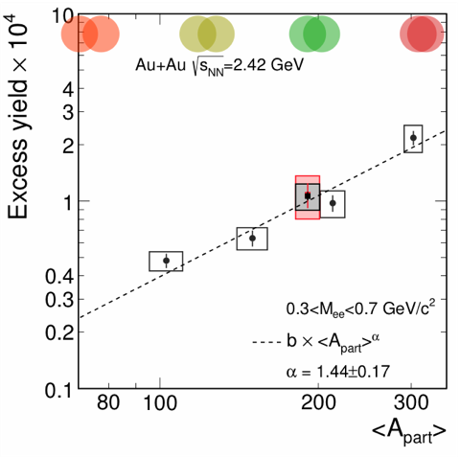

Dileptons as a probe of dense matter
Excess dilepton yield used to characterize the dense hadronic phase
Spectrometer
Thermometer
Chronometer
Barometer
Polarimeter
Thermal origin
  T_{eff} vs. M_{ll}
  v₂ vs. M_{ll}
  γ* polarization
  via lepton angular
  distribution
  M_{ll} of excess pairs
preliminary
Fireball duration
Polarization
Density dependence
Recent results from Au+Au experiment:
See T. Galatyuk, Quark Matter 2018
Notes:
Inv. mass=

