Slide 1

Recent results on the hadronic cross
section measurements with the CMD-3
detector at e+e- collider VEPP-2000
Fedotovich G.V.
On behalf of CMD-3 collaboration
Budker Institute of Nuclear Physics
Novosibirsk State University
MESON 2018, 7 – 12 June
Krakow, Poland

Slide 2
Outline
Motivation
Collider and detector
Experiment
Recent results
Perspectives and Conclusion

Slide 3


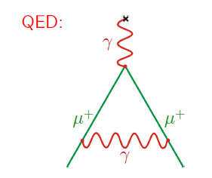
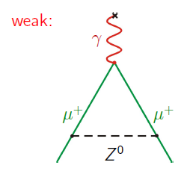
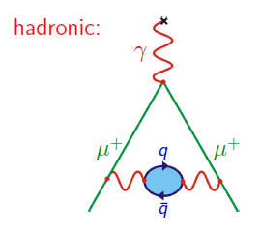
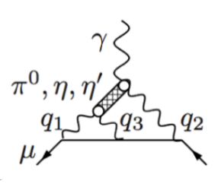
Muon anomaly, a_{m} = (g-2)_{m}/2
New experiment at FNAL: 140 ppb
QED
WEAK
HADRONIC
LbL
0.29 ppb
9 ppb
370 ppb
220 ppb
Major contribution to (g-2)/2 comes from energy range of the VEPP-2000 and gives ~ 92% and determines its uncertainty

Slide 4

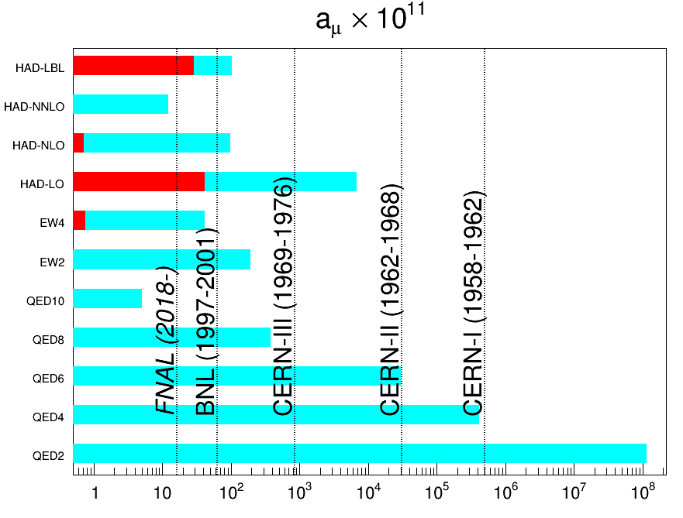

History of $a_{μ}$ measurements
theoretical uncertainty
QCD
precision of experiment
SM contribution to $a_{μ}$
Weak
QED

Slide 5
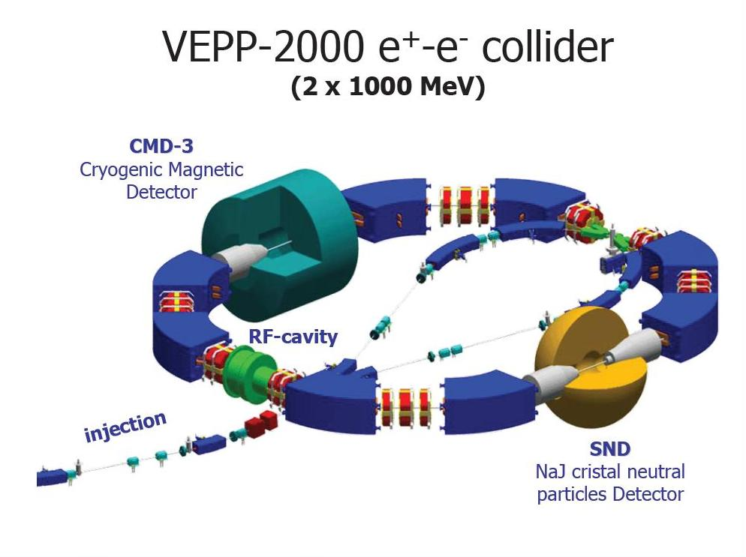
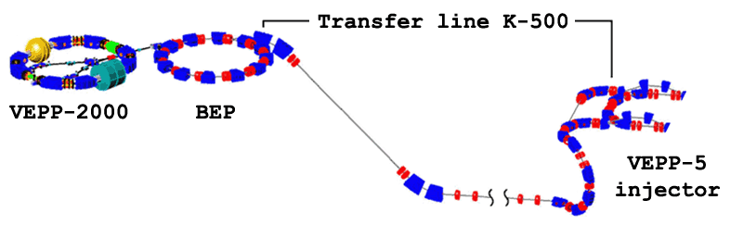

VEPP-2000 collider (2017-2018)
VEPP-2000 collider began to operate since the end of 2010
c.m. energy E=0.3-2.0 GeV
from flat to round beam optics
Luminosity at E=1.8 GeV
1×10³² cm⁻² sec⁻¹ (project) 4×10³¹ cm⁻² sec⁻¹ (achieved in 2018)

Slide 6
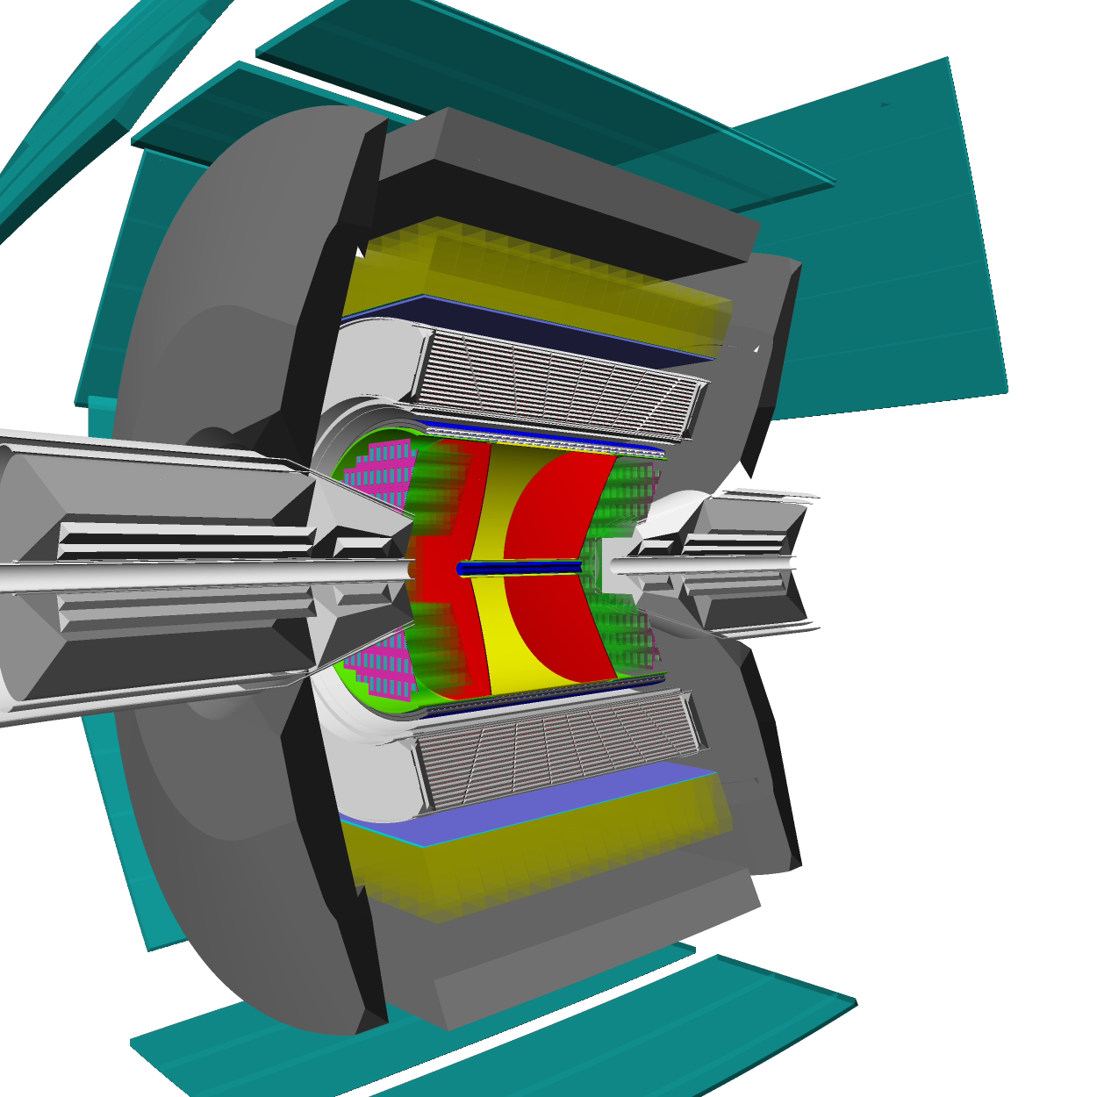
CMD-3 detector
Mu
DC – 1218 hexagonal cells with sensitive
wires, W-Re alloy, 15 μ in diameter, spatial resolution ∼ 100μ.
Z-chamber – start FLT, precise
z-coordinate ~ 500 μ (detector acceptance)
LXe calorimeter thickness 5,1X₀, 196 towers & 1286 strips. Spatial resolution 1 – 2 mm, measurement of conversion point for g’s measurement of shower profile
TOF – 16 counters, time resolution ~ 1ns
Calorimeter with CsI crystals (∼3,5 t), 8 octants, number of crystals - 1152, 8 X₀.
MR system – 8 octants (cosmic veto, ~ 1ns ) particle ID (mainly p, n)
Project magnetic field - 1,5 T
(current value 1.3 T)
DC
ZC
LXe
TOF
CsI
BGO

Slide 7
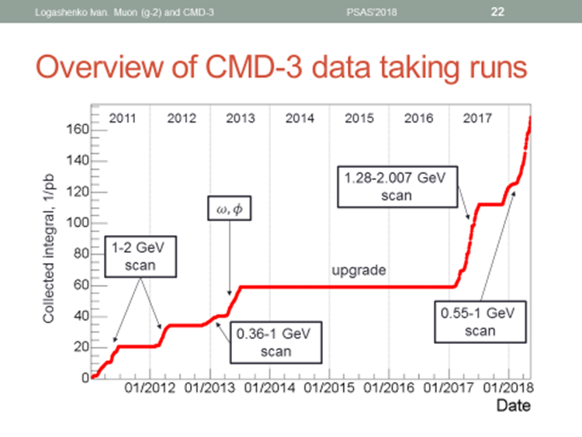
The rate statistics collection, 1/pb

Slide 8
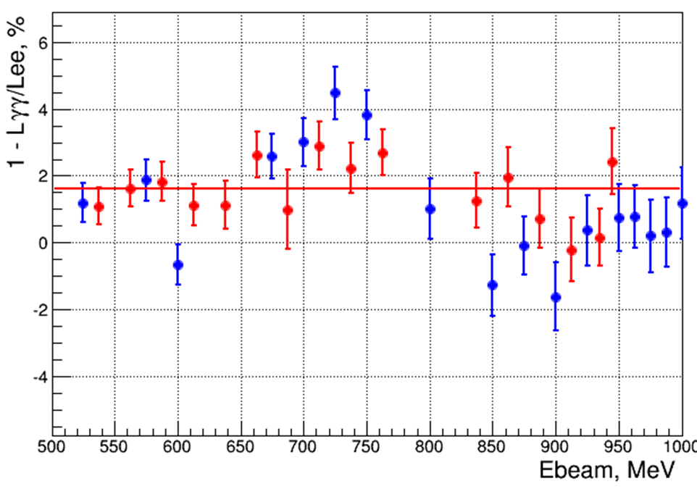
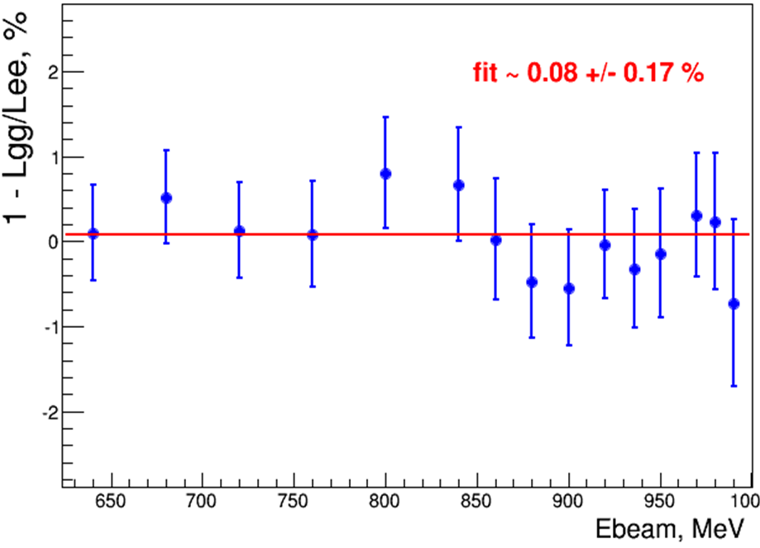
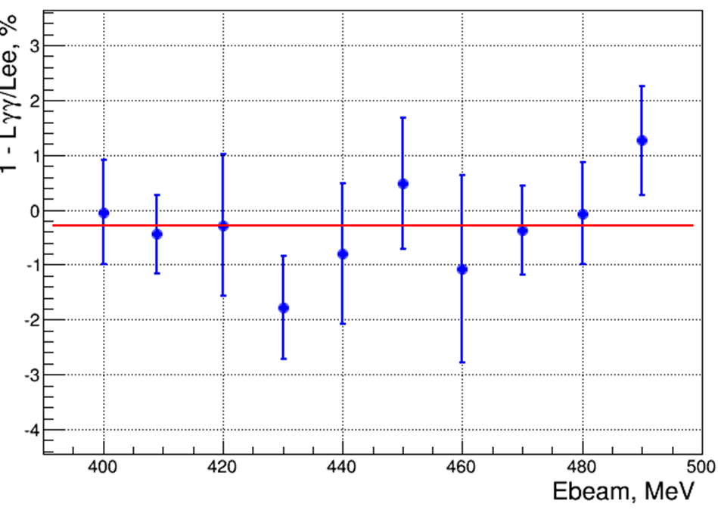
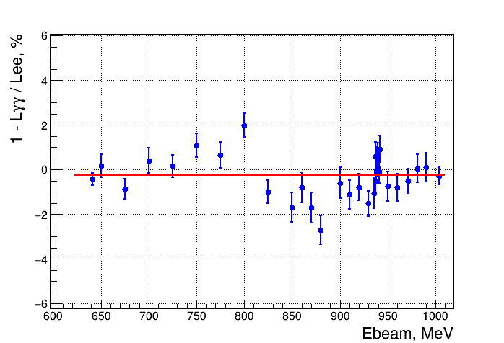
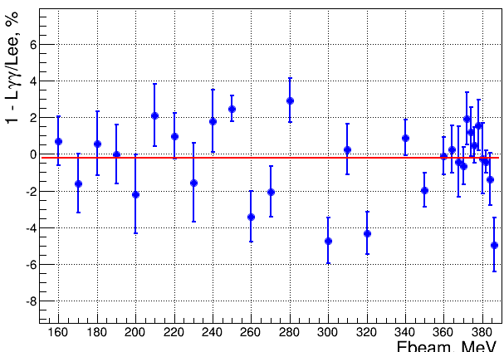
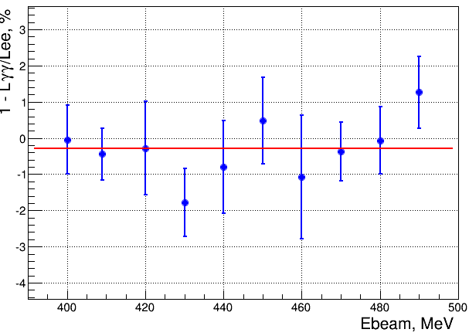
Luminosity determination
Fit: (2 ± 1)%
Fit: (0.1 ± 0.2)%
Preliminary
scan up & down, 2011
scan up, 2012
Fit: (-0.3 ± 0.3)%
Fit: (-0.25 ± 0.09)%
Overall runs systematic uncertainty is about 1%
ϕ→ω scan, 2013
scan 2017
8

Slide 9

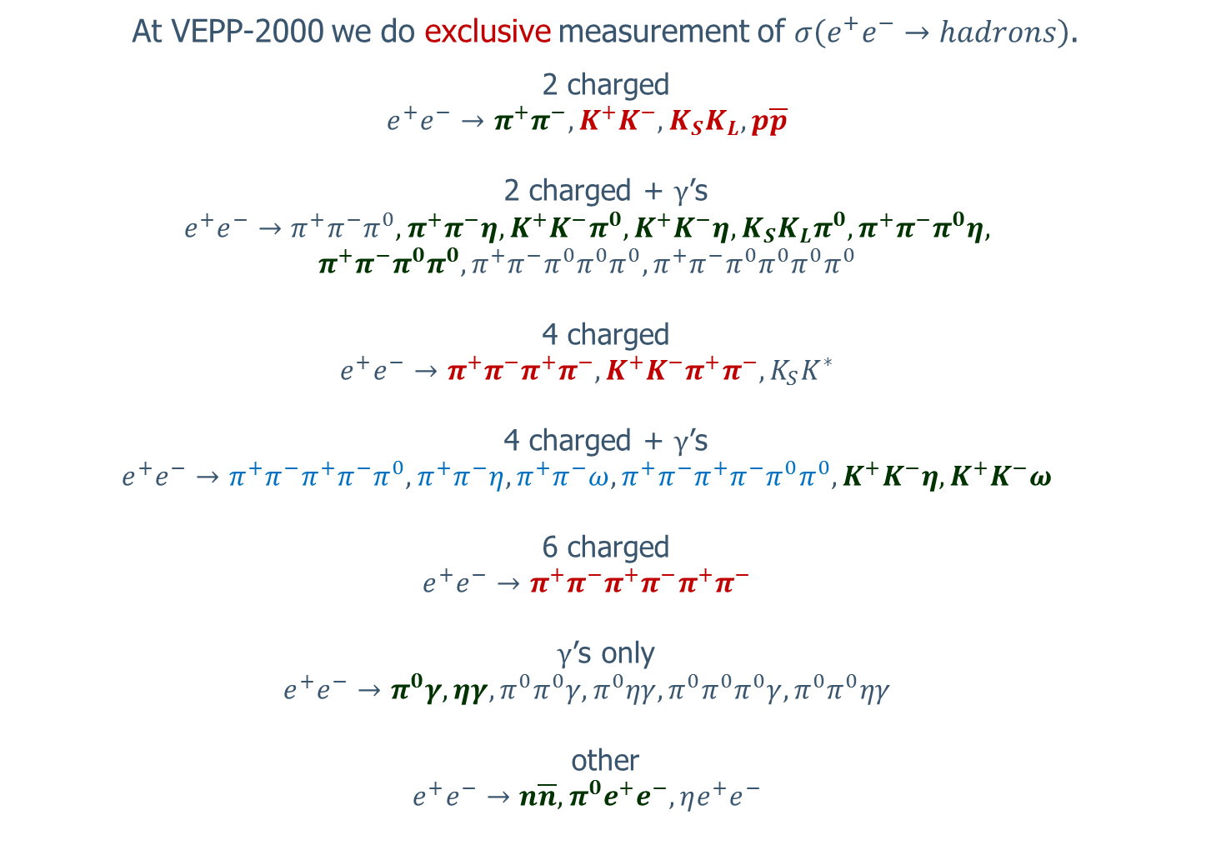
Exclusive channels $e^{+}e^{−}→hadrons$
At VEPP-2000 we do exclusive measurement of $σ\left(e^{+}e^{−}→hadrons\right)$.
2 charged
  $$e^{+}e^{−}→π^{+}π^{−}, K^{+}K^{−},K_{S}K_{L},p\overline{p}$$
2 charged + $γ$’s
  $$e^{+}e^{−}→π^{+}π^{−}π^{0}, π^{+}π^{−}η,K^{+}K^{−}π^{0}, K^{+}K^{−}η,K_{S}K_{L}π^{0}, π^{+}π^{−}π^{0}η,$$
  $$π^{+}π^{−}π^{0}π^{0},π^{+}π^{−}π^{0}π^{0}π^{0}, π^{+}π^{−}π^{0}π^{0}π^{0}π^{0}$$
4 charged
  $$e^{+}e^{−}→π^{+}π^{−}π^{+}π^{−}, K^{+}K^{−}π^{+}π^{−},K_{S}K^{∗}$$
4 charged + $γ$’s
  $$e^{+}e^{−}→π^{+}π^{−}π^{+}π^{−}π^{0}, π^{+}π^{−}η,π^{+}π^{−}ω,π^{+}π^{−}π^{+}π^{−}π^{0}π^{0}, K^{+}K^{−}η,K^{+}K^{−}ω$$
6 charged
  $$e^{+}e^{−}→π^{+}π^{−}π^{+}π^{−}π^{+}π^{−}$$
$γ$’s only
  $$e^{+}e^{−}→π^{0}γ, ηγ,π^{0}π^{0}γ,π^{0}ηγ,π^{0}π^{0}π^{0}γ,π^{0}π^{0}ηγ$$
other
  $$e^{+}e^{−}→n\overline{n}, π^{0}e^{+}e^{−}, ηe^{+}e^{−}$$
red – results are published
green – are under study
blue – to be studied

Slide 10
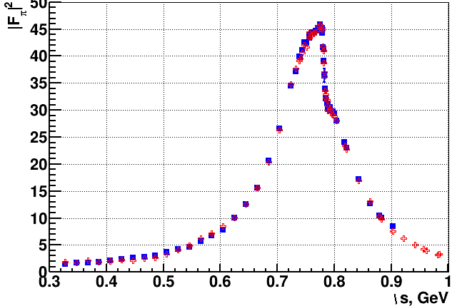
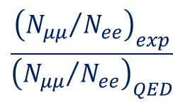
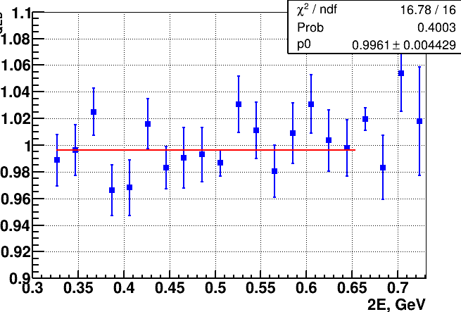
e⁺e⁻ → π⁺π⁻ (2013 data, 9.4 pb⁻¹)
2013 data
2013 data
by momentum
PRELIMINARY
Preliminary
Fit: (-0.4 ± 0.5)%
Only statistical errors are shown
Work in progress
Work in progress
by energy deposition
by energy deposition
work is ongoing
Two methods of data processing: by energy deposition – red points
by momentum - blue points
10

Slide 11
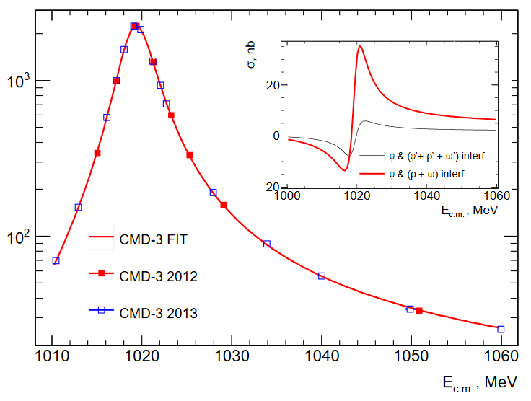




CMD-3 results from 2011-2013
Select by decay K_{s}→π⁺π⁻
σ = 10×[σ(fit) - σ(ϕ)]
$$K_{S}K_{L}$$
PLB 760 (2016) 314
$$K^{+}K^{−}$$
syst. uncert. ~ 2 – 3%
PLB 779 (2018) 64
$$π^{+}π^{−}π^{+}π^{−}$$
$$π^{+}π^{−}π^{+}π^{−}$$
PLB 768 (2017) 345
Preliminary
st.err.~1 - 2%
ρ⁰, a₁(1260)π & a₂(1320)π

Slide 12
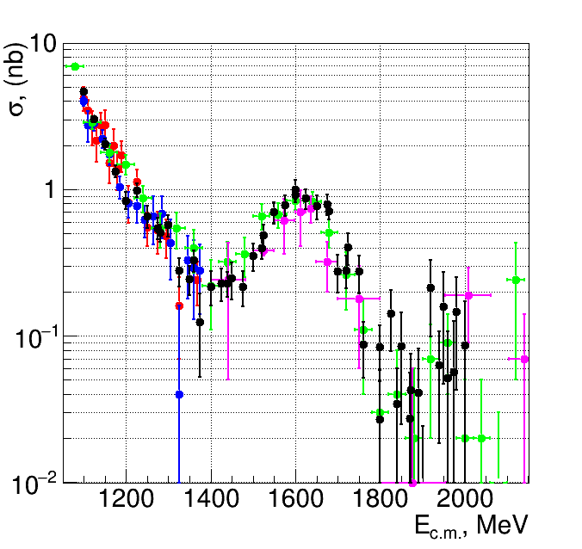

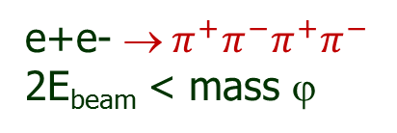
CMD-3 recent results from 2011-2013
e+e- ${ π}^{+}π^{−}π^{+}π^{−}$
2E_{beam} < mass ϕ
Preliminary
cross section, nb
CMD-3
CMD-2
SND
BaBar
DM1
Good agreement with all previous results
in E_{cm} = 1100 – 2000 MeV: 54 energy points
Integrated luminosity ~22 pb⁻¹
1889 events with fully reconstructed K_{S} → π+π−

Slide 13
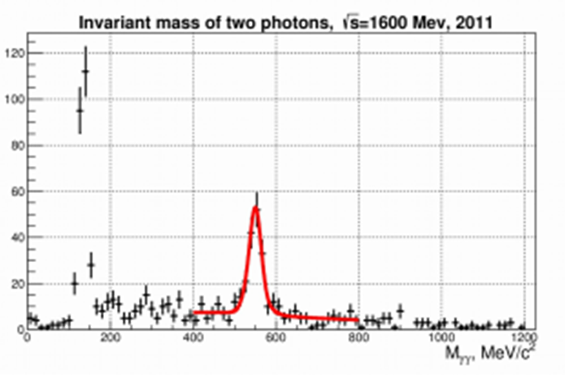
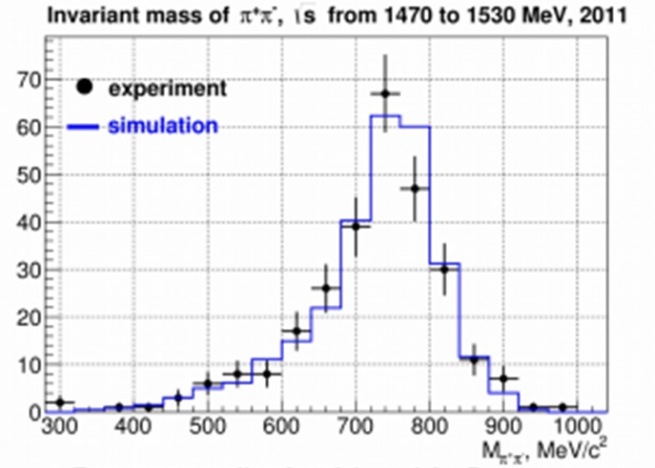


CMD-3 published results from 2011-2013
Clearly seen complex structure of intermediate states and their relative contribution changes with energy
$$3(π^{+}π^{−})$$
PLB 723 (2013) 82
DATA@E = 1720 МэВ
ω(782)3π → (61±6)%
ρ(770)4π → (27±7)%
ω(782)η → (12±4)%
DATA@E = 2000 МэВ
ω(782)3π → (49±11)%
ρ(770)f₀(1370) → (46±13)%
a₀(980)ρ → (5±2)%
inv.m(γγ)
$$π^{+}π^{−}π^{0}η$$
PLB 773 (2017) 150
Intermediate states dominate: e+e− → ω(782)η, φ(1020)η and a0(980)ρ(770)
inv.m(ππ)
Cross sections are consistent with each other for both η decay mode:
η→π⁺π⁻π⁰ and γγ

Slide 14
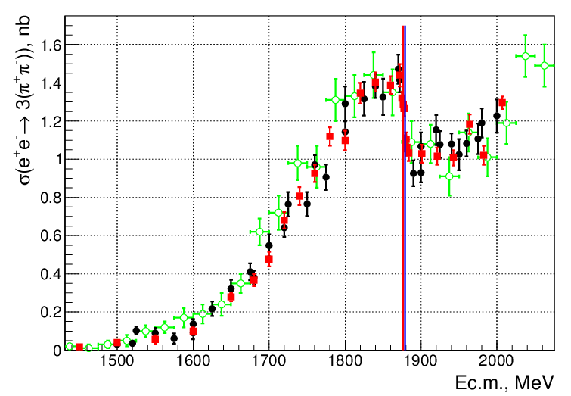
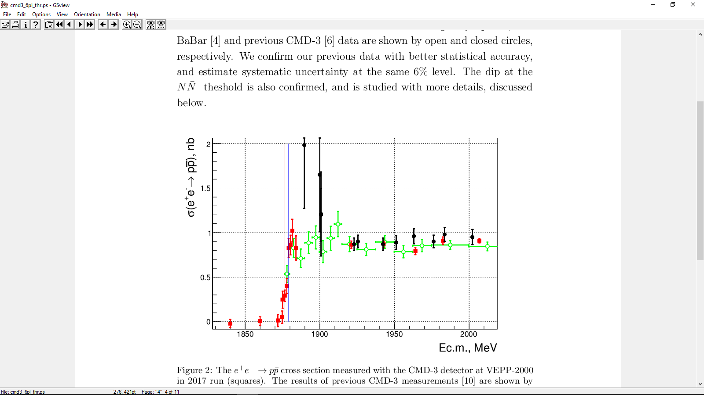
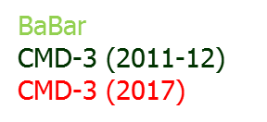


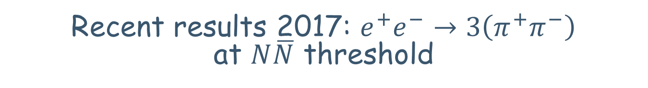


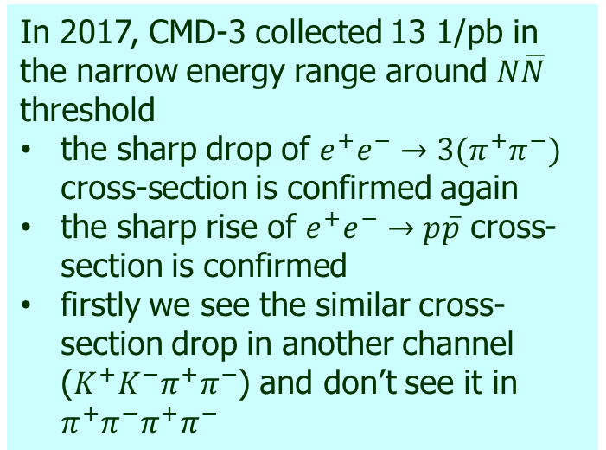

Recent results 2017: $e^{+}e^{−}→3\left(π^{+}π^{−}\right)$ at $N\overline{N}$ threshold
In 2017, CMD-3 collected 13 1/pb in the narrow energy range around $N\overline{N}$ threshold
the sharp drop of $e^{+}e^{−}→3(π^{+}π^{−})$ cross-section is confirmed again
the sharp rise of $e^{+}e^{−}→p\overline{p}$ cross-section is confirmed
firstly we see the similar cross-section drop in another channel (${K^{+}K^{−}π}^{+}π^{−}$) and don’t see it in $π^{+}π^{−}π^{+}π^{−}$
$$3(π^{+}π^{−})$$
BaBar
CMD-3 (2011-12)
CMD-3 (2017)
Preliminary
$$e^{+}e^{−}→2\left(π^{+}π^{−}\right)$$
$$p\overline{p}$$
$$p\overline{p}$$
$$n\overline{n}$$

Slide 15
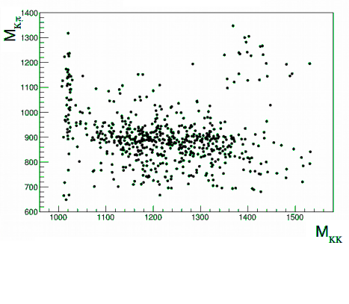
e⁺e⁻ → K⁺K⁻π°
φ(1020)
K*(892)
K*(892)
M_{KK}
Analysis is based on the integrated
luminosity 24 pb⁻¹
It is consistent with BaBar but more
precise
Number of selected signal events was
found to be 940 ± 57.
The main physical background comes
from the processes: e+e- → K⁺K⁻π⁰π⁰,
K⁺K⁻γ, π⁺π⁻π⁰π⁰, π⁺π⁻π⁰
The plot Kπ vs K+K- inv. mass clearly shows ϕπ° and K*(892)K mechanism
Detection efficiency was determined according to SIM & was found to be ~12% ÷18% and change with energy
The current systematic uncertainty is
estimated as 7 ÷ 10%

Slide 16
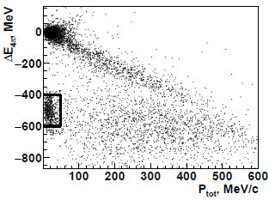
e⁺e⁻ → K⁺K⁻π⁺π⁻
π+π-π+π-
K+K-π+π-
ΔΕ = |Ε_{π} + Ε_{π} + Ε_{π}+ Ε_{π} - 2E_{beam}| < 100 MeV
ΔP = |P₁ +P₂ +P₃ +P₄ | < 80 MeV/c
CMD-3 studies use 22 pb⁻¹ between 1.5 and 2 GeV, more than 20000
events with 3 and 4 tracks were selected for analysis;
Ionisation losses in DC dE/dx provide good K/π separation;
Analysis of π⁺π⁻, K±π∓, K⁺K⁻ inv. masses clearly show signals from ρ⁰,
K^{*0}(892), ϕ;
Many different mechanisms seen: K₁(1270)K → KρK, K*(892)Kπ,
K₁(1400)K → K*(892)Kπ, ϕπ⁺π⁻.
16

Slide 17
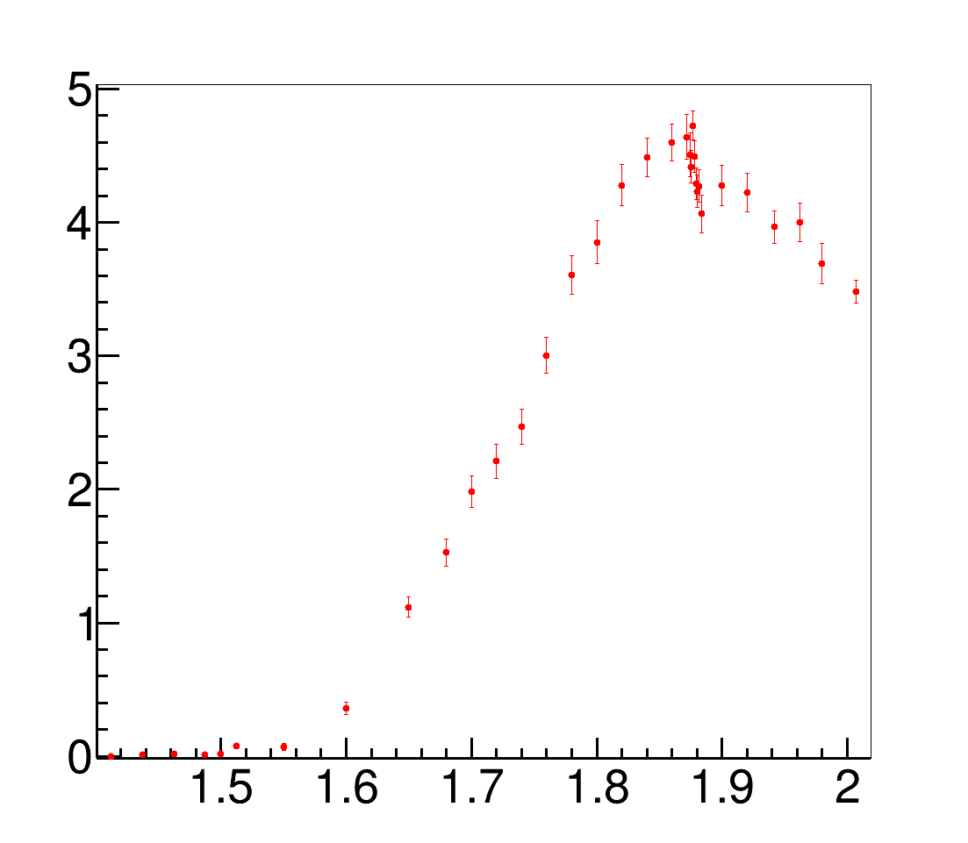
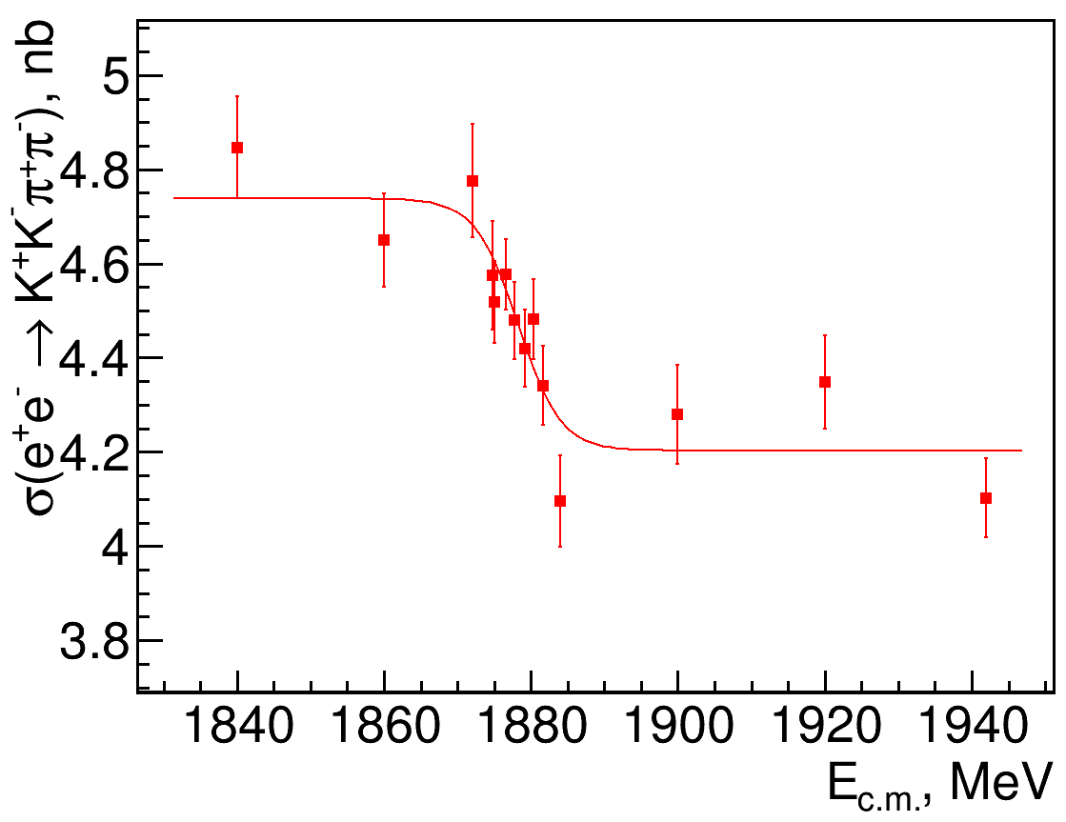
2017: e⁺e⁻ → K⁺K⁻π⁺π⁻
Integrated luminosity increased: 22 → 37 pb⁻¹. Near p-pbar threshold statistic increase by four times and XS was measured at 9 energy points with statistic at each ~1500 events.
Continuously monitoring beam energy with CBST (~ 100 keV)
Analysis is based on the data sample with 4-track events only in DC (background smaller than ~1%)
XS fast drops similar to the six-pion channel (Δσ ∼ 0.5 nb)
Cross section, nb
Preliminary
, GeV
This phenomenon has no theoretical explanation. Still the puzzle

Slide 18

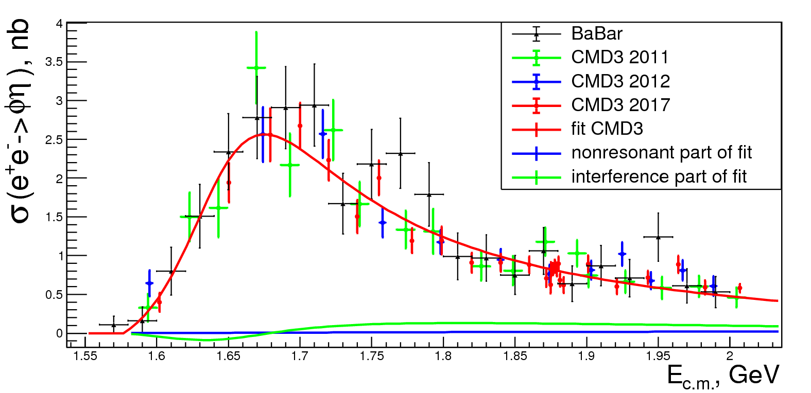
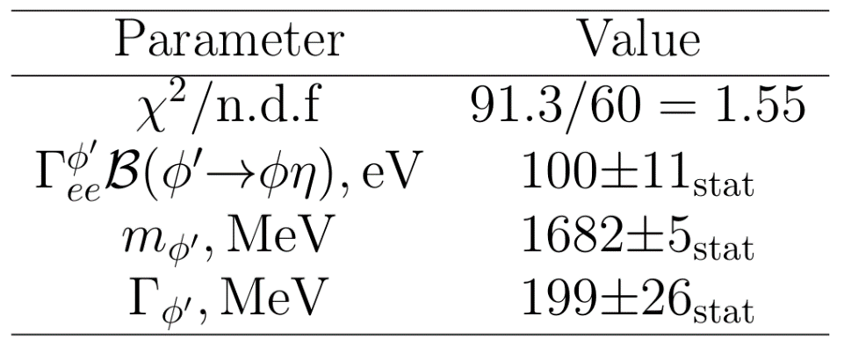

e⁺e⁻ → K⁺K⁻η
XS e⁺e⁻ → K⁺K⁻ω
Preliminary
XS was measured at 23 energy points between 1.57 - 2.0 GeV and includes ~1600 signal events & ~600 bkg
Analysis empasizes the dominant ϕ-η signal, studies of nonresonant K⁺K⁻η are needed
18

Slide 19
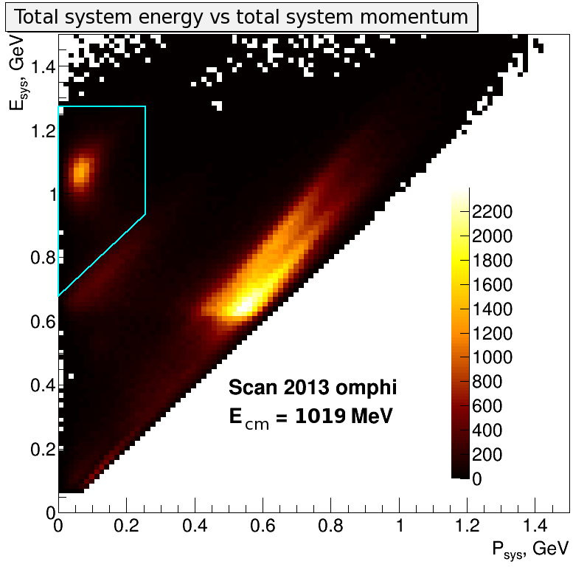
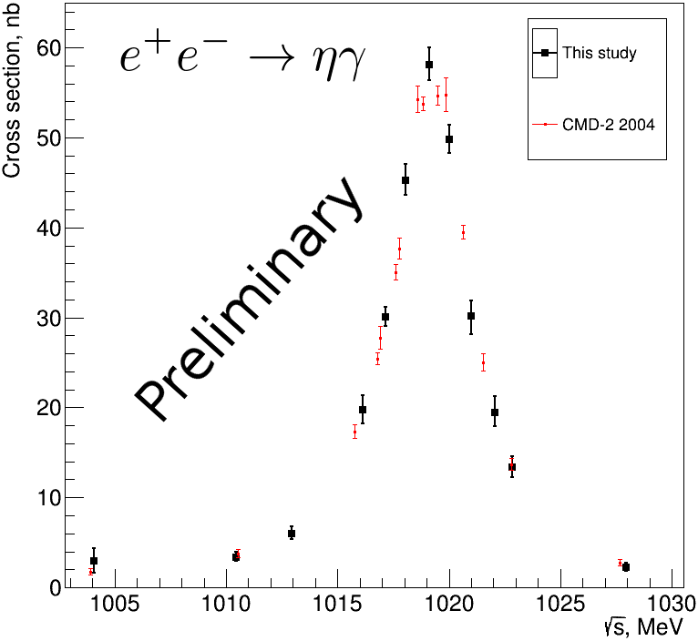
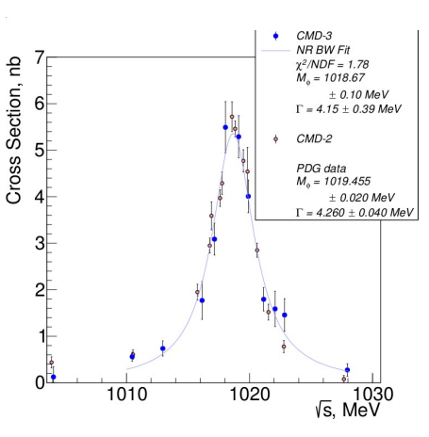

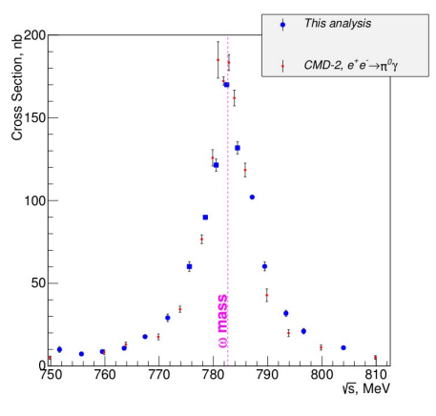

e⁺e⁻ → π⁰γ,ηγ → 3γ
Process are under study in CMS energy range 750-1030 MeV. Data were collected in 2013
Main physics background is two-gamma annihilation with one radiated photon
Φ → ηγ
Φ → π⁰γ
Preliminary
E _{syst} = (Eγ₁+Eγ₂+Eγ₃)/ 2E_{beam} ∼ 1
ω → π⁰γ
Psyst = | $\vec{p1}$ + $\vec{p2}$ +$\vec{p3}$| ∼ 0
Preliminary
Kinematic reconstruction is applied to all events with three photons
Common initial points of photon production were assumed
The combination of three photons with a minimal χ² value is used in analysis

Slide 20
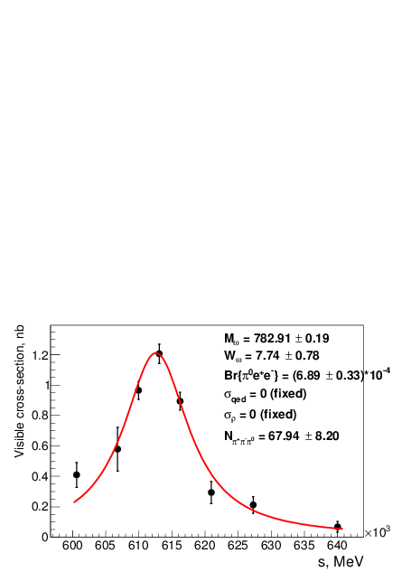
e⁺e⁻ → ω → π⁰e⁺e⁻
Motivation:
study of the internal structure of the vector mesons (transition form factor).
The precise value of the decay branching ratio can be useful for interpretation of experiments on
quark-gluon plasma
Preliminary
Background separation:
• π⁺π⁻π⁰: opening angle between tracks, kinematic of the decay, recoil mass of photon pairs.
• π⁰γ: The separation method for π⁰e⁺e⁻ and π⁰γ (with conversion γ on material of the detector) is based on information from drift chamber (track momentum, vertex position) and uses a neural network.
Experiment | Br(ω → π⁰e⁺e⁻) | events | data, pb⁻¹
CMD-2 | (8.19±0,71±0.62)∗10⁻⁴ | 230 | 3.3
SND | (7.61±0,53±0.64)∗10⁻⁴ | 613 | 9.8
CMD-3 | (6.90±0.33)∗10⁻⁴ | 1169 | 8

Slide 21
SUMMARY and OUTLOOK
VEPP-2000 collider successfully operated at √s = 2m_{π} -2 GeV
with L_{max} = 4x10³¹ cm⁻²s⁻¹ and collected ~160 pb⁻¹ per detector
CMD-3 results must provide the systematic accuracy ~0.3-0.5% for π⁺π⁻
(0.2 – 0.3 ppm) and ~3% for multibody modes
Energy region near N-Nbar threshold carefully scann again and statistic
increased by a factor of 4
For the first time an anomalous behavior of the XS for the process
e+e- → K⁺K⁻π+π- near N-Nbar threshold is also revealed
Various studies of transition form factors are in progress:
e⁺e⁻ →π⁰γ, ηγ, π⁰e⁺e⁻, ηe⁺e⁻
We start analysis of the multihadron processes with Ks in final states:
K_{S}K±π±, K*±K⁻⁺ → K_{S}π±K⁻⁺, K*±K*⁻⁺ → K_{S}π±K_{L}π⁻⁺ and so on
We plan to collect the integrated luminosity ~ 1fb⁻¹ in 5 years, which
should provide new precise results on multihadron production

Slide 22
BACK SLIDES

Slide 23
𝑒+𝑒− symmetric beams machine for the energy scan in range 𝑠∈(2𝑚𝜋;2.005 GeV)
• Round beams technology used
• The maximum luminosity is 10³² cm⁻²s⁻¹ at
2.0 GeV
• Compton backscattering beam energy
measurement (±60 keV precision)
• ~ 120 pb-1 is collected by each detector, the
goal is to collect ~1 fb-1 in ~5 years
CMD-3
SND

Slide 24
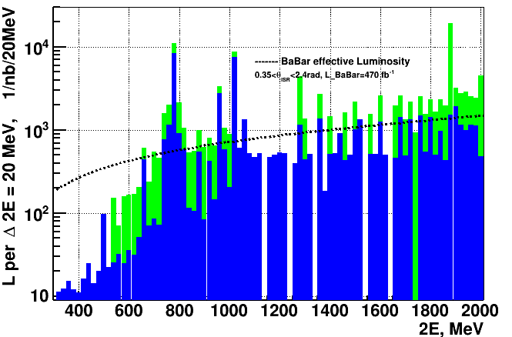
History of the collected luminosity
Beam energy 2E, MeV
Collected L ~ 60 pb⁻¹ (2010 – 2913)
8.3 pb⁻¹ ω-region
9.4 pb⁻¹ region below 1 GeV (except ω)
8.4 pb⁻¹ ϕ-region
34.5 pb⁻¹ region higher than ϕ-meson
Collected L ~ 100 pb⁻¹ (2017 - 2018)
~25 pb⁻¹ ω-region
~15 pb⁻¹ region below 1 GeV(except ω)
~10 pb⁻¹ p-pbar-region
~50 pb⁻¹ higher ϕ-meson (2017)

Slide 25
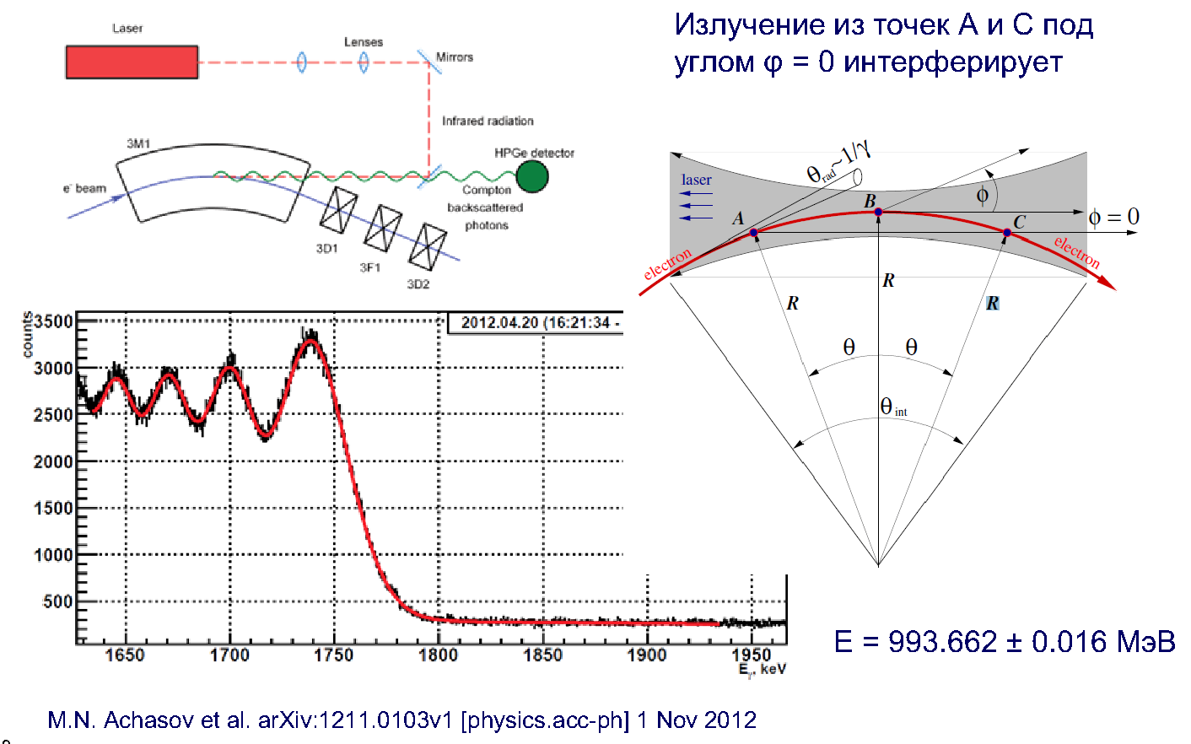
Energy measurement
Energy is monitored continuously using Compton
backscattering techneques
Radiated photons from any points in orbit from A to C at zero angle interfere with each other
The width of the transition determines the accuracy of the average beam energy.
Beam energy spread is about 1 MeV

Slide 26
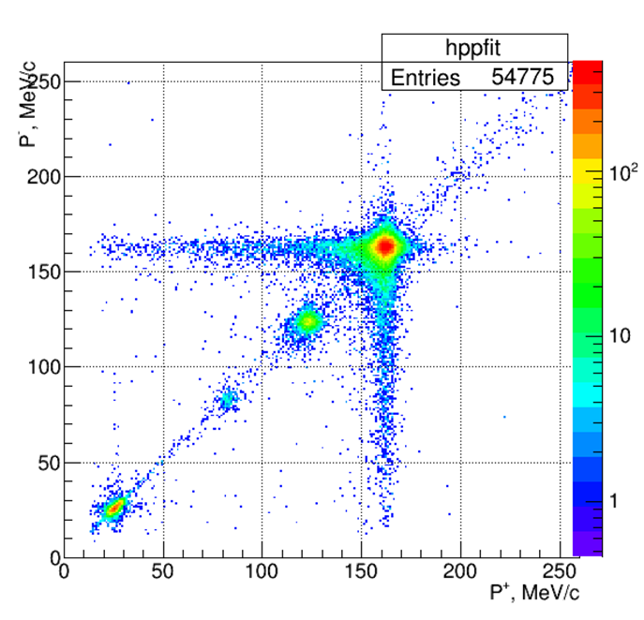
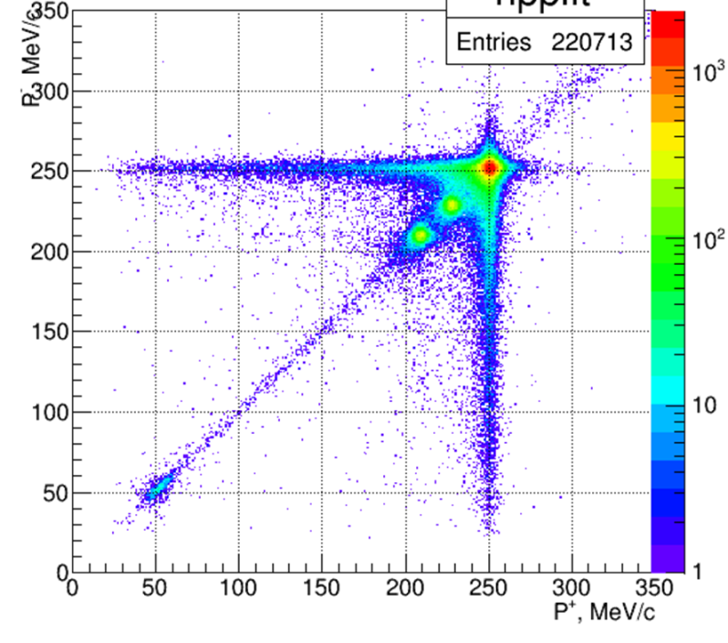
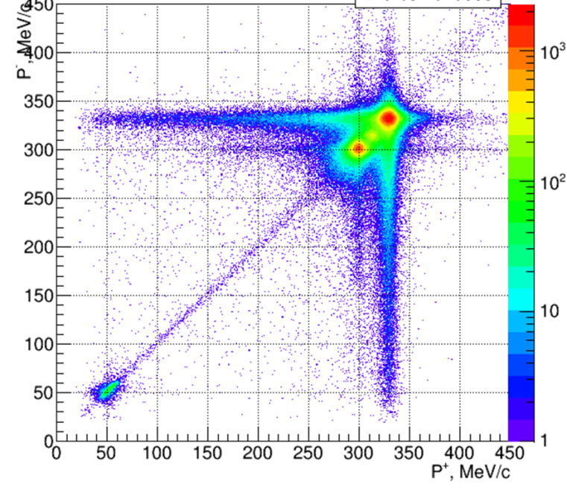
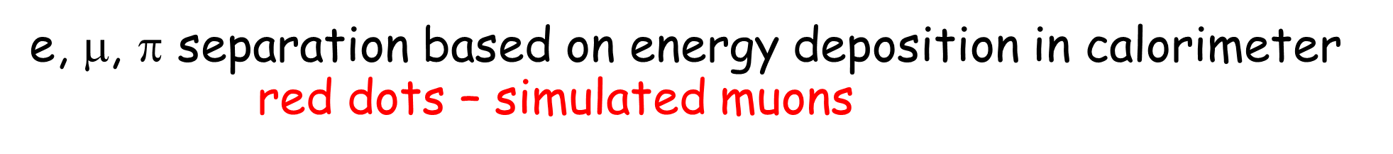
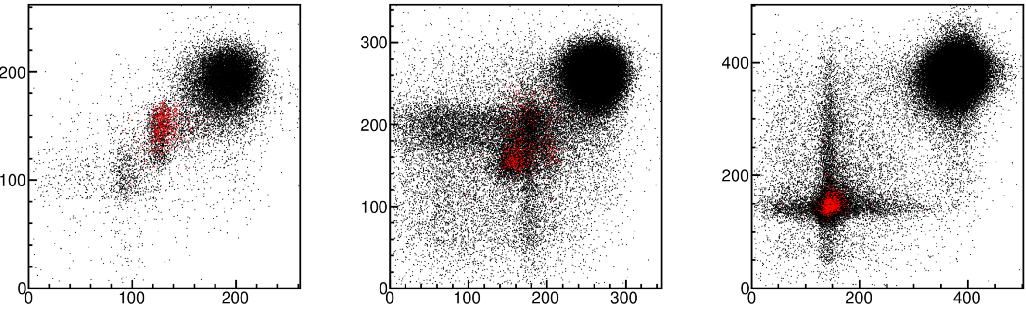


Luminosity determination (e+e- & γγ)
e
π, μ
e
cosmic
μ
π
Cosmic
e
π, μ
e
π, μ & cosmic
Cosmic and μ, π clusters begin to overlap with energy
26

Slide 27
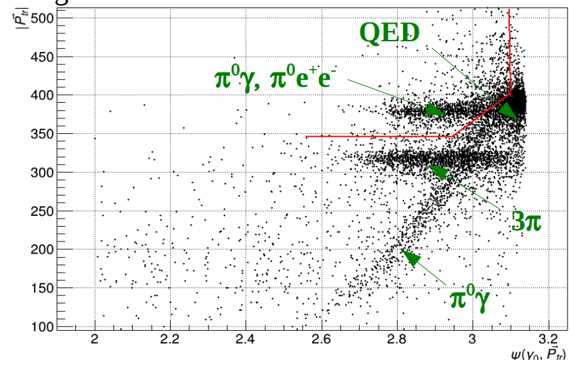
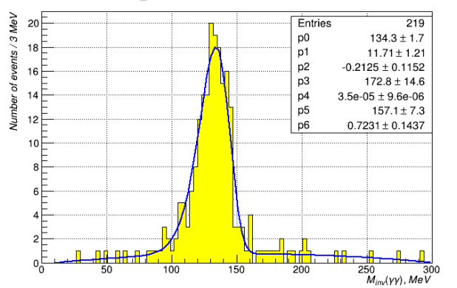
e⁺e⁻ → ω → π⁰e⁺e⁻
The total momentum of charged particles |P_{tr}| vs angle between the most energetic photon direction. Red line presents the selection criteria
|P_{tr}|
ψ(γ₀,P_{tr})
Preliminary
Events/3 MeV
m(γγ) MeV
The analysis is still in progress. Our statistics is enough to decrease statistical error twice with respect to the previous CMD-2 result. Additionally with better detector performance we hope to reach the most precise result also for the ηee channel.

Slide 28
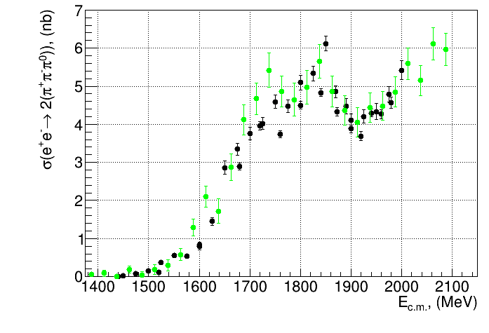
CMD-3 (Preliminary)
BaBar

