Slide 1

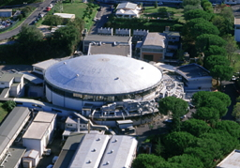
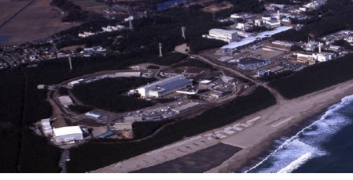

SMI – STEFAN MEYER INSTITUTE
MESON 2018, Cracow
Spectroscopy of kaonic atoms at DAFNE and J-PARC
J. Marton
for SIDDHARTA Coll.
SMI Vienna, Austria
WWW.OEAW.AC.AT/SMI

Slide 2
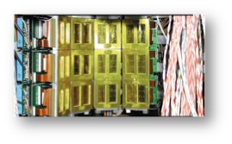
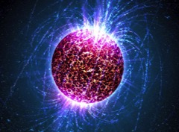
Motivation
Hadronic Physics according to the mass scale
  Light quarks up, down
  (Semi-) light quark - strange quark
  Heavy quarks charm, bottom, top
Strong interaction with strangeness - regime of spontaneous and explicit chiral symmetry breaking
Powerful theoretical approaches like effective field theory in
antikaon-nucleon interaction
Scattering and spectroscopic (e.g. kaonic atoms) investigations - some key data still missing
Role of strangeness in the universe (compact stars, relation to GW in binaries)? “Hyperon puzzle”, hyperons in medium

Slide 3

Outline
Hadronic atoms as unique probes for strong interaction at threshold
Results of experiments at DAFNE/LNF-INFN
Kaonic deuterium experiments SIDDHARTA2, E57
  Experimental challenges (yield, background)
  Target and Instrumentation
Summary and Outlook

Slide 4
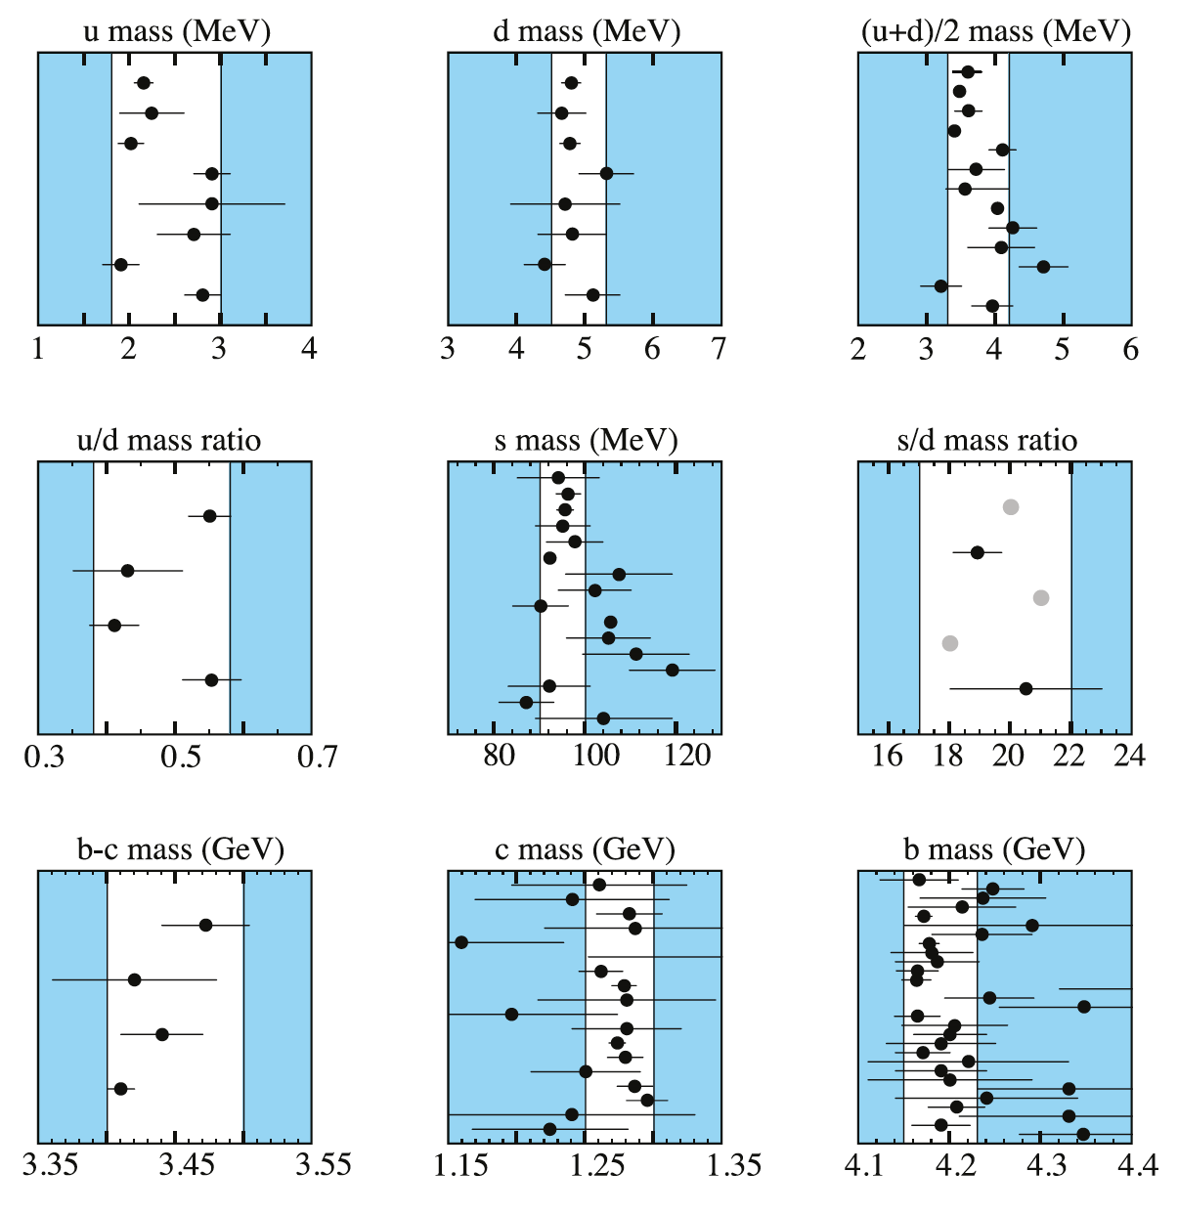
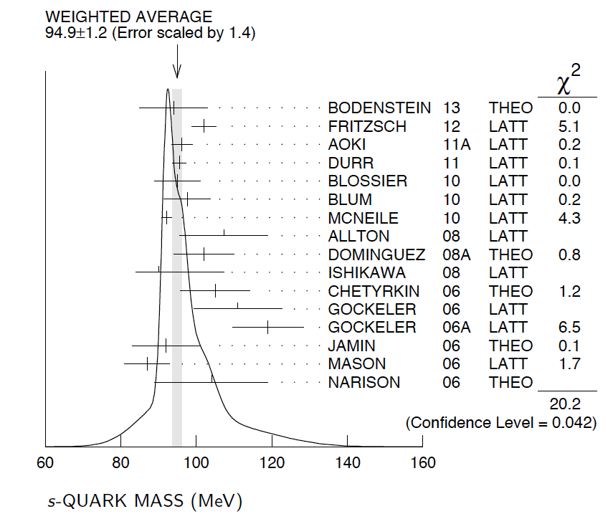
Strangeness
Strange quark – not light but not heavy
Kaonic atoms →
Spontaneous and explicit
Chiral symmetry breaking in
low-energy QCD

Slide 5
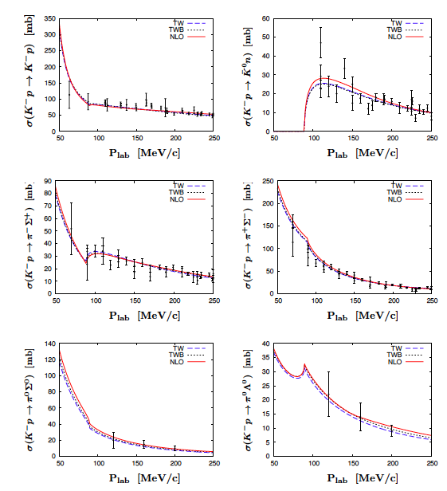
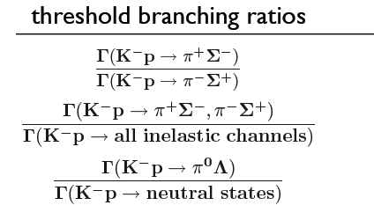
Sources of experimental information on K_{bar}N interaction
K-p scattering data
for threshold data extrapolation
necessary
Threshold branching ratios
Kaonic atom data
Kaonic hydrogen
Kaonic Deuterium
1s state shift
1s state width
→ x-ray spectroscopy
Constraints from precise kaonic hydrogen measurements → sub-threshold extrapolations of the KbarN amplitude with
strongly reduced uncertainties

Slide 6
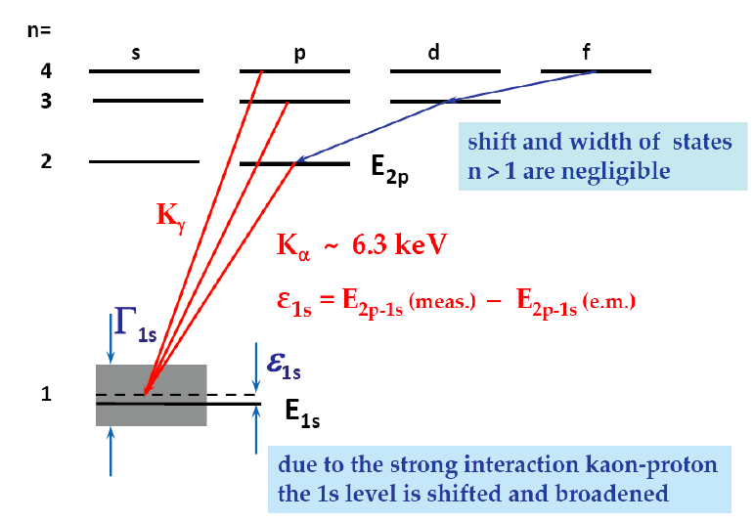
Cascade in hadronic atoms (KH,KD)
n
~ 25
3
2
1
Stark-mixing
l=0 1 2 n-1
external Auger effect
chem. de-excitation
nuclear
absorption
Coulomb de-excitation
X-ray radiation
K_{α}
Probing strong interaction at threshold
Γ_{1s}
observable hadronic
shift and broadening
ε_{1s}

Slide 7
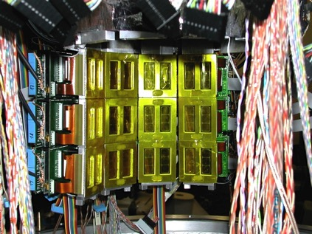
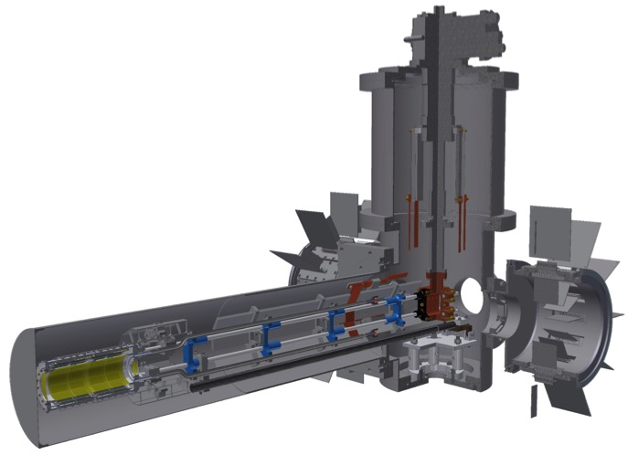
Kaonic atom spectroscopy
SIDDHARTA2@DAFNE E59@J-PARC
E57
Kaon Source from Φ meson
Low-momentum kaon beam

Slide 8



SIDDHARTA-2 Collaboration
SIlicon Drift Detector for Hadronic Atom Research by Timing Applications
LNF- INFN, Frascati, Italy
SMI- ÖAW, Vienna, Austria
Politecnico, Milano, Italy
IFIN – HH, Bucharest, Romania
TUM, Munich, Germany, Germany
RIKEN, Japan
Univ. Tokyo, Japan
Victoria Univ., Canada
Univ. Zagreb, Croatia
Helmhotlz Inst. Mainz, Germany
Univ. Jagellonian, Krakow

Slide 9
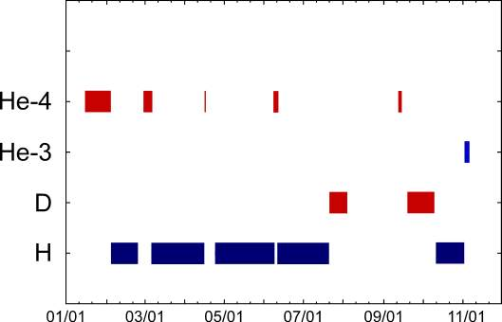
SIDDHARTA data overview

Slide 10
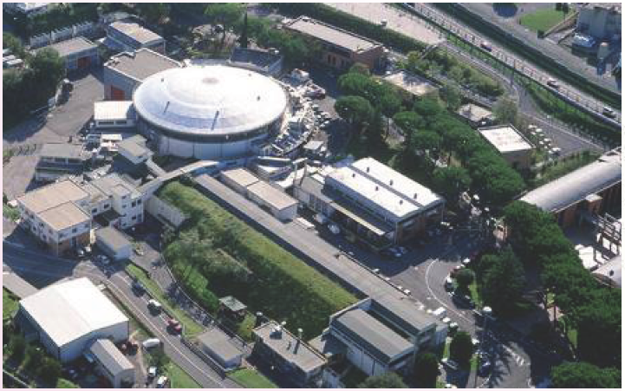
Kaonic atoms at DAΦNE/Frascati
e⁺-e⁻
collider
Accu.
LINAC

Slide 11
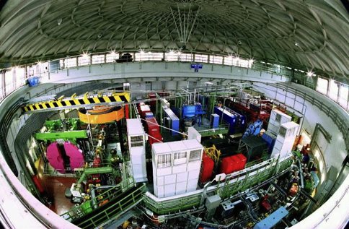
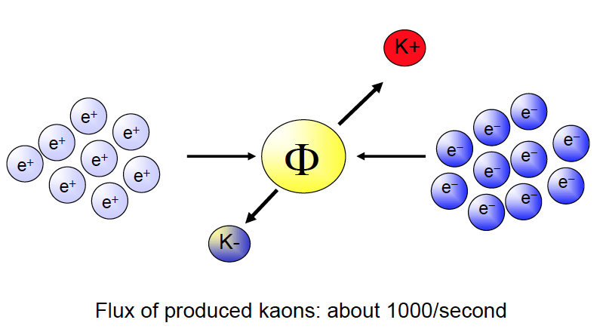
DAΦNE:
Φ Factory of LNF-INFN
Double annular electron-positron collider producing Φ (1020 MeV) resonantly (σ ≈ 5 μb
  m_{Φ} = 1019.413 ± 0.008 MeV
  Γ = 4.43 ± 0.06 MeV

Slide 12
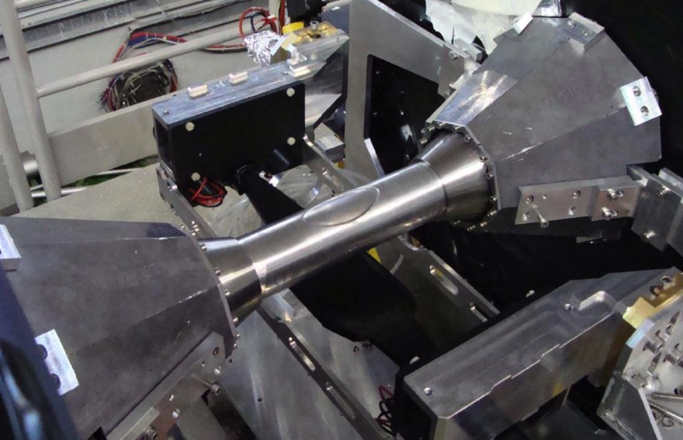
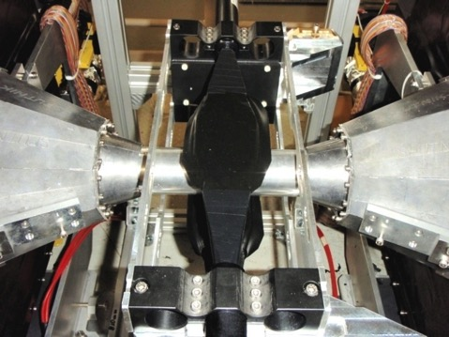
Beam pipe in e⁺e⁻ intersection of SIDDHARTA
SIDDHARTA used the KLOE intersection of DAFNE
Luminosity increased with new system providing a large crossing angle (crab waist system)
Kaon window
Kaon detectors sitting below
and above the intersection

Slide 13
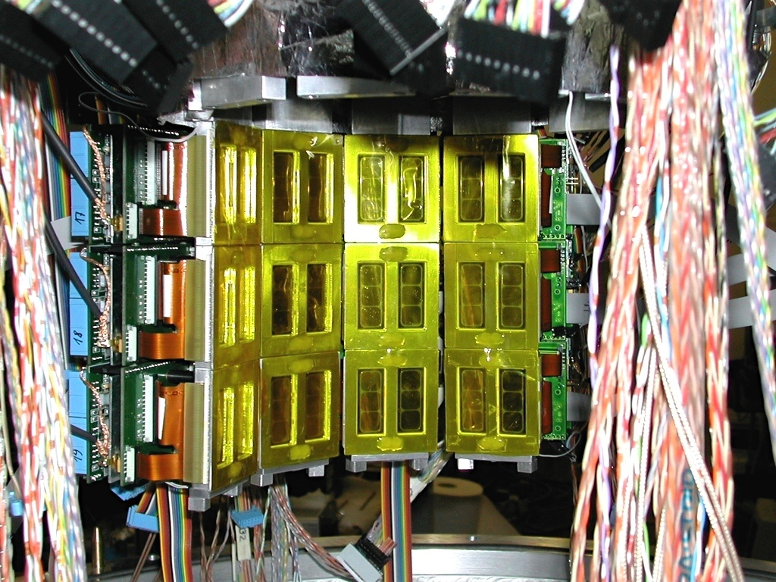
SIDDHARTA SDD Array
144 SDDs =144 cm² active area

Slide 14
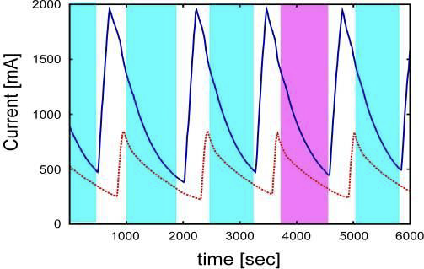
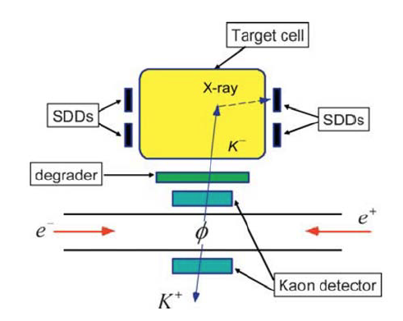
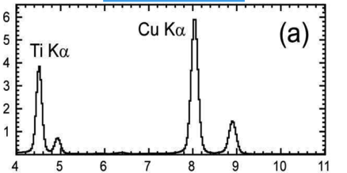
SIDDHARTA data taking
Charged kaons from Φ decay
Φ → K⁺ + K⁻ (BR ≈ 50%)
electrons
positrons
Calibration with X-ray tube and Ti/CU foils
keV
Syst. error ≈ 3-4 eV

Slide 15
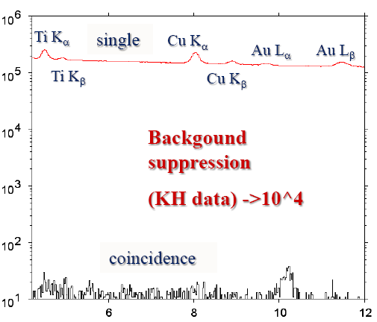

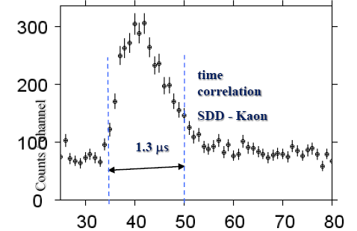
Background suppression in SIDDHARTA
Efficient background suppression by using the kaon - x-ray correlation
X-ray energy [keV]
time [83 ns/ch]

Slide 16
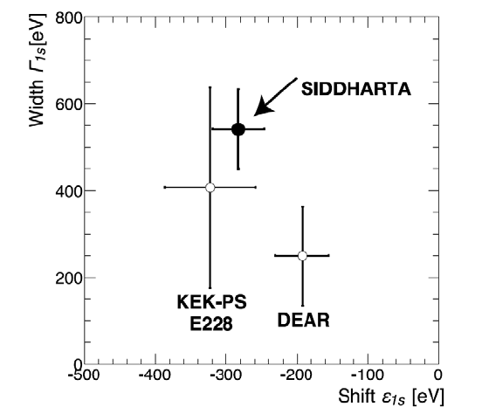
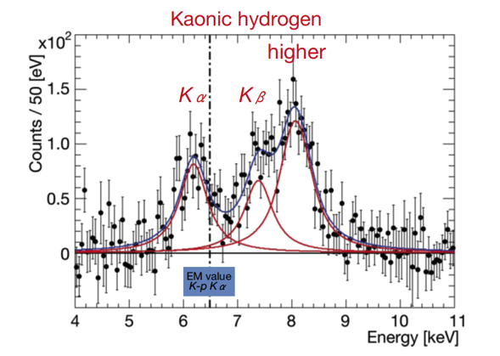
K⁻p result SIDDHARTA
X-ray spectrum with background subtracted
ε_{1S}= −283 ± 36(stat) ± 6(syst) eV
Γ_{1S}= 541 ± 89(stat) ± 22(syst) eV
Physics Letters B704 (2011) 113

Slide 17
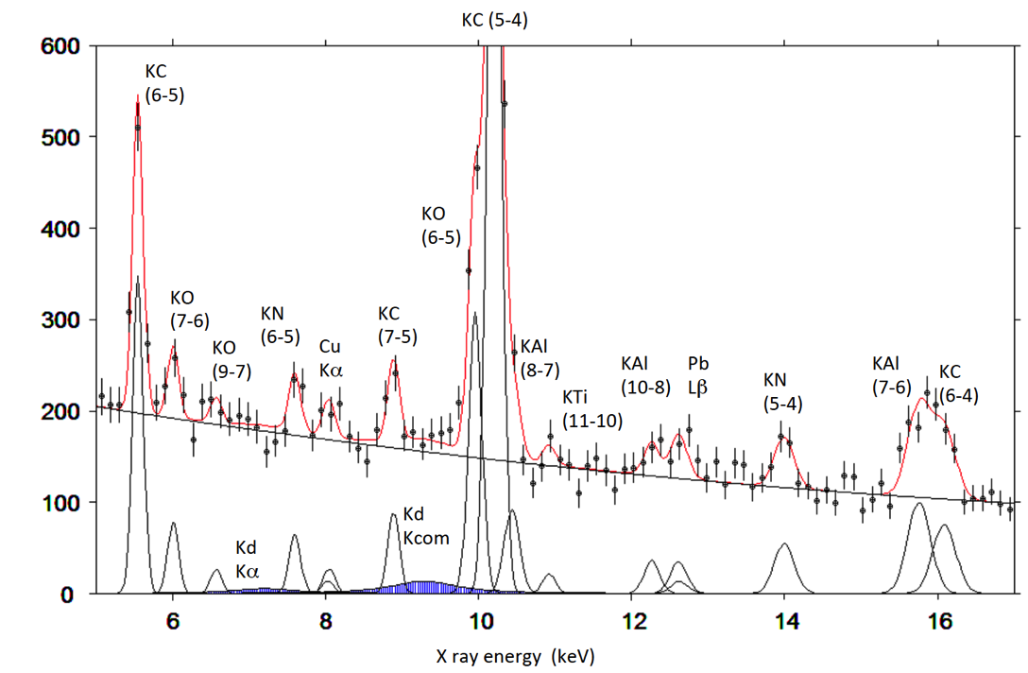
Kaonic atoms with deuterium gas (SIDDHARTA)
fit for shift about 500 eV, width about 1000eV, Kα / Kcomplex = 0.4
First exploratory K⁻d
x-ray experiment
2p-1s
3p-1s and higher

Slide 18
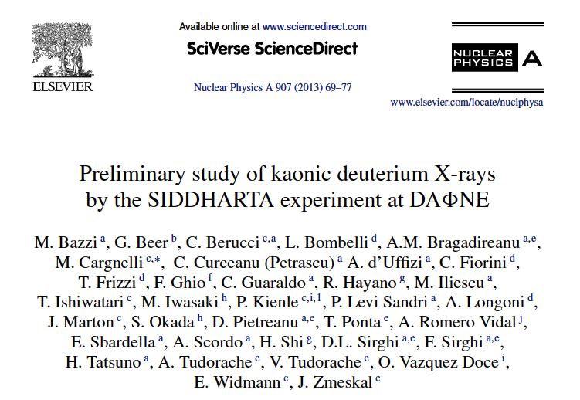

Yield of K-series in KD
Upper limits (90 C.L.)
for the x-ray yield
(SIDDHARTA)

Slide 19
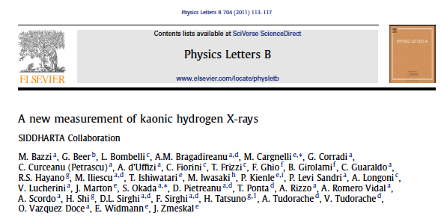
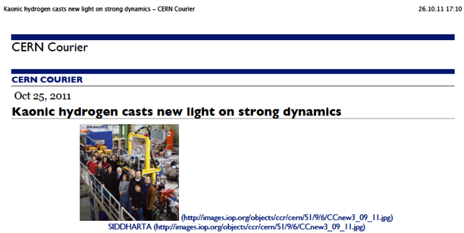
Kaonic Hydrogen: 400pb⁻¹, most precise measurement, Physics Letters B704 (2011) 113
Kaonic deuterium: 100 pb⁻¹, exploratory
first measurement ever, Nucl. Phys.A907 (2013)69
- Kaonic helium 4: first measurement ever in gaseous target; published in Phys. Lett. B 681 (2009) 310; NIM A628 (2011) 264 and
Phys. Lett. B 697 (2011)
- Kaonic helium 3: 10 pb⁻¹, first measurement, published in Phys. Lett. B 697 (2011) 199
Results of SIDDHARTA

Slide 20
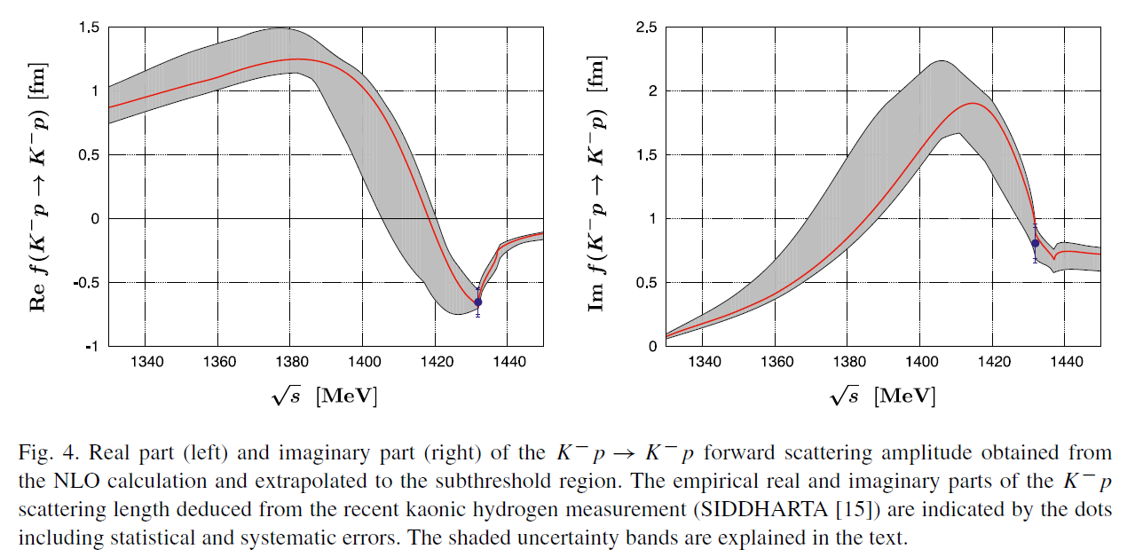
Chiral SU(3) theory of antikaon-nucleon interactions with improved threshold constraints
Y. Ikeda, T. Hyodo and W. Weise, Nucl. Phys. A881 (2012) 98-114.

Slide 21
Motivation for new experiments
SIDDHARTA – K-p strong interaction observables
SIDDHARTA – First exploratory experiment on K⁻D
But: No data on hadronic shift and width of 1s state of kaonic deuterium
→ still to be measured
Study of K-n interaction: Isospin-dependent scattering lengths from KH and KD → K⁻p interaction at low energy is well understood, but the case of K⁻d represents the most important missing information
High resolution studies of kaonic atoms (e.g. K-He, heavier kaonic atoms)

Slide 22
Kaonic deuterium Experiment:
SIDDHARTA2 @ DAΦNE

Slide 23
Chiral SU(3) coupled channels dynamics
W.Weise
Needed: accurate constrains from antikaon-deuteron
threshold measurement

Slide 24
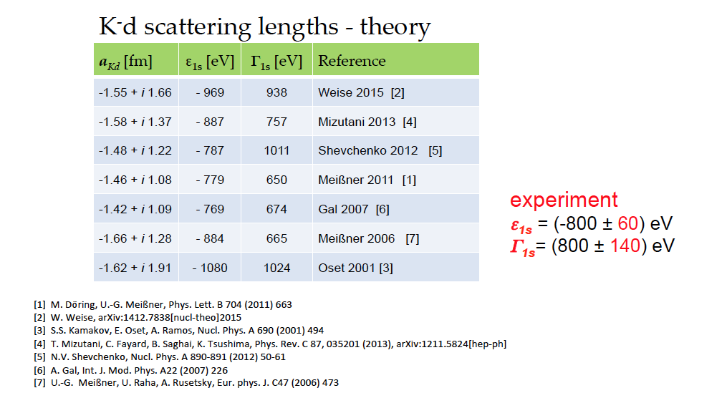

Slide 25
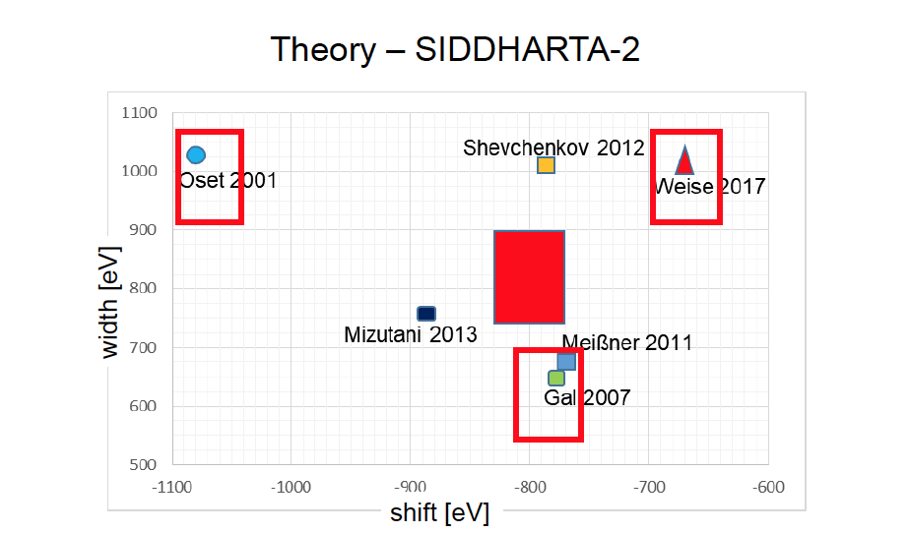

Slide 26
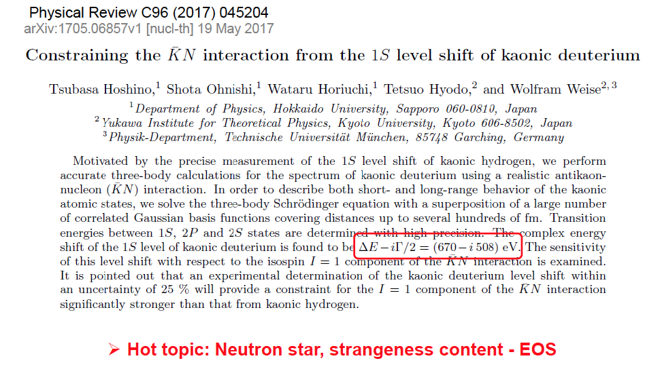

Slide 27

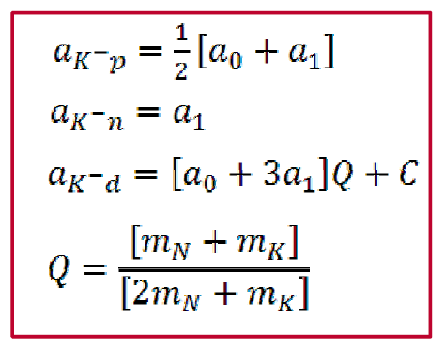
Isospin scattering lengths
The isospin scattering lengths a₀ and a₁ for I=0,1 cannot be determined from ε_{1s} and Γ_{1s} from kaonic hydrogen.
The (modified) Deser-type formula U.G.Meißner,U.Raha,A.Rusetsky,Eur.Phys.J.C35(2004)349,arXiv:hep-ph/0402261.
Kaonic deuterium provides
the lacking information
a_{p} = ½(a₀+a₁)
a_{n} = a₁

Slide 28
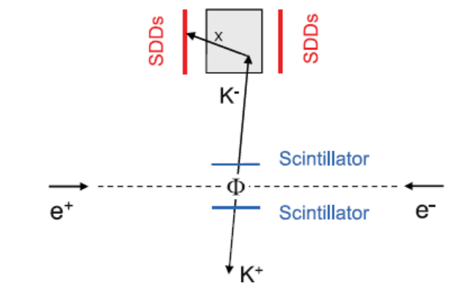
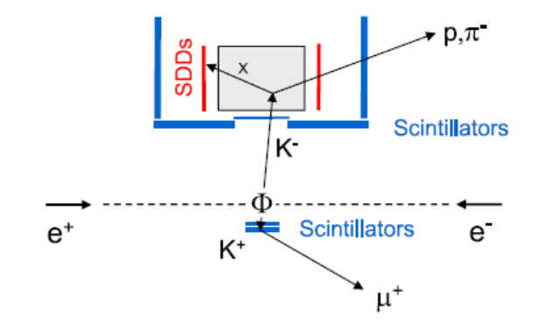
From SIDDHARTA to SIDDHARTA2
  New SDDs with CUBE preamp
  Factor 2 in density of deuterium gas
  Kaon trigger geometry and arrangement
  Discrimination K⁺/K⁻ by lifetime detector
  Active shielding of apparatus
  Better timing resolution of SDDs by cooling
SIDDHARTA
SIDDHARTA2

Slide 29
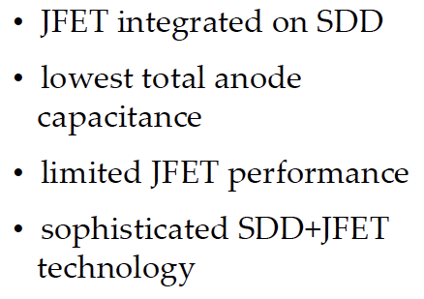
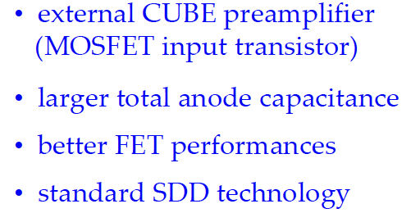
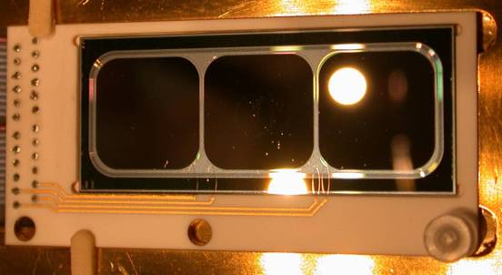
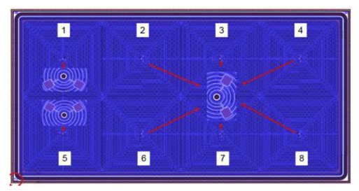
New SDDs for SIDDHARTA2
SIDDHARTA
SIDDHARTA2
3x1 matrix
4x2 matrix

Slide 30
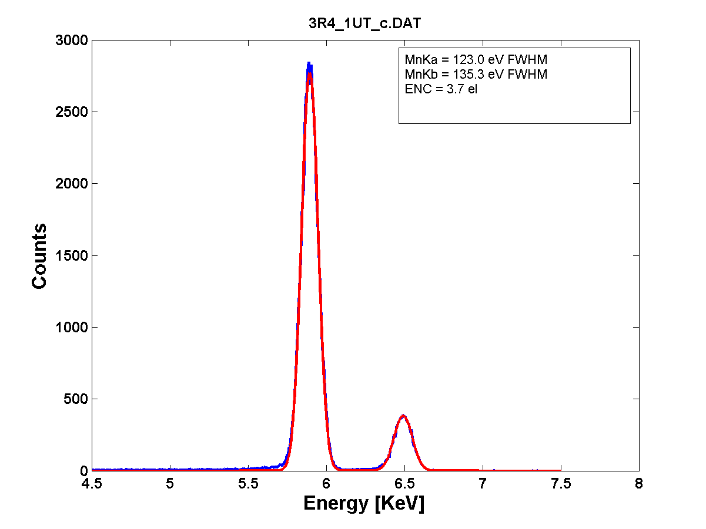
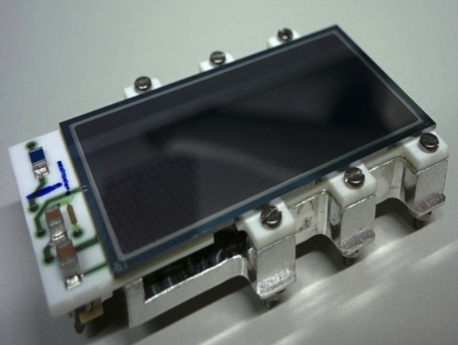
New SDD technology: CUBE preamplifier
SDD characteristics:
area/cell = 64 mm²
total area = 512 mm²
T = - 100°C
drift time < 500 ns
⁵⁵Fe spectrum
123.0 eV FWHM

Slide 31
SDD Characterization
Extremely important for precision x-ray spectroscopy
  Stability
    Long term monitoring gain and offset
    Stability under small temperature variations
    Gain stability at different x-ray rates
  Linearity
  SDD time response at various temperatures
  SDD operation at low temperatures
  Radiation hardness

Slide 32
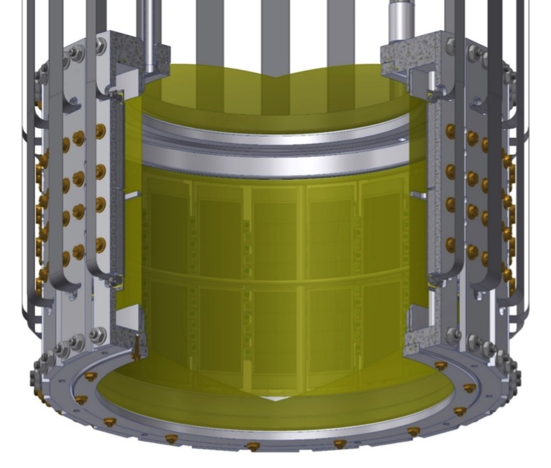
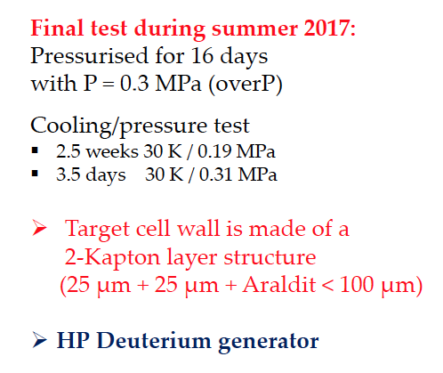
Cryo-Target – SDD geometry
Working temperature: 30 K
Working pressure : 0.3 MPa

Slide 33
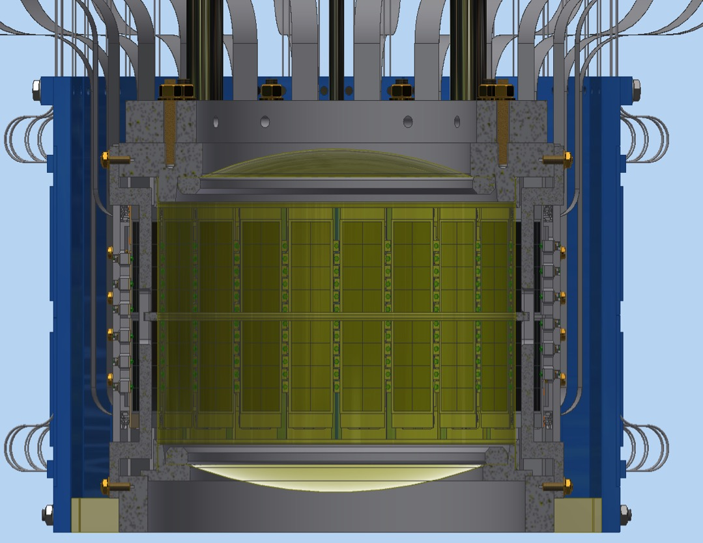
Cryogenic target-SDDs-veto-2 arrangement
Veto-2
SDDs
Cryo-target

Slide 34
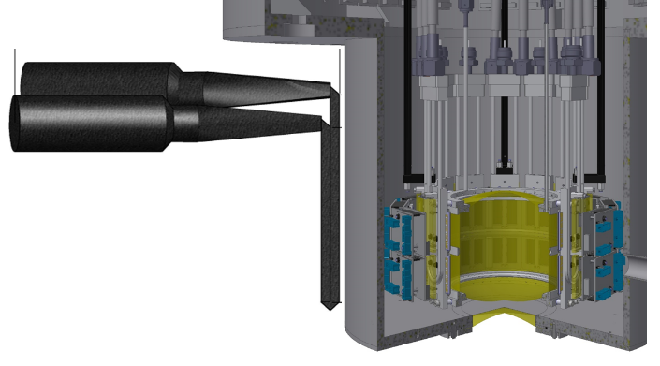
The veto-1 system
To achieve a good timing resolution, (independent of the “hit” position) < 600 ps (FWHM),the scintillator has to be read out on both side.
Because the available space is limited due to shielding material, the photomultiplier tubes have to be on the same side (a special light-guide mirror design was used).

Slide 35
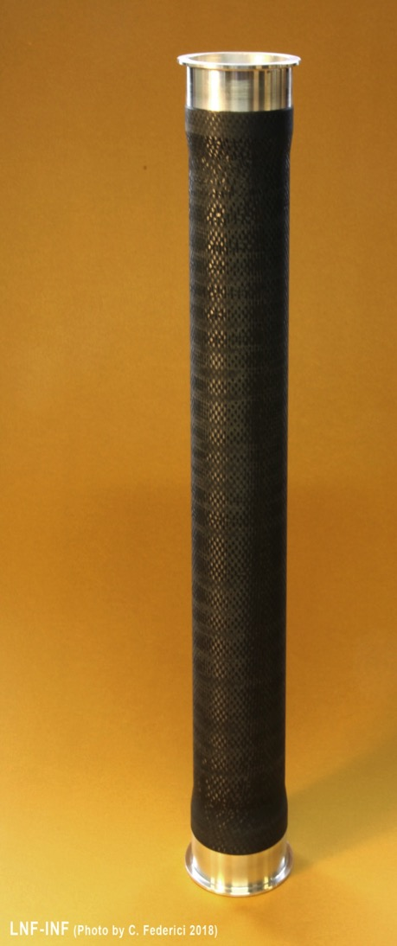
SIDDHARTA-2 beam pipe
delivered
  final inner diameter 57 mm
  Alu thickness 150 µm
  Carbon fibre reinforcement 500µm

Slide 36
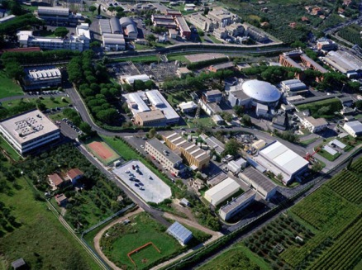
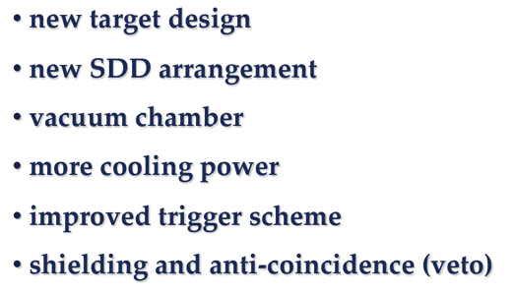
SIDDHARTA2 Setup at DAFNE

Slide 37
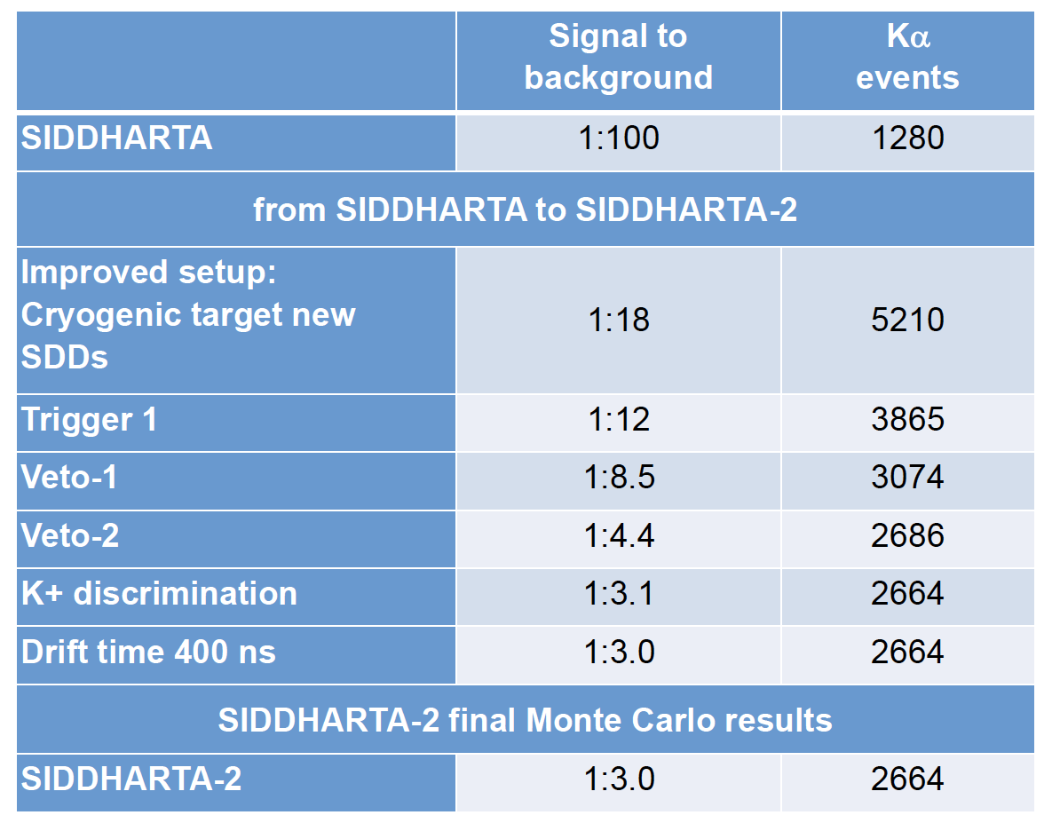

Slide 38

Kaonic deuterium with SIDDHARTA2 at DAFNE

Slide 39
Kaonic deuterium Experiment:
E57 @ J-PARC

Slide 40


Slide 41

X-ray yields in K⁻D
T.Koike, T. Harada, "calculation of K-p and K-d atoms", Phys. Rev. C 53 (1996) 79
T. S. Jensen, “Atomic Cascade in Kaonic Hydrogen and Deuterium”, Proceedings of DAFNE 2004: Physics at meson factories, June 2004.

Slide 42

Setup at J-PARC K1.8BR

Slide 43

Target and X-ray detectors

Slide 44

4x2 SDD arrays
SDD-chips for kaonic hydrogen
48 SDD-chips for kaonic deuterium
4 pieces – long term tests at SMI
8 pieces – long term tests at LNF
7 pieces – for tests at J-PARC
in total 38 pieces bonded and tested
assembling / bonding rate successful
Shipping package
4x2 SDD array single unit

Slide 45


Slide 46



K-d setup at J-PARC – first tests
J-PARC, Dec.2017
assembling of target cell + 2 SDD arrays
feedthroughs to amplifier boards

Slide 47

Notes:
For 250 K-p K(alpha) events, assuming S/B = 4:1
dE = 280 +- 40 width= 540 +- 110

Slide 48

J. Zmeskal, PAC Meeting 2018

Slide 49

Thank you for your attention

Slide 50


Commissioning of the E57 apparatus
for stage-2 approval (proof of principle using K⁻p)
DAQ WITH HYDROGEN
45 kW proton beam, 3 days
detector area 120 cm²
4% LHD
K_{high}
K_{β}
counts per 80 eV bin
K_{α}
ε_{1s} = -283 ± 36(stat) ± 6(syst) eV
Γ_{1s} = 541 ± 89(stat) ± 22(syst) eV
achievable precision:
sigma(shift) ~ 35 eV
sigma(width) ~ 71 eV
X-ray energy [keV]
Notes:
For 250 K-p K(alpha) events, assuming S/B = 4:1
dE = 280 +- 40 width= 540 +- 110

Slide 51
SPARE

Slide 52
Schedule 2018 at J-PARC
 | Jan |  | Feb |  | Mar |  | Apr |  | May |  | Jun
Cryogenic target + SDD at J-PARC
SDD + E15 DAQ at J-PARC
Final tests with 24 SDDs
switching time from E62 to E57 2.5 weeks

Slide 53
Time-line SIDDHARTA2
Setup ready 2018
Installation at DAFNE
Beam time after optimization 800 pb⁻¹
First determination of the hadronic shift and width of the 1s ground state of kaonic deuterium leading to the extraction of the isospin-dependent scattering lengths

Slide 54


Summary
SIDDHARTA – important results on
light kaonic atoms, AMADEUS studies on K_{bar} interaction on nuclei
Strong impact for K_{bar}N theory
SIDDHARTA – first exploratory experiment on K⁻d – important for the planning of SIDDHARTA2
SIDDHARTA2 with strongly improved apparatus aiming at a first extraction of 1s state shift and width in kaonic deuterium
SIDDHARTA2 at DAFNE – beamtime in 2018/2019
P24756-N20

Slide 55
Spare

Slide 56
The interaction of antikaons (K-) with nucleons and nuclei in the low-energy regime represents a very active research field in hadron physics. A unique and rather direct experimental access to the antikaon-nucleon scattering lengths is provided by precision X-ray spectroscopy of transitions in low-lying states in the lightest kaonic atoms (i.e. kaonic hydrogen and deuterium). In the SIDDHARTA experiment at the electron-positron collider DAFNE of LNF-INFN we measured the most precise values of the strong interaction observables. The strong interaction on the 1s ground state of the electromagnetically bound K-p atom is leading to an energy shift and broadening of the 1s state. SIDDHARTA will extend the spectroscopy to kaonic deuterium to get access to the antikaon-neutron interaction. At J-PARC a kaon beam is used in a complementary experiment with a different setup for spectroscopy of kaonic deuterium atoms.The talk will give an overview of the of the upcoming experiments SIDDHARTA and the complementary experiment at J-PARC.Furthermore, the implications of the experiments for the theory of low-energy strong interaction with strangeness will be discussed.

Slide 57


Comparison kaonic ³He and ⁴He
K-4He (3d-2p)
K-3He (3d-2p)
PLB697(2011)199

Slide 58

Kaonic helium results
calibration under control within several eV

Slide 59


Yields in kaonic helium atoms
Study of the x-ray pattern in kaonic helium atoms (transitions to the 2p state)
First determination of the absolute yields
Indications of weak molecular Stark mixing
Data are calling for improved cascade calulations

Slide 60

New x-ray detectors

Slide 61


New SDDs for x-ray detection
(FBK and Politecnico Milano)
Excellent active to total area 85%
Large solid angle
Very good energy resolution
Very good timing at low T
Test with Fe-55
Source
Mn Kα
127 eV (FWHM)

Slide 62
Outlook: New precision studies with new technologies
Kaonic helium 2p state shift/width
2 level studies in kaonic atoms

Slide 63



New experiments - microcalorimeter
Study of 2 transitions in the same kaonic atom for separating
one-nucleon 1N) from multi-nucleon (mN) processes
using micro-calorimeters
Further applications of
microcalorimeters for precision x-ray studies:
K-He-3,4 2p-shift/width
Charged kaon mass

Slide 64
There is substantial progress in the understanding of the strong interaction involving strange quarks. However, many aspects of the interactions of antikaons with nucleons and nuclei are still open which are also related to the open question about the role of strangeness in neutron stars. The K⁻ nucleon interaction is strongly attractive at low energies in agreement to theory. This attraction is observed in kaonic hydrogen, which was studied in experiments at the DAΦNE electron-positron collider of LNF-INFN (Frascati/Italy). Resonances like the elusive Λ(1405) in the s-wave impose questions about its nature. In recent theoretical studies it is described as a dynamically generated resonance with two poles. This topic is included in the AMADEUS project at LNF-INFN, which is focused on the study of the nuclear interaction with strangeness at low energy. On the other hand the SIDDHARTA2 project also at LNF-INFN will study kaonic deuterium to extend our knowledge with the antikaon-neutron interaction. Together with our result on kaonic hydrogen we will be able to deduce the scattering lengths in both isospin channels. The results of the antikaon interaction experimental studies and an outlook to the future studies will be presented.

Slide 65

What is a exotic (kaonic) atom?

Slide 66

Exotic atoms
Studies of fundamental interactions and symmetries
with exotic atomic bound systems
K⁻p, K⁻d
π-p, π-d
….
Hadronic atoms are
sensitive probes for
the strong interaction
at lowest energy
(direct study of strong
interaction at threshold)
Lamb-shift
muonic hydrogen
→ Proton radius

Slide 67


Kaonic hydrogen and deuterium
Principal interaction = electromagnetic.
Strong interaction manifests in hadronic shift and width of the 1s state → energy displacement from the electromagnetic value of the 1s state and broadening due to K⁻ absorption
calculated solving the Klein-Gordon (KG) equation and taking into account vacuum polarization (VP) and final size (FS) effect (accuracy ~1eV).
Strong interaction effect on 2p state is weak (meV) and experimentally undetermined, nevertheless has severe consequences for the x-ray yield.

Slide 68

Goal
Measurement of the shift ε_{1s} and width (broadening)
Γ_{1s} of the ground state 1s
Since only the 1s state is measurably affected by strong interaction → measured K line energies compared to calculated e.m transition energies yield ε_{1s} and Γ_{1s}
Transition | e.m. energy (keV) (calculated, without strong interaction)
KD (2-1) | 7.808
KD (3-1) | 9.255
KD (4-1) | 9.765
KD (5-1) | 9.994
KD (6-1) | 10.119
.. | ..
KD (∞) | 10.41

Slide 69



Experiments on kaonic hydrogen
Older experiments used liquid targets
which have the disadvantage of
lower yields (Stark effect)
KpX, PRL1997
KEK (K beam)
Gas target
Si(Li) detectors
DEAR, PRL2005
DAFNE (e⁺ e⁻ collider)
Gas target
CCD detectors
SIDDHARTA, PLB 2011
DAFNE (e⁺ e⁻ collider)
Gas target
SDD detectors

Slide 70


Predictions
Real and imaginary part of the K⁻n → K⁻n forward scattering amplitude in the sub-threshold region
Imaginary part of the I=0
KbarN and Σπ amplidudes
Error bands due to constraints by SIDDHARTA

Slide 71

Comparison KH-KD
 | Kaonic hydrogen | Kaonic deuterium
Yield (Kα) estimates | 3% | 0.3% (depending on 2p state width)
Energy (Kα) e.m. | 6.5 keV | 7.8 keV
Shift (1s) | -283±36(stat)±6(syst) | -800 ? (estimate)
Width (1s) | 541±89(stat)±22(syst) | 800 ? (estimate)
KH
????
KD

Slide 72

AMADEUS
AMADEUS collaboration
116 scientists from 14 Countries and 34 Institutes
lnf.infn.it/esperimenti/siddharta
and
LNF-07/24(IR) Report on lnf.infn.it web-page (Library)
AMADEUS started in 2005 and
was presented and discussed in all the LNF Scientific Committees
Antikaon Matter At DAΦNE: Experiments with Unraveling Spectroscopy
EU Fundings FP7 – HP2 and HP3:
Network WP9 – LEANNIS;
WP24 (SiPM JRA);
WP28 (GEM JRA)

Slide 73



DAΦNE kaon source + KLOE
Powerful combination of DAFNE with the detector system of KLOE (96% acceptance)
Very good performance for the detection of charged and neutral particle in the relevant energy range

Slide 74



Kaon scattering
Subthreshold resonances
Antikaon nuclear absorption
AMADEUS- a laboratory
for low-energy kaon physics
Antikaon bound states
Hypernuclear physics
Consequences of strangeness
for dense baryonic matter (neutron stars)?

Slide 75

Pre-AMADEUS studies with KLOE data
Study of antikaon interaction in nuclear matter following K⁻ absorption in the DC gas (or structure materials)
KLOE drift chamber (DC) gas: mainly ⁴He (90% ⁴He, 10% isobutane C₄H₁₀)
0.1% K⁻ stop in the DC gas (Monte Carlo, data analysis)
Enables the study of K⁻ absorption and searches for bound states (e.g. with 2 fb⁻¹ hundreds of kaonic clusters) – analysis of Λ/Σ – p,d, t correlations
However: Analysis complicated due to material mix
KLOE Drift Chamber (DC)

Slide 76

Antikaon absorption in nuclei

Slide 77


Quasi-bound kaonic nuclei ?
Decay widths and binding energies from
experiment and theory:
The present knowledge
from experiment and theory is still insufficient to
make a clear statement about quasi-bound kaonic nuclear systems
Experiments so far:
FINUDA
KEK
DISTO
FOPI
HADES
OBELIX
J-PARC E15, E27
Future: AMADEUS
Theory

Slide 78




Recent results from Pre-AMADEUS
L_{int}= 1.74 fb⁻¹
K⁻_{stop} = 3.25 10⁸
K-pp ?
ppK⁻/K−stop=(0.044±0.009stat+0.004−0.005syst)·10⁻²
Significance 1σ –
not sufficient to claim
ppK⁻ observation
Physics Letters B, Volume 758, 10 July 2016, Pages 134-139

Slide 79


Possible AMADEUS Setup
Axial magnetic field: 0.5T

